Slide 1
Certificate of Higher Education in Skills for the Workplace
Effective Team Working & Communications
(BMSW 4002)
Channels of Communication

Slide 2

So far…..
We have..
Overview the module
Defined what communication is?
Explored the functions of communication
Discussed 3 models of communication
Identified the barriers to communication

Slide 3

IN This Session…
We will discuss,
Communication Channels

Slide 4

What is a Communication Channel?
Communication channel means the medium or media through which the message
passes. (Rayudu, 2009, p10)

Slide 5
Why do people choose one channel of communication over another?
Channels differ in their capacity to convey information.
Channel Richness
A channel that is ‘rich’ can;
handle multiple cues simultaneously,
facilitate rapid feedback, and
be very personal.

Slide 6
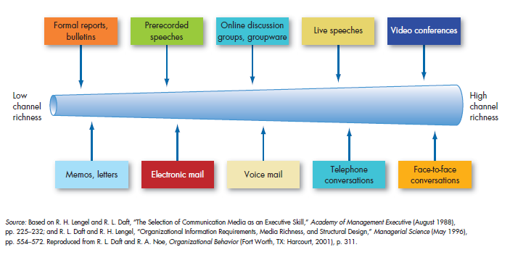
Channel Richness

Slide 7
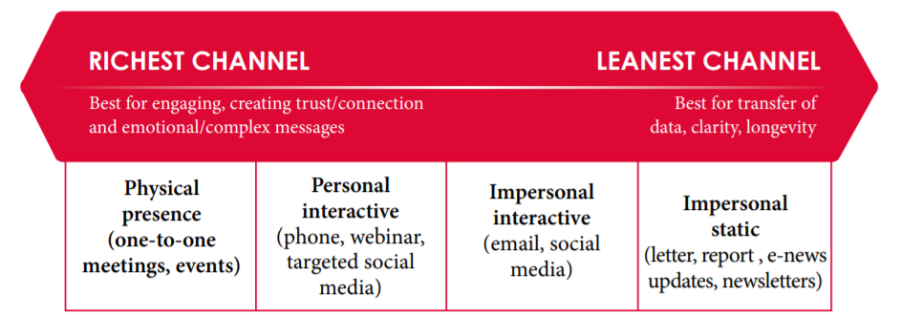
Richness of channels in Healthcare
Source: (The Health Foundation, 2015)

Slide 8
Choosing the right channel
Suitable for routine messages.
Routine messages tend to be straightforward and have minimal ambiguity; channels low in richness can carry them efficiently.
Low -Richness
Channel
Suitable for non - routine messages.
Non routine communications are likely
to be complicated and have the potential for misunderstanding. Managers can communicate them effectively only by selecting rich channels.
High -Richness

Slide 9
Activity 1 – 35 minutes
Source: (The Health Foundation, 2015)
Read Morgan (2017) p250 – p255 ‘Components of Communication’ (available on week 8 Moodle)
In-person meetings and video meetings are considered to have the same level of richness.
Do you agree? Make one point for or against, support your answer using reference to this section of the book.
Email your response to your lecturer for feedback.
Notes:
Instructions for Lecturers:
1) Divide the class in to 5 groups
2) Distribute one pack of cards for each group
3) Hand each group a flip chart paper and a marker
4) Instruct students to draw box with 4 cells (matrix). Name the horizontal axis written methods and oral methods. Name the vertical axis broad audience and target audience.
5) Instruct the students to place the cards in the appropriate cell.
6) Get them to compare their results with other groups in the class (You could do it in a form of a competition and use peer assessment to add more interest)
7) Do they notice the meaning behind the different colour of the cards?

Slide 10

Face to face communication

Slide 11

Activity 2 – Role Play
Scenario
– You are a duty manager at Care Home.
You receive a phone call from a person requesting permission to visit her mother in your care home.
You explained the present pandemic situation and deny permission.
After an hour this caller arrives at the care home.
You answer need to answer the doorbell and speak to the individual.
How will you communicate and deal with it.
Use Morgan (2017), p 260 - 261, ‘Using language and communication tactfully in difficult conversations’ to support you. (available on week 8 moodle)
Go to your assigned channel/chat group to have a go at role playing this situation, take it in turns to play the visitor and the duty manager.

Slide 12

Reflection on the Activity…
Everyone had the same instructions. But why did we get different results?
How does this relate to you?
What could you do to improve your skills on face to face communication?

Slide 13
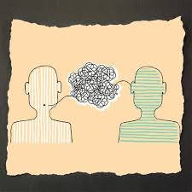
Listening Skills: Background to Listening
We listen (c.120 words a minute) much slower than we think (up to c.3000 words a minute)!
Most of the time we are not really listening - only 25% of content is actually being listened to….. Distracted, pre-occupied, and not interested.
We remember very little – one word in eight?
Attention spans are short: on average 4-5 minutes
Hearing is passive – thresholds are high stimuli is unnoticed, Listening is active and hard, uses cognitive resources.

Slide 14
Activity 3 - Barriers to Listening
Quintanilla and Wahl (2017) outlines possible barriers to listening. (see Maund et al, 2017, p90).
External noise – phones, families, traffic…
and
Internal noise – anxiety, emotions.
For a patient in a video consultation – identify one possible external noise and one possible internal noise that may cause a barrier to listening.
What could be the consequence of not listening fully in this context?
Use Maund et al (2017), p90 - 91 to support your answer.

Slide 15
4 simple steps to Improved Listening performance
Observe
Focus
Acknowledge
Respect
Quintanilla and Wahl (2017 as cited by Maund et al, 2017), p98

Slide 16
Active listening
Active listening is the key to understand the content of the message that is communicated
Listeners should focus on the message and listen to it completely before responding or making judgement
Active listeners pay attention to their postures
Acronym SOLER describes five specific behaviours
  S- Square- Face the person squarely
  O- Open – Keep an open posture without crossed arms or legs
  L- Lean – Slightly lean forward to show your interest
  E- Eye contact- Maintain eye contact
  R – Relax- Stay relaxed
  (Griffiths & Dunham, 2015)

Slide 17
How to become a good Listener?
Listen with a purpose
Establish non-threatening eye contact
Physically concentrate
exchange of feed back
Maintain topic of conversation
Confirm Understanding
Ask Intelligent questions
Mirror the other party
Adopted from Hoppe, 2007

Slide 18
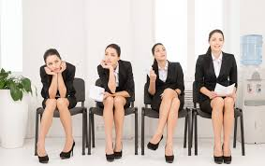
Body Language
(Non-verbal communication)

Slide 19
Posture
Be Audible
Listen
Eye Contact
Choice of words
Stand or sit upright
Avoid slouchy position
Be audible & clear
Ensure sound quality if on videoconferencing
Improving Face To Face Communication
Choose appropriate words
Avoid the use of jargon
Get the true meaning of the message
Don’t talk all the time
  Maintain good eye contact
  Avoid looking down
  Avoid staring
( adapted from Rayudu, 2009)

Slide 20
DO NOT DISPLAY THESE BEHAVIOURS (While pretending to listen)
Don’t Fake Interest
Don’t pretend you seek only facts
Don’t undermine the other party
Don’t cut him out until it seems appropriate
Don’t prejudge
Don’t criticise especially if you concentrate on the irrelevancies

Slide 21
Non-verbal communication
Research conducted by Mehrabian (1981) identified that messages are interpreted as:
  7% from verbal cues
  38% from vocal cues (volume, pitch)
  55% from non-verbal cues
Non-verbal communication involves facial expressions, body gestures, gestures and movements and proxemics

Slide 22
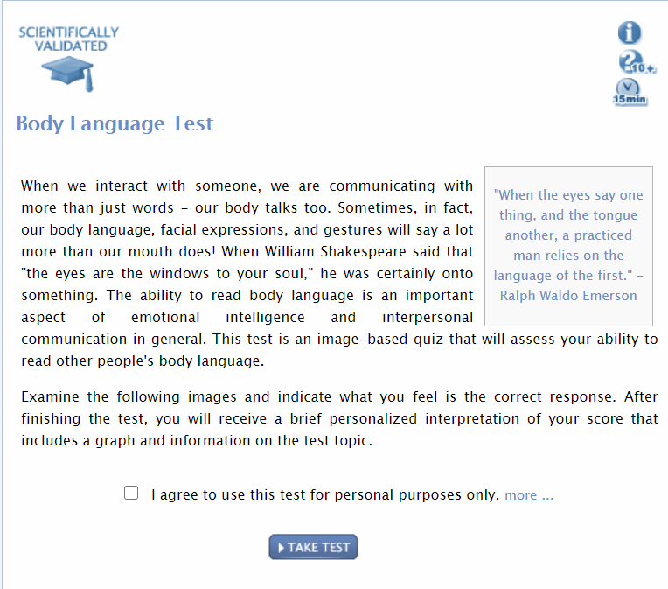
How good are you in interpreting body language?
Try completing this exercise online..
https://testyourself.psychtests.com/testid/3764

Slide 23
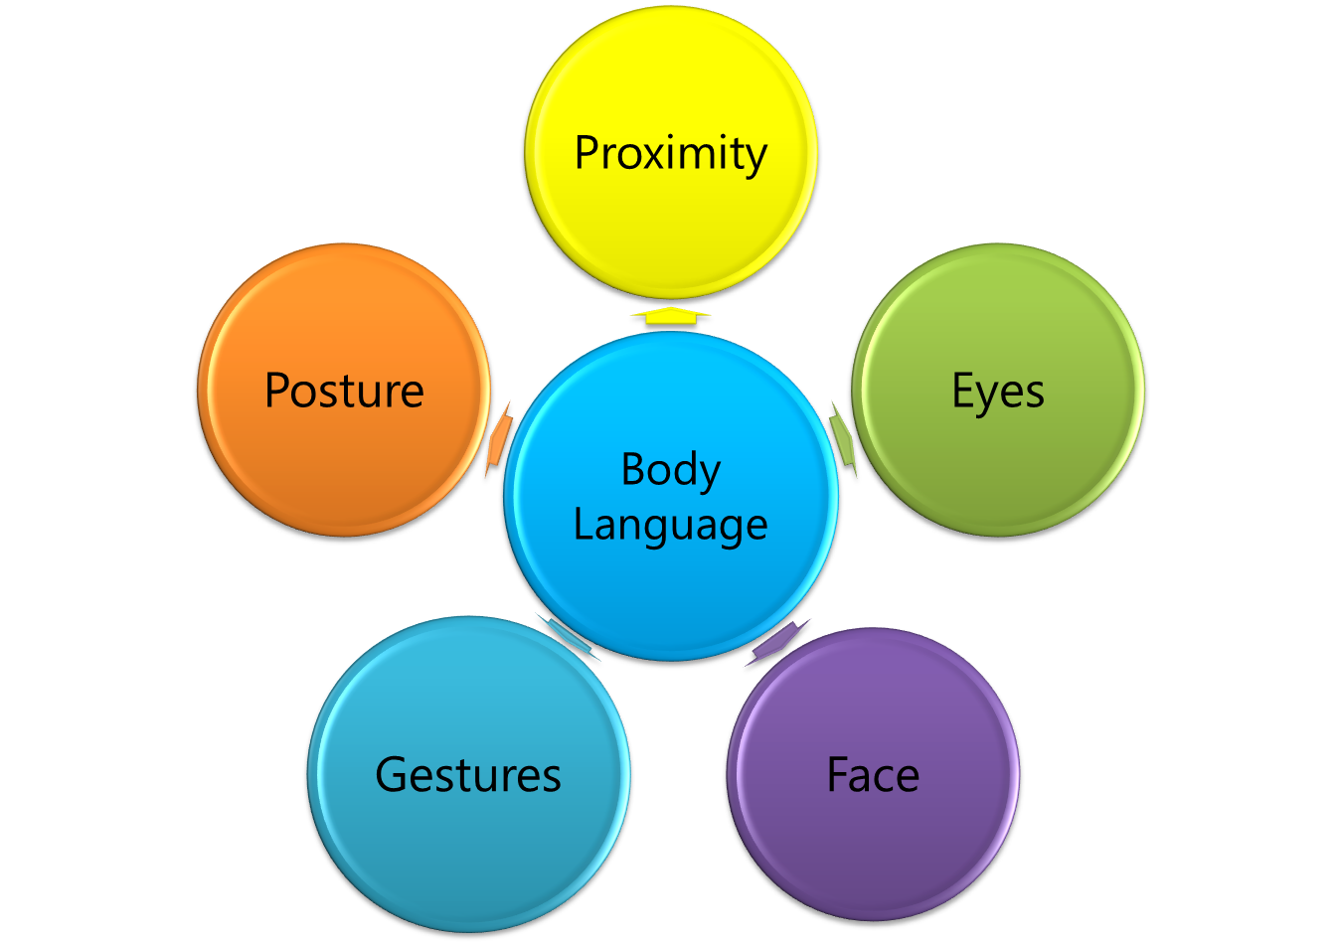

Slide 24
Proximity
Intimate – within 18”
Personal – 2 to 4 feet
Social - 7 feet
Public – 15 to 25 feet
You need to respect these zones and not “stand too close”

Slide 25
Points to note on facial expressions
Avoiding eye contact (hiding)
Looking past you (bored)
Piercing (angry)
Steady (honest)
Head turned slightly (evaluating you)
Tilted head (uncertain)
Nodding (agreement)
Smiling (confident?)

Slide 26
Gestures and Postures
Arms Folded Tightly (not receptive, challenging speaker)
Arms over the back of the chair or on back of head (needs to show dominance)
Open palms (positive)
Steepling of hands (negotiator trying to get into control)
Hands wriggling (nervous)
Self touching (seeking approval/losing confidence/general nerves)
Never cross your legs
(you do not care… showing disrespect)

Slide 27
Para Language
Voice Tone and Cadence (tempo)
Rate of Speech
Volume
Stress
Rhythm
Intonation (Pitch)
Speed and pauses

Slide 28
Time to think: Will you use your body language to improve your Presentation?
The Importance of Body Language in Presentations
Watch the video on Moodle
https://www.youtube.com/watch?v=IqqiDw58NSE

Slide 29

Summary
Can you explain;
Why we use different channels for communication?
The key points in face to face communication?
The 5 key points that constitutes body language.
Questions & Answers

Slide 30
References
Griffith, B. and Dunham, E. (2015). Interpersonal Dynamics and Conflict. Working in Teams: Moving from High Potential to High Performance. London: SAGE Publications, Inc
Hoppe, M. H. (2007). ‘Lending an ear: Why leaders must learn to listen actively’. Leadership in Action, 27: pp.11–14
Mehrabian, A. (1981). Silent Messages: Implicit Communication of Emotions and Attitudes 2nd edn. Belmont, CA: Wadsworth.
Morgan, P. (2017), The Business Student’s guide to study and employability, London: SAGE.
Quintanilla, K.M. and Wahl, S, T., (2017) /business and Professional Communication, 3rd edn. Thousand Oaks: SAGE.
Rayudu, C., (2009) Communication, Global Media, Mumbai. Available from: ProQuest Ebook Central.
The Health Foundation. (2020). Communication Channels: A Guide. [online] Available at: <https://www.health.org.uk/sites/default/files/Communications-channels.pdf> (Accessed: 28 May 2020).

Slide 31

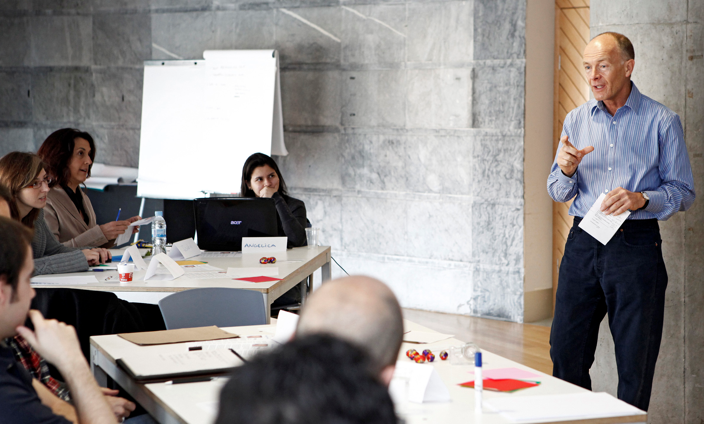
Next Session…
Communication in Organisations

