Slide 2
Creating and Capturing Value THROUGH E-BUSINESS STRATEGIES

Slide 3
Creating and capturing value through e-business strategies: the value-process framework (VPF)
After this session you should be able to:
Identify the main drivers for value creation and capturing
Understand how the value-process framework (VPF) integrates the value chain and the five forces analyses
Apply the VPF to conduct an overarching strategy analysis.

Slide 4
Value is created if the perceived use value exceeds costs
Value creation
€
Perceived use value
Value created
Costs

Slide 5
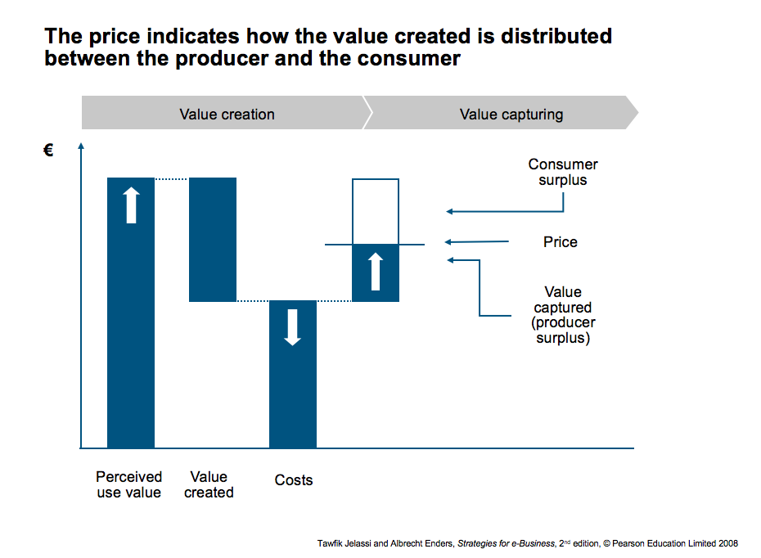

Slide 6
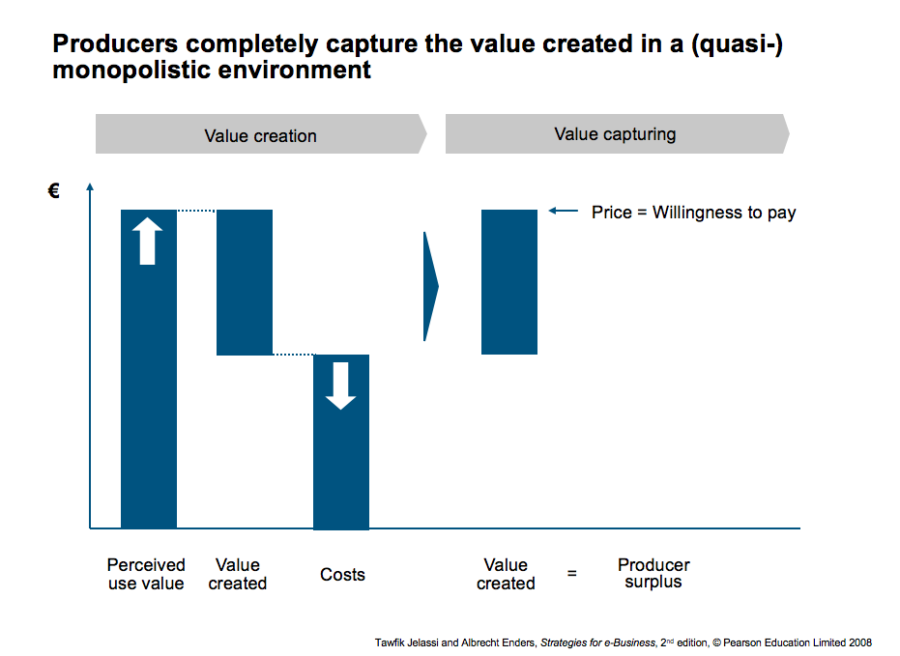

Slide 7
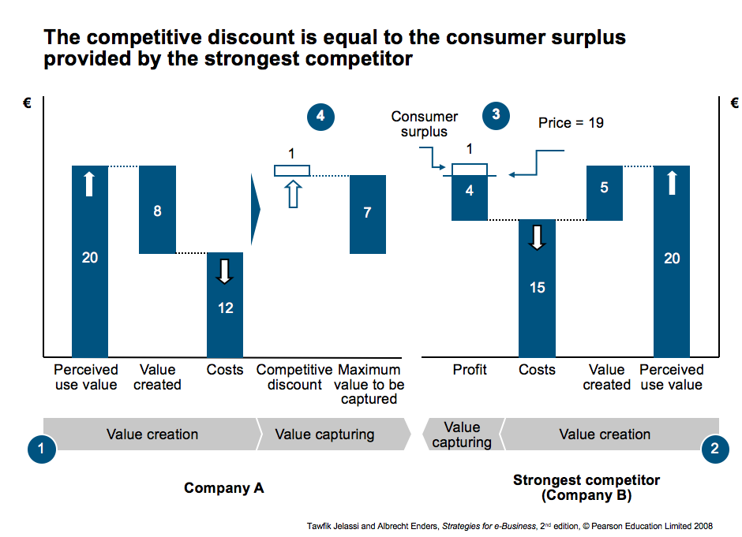

Slide 8
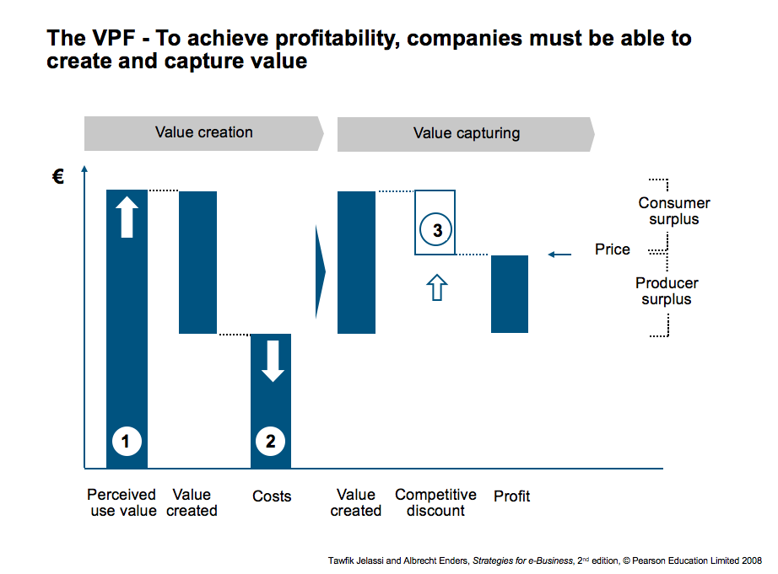

Slide 9
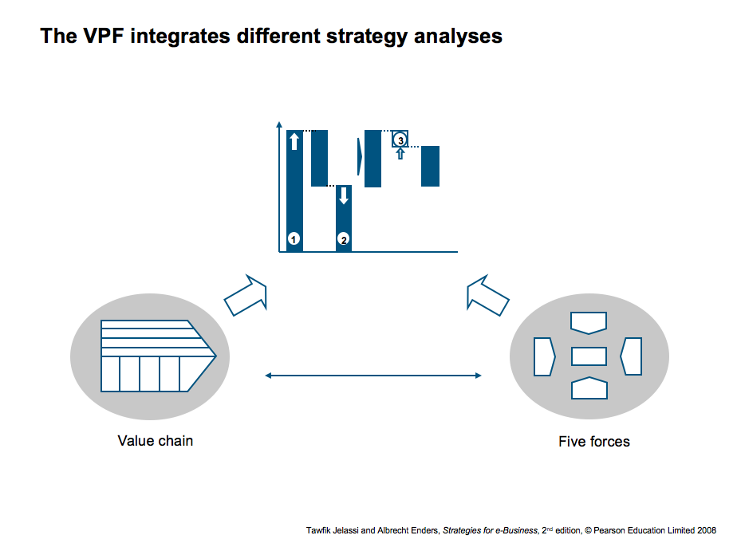

Slide 10
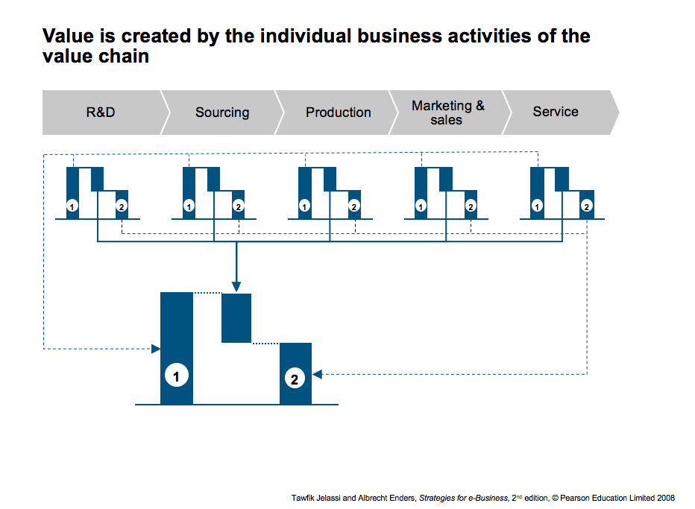

Slide 11
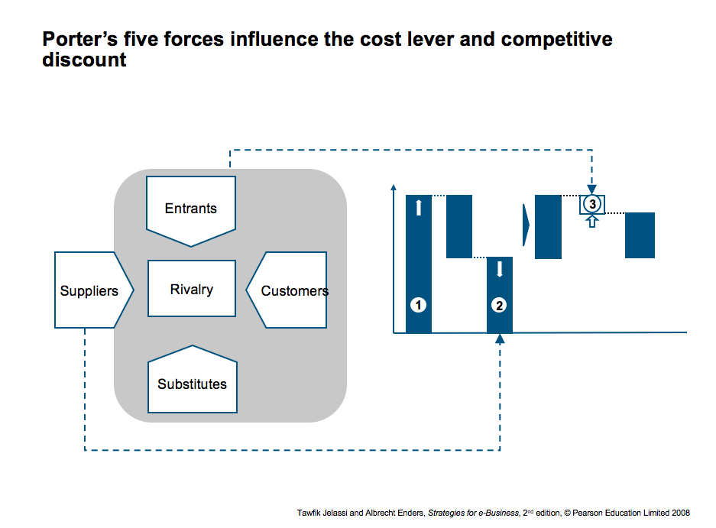

Slide 12


