Slide 1
Task 1: Individual presentation
Name: Julaka awal
Student’s ID number: 2427684
Module code: LCHS4010
Module name: Psychology in Health and Social Care
Lecturer: Shaila Hussain

Slide 2
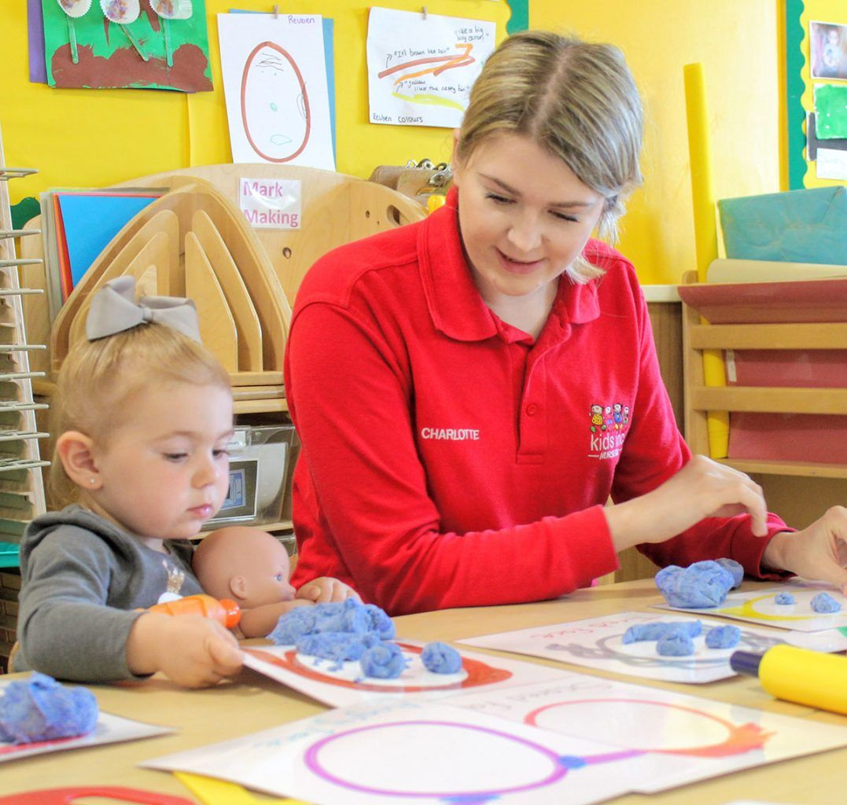
1. Introduction: Amira's Scenario & Chosen Theory
Scenario Summary
Amira: a spirited 3-year-old embarking on her journey in a new nursery setting! However, she faces some challenges that stir up her world—she experiences significant anxiety when apart from her carers, communicates sparingly, and finds it tough to join in on the fun during group playtime.
My Role As a dedicated practitioner, I'm focused on understanding Amira's developmental needs and creating a support plan that fosters her emotional, social, and cognitive well-being.
Chosen Lifespan Psychological Theory
Theory: Bowlby's Attachment Theory.
Relevance: This important idea focuses on separation anxiety, giving us key insights to help understand and improve Amira's emotional and social skills during these early years. Together, we can create a path for her to succeed and grow!

Slide 3
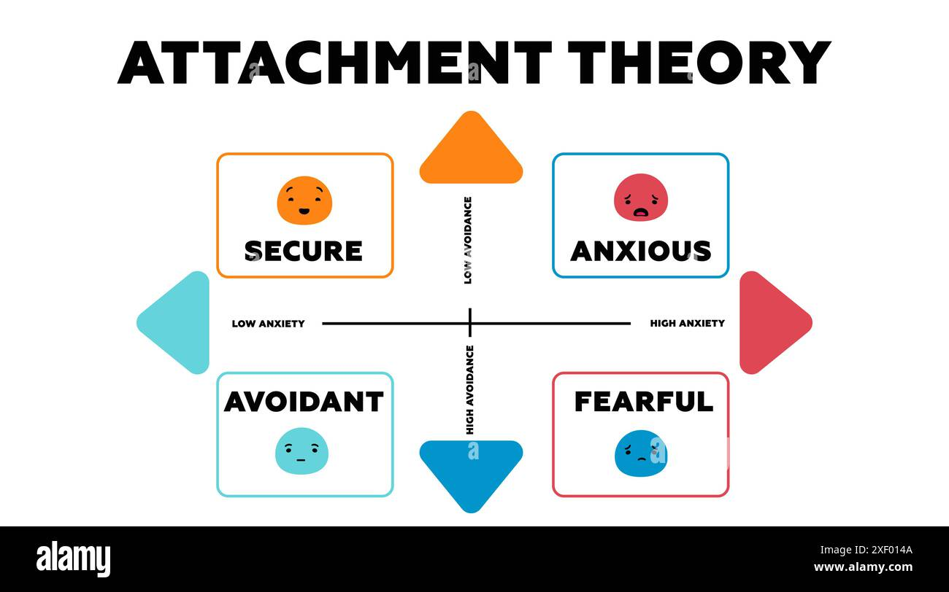
2. Explanation of Bowlby's Attachment Theory
Core Concepts
Innate Drive: Imagine an incredible biological and evolutionary impulse that ignites an infant's desire to bond with a primary caregiver! This instinct is a lifeline, driving the little one to seek closeness for safety and survival in an ever-changing world.
Secure Base: Think of the caregiver as a superhero! They create a "secure base" that empowers the child to bravely explore their surroundings, knowing there’s a comforting "haven" to return to whenever challenges arise or fears loom large.
Internal Working Model (IWM): Picture the early years of life as a crucial time for building a foundation—the Internal Working Model! This fascinating cognitive structure shapes a child's expectations about themselves (Do I deserve love?), the world around them (Are people trustworthy?), and the nature of relationships. It’s like the ultimate guidebook that influences all future connections and helps a child learn to navigate their emotions.

Slide 4
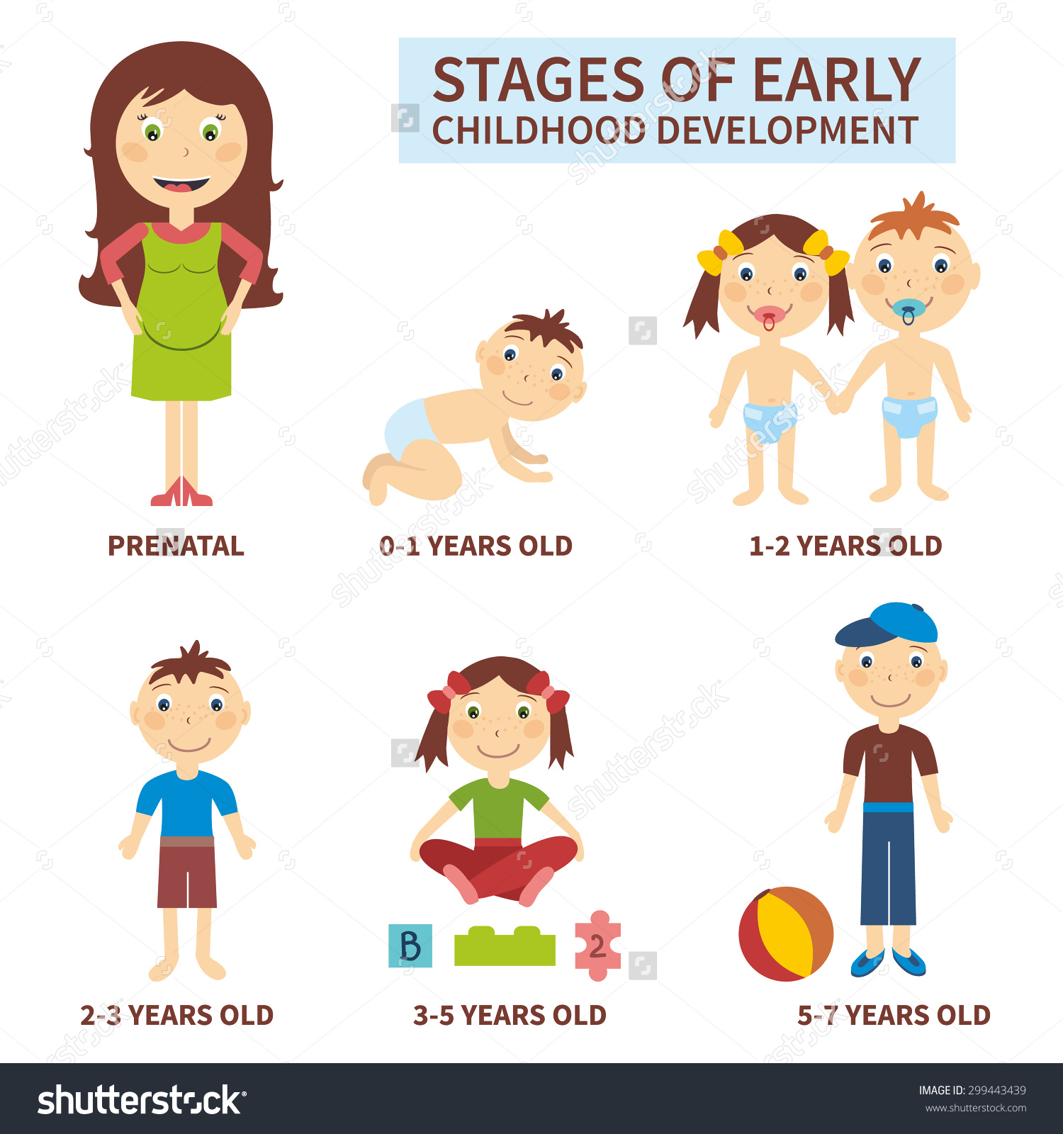
The Exciting Journey of Early Childhood Development!
Imagine: the incredible impact of a strong attachment in a child's life! It's the foundation for mastering emotions, building social skills, and feeling confident during play and learning adventures. But wait, there's more!
Meet Separation Anxiety: a common expression of attachment that many children, like Amira, experience when they're learning to explore the world around them. While this protest phase is completely normal, if it becomes too intense or hangs around for too long, it could indicate an insecure attachment. Let's cheer on our little ones as they navigate this exciting journey of discovery!

Slide 5

3. Application of the Theory to Amira
Explaining Amira's Behaviour
Anxiety When Left: When Amira's secure base disappears, she experiences a surge of emotions and focuses intently on bringing her caregiver back. This could indicate an anxious-ambivalent attachment pattern, keeping her on edge about her caregiver's availability.
Difficulty Engaging in Group Play: In the nursery, Amira doubts the safety of her new environment and the staff, which makes it hard for her to engage in group play. She lacks the emotional security needed to enjoy social interaction.
Limited Verbal Communication: Overwhelmed by emotional distress, Amira struggles with complex cognitive and linguistic tasks. In her battle to manage her emotions, her development in these areas temporarily stalls.
Amira's journey illustrates the vital link between emotions and development!

Slide 6
4. Practical Strategies and Interventions
The goal is to provide a secondary secure base within the nursery and facilitate the revision of her IWM through positive experiences.
Developmental Need | Strategy/Intervention | Rationale (Based on Attachment Theory)
Separation Anxiety | Implement a Key Person Approach (e.g., Sarah). Ensure Sarah is consistently present during drop-off and acts as a safe haven. | Builds a secondary attachment figure to allow Amira to transfer her need for security, making separation less traumatic.
Lack of Exploration/Play | Scaffolding Play: Key Person (Sarah) should gently facilitate one-on-one play, then transition to small, managed groups, remaining physically close initially. | Sarah acts as the secure base. Once Amira trusts her proximity, she can venture further into the environment (the play) and gradually build confidence.
Limited Communication | Emotional Coaching: Sarah should verbally label and validate Amira's feelings ("You are feeling sad/scared right now, and that's okay. I am here."). | Helps Amira develop emotional regulation. When her anxiety is managed, cognitive resources are freed up for communication and learning

Slide 7
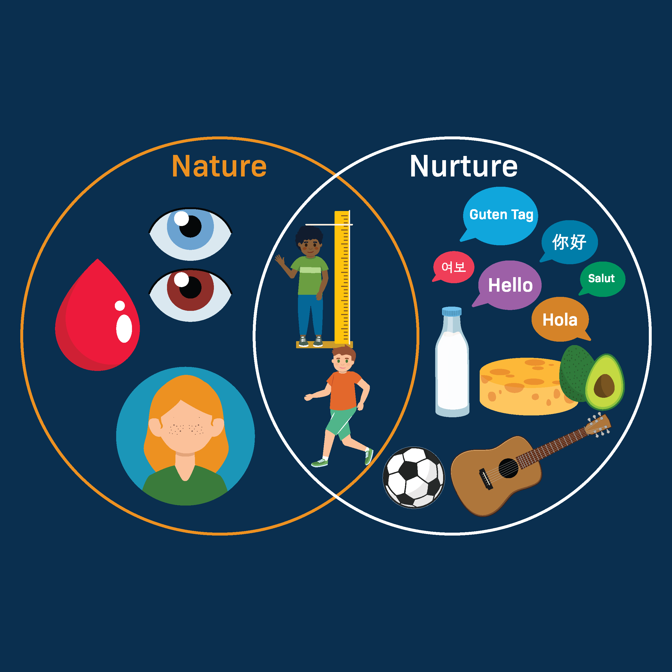
5. Biological and Environmental Influences (Nature and Nurture)
Shaping Psychological Development
Nature (Biological): The innate drive to form an attachment bond is a biological imperative. Amira is biologically programmed to protest when her primary caregiver leaves.
Nurture (Environmental): The quality of caregiving received (environmental influence) determines the outcome of that drive. For Amira, her current anxiety is likely a response to the perceived consistency and responsiveness she has experienced.
Intervention's Role: Our intervention (the key person's consistent, sensitive care) is a positive environmental influence designed to mitigate the effects of any prior insecure attachment, essentially offering Amira a new, corrective emotional experience to modify her IWM.

Slide 8

6. Critical Evaluation
Usefulness in Health and Social Care
Foundation for Success: Attachment theory underpins innovative approaches like the Key Person method, highlighting emotional security as vital for effective learning.
Non-Judgmental Perspective: Viewing Amira's anxiety as a natural response to insecurity helps us foster empathy and support rather than labelling it as ‘misbehaviour.’
Dynamic Interventions: This theory encourages practitioners to prioritise relationship quality, as strong connections enable every child to thrive.
Limitations in Health and Social Care
Cultural Context: The original theory sparked debate by emphasising a single primary attachment figure, overlooking the diverse caregiving structures across cultures. It’s fascinating to see the variety in our attachment experiences!
Risk of Determinism: Some critics claim the theory suggests early experiences are fixed. However, recent research shows that our internal working models can change through nurturing, positive relationships. Just think about how a strong bond with her Key Person can transform Amira’s outlook!

Slide 9
7. Conclusion
Bowlby's Attachment Theory offers a well-supported, evidence-based framework for understanding Amira's distress by emphasising the importance of early emotional bonds and secure attachments. By adopting the key person approach—where a designated caregiver consistently interacts with her—we can foster a sense of safety and trust. This stability can help her gradually transition from feelings of anxiety and social withdrawal to confident exploration of her environment and active participation in nursery activities, promoting her emotional development and overall well-being

Slide 10
7. References
Bowlby, J. (1969). Attachment and Loss, Vol. 1: Attachment. Hogarth Press.
Ainsworth, M. D. S. (1978). Patterns of Attachment. Erlbaum.
Schaffer, H. R. (2009). Child Psychology (1st ed.). Sage Publications.
Belsky, J. (2005). The development of attachment: Past and future. Child Development, 76(4), 922-940.
Goldschmied, E., & Jackson, S. (2004). People Under Three: Young Children in Day Care. Routledge.
Gerhardt, S. (2004). Why Love Matters: How Affection Shapes a Baby's Brain. Brunner-Routledge.

