Slide 1
Time Management Matrix
Decision Making

Slide 2
The Time Management Matrix
The Time Management Matrix enables decisions makers to determine how an organisations/departments time is used
The matrix allows management to prioritise activities and workload appropriately
It is based on the idea that time is spent in a four quadrant matrix

Slide 3
Time Management Matrix
The Time Management Matrix was popularised as a management model by Stephen Covey in his book "The 7 Habits of Highly Effective People".
It shows how all workplace tasks can be divided according to two criteria:
how important they are (the vertical axis in the diagram) and how urgent they are (the horizontal axis).
As a result of these two criteria, the model creates four squares which Covey calls "quadrants" and which are the keys to time management performance.

Slide 4
Stephen Covey, author of The Seven Habits of Highly Effective People and First Things First popularised the concept of a Time Management Matrix for prioritising.
This method advocates the use of four quadrants to determine the tasks you “need” to do and deciding what should be made a priority.

Slide 5
Quadrant 1 - Urgent and Important
In Quadrant 1 of the Time Management Matrix, (top left), are the urgent and important tasks. These are the things that we have to do because they are our responsibility and need immediate attention.
These are usually emergencies, crises, and pressing deadline-driven problems.
They may be the result of our procrastination or inability to face up to doing them at the right time. Covey calls these "firefighting" tasks.
Jot down your own Quadrant 1 activities and work out how much time you spend on these in a day or a week.

Slide 6
Quadrant 2 - Important but not Urgent
In Quadrant 2 of the Time Management Matrix, (top right), are the important but not urgent tasks.
These are the tasks that aren't pressing but, if we do them, will ensure fewer, if any, problems down the line.
They include time on personal health and development, unhurried "quality time" with others, prevention work, thinking time such as planning and preparation, and clarifying our values. Covey calls these "productive" tasks and suggests that this is the Quadrant that requires most of our attention.
Jot down your own Quadrant 2 activities and work out how much time you spend on these in a day or a week.

Slide 7
Quadrant 3 - Urgent but not Important
In Quadrant 3 of the Time Management Matrix, (bottom left), are the urgent but not important tasks.
These are the things that we allow to interrupt our working lives because we believe they take precedence over other tasks.
The worst examples of such tasks are personal "drop-in" callers, answering every phone call and wading through junk mail. Covey calls these "distractions".
Jot down your own Quadrant 3 activities and work out how much time you spend on these in a day or a week.

Slide 8
Quadrant 4 - Neither Urgent or Important
In Quadrant 4 of the Time Management Matrix, (bottom right), are the not important and not urgent tasks.
These are the things that we don't need to do but that so often we end up doing to fill in time or because we like doing them.
These include aimless web browsing, socialising around the drinks machine, and attending unnecessary meetings. Covey calls these "time-wasters".
Jot down your own Quadrant 4 activities and work out how much time you spend on these in a day or a week.
Notes:
Quadrant 1 - Urgent and Important
The Quadrant of Necessities - reactive tasks that need to be done, often at the last minute. Crises, 'fire-fighting' and looming deadlines are typical examples.
Time spent in this quadrant can't be avoided, but it can be significantly reduced if you're prepared to spend more time in...
Quadrant 2 - Important but not Urgent
The Quadrant of Quality - proactive tasks, often habitual, that maintain or improve the quality of your work and life. This is the one to aim to spend more time in.
The more you expand this quadrant, the more you reduce the other three, particularly 'pseudo-emergencies' that should never have been allowed to become so.
One useful way to evaluate what matters is explained in the Pickle Jar theory.
Examples include maintaining and building relationships, regular exercise, healthy eating or learning new skills..
Quadrant 3 - Urgent but not Important
The Quadrant of Deception - plenty of people have gone home in the evening wondering where all the time went. Well, it was here! It's so easy to get sucked into doing things that are the wrong side of the 80-20 rule.
Many meetings, popular activities and easy tasks are probably a waste of your time.
Some of the worst culprits? Other people! What are you like at managing interruptions?
So, how do you deal with time wasting activities?
Learn how to be assertive and say 'No'.
Delegate work.
Quadrant 4 - Neither Urgent or Important
The Quadrant of Waste - you know what it is and you know when you've been in it. The trick is to know when you're in it. Often, it starts out as restful time (which is Quadrant 2).
The tipping point comes when you spend too long doing mindless things.
Wasting time online, TV and excessively long conversations are classic examples.
Wasting time is inevitable, but there are strategies for changing bad habits that will help you waste less. You can even learn how to waste time well.

Slide 9
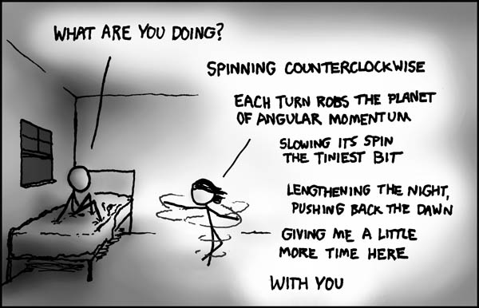
Quadrant 1

Slide 10
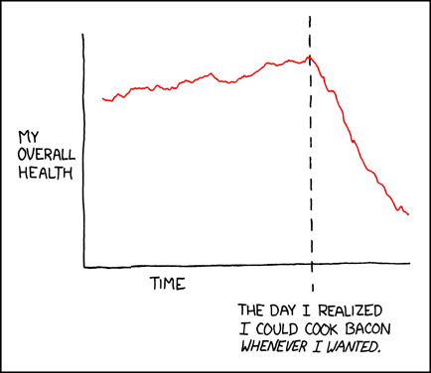
Quadrant 2

Slide 11
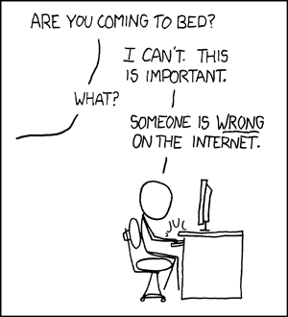
Quadrant 3 -

Slide 12
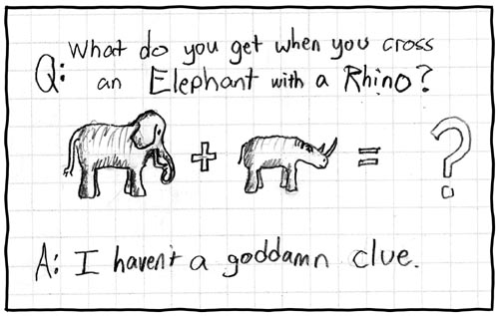
Quadrant 4 – an example of inefficient use of time

Slide 13
What Are "Urgent" and "Important" Activities?
In a 1954 speech to the Second Assembly of the World Council of Churches, former U.S. President Dwight D. Eisenhower, who was quoting Dr J. Roscoe Miller, president of Northwestern University, said: "I have two kinds of problems: the urgent and the important. The urgent are not important, and the important are never urgent." This "Eisenhower Principle" is said to be how he organized his workload and priorities.
He recognized that great time management means being effective as well as efficient. In other words, we must spend our time on things that are important and not just the ones that are urgent. To do this, and to minimize the stress of having too many tight deadlines, we need to understand this distinction:

Slide 14
Important activities have an outcome that leads to us achieving our goals, whether these are professional or personal.
Urgent activities demand immediate attention, and are usually associated with achieving someone else's goals.
They are often the ones we concentrate on and they demand attention because the consequences of not dealing with them are immediate.

Slide 15
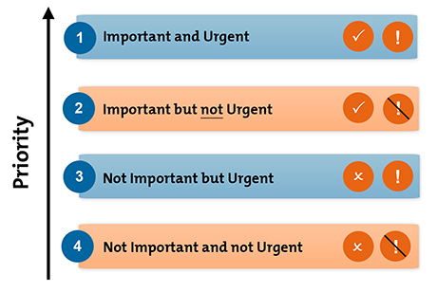
Eisenhower's Urgent/Important Principle
Notes:
Can you see the similarity to Covey’s Time Management Matrix?

Slide 16
1. Important and Urgent
There are two distinct types of urgent and important activities: ones that you could not have foreseen, and others that you've left until the last minute
However, you can't always predict or avoid some issues and crises, particularly in organisations.
Here, the best approach is to leave some time in your schedule to handle unexpected issues and unplanned important activities. (If a major crisis arises, then you'll need to reschedule other tasks.)

Slide 17
2. Important but not Urgent
These are the activities that help you achieve your personal and professional goals, and complete important work.
It is important to ensure that there is sufficient time to do these things properly, so that they do not become urgent.
Furthermore, it is important to leave enough time in a schedule to deal with unforeseen problems. This will maximize the organisations chances of keeping on track, and help reduce the possibility that the activity/work will become more urgent than necessary.

Slide 18
3. Not Important but Urgent
Urgent but not important tasks are things that can prevent an individual from achieving their goals
A common source of such activities is other people. Sometimes it's appropriate to say "no" to people politely, or to encourage them to solve the problem themselves.
Alternatively, try to have time slots when you are available, so that people know they can speak with you then. A good way to do this is to arrange regular meetings with those who interrupt you often, so that you can deal with all their issues at once. You'll then be able to concentrate on your important activities for longer.

Slide 19
4. Not Important and not Urgent
These activities are just a distraction – avoid them if possible.
You can simply ignore or cancel many of them. However, some may be activities that other people want you to do, even though they don't contribute to your own desired outcomes. Again, say "no" politely, if you can, and explain why you cannot do it
Notes:
Key Points
Eisenhower's Urgent/Important Principle helps you quickly identify the activities that you should focus on, as well as the ones you should ignore.
When you use this tool to prioritize your time, you can deal with truly urgent issues, at the same time as you work towards important, longer-term goals.
To use the tool, list all of your tasks and activities, and put each into one of the following categories:
Important and urgent.
Important but not urgent.
Not important but urgent.
Not important and not urgent.
Then schedule tasks and activities based on their importance and urgency.

Slide 20
Why is it important for

