Slide 1


Introduction to the Module
Business Law and practice BMLW5005

Slide 2
Your Lecturer
Cerys Davies
Senior Lecturer, Qualified Solicitor and former Police Officer
Former specialism: Employment Law
Trained and worked in a large commercial firm in Cardiff
Over 15 years teaching experience.
My email – cerys.davies@uwtsd.ac.uk

Slide 3
Business Law and Practice (BLP)
AIM
• To develop a broad and detailed understanding of Business Law and how it works within the legal framework
LEARNING OUTCOMES
Evaluate the formation, purpose and principles of partnership and company law
Progress business transactions arising during the life and development of a business and demonstrate a critical understanding of the interests of different parties involved in the business including directors, shareholders and creditors of a business
Critically analyse the management of a company in regards to structure and funding and be able to select an appropriate medium and structure to meet the client's commercial requirements and to advise on the legal and taxation implications

Slide 4
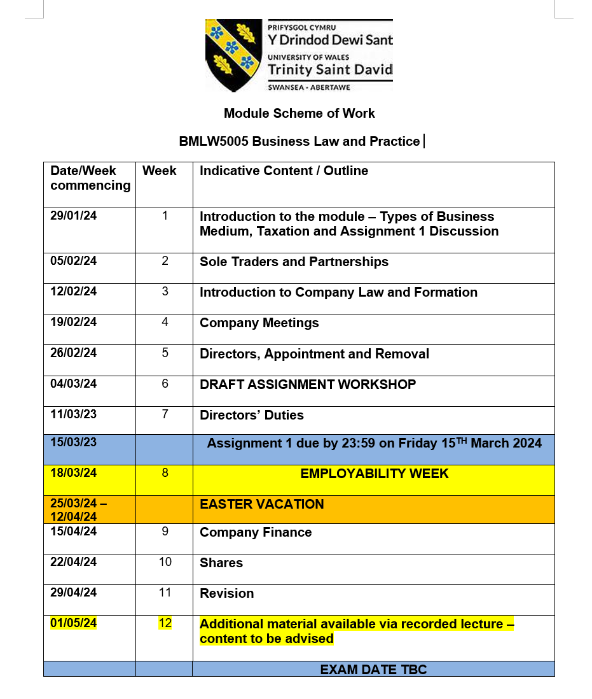


Slide 5
Assessment
1. Coursework (50%)
Essay – 2000 words
2. Exam (50%)
2 hour open book exam

Slide 6
Good Sources?
There is a 90+% chance that the BBC isn’t an appropriate source!!
There a number of very good sources available via the Library including books, YouTube videos, websites to look at
Make good use of the resources available at the library – Lexis Nexis
Look at the reading list uploaded to Moodle.
Extra reading list on Moodle!

Slide 7

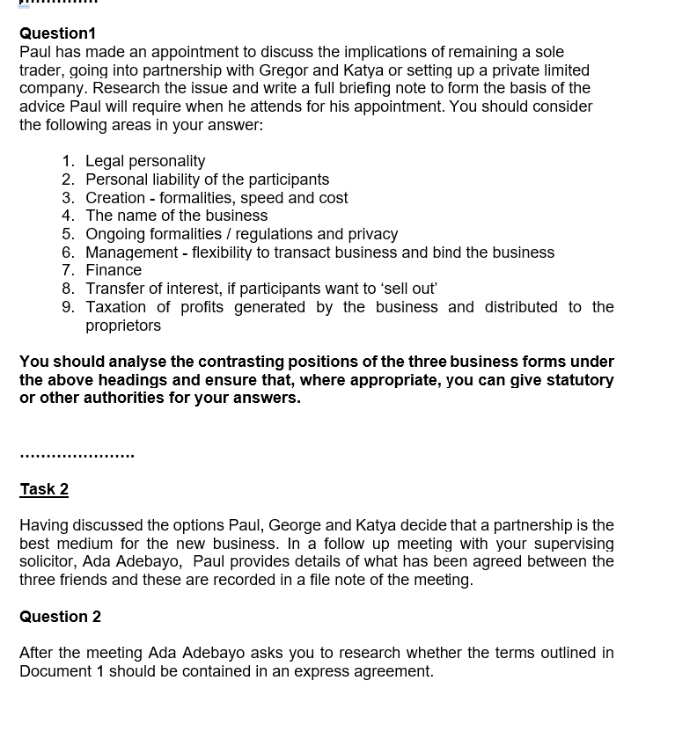



What is your first assignment?

Slide 8
Submission Dates
Draft submission Workshop
Hand in date 15th march 2024
Provisional mark April 2023

Slide 9
Questions
Why does anyone start a business?
What is the risk/reward ratio?
What are the options?
What factors influence choice?
Can you advise a client on the best option?

Slide 10
Why does anyone start a business?
Freedom: No-one telling you what to do
Enjoy rewards of own efforts
Perception of higher earnings
Risk / reward ratio

Slide 11
What is the Risk/Reward Ratio? I
Rewards
- Self Employed: Potential earnings
unlimited
- Employee: Earnings limited by
contract of employment

Slide 12
What is the Risk/Reward Ratio? II
Risks
- Self Employed: potential unlimited liability. Personal
bankruptcy if business fails
- Employee: Limited risk and liability. Redundancy if business failes

Slide 13
What are the options?
Sole Trader
Partnership
Company
- Private Limited Company
- Public Limited Company
Limited Liability Partnership (LLP)

Slide 14
Owners/Managers
Are they the same?
Owners Managers
Sole Trader No Distinction
Partners No Distinction
Company Members Directors

Slide 15
What factors influence choice?
Creation
- How much will it cost to set up?
- Speed?
- Formalities to set up
Remuneration & taxation
Borrowing & security

Slide 16
What factors influence choice?
Ongoing formalities
Privacy
Exit route
Management
Personal liability

Slide 17
Personal Liability
Sole Trader – Unlimited liability
Partnership – Unlimited liability
Company – Limited liability

Slide 18
Can you advise a client on the best option?
Can you advise a client on the best option?

Slide 19
Task
Read the following sections of the Partnership Act 1890:
- Ss 1, 5-6, 9-10, 14, 24, 26, 32 and 3
Read the following sections of the Companies Act 2006:
-Ss 53-55, 59, 66, 82-84
-Ss 386, 444, 853A, 1085-1086
-Ss 1192-1194, 1197, 1200-1206
Read the Business Names (Sensitive Words and Expressions) Regulations 2014

Slide 20
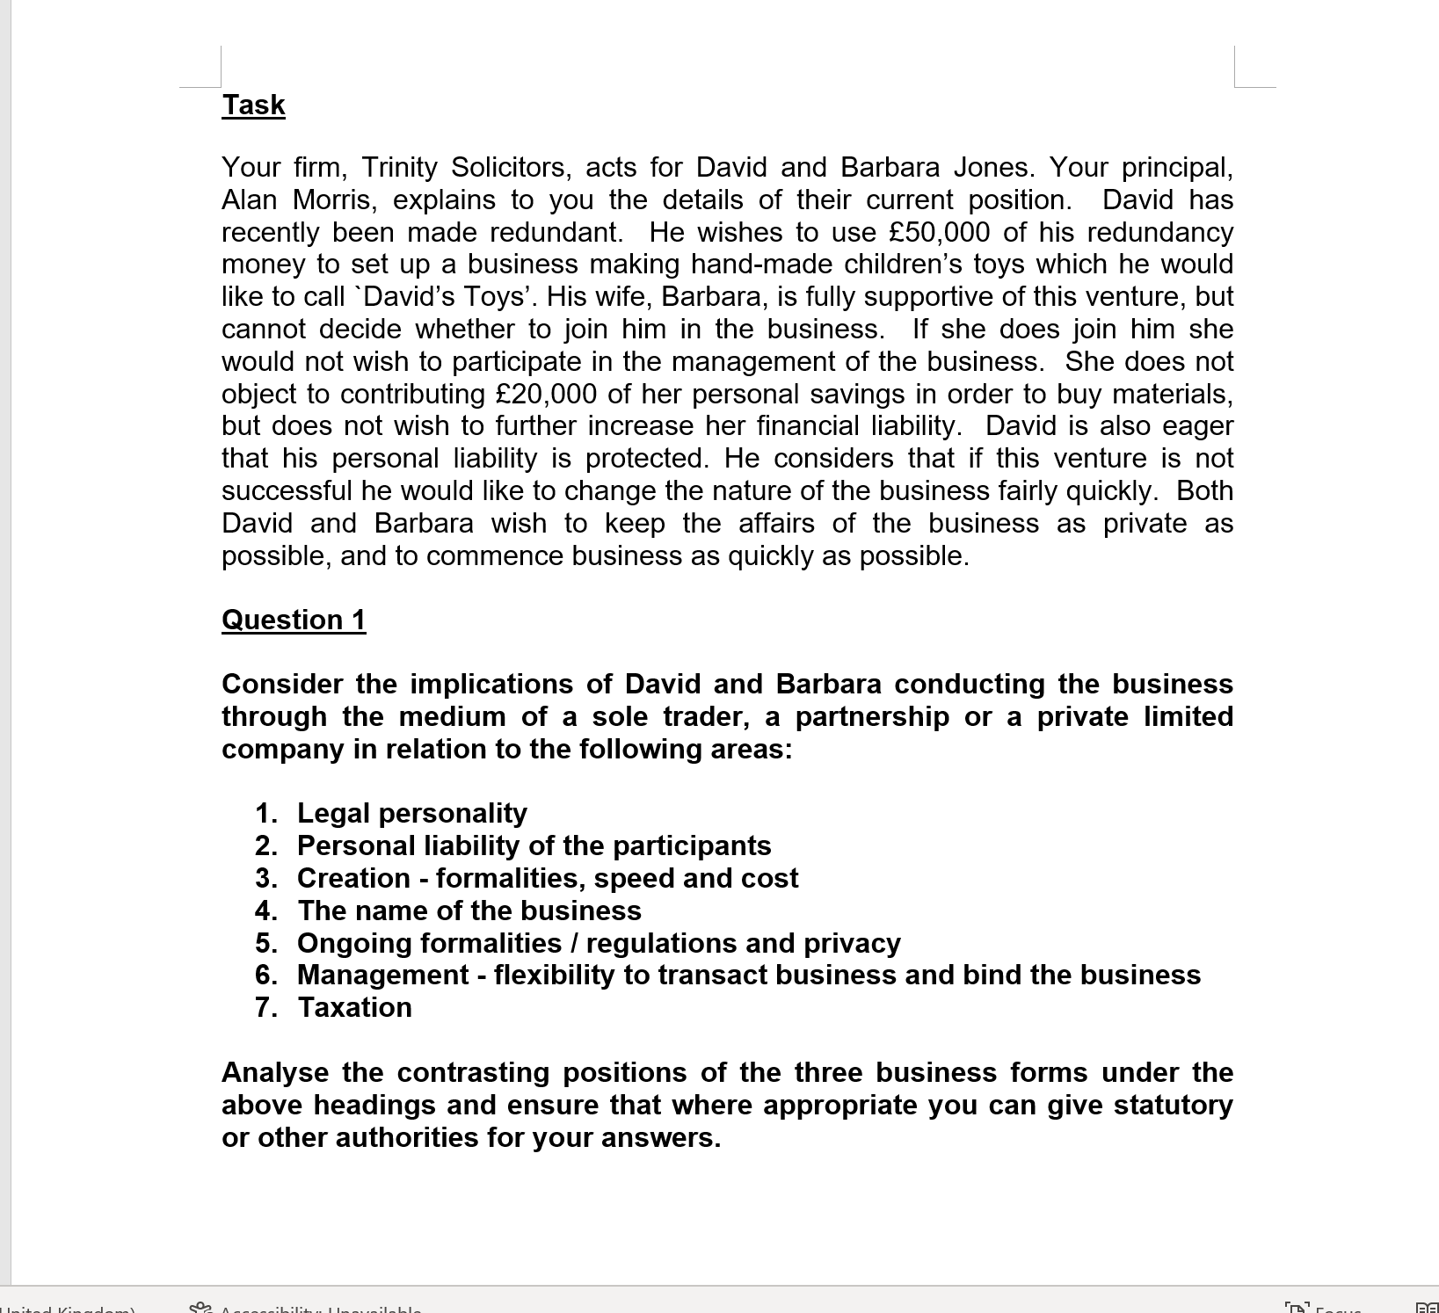

Slide 21



Any Questions?

