Slide 1
Module Name : Embedded C
Module Code : ACDA4013
Topic : LED Blinking
Lecture : 9
Lecture By,
Mrs. Jenifer Prince Devaraj,
Lecturer - Embedded Electronics,
Faculty of Applied Computing,
UWTSD
Email:j.prince-devaraj@uwtsd.ac.uk

Slide 2
Programming on PIC
Exercise 1: Write and design an embedded C program to blink an LED using the PIC16F877A microcontroller, with the LED connected to the first pin of PORTB (RB0).
UWTSD Lectures / ACDA4013 – Embdded C

Slide 3
Programming on PIC
Header File
UWTSD Lectures / ACDA4013 – Embdded C

Slide 4
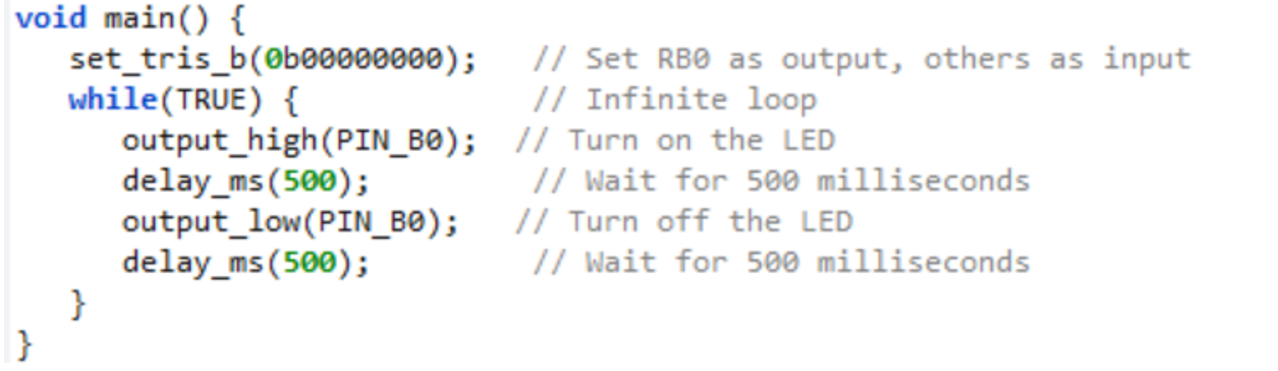
Programming on PIC
C File
UWTSD Lectures / ACDA4013 – Embdded C

Slide 5
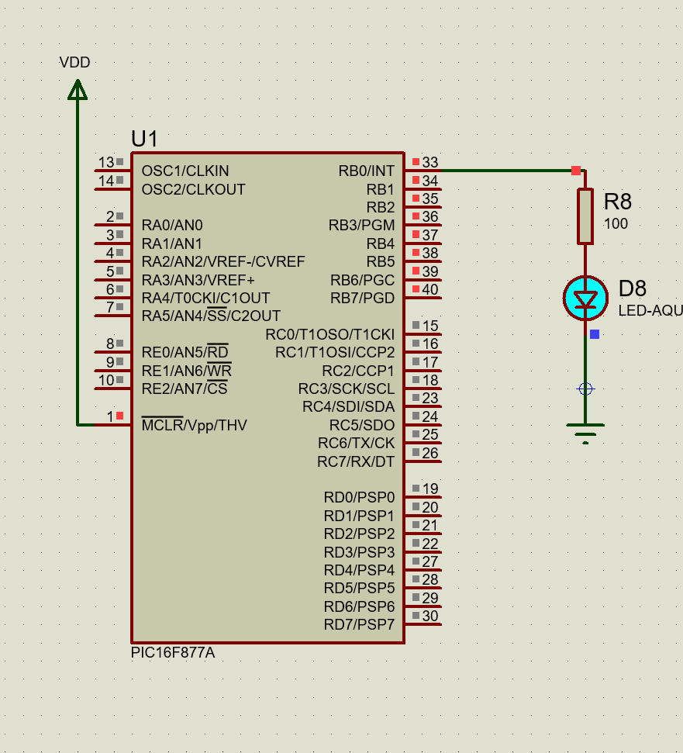
Programming on PIC
UWTSD Lectures / ACDA4013 – Embdded C

Slide 6
Programming on PIC
Exercise 2: Write and design an embedded C program to blink all the LEDs connected in Port B with a delay of 2 seconds using the PIC16F877A microcontroller.
UWTSD Lectures / ACDA4013 – Embdded C

Slide 7
Programming on PIC
Header File
UWTSD Lectures / ACDA4013 – Embdded C

Slide 8

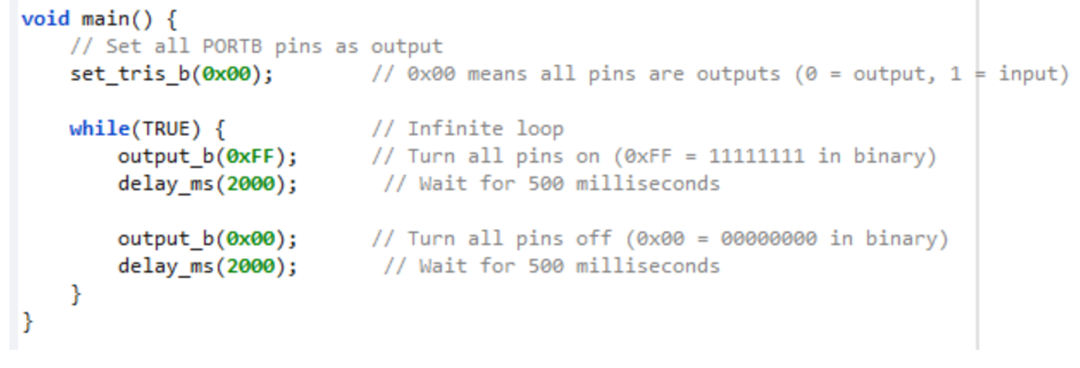
Programming on PIC
C File
UWTSD Lectures / ACDA4013 – Embdded C

Slide 9
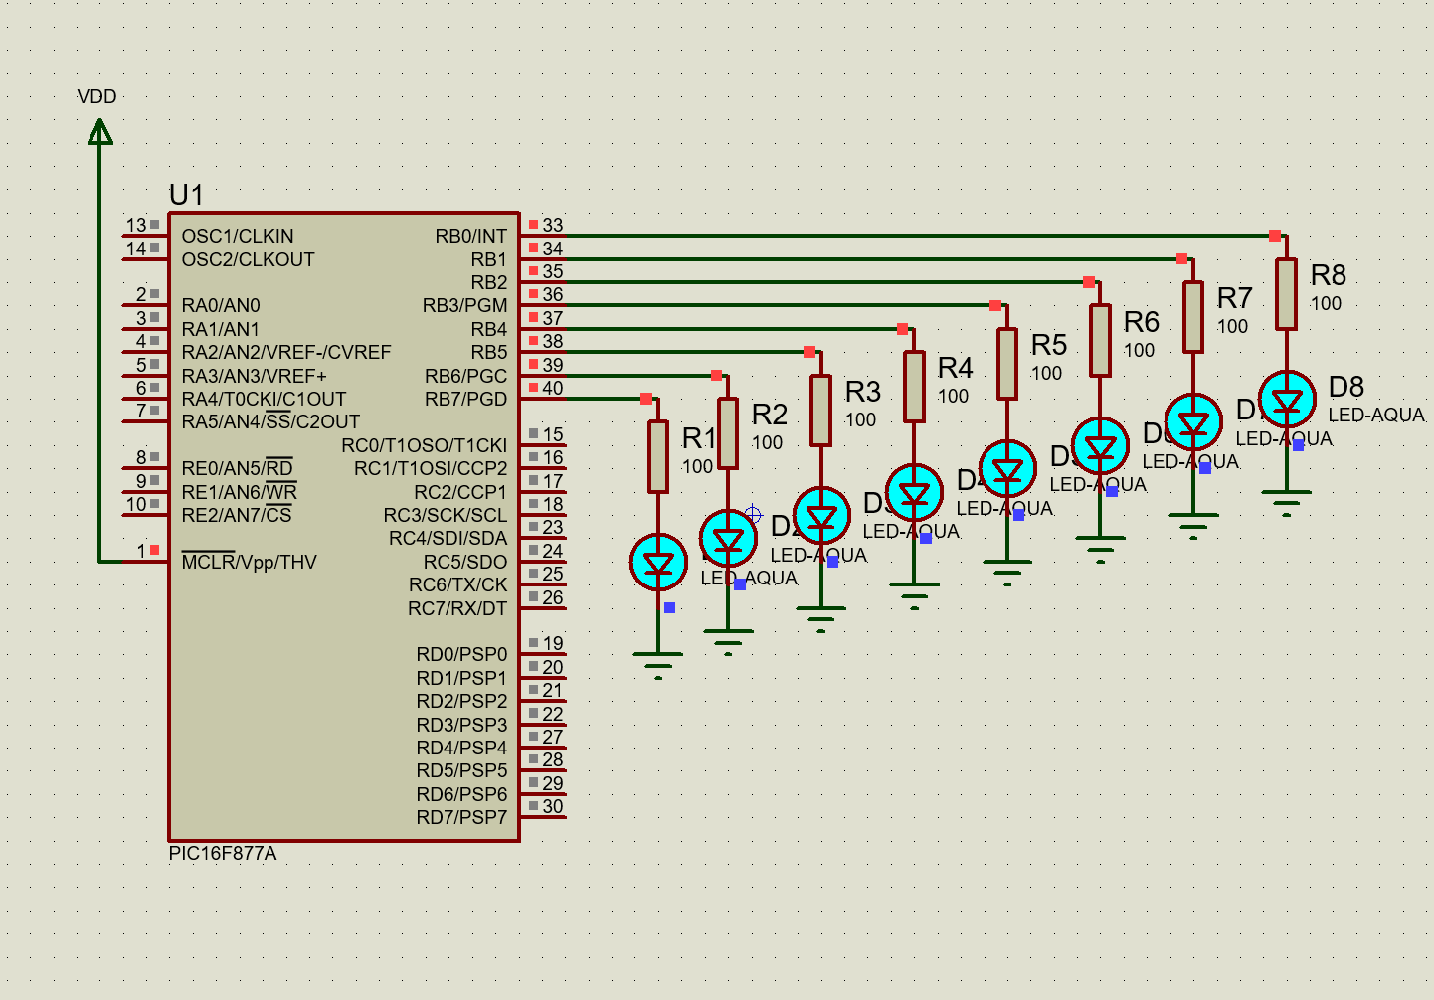
Programming on PIC
UWTSD Lectures / ACDA4013 – Embdded C

Slide 10
Programming on PIC
Exercise 3:
Design a circuit using the PIC16F877A microcontroller where each pin of PORTD is connected to an LED with a 100Ω current-limiting resistor. Additionally, connect a push button to the second pin of PORTC. The circuit should perform the following functions:
    When the switch is pressed, all LEDs on PORTB should be turned ON.
    When the switch is released, all LEDs should turn OFF.
UWTSD Lectures / ACDA4013 – Embdded C

Slide 11
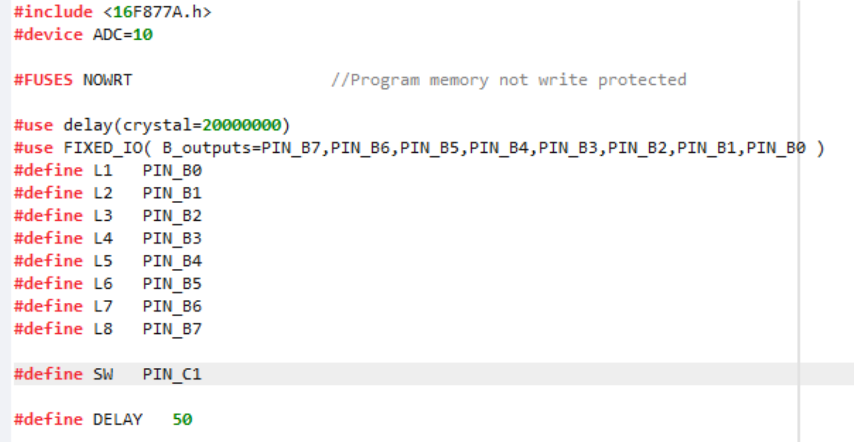
Programming on PIC
Header File
UWTSD Lectures / ACDA4013 – Embdded C

Slide 12
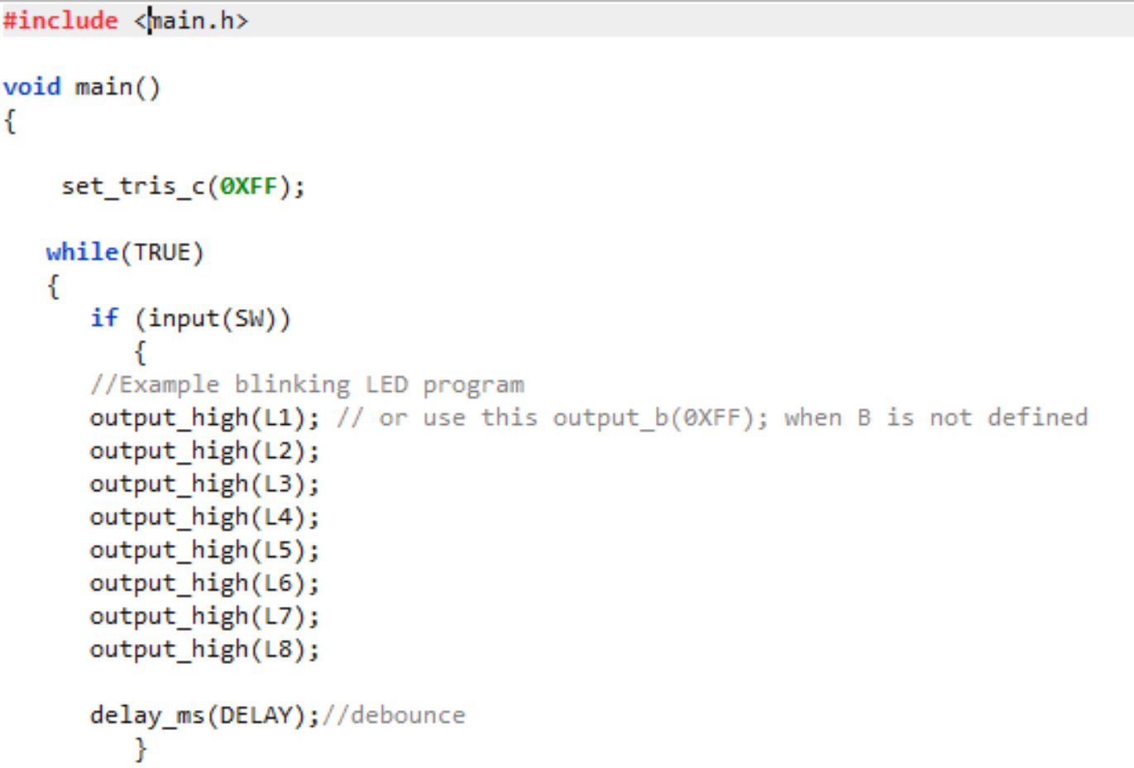
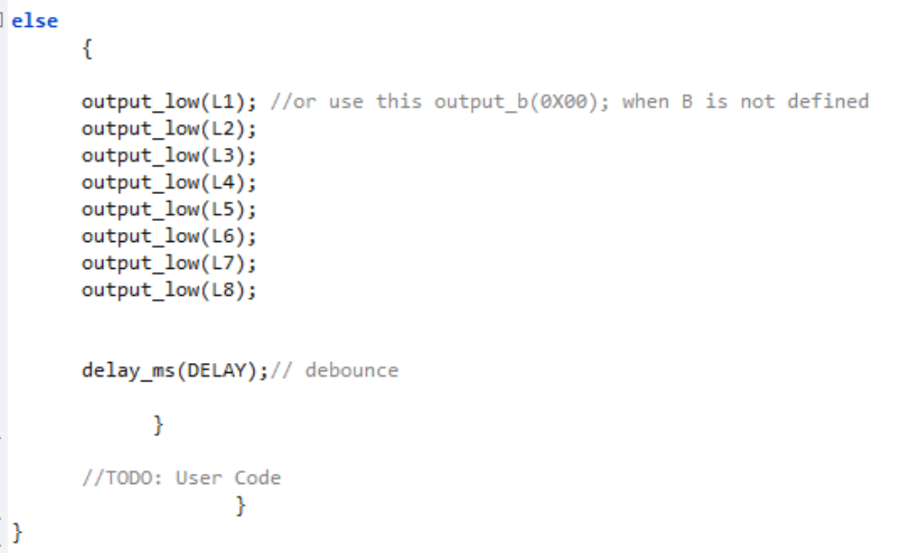
Programming on PIC
C File
UWTSD Lectures / ACDA4013 – Embdded C

Slide 13
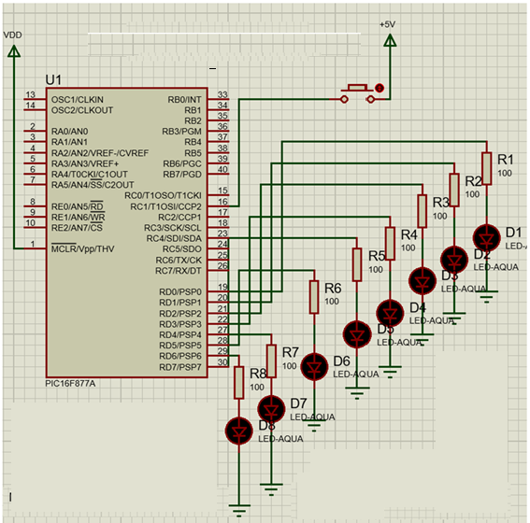
Programming on PIC
UWTSD Lectures / ACDA4013 – Embdded C

Slide 14
Thank You

