Slide 1
Community Care and Development
Name of the Student: Helen Deen
Student ID: 1905886
Lecturer: Chizoba Esio bassey
Viva Presentation

Slide 2

Introduction
The following presentation provides information about the specific community of job seekers who have been identified to be unemployed individuals. It has also helped in focusing on the reasons for unemployment which has helped in understanding the effectiveness of the community within the educational area. The presentation also focuses on the needs and demands of the jobseeker which is effective in providing opportunities for impacting the achievement of employment opportunities effectively. The presentation also discusses the theories, policies, and practice that has a major impact on the chosen community. This has helped in understanding the impact of discrimination on unemployed individuals which has led to various problems.
Notes:
The presentation also describes the impact of a community project on the job seekers which has been identified to be beneficial for the growth and development of the individuals. It has also helped in understanding the impact of technology on social media within the community which has been beneficial in providing employment opportunities. It also describes the importance of sustainability within the community of job seekers which can be effective in providing opportunities for growing and developing with the integration of job opportunities within an interview.

Slide 3

Community
A community is described as a group of people having common interests or living within a particular area showing common characteristics.
A community of people has been identified to be efficient in expressing their shared beliefs towards the goals and values and also has the ability to develop efficiency in taking responsibilities and impacting communication.
Job seekers are referred to as a community of people who have the potential of applying for a job by identifying an opportunity by actively looking for it.
Job seekers are considered the unemployed group of people who tend to look for work working opportunities within an environment.
Notes:
Job seekers are the group of people who are considered to be a community that has a common and shared interest in availing employment opportunities effectively. They are identified to share similar interests which allow them to actively look for employment opportunities through their knowledge and skills. Job seekers have also been identified to be an unemployed group of people who have the tendency to actively participate in the research process of finding effective and efficient jobs according to their capabilities (Chen and Sivakumar, 2021). The collective approach of job seekers allows them to develop a community of people who are intended to find efficient jobs for themselves impacting the opportunities of achieving efficient jobs according to their interests.

Slide 4
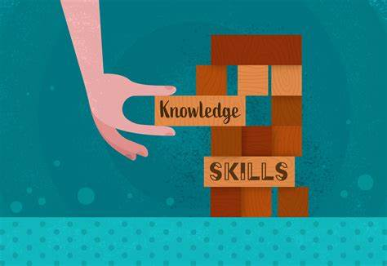
Description of the community
Job seekers have identified an effective group of people or a community who have the tendency of impacting their activities for achieving their goals efficiently.
Job seekers have the effectiveness of being resilient in finding their jobs based on their capabilities and analyzing their knowledge and skills.
They are also identified to be leaders oriented which have a huge impact on the community of the job seekers providing them effective opportunities of finding efficient jobs.
Job seekers are also known to be competitive as they have the urge of achieving employment opportunities through their active participation (Hendriarto, 2021).
They are often identified to be the community of people who are known to be ambitious.
Notes:
The community of job seekers has been identified to be one of the most wanted groups by recruiters or hiring managers who have the tendency of prioritizing their job efficiently. This provides an opportunity for the job seekers in availing efficient jobs according to their needs. Job seekers have also been identified to have certain qualities which include resiliency, leadership-oriented, competitiveness, and ambition which are implemented effectively for impacting the community effectively. These groups of job seekers have the tendency of creating a positive image and an impact on society which is beneficial for them in creating job opportunities effectively. This is helpful for them in achieving job opportunities that are required for impacting their lifestyle effectively and efficiently.

Slide 5

Theories, policies, and practices affecting the community
Job seekers have been identified to have a negative impact due to the implementation of recession leading to unemployment.
The negative impact of nominal wages affected the process of inflation which led to the fall of real wages leading to unemployment. The economic growth has been identified to be stagnant which has impacted negatively on the employment opportunities weakening the economy. The fall in labor productivity has also impacted negatively employment opportunities leading to unemployment.
The fast-changing nature of the economy has also impacted negatively employment opportunities affecting structural unemployment. Demand deficient unemployment has also been observed during the recession which has impacted the reduction in the experiences of the organization affecting the products and services (Huda and Hashim, 2021).
Notes:
Many theories policies and practices have a negative impact on the community of job seekers which has led to unemployment. The UK has been able to state the effective cause of unemployment which has been existing within the country impacting negatively on the growth and development of the job seekers. This helps in identifying the impact of recession which has led to the unemployment of job seekers. Communities have been able to identify the issues related to long-term unemployment which has led to damage to the individuals and has also affected the mental and physical health of the people. The impact of Unemployment has led to a negative impact on economic growth.

Slide 6

Discrimination faced by the community
Job seekers have been identified to face unemployment discrimination often due to unethical practices within the hiring process.
The impact of unemployment discrimination has also affected capable job seekers which have directly affected their development of the unemployed people or the job seekers are often identified to be responsible for their situation which reflects on their work ethic and bad personalities (Korkeila, 2021).
This creates a negative image and impacts job seekers. The hiring process has also shown signs of discrimination against the unemployed people which has impacted the opportunity for employment for the unemployed people negatively.
Notes:
The negative reputation for certain job seekers has led to a negative impact on the image of the jobseeker community which has led to the implementation of discrimination against unemployed individuals during the hiring process. Unemployment has been identified to be one of the negative aspects which have impacted the thoughts of the hiring individuals or the employers impacting negatively with the rise in the discrimination process. This also has the tendency of neglecting the efficiency of an unemployed individual which has a long impact on the Employment Opportunity of the individuals. This has led to the development of various laws against unemployment discrimination which has been identified to be a serious problem (Lin et al., 2021).

Slide 7

Community project
Job seekers have been provided with various facilities for impacting their knowledge and skills effectively providing them employment opportunities efficiently.
They are also identified to be effective in emphasizing their productivity and performance which has been effective in providing efficient ways of being a part of the hiring process.
The onset of the coronavirus pandemic had led to an increase in security which had affected the productivity and performance of unemployed individuals.
This had led to the development of projects in providing support to the jobseeker community effectively.
The impact of community projects on job seekers has also been able to provide them with opportunities of enhancing the work-life balance effectively (Liu et al., 2021).
Notes:
Job seekers are one of the unemployed communities which has a major impact on the processes of employment opportunities with the help of hiring individuals. This has led to the understanding of the need for community projects for the job seekers which can be effective in providing them efficient opportunities of achieving employment effectively through their knowledge and skills. Opportunities for job seekers through community projects can also be effective in providing them opportunities of finding the right organization which could be highly beneficial for unemployed individuals. This also has the ability to provide the individuals the opportunity of getting hired in remote locations with the implementation of multiple interview rounds effective in providing employment opportunities.

Slide 8

Impact of technology and social media on the community
Technology has been able to provide opportunities to create a digital environment for job seekers effective in reaching job opportunities efficiently.
The impact of technology has provided opportunities in integrating exposure to the vulnerable environment in seeking jobs efficiently.
The impact of technology has been able to conveniently create opportunities for job seekers which have been beneficial in providing them employment opportunities.
Social media has also been able to provide the opportunity for job searching for unemployed individuals effective in seeking a job and connecting with recruiters (Park et al., 2022).
The implementation of technology has also been able to impact the AI-driven tools which have also been beneficial for the recruiters in selecting and detecting the best candidates among the applicants.
Notes:
Technology has been able to impact the labor market efficiently providing opportunities for seeking jobs effectively. This has been beneficial in impacting the pattern of searches for the job seekers which has been beneficial in identifying the opportunities and grabbing them efficiently for impacting the lives of the people. The impact of technology and social media has also been able to provide opportunities in connecting with the recruiters efficiently which has been beneficial in enhancing the opportunities of getting a job effectively. Social media has improved the process of connectivity and communication effectively which has helped in the identification of these skills and experiences of an individual which increases the potential of the recruiting agencies for identifying the relevant candidates.

Slide 9
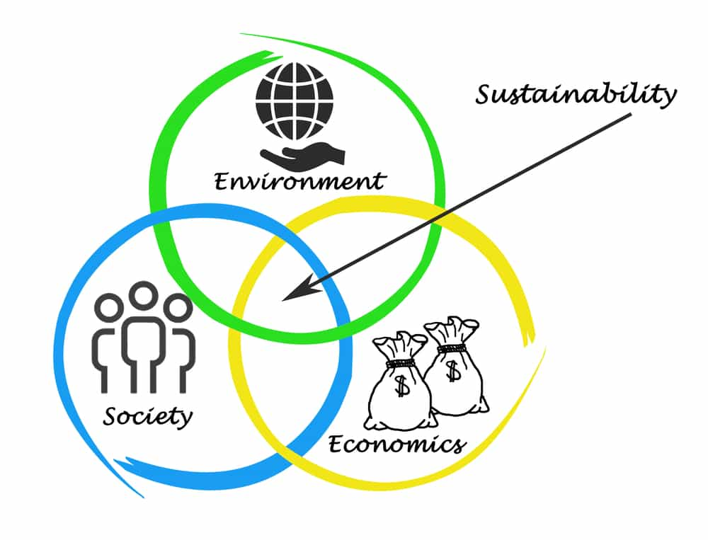
Sustainability of the community
The implementation of sustainability within an environment has been identified to be efficient in providing unity among the members of a community which helps in developing better work culture.
This is also effective in implementing work-life balance which has been identified to have a great impact.
The mental stability of people is achieved with the implementation of sustainability which helps in increasing the productivity of an individual (Solaiman and Ghuloum, 2022).
The impact of sustainability has also provided the jobseeker community with an opportunity of implementing good use of the skills and experience for achieving a sustainable career.
Sustainability has also been able to impact the performance of an individual which is effective for getting recruited into an organization efficiently.
This has been beneficial in developing skills and knowledge which helps in increasing the productivity of an individual for impacting the community of the job seekers.
Notes:
Sustainability for the job seekers is necessary to be implemented for impacting the well-being of the individuals within the community. This is beneficial for improving the Environmental Quality effectively providing opportunities for growing effectively. Sustainable features have been effective in providing efficient knowledge and experiences to the people providing them opportunities in getting employed during the recruitment process along with the implementation of the retention process. The impact of sustainability has also been identified to be beneficial in providing opportunities in increasing productivity which is possible by the overall engagement of the individuals within the community of the job seekers (Thompson et al., 2021).

Slide 10

Conclusion
From the above presentation, it can be concluded that job seekers are a community of people who have the tendency of engaging in the activities of seeking jobs effectively. They have been identified to be the group of people who have been able to impact their opportunities of getting recruited with a similar motive. It also provides information about the community of the job seekers which provides a brief idea about their efficiency and efficacy. It has also been able to provide information about the theories, policies, and practice which has a major impact on the community of job seekers. It has been identified to be beneficial in providing effective opportunities for job seekers in getting the necessary job according to their knowledge and skills.
Notes:
The impact of effective opportunities has also been able to create opportunities in jobs and employment opportunities which is required to be fulfilled by the job seekers. This has a major impact on the Skills of the job seekers which has a major impact on the growth and development of the community for the job seekers. It has also been able to provide information about the unemployment discrimination which is faced by the community of job seekers. This has led to the identification of the problems that have been faced by the job seekers during the job interviews and the recruitment and hiring process. This has led to the understanding of the impact of community projects on the community of job seekers which is effective in providing opportunities in impacting the knowledge and skills of the job seekers.

Slide 11
References
Chen, Y. and Sivakumar, V., 2021. Investigation of finance industry on risk awareness model and digital economic growth. Annals of Operations Research, pp.1-22.
Hendriarto, P., 2021. Understanding of the role of digitalization to business model and innovation: economics and business review studies. Linguistics and Culture Review, 5(S1), pp.160-173.
Huda, M. and Hashim, A., 2021. Towards professional and ethical balance: insights into application strategy on media literacy education. Kybernetes.
Korkeila, J., 2021. Organization of Community Psychiatric Services in Finland. Consortium Psychiatricum, 2(1), pp.55-64.
Lin, J., Luo, Z., Benitez, J., Luo, X.R. and Popovič, A., 2021. Why do organizations leverage social media to create business value? An external factor-centric empirical investigation. Decision Support Systems, 151, p.113628.
Liu, T., Jiang, T., Liu, M. and Ou, Y., 2021. Innovative design of community care services based on the concept of environmental sustainability. In E3S Web of Conferences (Vol. 245, p. 02035). EDP Sciences.
Park, Y., Park, S. and Lee, M., 2022. Analyzing Community Care Research Trends Using Text Mining. Journal of Multidisciplinary Healthcare, 15, p.1493.
Solaiman, B. and Ghuloum, S., 2022. Towards community care: Qatar's rapidly evolving mental health landscape. BJPsych International, 19(1), pp.15-18.
Thompson, J., Cook, G., Masterman, C., Parkinson, M. and Bainbridge, L., 2021. Rapid evidence review to understand effective frailty care pathways and their components in primary and community care. International Journal of Health Governance.

Slide 12


