Slide 1
Effective teamwork and communication
BMSW4002
Lecturer:Anita Nan
Andreea Burdujel:2133989
Geani-Paul-Matei:2133988
Alina-Elena-Matei:2124304
Bocirnea Georgean:2133492
Leonardo Mihai:2133451
Effective Team Work and
Communication
Assessment 2 (Group
Presentation)

Slide 2

Introduction
•Working in team to solve problems and achieve colective goals în a Common experience for many. Wile team can achieve extraordinary results,they can also deteriorate into an ineffective and immobilized group of individuals. As individuals join together and build trust ,groups develop a shared identity and a common purpose as they progres through predictable stages of development.
Notes:
It is beneficial for maintaining a team or within the organisation. In the Research report, Walmart has developed the concept of the team work which is helped to increase the performance in the problem solving, and word production for stimulating the new growth. The group project has developed the increment of the beneficial strategy towards employee which has helped to increase the motivation among the employees.

Slide 3
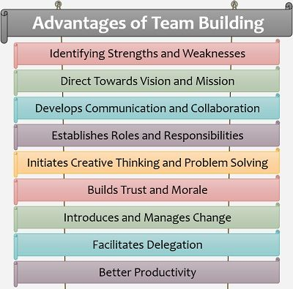
Benefits and disadvantages of the team working
• Team working can make work more efficient and fun.working with others enable members to:
•Increase productiviti(synergy-1+1=3)
•Grup work gives members the chance to learn from each other.
•Pool their Ideas and see problems from different perspectives
•Give spport to each other......etc....
Notes:
There are so many advantages of the team work in Walmart organisation. Teamwork has helped for increasing the collaboration and also has opportunities for developing the marketing growth ideas. Ultimately, this has helped to increase in marketing and business productivity. The team members are essential to solve their critical and complex problem and completed at various task by improving the skills.
The organisation has developed their management team by improving skills and knowledge and also they are developed a proper team with the expertise people being different abilities and skills. On the other hand, the Teamwork has improved the communication skills and maitnained the work environment throughout the organisation. The decision making process will be delayed and prolonged and the organisation has organized a different meetings for scheduling times with their team members who are efficiently handle the critical and difficult situation and make decisions rapidly.

Slide 4
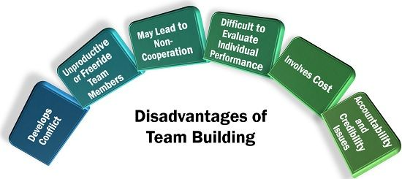
Disadvantages of the team working
•Inavasion of Privacy:
-Although communication Technology allows People to share information with friends and others around.
•Reducing face-to-face communication:
-The access that People have on the internet,and social media specifically, has become too easy.
•On-line bullyng:
-bullies have been around forever,but the use of communication Technology, more specifically social media, are now giving them a whole New platform for their action.
Notes:
Instead of different advantages of the team work in Walmart organisation, the organisation has sometimes faced different disadvantages of the teamwork which has hampered the work environments. The team members are becoming lazy in work pressure and sometimes it has hampered the Possibility of the team growth and development of the marketing business. The employees review cannot be efficient in the team situation and it may be difficult for specifying the contribution of the team members. Business leaders can reduce this to conduct the evolution of the team members in organisation. This lazy member may create resentment within the team which has resulted the reduction of the productivity growth in organisation. It is challenging to manage a team without weekly meetings, but consultations must be properly controlled and arranged. They must always have an objective and a purpose, or they will devolve into a social occasion, major drawbacks of group projects and team cohesion. In addition to conflicts among individual people, communities could be subdivided into different, each of which has its own action plan and "ideological" placement. This circumstance is hard to solve without disintegrating and reconstructing the entire team.

Slide 5
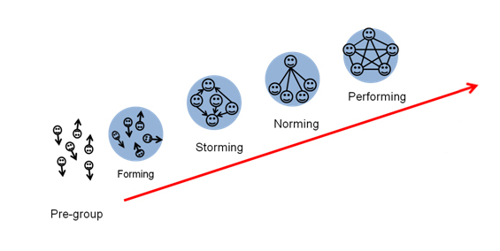
Stages of the team development
•Who is Bruce Tuckman:
-is profesor in philosophical psychological, and comparative studies ohio state universiti
•Forming:
-members depend on leader for guidance and leadership
•Storming
-during the storming stage,team discover teamwork is more difficult than they expected.
•Norming
-The norming stage begins as the team moves belonid the storming stage and begins to function as a team
•Performing
-when a team reaches the performing stage it is functioning as a higth performance team.
Notes:
It is challenging to manage a team without weekly meetings, but consultations must be properly controlled and arranged. They must always have an objective and a purpose, or they will devolve into a social occasion, major drawbacks of group projects and team cohesion. In addition to conflicts among individual people, communities could be subdivided into different, each of which has its own action plan and "ideological" placement. This circumstance is hard to solve without disintegrating and reconstructing the entire team.

Slide 6

Team roles
• Who is Belbin:
•Belbin born (4 june 1926 ) is a brithis researcher and manageament consultant Best known for his work on manageament teams.
•Situational leadership it has 4 leadership style:
•Telling:this the most direct form of leadership
•Selling:’Selling’is where the leader May need to convince or persuade some of the team members.
•Participating:where the leader tries to build relationship with those on the team.
•Delegating:is where the leader passes on most of the responsibilities.
•People Oriented :coordintors,Team workers,resources,investigators.
•Thought oriented:Plants,monitor,evaluators,specialists.
•Action oriented:Shapers,implementers,
completer-finisher
Notes:
Organisation has assisted the management with the supervision of the associate in their assigned area for developing the responsibility and assigning the duties to their associates. There are organized feedback and goals for the communication which are associated on the procedure and process and also provided guidance and direction for associating with service approach and also techniques for ensuring the member complaints with issues. The organisation has also ensure that the compliance with the procedure and policies and also support it to participate hiring, coaching, promoting, evaluating and scheduling the associates in the open door policy.

Slide 7

Managing conflict
•Communication:
-communication barriers include poor listening skills;insufficient sharing of information etc....
•Structural disagreements include the size of the team,levels of participation and levels of interdependence among employees.
•Personal Factors:
-include things such as:an individual’s self-esteem ,their personal goals ,values and needs.
Notes:
The conflict management has included the change in organisation structure for avoiding the conflict. This has also changed the environment in the organisation and also created lack of problem solving and majority rules in workforce environment. Other than that, conflict Management process has increased the negative aspect in organisation which has affected the business performance and effectiveness in the development organisational setting.

Slide 8
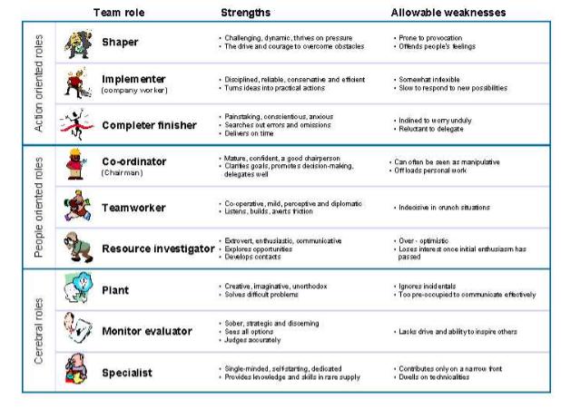
Successful team development
•Wou can leader make sure that a team develops and keeps developing?
•Understand responsibilities:
-make sure that everyone knows what is expected of then
• Cover the belbin roles:
-as a far possible ,the leader should ensure that the team covers the nine Belbin team roles.
•Have Common goals:
-be sure each team member shares the same objectives
Notes:
Walmart has developed effective teamwork for the challenging business climates. They have provided an excellent opportunity for establishing the similar ground to fulfillment of the business objectives. Appreciation, encouragement and empathy are one of the most important ingredients of the effective teamwork in organisation. Walmart have used cost leadership strategy for becoming the highest and largest company in the world.

Slide 9
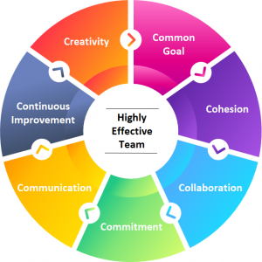
Effective team
•Competent team members:team members must be educated,trained,and know what they are doing.
•Colaborative climate:effective teams create a positive, supportiv climate.
•Result-driven structure:teams must have an efficient and organized method of achieving outcomes.
•Clear elevating goal:the goal must excite and motivate the team.
Notes:
Based on the above analysis, it has been stated that proper vision of the leader Available the team members for developing the emotional response system and also developed organisational objectives and missions. other than that, the leadership capabilities has been significantly develop by adapting the emotions and attitudes among Their employees will be helped to become a good leader among the team. The good leaders are H and self conscious on how verbal and nonverbal communication has been affected the employees in an organisation. Considering the development of an effective team in Walmart, the organisation has suggested inspirational strategies for formulating the entire team dynamics at the organisation. Few strategies have formulated the group dynamics for embarrassing the strength and weakness of the group member. This team Strategies and helped a clear dimension of the responsibility among the team members and also develop the acceptance of the feedback about their employees.

Slide 10
Conclusion
•The helps understand the various aspects of the virtual learning environment and how extensively People accept the concept and get accustomed to the various teaching tools and techniques.
•The detailed research conducted in understanding the laidback that has been occuring and how to impruve them like the time and how to overcome that and make a routine and follow that stricly.
•Stating how they can provide feedback to each other and make the process even better.
Notes:
In the Walmart organisation, the business manager has produced change model in employment and leadership structure. The leadership has about it the necessity of the employees and workers for developing their business strategy and their workers will be walked for supporting the targeted business objectives. The organisation has embraced such business practice for addressing different issue which is affected the business performance. Evaluating the impact on the management ability has also enhance the job satisfaction of their organisational employee and developed training program for changing skills and knowledge towards the improvement of the operational activities by maintaining the improvement of the self perceived capabilties and self awareness.

Slide 11
Reference list
•Belbin,R Meredith.(2012).Team Roles at work Abingdon,Oxon:Routledge
•Maund ,A .,Schriek,M.,&Tinkler ,P.K.(2017).(eds.) Certificate în Higher Education:Skills fot the Workplace student Yearbook.London:Sage
•Tuckman,B.W.(1965)’Developmental sequence în small groups’,Psychological Bulletin,63,384-399
•Heresy ,P.and Blanchard,K.H.(1969).Management of Organizațional Behavior-Utilizing Human Resources .New Jersey;Prentice Hall.Maund

Slide 12
Question

