Slide 1
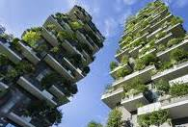
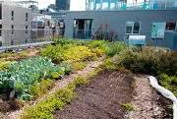
Raghvir Dhaliwal - 2124976
Course: MA Equity and Diversity in Society ​
Module: Sustainable Communities
Module Number: ECGE7007Q
Original submission date: 13th December 2024
Deferential deadline : 20th December 2024​

Slide 2
Critically engage with ONE model of a Sustainable Community.
A Critical engagement of Sustainable Communities: Livable Cities and Towns
Analysis of the Elephant & Castle sustainable communities' project

Slide 3
Definition of Community and Historical Context
Community: “A community is a social unit that shares common values, geographic boundaries, and social connections, fostering a sense of belonging and collective identity among its members,” (Tönnies,(1887).
Historically, communities were often defined by geographic proximity and shared livelihoods. In the contemporary context, communities can also form around shared interests or identities, transcending geographical boundaries, such as online communities.
“In modern society, “individuals are brought together not merely by family connections or proximate living conditions, but by shared interests, values, and the complex social structures that bind them.” (Tönnies’ (1887 [2017]) . Idea of gemeinschaft and gesellschaft)
Calhorn also argued and looked at the intersectionality and entwined nature and the change in viewpoints that should be considered when viewing the ideal for required made urban ‘communities’ and the initial idea of urban ‘society’ or urban lifestyle started to be floated Gemeinschaft and Gesellschaft. Craig Calhoun (2002).
Tönnies argued, urban communities “tends to be much more fragmented and compartmentalized”. Tönnies, F. (2001).

Slide 4
Definition of Sustainability and Historical Context
“Sustainability is the capacity to endure in a relatively ongoing way across various domains of life.” (Bruntland, 1987).
” It encompasses environmental integrity, economic viability, and social equity, ensuring that future generations can meet their own needs”.(Brundtland, 1987).
“Indian civilization has been distinctive in locating its sources of regeneration, material and intellectual, in the forest, not the city. India's best ideas have come when man was in communication with tress and rivers and lakes, away from the crowd” Rabindranth Tagore.
(For Rabindranth Tagore see :Theroroes and Principles of sustainability) https://www.youtube.com/watch?v=SOl0BNY5iiY)

Slide 5
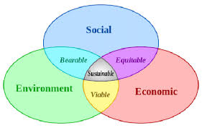
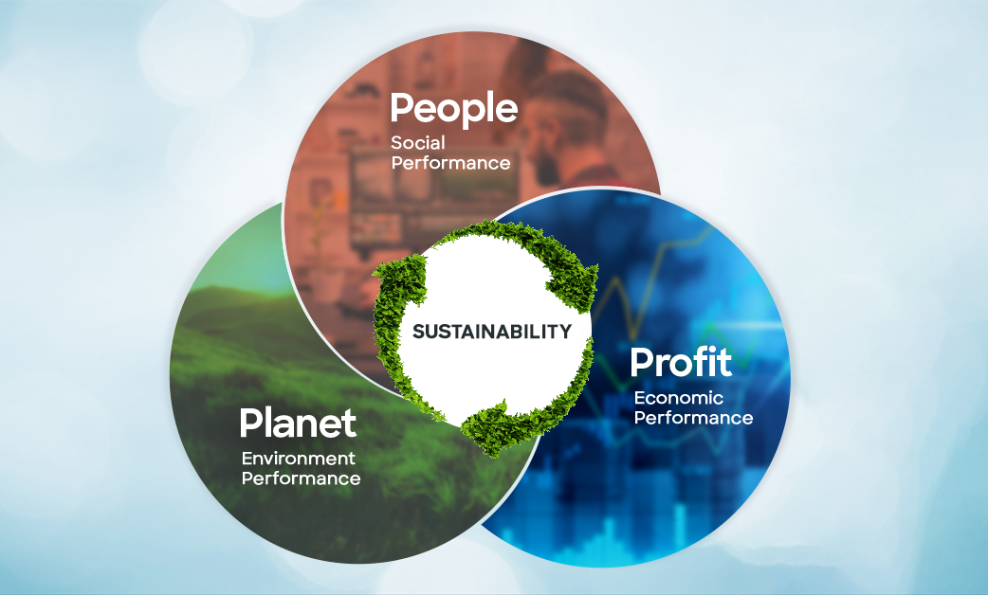
People, Planet & Profit - Triple Bottomline
Elkington economist's viewpoint in 1998, the need for balance between the three aspects and the why, to achieve sustainable Growth, so now taking sustainability onto the growth and continuous aspect (1998).
ResearchGate. Available from: https://www.researchgate.net/figure/The-three-circles-model-of-sustainable-development-with-overlaps-labeled_[accessed 8 Dec 2024]
Image People, planet & Profit- Triple bottom Line Linkedin 2020
[accessed 8 Dec 2024]

Slide 6
People, Planet & Profit –
Triple Bottomline
“John Elkington provided a framework to measure sustainability, Srivastava (2021), ”suited to measure performance in the western corporate world an accounting framework, called the triple bottom line -TBL “ (Slaper and Hall 2011). See Srivastava. (2022).
  “Development that meets the needs of the present without compromising the ability of future generations to meet their own needs.” World Commission on Environment and Development (1987).
Srivastava, et al. 2022 argue:
  “That societal and environmental issues cannot be put a figure on in the same way as financial data“
  “its a philosophy which is not based on the real concept, it's not new or unique or innovative and, it only explains the already existing concept of corporate social responsibility” Srivastava, et al. (2022)
This view is supported by Henriques et al. 2013 who argues the need for human behavior as a main factor when referring to TBL for economical business interests.
‘’ The process of maintaining sustainability in the TBL is undoubtedly facilitated by the citizenship behavior of companies” Henriques et al. (2013).

Slide 7
Ideological stances taken by Sustainable Communities
Environmentalism
“Park & Allaby (2017) ‘the political beliefs that motivate an organized social movement of people who share a concern about solving problems of environmental pollution and natural resources”.
Xiong (2014) argue that shallow environmentalism treats environmental and ecological destruction by addressing immediate physical symptoms but refuses to reflect critically on the underlying cultural, political, and ideological matters.
Strong sustainability – Is lasting, good practice and a good quality life experience with a focus on health, safety and wellbeing. All living things are considered and not harmed. An understanding of how to work in unison with nature and, focus on people and planet.
Eco-centric approaches - Social Ecology, Eco- Socialism, Eco Feminism
& Deep Ecology. Approaches with sole focus is people and planet.
Social Ecology – strongly opposes the capitalist views and aims to connect and link people and planet again profit is not considered as important.
Henriques et al. (2013)
Lynn White Jr. (2008)

Slide 8
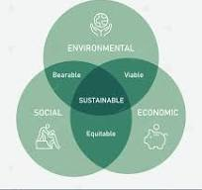
Ideological stances - Social Ecology
Social Ecology integrates social ecological and stances, social justice, community involvement, and responsible environmental stewardship.
The model emphasizes the interconnectedness of social systems and ecological health.
Socialist Alternative a marginalized green movement and they refer to eco socialists share many of the criticisms made of market-led environmentalism. Democratic Green Socialist
Bookchin in White (2008)
Paulson 2016
Attfield 2003

Slide 9
Social Ecology continued
“Social ecology – The environmental issues are deeply rooted in social hierarchies and inequalities.” Bookchin (2008)
“A socially just community is vital for ecological sustainability; one cannot exist without the other”. Agyeman (2005)
Social perspectives, with social justice, social structures that embedded equality with a recognition of marginalized voices in planning.
Responsible environmental stewardship democratic engagement in fostering sustainability.
Bookchin in White (2008) Max Ali (2001)

Slide 10
Social Ecology Model adopted by Sustainable Communities
A sustainable community manages its human, natural, and financial capital to meet current needs while ensuring that adequate resources are available for future generations.’ Institute of Sustainable Communities (2024)
A Sustainable Community encompasses– social well-being, equity, healthy ecosystems economic viability, participation, personal and community safety and security. Overall a good quality of life.
Institute of Sustainable Communities (2024)

Slide 11
Urban sustainable communities models
Models of Urban 20-minute:
Transition Towns
20-minute neighborhoods
Livable Towns and Cities.
London Battersea Regeneration program

Slide 12
Livable Towns / Cities
Livable Towns / Cities planning includes projection methods referred to as “Backcasting”.
Backcasting, is a process that starts with the ” to be ” sometimes referred to as the desired future state and then plan backwards from that point looking at gaps, synergies and what needs to be built on as good practice.
Criteria that doesn’t comprise the environmental, social or economic goals of sustainable development, and, enables the tripartite model. R Roseland M (1997) and Harvey [2011
R Roseland M (1997) and Harvey [2011] describe an ideal “eco-city” as a city that Operates on a self-contained local economy that obtains resources locally through maximizing resources through efficiency and conservation.
(see Bibri, S.E. and Krogstie, J. (2019b)p11)
(Livable Cities San Francisco, 2021)

Slide 13
Livable Towns / Cities
Urban Design: Promotes mixed-use developments and public spaces. Studies show that cities with diverse land use see a 25% increase in social interaction (UN Habitat, 2016).
Green Spaces - Access to parks and recreational areas contributes to mental health and reduces urban heat. For example, one study found that urban green spaces can reduce heat by up to 5°C (Tzoulas et al., 2007).
Public Transport: Improved transport options can reduce car usage by 30%, leading to lower emissions and enhanced air quality (Transport for London, 2020).
“Livability encompasses the environmental, social, and economic dimensions of urban life, creating spaces where people thrive. "Lloyd et al. (2017) (see Bibri, S.E. and Krogstie, J.)
“ small steady state market economy is what these projects aim for which is against the capitalist system government…….. A small, steady state market economy, …. absolute need will always be there for it to grow and break out of any controls on economic expansion that might be imposed by a green government.”
(Democraticgreensocialist)

Slide 14
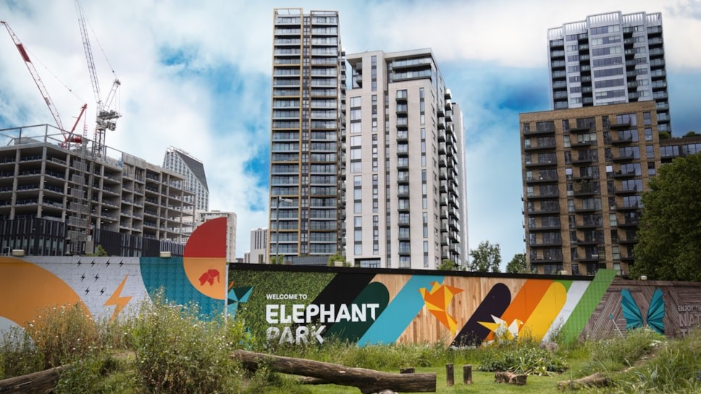
Case Study: The Elephant and Castle Regeneration Project, London
The vision:
- To create a thriving neighborhood that would set new standards for urban development
Transforming A sustainable heat network for a thriving community
Eon-uk.news (2024)
Key Objectives
-Deliver 3000 new homes, including affordable housing options.
-Create vibrant public spaces and improve transportation links.
-Preserve and promote local culture and businesses.

Slide 15
Elephant and Castle Livable Town
INNOVATION
“state-of-the-art district heating network, a scheme that will not only meet the community's energy needs but also contribute to a greener future” e.on (2024).
LIVABILITY IN COMTEMPORTARY URBAN LONDON.
Urban regeneration can rejuvenate communities, improve living conditions, and foster economic growth if designed with inclusivity in mind”* (Tiesdell & Oc,2016).
“Successful urban renewal requires the active participation of local residents to ensure that the development meets their needs” (Cuthill, 2003).

Slide 16
Elephant and Castle Livable Town
GOOD/ BEST PRACTICE
Public consultation involved Over 200 members who feedback further developed plans in response to their opinions and voices.
Partnerships with local authorities, Universities, Housing Bodies, Transport providers and development partners.
Balancing urban development with community needs and environmental sustainability.
UNIQUE IDEAS
Private and local companies providing key services
Income generation a major consideration
The Elephant and Castle regeneration communities local voices were heard , “it was recognised the concerns raised by local residents and the traders in the center, which is why the council pushed the developers to increase the genuinely affordable housing and guarantee more retail space is affordable. Johnson Situ (2018).

Slide 17
Critique of Livability - Regeneration Projects Like Elephant & Castle
Controversial and fears from local settled communities
Major concerns including and regarded as the most impactful is the gentrification risk!
High possibility of born and breed locals having to leave the area due to affordability.
Urban development will see large increases in property prices and rents, making the area unaffordable for the current settled community.
“The pursuit of livability can sometimes overshadow the need for social equity, leading to gentrification and exclusion. "Cameron (2014)
The complex nature of balancing the long term needs of diverse communities, integrating social justice, public consultation, responsible governance for good quality, provisions like schools and other facilities a strong sustainable community requires Harris, P. (2018). Mensah, S. (2011)
“The notion that all community members will engage equally in governance is often unrealistic, leading to disparities in representation.” Bickerstaff & Walker (2001)
“Improving liveability without addressing social equity can lead to the exclusion of vulnerable populations.” Teghtsoonian (2009)

Slide 18
Conclusion
The Social Ecology model provides a robust framework for understanding the relationship between social justice and environmental sustainability. However, when contrasted with the livability model, it reveals potential contradictions in urban planning priorities and real complexities.
Although both are sustainable and beneficial approaches a combination that truly encapsulates the strengths of both Social Ecology principles and livability models will be the way to greater inclusivity and sustainable urban environments.
“The best communities will emerge from a synthesis of ecological responsibility and a commitment to social justice.” Agyeman et al. (2016)
This forward-looking statement emphasizes the potential for a holistic approach to community development.

Slide 19
Conclusion
The Elephant and Castle regeneration project embodies the principles of liveable towns and cities by integrating ecological sustainability, social inclusivity, and economic opportunity. Which we are also known as the 3 P’s, Tripartite or 3 pillars
The project’s commitment to mixed-use development, improved public spaces, sustainable architecture, and community engagement reflects an approach to urban renewal that is rooted in contemporary ideas of liveability.
While challenges remain, particularly regarding social inclusion and the risk of displacement, the project represents a significant step toward creating a more sustainable, and equitable, urban future for South London.
The economic factors lead by the need for social inclusion and equity could be regarded as the projects biggest USP.

Slide 20
Bibliography
Adams W.M. Green Development (2001) (2nd edition) London: Routledge. Available at: Full details and actions for Green Development: Environment and Sustainability in a Developing World (Accessed 21/11/2024)
Agyeman, J. (2005). “Sustainable Communities and the Challenge of Social Justice.” Cambridge University Press. (Accessed 12/11/2024)
Agyeman, J., Evans, T., & Lang, J. (2016). “The Role of Social Justice in Sustainable Community Development.” Sustainability, 8(8), pp.781.
Attfield, Robin, (2003). Environmental Ethics Oxford: Polity.10.21001.(Accessed 12/10/2024)
Ajl, Max. “Green Social Democracy or Eco-Socialism?” A People’s Green New Deal, Pluto Press, 2021, pp. 75–96. JSTOR, Available at: https://doi.org/10.2307/j.ctv1p3xjwp.9. 2024[Accessed 1/12/2024]
Bickerstaff, K., & Walker, G. (2001).“Risk, Responsibility and the Governance of Uncertainty in the UK.” Environment and Planning C: Government and Policy,19(2), pp.139-160.
Bulkeley, H. (2010). Cities and Climate Change: Urban Sustainability and Global Environmental Governance. Routledge.

Slide 21
Bibliography
Bibri, S.E. (2018) ‘Backcasting in futures studies: a synthesized scholarly and planning approach to strategic smart sustainable city development’, European journal of futures research, 6(1), pp. 1–27. Available at: Backcasting in futures studies: a synthesized scholarly and planning approach to strategic smart sustainable city development – ProQuest (Accessed 22/11/2024)
Bibri, S.E. and Krogstie, J. (2019a) ‘Generating a vision for smart sustainable cities of the future: a scholarly backcasting approach’, European journal of futures research, 7(1), pp. 1–20. Available at: Generating a vision for smart sustainable cities of the future: a scholarly backcasting approach – ProQuest [Accessed 22/11/2024]
Bookchin, M. (1993) What is Social Ecology? The Anarchist Library Available at: What is Social Ecology? | The Anarchist Library [Accessed 12/11/2024]
Bookchin, M. (1996). Social Ecology and Communalism. AK Press. Available at: Social Ecology and Communalism. Accessed 16/10/2024
Cameron, S. (2014). “The Liveability Debate: A Critical Review.” *Journal of Urban Studies*, 51(9), pp.1724-1737.
Cuthill, M. (2003). "Building community capacity: A resource for local government." Urban Policy and Research, 21(4), pp.291-304. DOI: 10.1080/0811114032000151306.(Accessed 4/11/2024)
Calhoun, C.J. (2002) Dictionary of the social sciences. Oxford: Oxford University Press. Available at: https://www-oxfordreference-com.ezproxy.uwtsd.ac.uk/display/10.1093/acref/9780195123715.001.0001/acref-9780195123715-e-313?rskey=XwLo8O&result=1 (Accessed 1/12/2024)

Slide 22
Bibliography
Dale, A. & Sparkes, J. (2010) ‘The 'agency' of sustainable community development’ in Community Development Journal 46(4): pp. 476-492 Available at: The ‘agency’ of sustainable community development | Community Development Journal | Oxford Academic (Accessed 01/12/2024)
Davis, M. (2015). “EcoVillage as a Model for Sustainable Living.” Journal of Environmental Psychology, 45, pp.60-72. (Accessed 16/10/2024)
Elkington, J. (1998). Partnerships from cannibals with forks: The triple bottom line of 21stcentury business. Environmental Quality Management, 8(1), 37-51. Available at: Partnerships from Cannibals with Forks: The Triple Bottom Line of 21st-Century Business. - EBSCO [Accessed 24/11/2024]
Fainstein, S. S. (2010). “The Just City.” Avalible at: “The Just City.” Cornell University Press. (Accessed 16/10/2024)
Harris, P. (2018). “Urban Regeneration and Social Equity: The Case of Elephant and Castle.” London Housing Studies, 34(2), pp.101-118.
Harvey F (2011) Green vision: the search for the ideal eco-city. Financial Times, London but I didn’t look at this this was in the Bibri, S.E. 2019b reference
Henriques, A., and J. Richardson, eds. (2013). The triple bottom line: Does it all add up. Routledge, London.
Hodson, M., & Marvin, S. (2010). “Urban Transitions: The Multi-level Governance of Climate Change.” *Journal of Urban Technology, 17(1), pp.109-127.

Slide 23
Bibliography
Institute of Sustainable Communities (2024) https://sustain.org/about/what-is-a-sustainable-community/ [Accessed 20/11/2024]
Lancaster University (2023) Liveable Cities: Transforming the Engineering of Cities for Global and Societal Wellbeing Available at: http://imagination.lancaster.ac.uk/project/liveable-cities/ (Accessed 9/12/2024)
Livable City (sic) (2021) Livable City Goals Available at: Home - Livable City [Accessed 19/11/2024]
Lloyd, S., et al. (2017). “Liveable Cities: A Comparative Analysis.”Urban Studies, 54(8), 1889-1905.
Roseland M (1997) Dimensions of the eco-city. Cities 14(4): pp.197 –202 but I didn’t look at this this was in the Bibri, S.E. 2019b reference
McKellar, S. (2018). “Edinburgh’s Liveable Neighborhoods: A Step Towards Sustainable Urban Futures.” Sustainable Cities and Society, 38, pp. 250-259. (Accessed 24/11/2024)
Mensah, S. (2011) “Is the regeneration of Elephant and Castle all that it’s cracked up to be?” Available at: Is the regeneration of Elephant and Castle all that it’s cracked up to be? .(Accessed 1/12/2024)

Slide 24
Bibliography
O'Riordan, T. (1999). Environment and environmentalism. In: Environmental Geology. Encyclopedia of Earth Science. Springer, Dordrecht. Environment and environmentalism | SpringerLink (Accessed 24/11/2024)
One Planet Council (No date) The One Planet Council Available at: https://www.oneplanetcouncil.org.uk/about-the-one-planet-council/ (Accessed 17/11/2024)
“Our Common Future” World Commission on Environment and Development WCED Oxford University Press. Brundtland (1987)
Paulson, N (2016) ‘Old Ideas, New Knowledge, Sustainable Communities’ TED Talks Available at: Old Ideas, New Knowledge, Sustainable Communities | Nels Paulson | TEDxUWStout [Accessed 22/11/2024]
Park, C. & Allaby, M. [eds.] (2017) A Dictionary of Environment and Conservation (3 ed.) Oxford: OUP Available at: Environmentalism - Oxford Reference (Accessed 22/11/2024)
Pelenc, J. (2015) Weak Sustainability versus Strong Sustainability: Brief for GDSR 2015 Available at: Microsoft Word - 122-Pelenc-Weak Sustainability versus Strong Sustainability (Accessed 24/11/2024).
Pretty, J. (1995). "Participatory Learning for Sustainable Agriculture." World Development, 23(8), pp. 1247-1263. DOI: 10.1016/0305-750X(95)00046-F. (Accessed 9/11/2024).
Raworth, K. (2021). Doughnut Economics: Seven Ways to Think Like a 21st-Century Economist. Random House.(Accessed 9/11/2024).

Slide 25
Bibliography
Srivastava, A.K., Dixit, S. & Srivastava, A.A. Criticism of Triple Bottom Line: TBL (With Special Reference to Sustainability). Corp Reputation Rev 25, 50–61 (2022). https://doi.org/10.1057/s41299-021-00111-x. Published, 22 March 2021, Issue Date February 2022. DOI https://doi.org/10.1057/s41299-021-00111-x
Shiva, V. (1988a) ‘Geopolitics of Food: America’s Use of Food as a Weapon’, Economic and political weekly, 23(18), pp. 881–882. Available at: Geopolitics of Food: America's Use of Food as a Weapon on JSTOR [Accessed 2/12/2024]
Situ 2018.https://www.insidehousing.co.uk/news/khan-keen-for-elephant--castle-development-to-deliver-affordable-housing-58462 2018 Inside housing accessed online (Accessed 13/11/2024)
Slaper, T.F., and T.J. Hall. 2011. The triple bottom line: What is it and how does it work. Indiana business review 86 (1): 4–8.
Sustrans (No Date) Liveable cities and towns for everyone Available at: Liveable cities and towns for everyone - Sustrans.org.uk [Accessed 16/11/2024]
Smith, Mark K. (2008) 'Sustainable communities and neighbourhoods. Theory, policy and practice', the Encyclopaedia of informal education. Available From: https://infed.org/mobi/sustainable-communities-and-neighbourhoods-theory-policy-and-practice/ (Accessed 9/12/2024)
Taylor, P.J. (2012) ‘Transition towns and world cities: towards green networks of cities’, Local environment, 17(4), pp. 495–508. Available at: https://doi.org/10.1080/13549839.2012.678310 [Accessed 17/11/2024)
Teghtsoonian, K. (2009). “Sustainable Urban Development:” The Challenge of Gentrification.” Environment and Urbanization”, 21(2), 243-258

Slide 26
Bibliography
TCPA (Town & County Planning Association) (2021) 20-Minute Neighbourhoods: Creating Healthier, Active, Prosperous Communities - An Introduction for Council Planners in England Available at : 20MN_Main.qxd [Accessed 13/11/2024]
Tiesdell, S., & Oc, T. (2016). Urban Regeneration: A Handbook for Decision-Makers. Routledge.
Tönnies, F. (2001). Community and Society (C. P. Loomis, Trans.). New Brunswick, NJ: Transaction Publishers. but in the 2001 edition translated by Charles P. Loomis, pages 22-30.(Accessed 19/11/2024) Tönnies, F. (1887 (2017) Community and Society Taylor & Francis Available at: Community and Society - Google Books (Gemeinschaft und Gesellschaft).(Accessed 9/12/2024)
Tönnies, F. (1887 (2017) Community and Society Taylor & Francis Available at: Community and Society - Google Books (Gemeinschaft und Gesellschaft).(Accessed 9/12/2024) Transport for London. (2020). “Annual Report on Public Transport Use.”Available at:https://tfl.gov.uk.(Accessed 12/11/2024)Transition Network (2023)Principles Available at: http://www.transitionnetwork.org/ [Accessed 13/11/2024]Transition Movement: http://www.transitionnetwork.org/ [Accessed 9/11/2024]

Slide 27
Bibliography
Tzoulas, K., et al. (2007). “Promoting Ecosystem and Human Health in Urban Areas Using Green Infrastructure: A Literature Review.” Landscape and Urban Planning, 81(3), 167-178. (Accessed 19/11/2024)
Topovan – Rabindranath Tagore ( no year) Theroroes and Principles of sustainability) https://www.youtube.com/watch?v=SOl0BNY5iiY (Accessed 10/11/2024)
University College London (2023) Liveable Cities Available at: Liveable Cities | UCL Department of Science, Technology, Engineering and Public Policy - UCL – University College London (Accessed 14/11/2024)
UN Habitat, United Nations Climate Change Learning Partnership (2007) Liveable cities: the benefits of urban environmental planning Available at: liveablecities_3.pdf (Accessed 9/11/2024).
UN Habitat. (2016). “Urbanization and Development: Emerging Futures.” World Cities Report.
White, D.F. (2008) Bookchin a critical appraisal. London: Pluto Press. Available at: https://files.libcom.org/files/BookchinCriticalAppraisal.pdf Bookchin : a Critical Appraisal [Accessed 19/11/2024]
World Commission of Environment and Development, (1987) Our Common Future New York: United Nations Available at: Our Common Future: Report of the World Commission on Environment and Development [Accessed 25/10/2024]
Xiong (2014) Xiong, T. (2014) ‘Shallow Environmentalism: A Preliminary Eco-Critical Discourse Analysis of Secondary School English as a Foreign Language (EFL) Texts in China’, The Journal of environmental education, 45(4), pp. 232–242. Available at: Shallow Environmentalism: A Preliminary Eco-Critical Discourse Analysis of Secondary School English as a Foreign Language (EFL) Texts in China. – EBSCO (Accessed 19/11/2024)

Slide 28
Biography websites /videos/news articles
Climateandcapitalism. https://climateandcapitalism.com/2020/11/13/the-return-of-nature-socialism-and-ecology/ (Accessed 24/11/2024)
Elephantandcastle.org.uk/whos-involved https://elephantandcastle.org.uk/whos-involved/ (Accessed 13/11/2024)
https://elephantandcastletowncentre.co.uk/news/get-living-shares-updated-plans-to-enhance-west-site-of-the-elephant/ (Accessed 13/11/2024)
https://www.socialistalternative.org/planning-green-growth/eco-socialism/ This is a description of what ECO socialism is. (Accessed 24/11/2024)
https://democraticgreensocialist.wordpress.com/a-socialist-contribution-to-the-debate-on-environmental-sustainability/?cv=1 (Accessed 13/12/2024)
https://green-socialist.com/ (Accessed 24/11/2024)
https://www.socialistalternative.org/planning-green-growth/eco-socialism/(Accessed 24/11/2024)
sustainable-communities-and-neighbourhoods-theory-policy-and-practice https://infed.org/mobi/sustainable-communities-and-neighbourhoods-theory-policy-and-practice/ [Accessed 11/11/2024]
Transforming-londons-elephant-park-a-sustainable-heat-network-for-a-thriving-community https://www.eon-uk.news/news/transforming-londons-elephant-park-a-sustainable-heat-network-for-a-thriving-community”eON (2024).(Accessed 13/11/2024)
Theories and principles of sustainability do I reference this here Available at: Theroroes and Principles of sustainability) https://www.youtube.com/watch?v=SOl0BNY5iiY) (Accessed on 4/11/2024)
The story of stuff. Available at: https://www.youtube.com/watch?v=9GorqroigqM. (Accessed 2/11/2024)
https://swlondoner.shorthandstories.com/Regeneration-of-EC/index.html revitalized neighborhoods and those at risk of gentrification. (Accessed 13/11/2024)

Slide 29
Biography
Images
People planet, profit wheel https://climateandcapitalism.com/2020/11/13/the-return-of-nature-socialism-and-ecology/ (Accessed 12/11/2024)
Image of people, planet & profit, image of sustainability wheel(Accessed 12/11/2024)
https://www.alamy.com/stock-photo/economic-sustainability.html (Accessed 12/11/2024)

