Slide 1

BMHP5032 Introduction to Physiology
Component 2 – Presentation
Care Plan
Student ID: 2331156
Student name: Gnahore Badi-charlotte Legre
Lecturer Name: Shaila Hussain

Slide 2
Introduction
Madame L is a joyful baker, aged 62. For several weeks, she experienced extreme fatigue and discomfort in her side. She visited her physician for examinations.
The doctor informed Madame L that she has cancer; specifically, she has breast cancer. This indicates that some cells in her breast have begun to grow abnormally and uncontrollably. These harmful cells can form a lump known as a tumor.
Fortunately, Madame L's cancer was detected early, which is positive news. Her treatment will probably involve surgery to remove the tumor, followed by a specialized medication called chemotherapy. This treatment circulates throughout her body to identify and eliminate any remaining cancer cells that may have spread.
Madame L is resilient. With her family’s support and her doctor’s guidance, she is prepared to combat this illness.

Slide 3
Information about the person
Madame L is a 62-year-old retired baker. She is married and resides with her spouse in a small town. They have two adult children who live nearby. Madame L is Caucasian American.
Here are her primary health measurements from her most recent check-up before her cancer diagnosis:
Her height is 5 feet 4 inches. Her weight is 150 pounds, resulting in a body mass index (BMI) of 26, classifying her as overweight.
Her blood pressure reads 138/85, which is slightly elevated; the ideal range is below 120/80.
Her resting heart rate is a normal 72 beats per minute.
Madame L does not suffer from diabetes. Her blood glucose level is healthy at 90 mg/dl. The only other minor health concern she has is mild arthritis in her hands, caused by her many years of baking.

Slide 4
Anatomy and Physiology
Anatomy: Madame L disease is in her breast. The breast is made mainly of milk-producing glands (lobules) and tiny tubes (ducts) that carry milk to the nipple. These structures are held in place by tatty and fibrous tissue.
Physiology: cancer is a disease of cells, the body’s tiny building blocks. Normally, breast cells grow, divide to make new cells, and then die in an orderly way.
In Madame L case, the DNA (the instruction manual inside a cell) in some breast cells got damaged. This damage caused those cells to ignore the body’s normal stop signals. They started to multiply out of control. This created a mess of extra tissue called a tumor.
A malignant (cancerous) tumor can invade nearly healthy breast tissue. Cells can also break away and travel through the blood or lymph system to other body parts, which is called metastasis.

Slide 5
Care Plan (1/3)
Before her diagnosis, Madame L had a calm but not very active lifestyle.
as a retired baker, she spent a lot of time at home. She enjoyed cooking, but her recipes often used a lot of butter, sugar, and white flour. She would snack on pasties white having tea. This diet, over many years, contributed to her being overweight.
Madame L main exercise was light gardening and short walks with her husband. She did not go to gym or do regular aerobic exercise. She had never smoked, and she only drank a little wine on special occasions.
Her main health behavior was being good about going to her yearly doctor’s check-ups. However, she often put off telling the doctor about small pains, like the one in her side, thinking they were just signs of normal aging. She did not regularly do breast self-exams.

Slide 6
Care Plan (2/3)
Assessment | Nursing Diagnosis | Goal / Expected Outcome | Interventions (Nursing Actions) | Evaluation
Patient reports breast pain following surgery or treatment. Patient appears uncomfortable. | Acute pain related to surgical procedure or tumour growth. | Patient will report reduced pain levels within 24–48 hours. | Assess pain using a pain scale; administer prescribed analgesics; encourage relaxation techniques and comfortable positioning. | Patient reports reduced pain and demonstrates improved comfort.
Patient expresses fear about diagnosis, treatment, and prognosis. | Anxiety related to cancer diagnosis and uncertainty about the future. | Patient will demonstrate reduced anxiety and express feelings openly. | Provide emotional support; encourage discussion of concerns; provide clear information about treatment; refer to counselling or support groups if needed. | Patient reports feeling more supported and shows improved coping strategies.
Surgical wound present following mastectomy or lumpectomy. | Risk of infection related to surgical wound and immunosuppression from treatment. | Surgical site will remain free from infection. | Monitor wound regularly; maintain sterile dressing techniques; monitor temperature and signs of infection; educate patient about hygiene. | Wound healing observed with no signs of redness, swelling, or infection.
Patient experiencing nausea, fatigue, or loss of appetite during chemotherapy. | Imbalanced nutrition less than body requirements related to treatment side effects. | Patient will maintain adequate nutritional intake and stable weight. | Encourage small frequent meals; provide high-protein foods; monitor weight and hydration; manage nausea with prescribed medication. | Patient maintains adequate food intake and stable nutritional status.
Patient expresses concerns about body changes after breast surgery. | Disturbed body image related to loss or alteration of the breast. | Patient will demonstrate acceptance of body changes and improved self-esteem. | Provide emotional reassurance; discuss prosthesis or reconstruction options; encourage participation in support groups; involve family support. | Patient verbalises improved self-confidence and adaptation to body changes.
(ROCK et al., 2022)

Slide 7
A multidisciplinary approach is essential in breast cancer care, involving oncologists, nurses, psychologists, and dietitians to support the patient’s physical and psychological wellbeing.

Slide 8
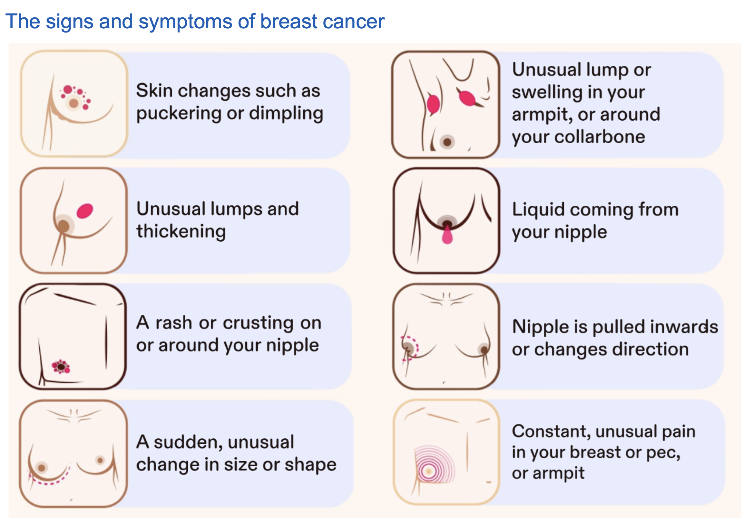
(NICE, 2021)

Slide 9
Care Plan (3/3)
Good communication is the key for Madame L care. The medical team must always explain things to her clearly, using simple words, not confusing medical terms. They should check that she understands her diagnosis and treatment choices. Madame L must feel listened to and able to ask any question without fear.

Slide 10
Important ethics rules must be followed.
Madame L autonomy, or her right to make her own choices , is most important. Doctor must get her informed consent before any treatment. This means she fully understands the benefits, risk and other options firs.
All her health information must be kept private and confidential. The team should also be very honest with her, while always being kind and giving hope. They must support her whole well-being, not just treat the cancer, and respect her personal values and family support system.

Slide 11
RISK FACTORS
Madame L has several risk factor that affect her health, mainly from her lifestyle and new condition.
Her cancer diagnosis is the biggest current risk. If not treated fully, it could spread. Her age (62) is also a common risk factor developing cancer.

Slide 12
Her lifestyle increases her risk factors. Being overweight (BMI of 26) makes recovery more difficult and raises the likelihood of other health issues. Her diet, rich in sugars and fats, hampers her immune system's ability to combat illness. Her sedentary routine with minimal exercise weakens her heart, muscles, and energy levels. Additionally, her past neglect of minor symptoms delayed her diagnosis. Although she doesn’t smoke and consumes little alcohol—positive habits—her other behaviors pose risks that must be addressed to improve her health and overcome cancer.

Slide 13
Recommendation
Care Routine: Madame L needs a balanced diet with more fruit, vegetables, and lean protein to support her strength during treatment. Gentle exercise, like daily short walks, should continue to fight tiredness. Her care team must teach her about managing treatment side effects.

Slide 14
Monitoring: nurses will regularly check her weight, blood pressure, and pain levels. They will watch closely for signs of infection, a major risk during chemotherapy. She needs scheduled scans to see if the treatment is working.
CARE PLANING: all plans must respect Madame L choices. A multidisciplinary team (doctors, nurses, a dietitian) will work together. They should connect Madame L with a cancer support group for her mental health. Clear plans for her family to help at home are also essential for her recovery.

Slide 15
Conclusion
Madame L a 62-year –old retired baker, has been diagnosed with breast cancer. This means some cells in her breast are growing out of control. Her past lifestyle, which included a rich diet and little exercise, contributed to her being overweight, a risk factor.
Her care plan must focus on both fighting the cancer and supporting her overall health. Key steps include a healthier diet, safe exercise, and clear communication from her medication team. They must monitor her closely during chemotherapy for side effects and progress.
Her care plan must focus on both fighting the cancer and supporting her overall health. Key steps include a healthier diet, safe exercise, and clear communication from her medical team. They must monitor her closely during chemotherapy for side effects and progress.

Slide 16
References
1.American cancer society (ACS) (2023) breast cancer facts& figures 2023-2024. Atlanta, GA: American Cancer society, inc.
2. Cancer research UK (CRUK) (2022) breast cancer statistics. Available at:
https://www.cancerresearchuk.org/ (Accessed:14 October 2023).
3. DeSantis, C.E. et al. (2022)’ breast cancer statistics, 2022, CA:A cancer journal for clinicians, 72(6), pp.524-514.
4. Koutoukidis, D.A. at. al. (2019) Association of weight loss and weight loss maintenance following diagnosis with improver survival in patients with breast cancer: a systematic review and meta-analysis obesity reviews, 20(12), pp. 1703-1717.
5 McMillan, S.S. et al. (2013) patient-centered approaches to health care: a systematic review of randomized controlled trials Medical care research and review, 70(6),pp.467-596.

Slide 17
6 National institute for health and care excellence (NICE) (2021) early and locally advanced breast cancer: diagnosis and management. NICE guideline (NG101). Available at: https://www.nice.org.uk (Accessed:14 October 2023).
7 Paterson, C. et al. (2016) determinants of quality of life in patients with advanced cancer: a systematic review. Palliative medicine, 30(7),pp.611-624.
8 ROCK , C. L et al. (2022) American cancer society guideline for diet and physical activity for cancer prevention, CA: A cancer journal for clinicians, 72(1),pp.30-47 ,
9 World health organization (WHO) (2020) breast cancer. Available at: https://www.who.int/ (Accesed: 14 October 2023).
10 Schmid, D. and leitzman, M.D. (2014) Association between physical activity and mortality among breast cancer and colorectal cancer survivors: a systematic review and meta-analysis, Annals of oncology, 25(7),pp.1293-1311.

