Slide 1

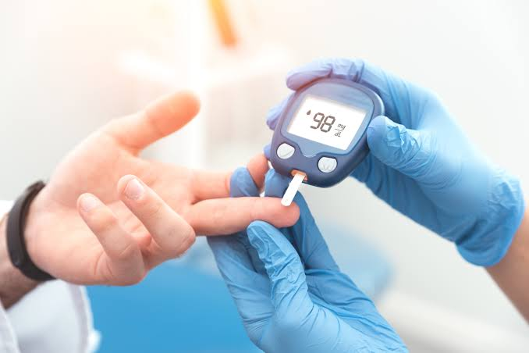
Module: Community Care and Management of Longer-term Conditions
Module code: LCHS7003
Assignment Title: Component 2 Individual Presentation
Student Name and ID: Fuaansha pimpale
(2530082)
Presentation Title: Type 2 Diabetes Mellitus in the UK: Diagnosis, Management, Prevention and Personalised Care

Slide 2
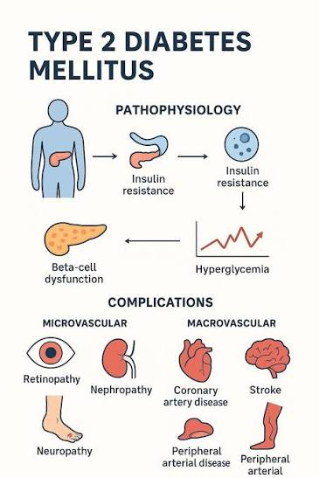
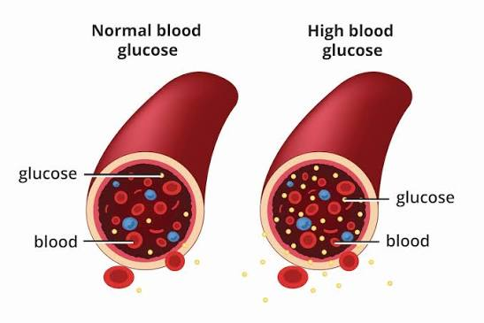
Understanding Type 2 Diabetes Mellitus (T2DM): Definition, Symptoms and Aetiology
T2DM is chronic hyperglycaemia due to insulin resistance and decreased insulin secretion (Galicia-Garcia et al. 2020).
The symptoms include polyuria (urinating in a thrashy condition), thirst, fatigue, blurred vision and slow wound healing (Vasilaki et al. 2023).
Risks include obesity or inactivity and age, genetics and ethnicity.
There is a 2-6 times increased risk due to family history.
Poverty makes any modifiable risk factor more likely, and T2DM is not only a lifestyle disease.
Notes:
Type 2 diabetes mellitus occurs when insulin proves to be ineffective, along with the production of insulin by the pancreas stopping, leading to the continuous occurrence of hyperglycaemia (Galicia-Garcia et al. 2020). Importantly, causation is multi-factorial and not just behavioural. While about 90% of newly diagnosed individuals suffering from T2DM are overweight or obese, other factors, such as genetics, ethnicity, ageing, and deprivation, also influence risk (HealthMatch, 2022). Thus, a focus on individuals' lifestyles fails to acknowledge other essential biological and structural drivers of health. Family history increases the risk by between 2x and 6x, and the prevalence of T2DM is significantly greater in people of South Asian, Black African and African-Caribbean backgrounds who also tend to develop the condition at a younger age, according to Diabetes UK.

Slide 3

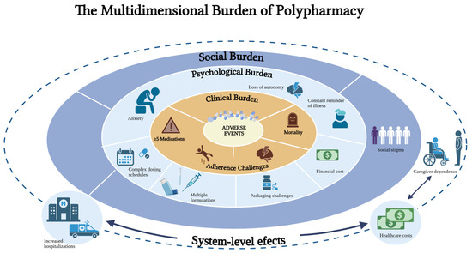
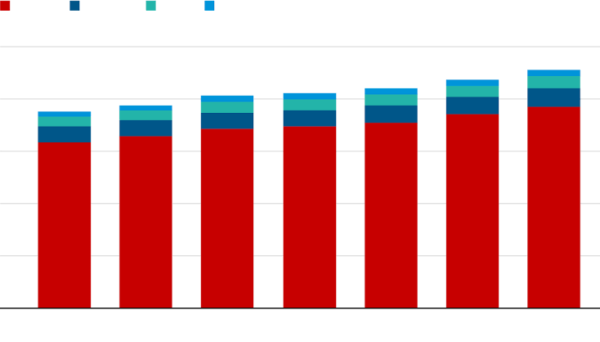
Economic, Social and Health Burden
Every 1 in 5 adults in the UK (≈12.2 million) has diabetes or prediabetes (Galvin, 2025).
A total of 4.6m have a diabetes diagnosis (HealthMatch, 2022).
There are 1.3m potential T2DM sufferers who go without a diagnosis and 6.3m prediabetics (Bower, 2025).
Globally, diabetes increased from 200m (1990) to 830m (2022) (WHO, 2024).
The prevalence of adults had doubled from 7% to 14%.
Figure: Every 1 in 5 adults in the UK has diabetes
(Source: Galvin, 2025)
Notes:
There is a high epidemiological cost for T2DM, and this is growing. Diabetes UK currently estimates that there are 12.2 million (1.3 million of which are undiagnosed) UK adults living with diabetes or prediabetes, representing a significant level of diabetes detection gap (Bower, 2025). According to WHO (2024), there has been an increased number of diabetes cases by more than 4 times since 1990 on a global level. Most importantly, the prevalence in both LMICs and the UK is increasing, which is showing increasing inequalities, as well as being a very considerable clinical-management problem in the UK; diabetes is also becoming a growing international public-health challenge.

Slide 4
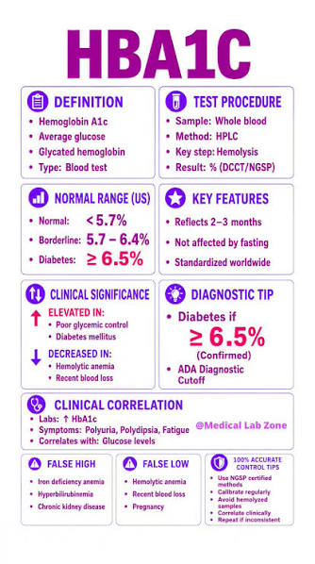

Diagnosis, Initial Assessment and Nursing Priorities
Diagnosis has been confirmed if HbA1c ≥ 6.5% (Gholap et al. 2013).
HbA1c 42–47 mmol/mol is non-diabetic hyperglycaemia.
Renal function, smoking status, cardiovascular risk, HbA1c, BP, BMI and lipids should be assessed initially.
Evaluate feet and eyes and current problems, in addition to medications, lifestyle and psychosocial factors.
In 2024/25, only 58.2% of people with T2DM/other diabetes received all eight care processes recommended in England (NHS Digital, 2025).
Notes:
Diabetes is confirmed if HbA1c ≥6.5% as per Gholap et al. (2013) and diagnosis should be followed by a whole-person response, not an HbA1c response. As with psychological, lifestyle and social needs, cardiovascular, renal, eye and foot risks need to be identified early. Importantly, data on the care processes in England show a gap in what is implemented in spite of standards. Practice nurses can reverse this by systematic review, risk assessment, continuity of care and the implementation of interventions based on preferences and multi-morbidity/treatment burden. Despite the progress, there is still a disparity between diabetes diagnosis and optimal long-term diabetes management, as only 45.2% of those with Type 2/other diabetes reached all three treatment targets (HbA1c, blood pressure and statin prescription) in 2024/25, in England (GOV.UK, 2026).

Slide 5
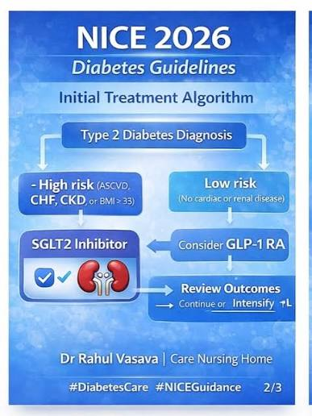
NICE NG28: Management and Treatment
NICE NG28: updated February 2026, individualised, holistic T2DM management (NICE, 2022).
Pharmacotherapy is backed up by healthy living + structured education.
Establish individual HbA1c target; check every 3-6 months until target is reached.
In the absence of relevant co-morbidity, consider giving modified-release metformin + SGLT-2 inhibitor (Huang and Lee, 2024).
Escalation may include DPP-4 inhibitors, GLP-1 RAs, pioglitazone, sulfonylureas or insulin.
SGLT-2 / GLP1 therapies offer cardiovascular and kidney protection, in addition to glycaemic effects.
Notes:
NICE's 2026 update marks a significant move away from glucose-focused treatment towards a holistic approach to risk reduction. Now providing modified-release metformin and an SGLT-2 inhibitor as initial options for adults who are not affected by any of the above (Huang and Lee, 2024). Treatment should still be personalised, however, due to considerations of benefit to tolerability, multimorbidity and patient preference. Practice nurses thus play a key role when it comes to education, monitoring, adherence and joint decision-making on treatment.

Slide 6
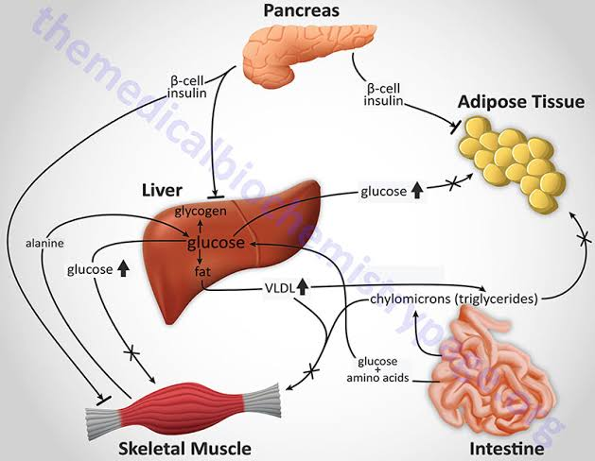
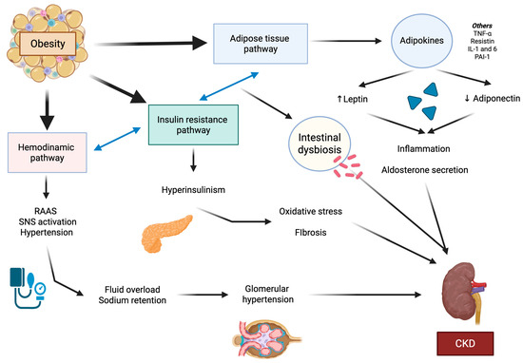
Comorbidities and Complications: Why Integrated Care Matters
Obesity, hypertension, cardiovascular disease (CVD), mental-health issues and chronic kidney disease (CKD) are often associated with T2DM (Wang et al. 2025).
Long-term problems include heart, kidney, eyes, feet and nerves.
Several factors can raise the risk for polypharmacy, adverse effects and treatment-burden risks.
NICE (2022) advises personalising treatment based on co-morbidities, preferences and/or likely longer-term benefit.
When there are multiple comorbidities, the treatment/management must be managed and agreed between the patient and GP based on the priorities.
Figure: CKD
(Source: León-Román et al. 2025)
Notes:
T2DM typically coexists, and cardiovascular and renal conditions may have a synergetic effect on prognosis and choice of drugs (Wang et al. 2025). Polypharmacy and undue treatment burden will result from treating each condition individually. So NICE (2022) calls for an integrated approach, namely for multi-morbidity. It is important to note that in the presence of multiple comorbidities, these should all be prioritised by professionals and patients. This changes the focus of disease management from categorical to the greatest good, safest and highest quality of life.

Slide 7
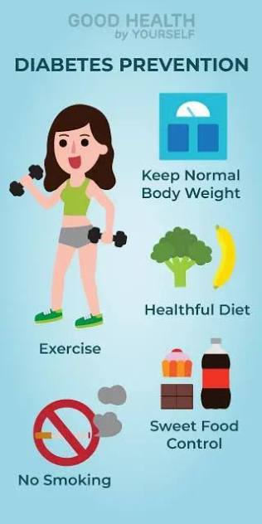

Prevention: From Individual Behaviour to Population Health
Primary: maintaining a healthy weight, nutrition, exercise and quitting smoking.
Secondary: screening adults at risk of diabetes (prediabetes) and intensive lifestyle interventions.
‘NHS Healthier You’ is a 9-month personalised prevention programme (NHS England, 2023).
Incidence of T2DM reduced by 37% after completion of programme with an average weight loss of 3.3 kg (NHS England, 2025).
Tertiary: optimisation of glucose, BP/lipids and eye, renal and foot surveillance.
Social and environmental obstacles also need to be dealt with in prevention.
Notes:
Prevention is done along the disease spectrum, not just trying to get patients to lose weight. Nearly 1 million people have registered for Healthier You, and completion of the programme is associated with a 37% reduction in the development of T2DM, as per NHS England (2025). However, the opportunities for behaviour change are socially patterned. Effective prevention therefore must be individual as well as tackling issues of affordability, health literacy and environments that limit the availability of healthier options, in particular for disadvantaged groups.

Slide 8
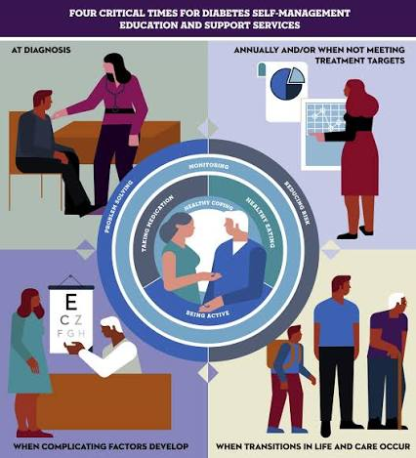
Co-Productive Care: Skills, Values and Behaviours
Skills
Values
Behaviours
active listening
motivational interviewing
health coaching • shared decision-making • culturally appropriate communication
Dignity
autonomy
compassion
equity/respect for lived experience.
Inquire about “What matters to you?”
Agree achievable goals collaboratively.
Communicate benefits/risks accessibly.
Discuss health literacy and stigma.
When NICE appraises medicines for the treatment of Type 2 Diabetes (T2DM), the Agency will make shared decisions.
Notes:
In co-production, there are two types of expertise: clinicians bring evidence and expertise of treatment, patients bring data on their lived situation, their preferences and priorities. This means that nurses need to listen, communicate risk effectively and not judge. However, co-production cannot be assumed by providing only options. Consumers and practitioners may have limited time to consult, participants may not have the language skills or health literacy they need for the discussion, and practitioners may dominate decision-making, which may limit participation and require intentional work to establish an equitable decision-making relationship.

Slide 9
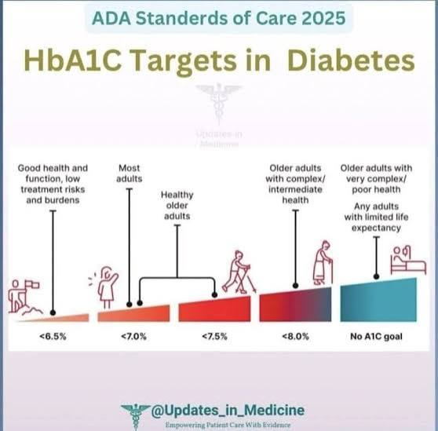
Applying the Six Components of Comprehensive Personalised Care
There are 6 evidence-based components for use with T2DM:
Shared decision making: National Essential Government/Negotiated (NEGO) medication and priority of treatment (NICE, 2022).
Personalised care/support planning (individual HbA1c, weight and wellbeing targets)
Enabling choice: informing treatment/services choice.
Social prescribing – link with exercising, weight and community support.
Self-managed step (education, health coaching and peer support).
This includes personal health budgets (personalised support where applicable).
All 6 highly recommended as an integrated delivery.
Notes:
Personalised care is especially relevant to management of T2DM, which is largely managed out of clinical appointments. Shared decisions and personalised planning can mean treatment can have more to do with what is important to the individual than just medication; social prescribing and self-management can build capability beyond the medication. NHS England emphasises that the six components work best as a whole. But workforce engagement, co-production and adequate community resources are required for implementation, not to be handed over to patients.

Slide 10
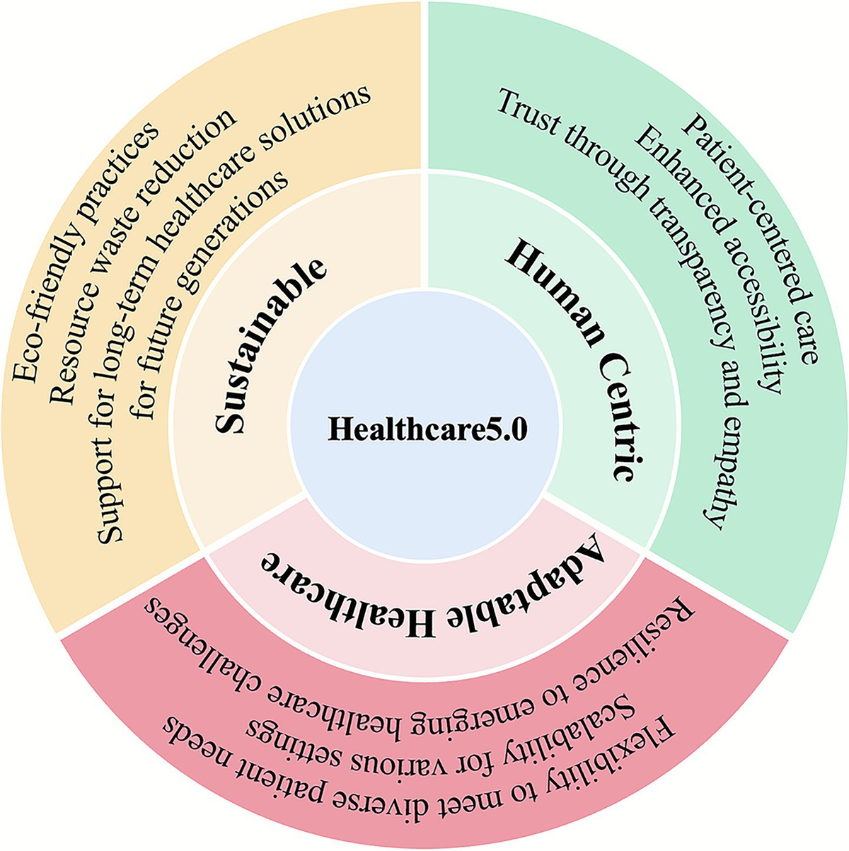
Recommendations and Conclusion
Recommendations
Primary care nurses must be aware of and take into account preferences, comorbidities, and polypharmacy in all reviews.
Integrate shared decision-making and individualised treatment goals.
Increase formal teaching and guides to self-management.
Determine psychological, cultural, socioeconomic and health-literacy barriers.
Establish patient–community/social care referral links.
Follow up efficacy and burden of treatments regularly.
Conclusion: Clinically, preventative and personalised care is important and should be integrated to manage T2DM and cannot be achieved with glycaemic control alone.
Notes:
In order for a practice nurse to have a better impact and improve outcomes, they need to move from focusing on a person's disease towards greater pro-action and whole-person care. NICE advises review of needs and circumstances at every review and cessation of ineffective treatment where relevant. This clinical approach with NHS personalised-care elements can help to build patient knowledge, confidence and control. However, inequalities and multimorbidity should be acknowledged within personalised care or the requirements of self-management will risk inadvertently having a disproportionate impact on individuals with higher levels of disadvantage related to socioeconomic or health-literacy factors. Looking ahead to the presentation, it is a good evidence based conclusion that was specifically required in NICE's updated NG28 to be taken on a case-by-case basis and account for comorbidities, polypharmacy and the likelihood of benefiting from long term interventions, as well as personal preferences.

Slide 11
References
Bower, E. (2025). Call for ‘urgent action’ as data show one in five UK adults has diabetes or prediabetes. [online] Gponline.com. Available at: https://www.gponline.com/call-urgent-action-data-show-one-five-uk-adults-diabetes-prediabetes/diabetes/article/1905171 [Accessed 3 Aug. 2026].
Galicia-Garcia, U., Benito-Vicente, A., Jebari, S., Larrea-Sebal, A., Siddiqi, H., Uribe, K.B., Ostolaza, H. and Martin, C. (2020). pathophysiology of type 2 diabetes mellitus. International Journal of Molecular Sciences, [online] 21(17), pp.1–34. Available at: https://pmc.ncbi.nlm.nih.gov/articles/PMC7503727/ [Accessed 3 Aug. 2026].
Galvin, G. (2025). 1 in 5 UK adults estimated to have diabetes in new record high. [online] euronews. euronews.com. Available at: https://www.euronews.com/health/2025/02/06/number-of-diabetes-cases-hits-record-high-in-uk-as-experts-warn-of-hidden-health-crisis [Accessed 3 Aug. 2026].
Gholap, N.N., Davies, M.J., Mostafa, S.A. and Khunti, K. (2013). Diagnosing type 2 diabetes and identifying high-risk individuals using the new glycated haemoglobin (HbA1c) criteria. The British Journal of General Practice, [online] 63(607), pp.e165–e167. doi:10.3399/bjgp13X663244.
GOV.UK (2026). Diabetes profile: statistical commentary, April 2026. [online] GOV.UK. Available at: https://www.gov.uk/government/statistics/diabetes-profile-update-april-2026/diabetes-profile-statistical-commentary-april-2026 [Accessed 3 Aug. 2026].
HealthMatch (2022). What is the leading cause of type 2 diabetes? Understanding the risk factors and disease. [online] HealthMatch. Available at: https://healthmatch.io/type-2-diabetes/what-is-the-leading-cause-of-type-2-diabetes [Accessed 3 Aug. 2026].
Huang, C.-Y. and Lee, J.-K. (2024). effects of sglt2 inhibitors with and without metformin in high-risk, treatment-naïve patients with diabetes. Journal of Clinical Medicine, [online] 13(5), p.1387. doi:10.3390/jcm13051387.
NHS Digital (2025). National Diabetes Audit Core Report 1: Care Processes and Treatment Targets 2024-25. [online] Available at: https://digital.nhs.uk/data-and-information/publications/statistical/national-diabetes-audit/report-1-cp-and-tt-data-release-2024-25/nda-report-1-cp-and-tt-data-release-2024-25 [Accessed 3 Aug. 2026].
NHS England (2023). nhs diabetes prevention programme (nhs dpp). [online] NHS England. NHS England. Available at: https://www.england.nhs.uk/diabetes/diabetes-prevention/ [Accessed 3 Aug. 2026].
NHS England (2025). nhs england » nhs initiative helps thousands more tackle their diabetes risk. [online] England.nhs.uk. Available at: https://www.england.nhs.uk/2025/05/nhs-initiative-helps-thousands-more-tackle-their-diabetes-risk/ [Accessed 3 Aug. 2026].
NICE (2022). Type 2 diabetes in adults: management. [online] Nice.org.uk. NICE. Available at: https://www.nice.org.uk/guidance/ng28 [Accessed 3 Aug. 2026].
Vasilaki, M., Vlachou, E., Kavga, A., Govina, O., Dokoutsidou, E., Evangelou, E., Ntikoudi, A., Mantoudi, A. and Alikari, V. (2023). Fatigue among patients with type 2 diabetes mellitus: The impact of spirituality and illness perceptions. Healthcare, [online] 11(24), pp.3154–3154. doi:10.3390/healthcare11243154.
Wang, H., Fan, K., Ning, Y., Li, Y., Qi, X., Wang, Z., Xu, K., Zhang, R., Zhou, Y., Dong, H. and Zheng, G. (2025). Hypertension and BMI as mediators of type 2 diabetes-induced CKD: insights from an integrative multi-database study. Diabetes Metabolic Syndrome and Obesity, [online] Volume 18, pp.3343–3361. doi:10.2147/dmso.s538554.
WHO (2024). Diabetes. [online] World Health Organization. Available at: https://www.who.int/news-room/fact-sheets/detail/diabetes [Accessed 3 Aug. 2026].

