Slide 1
how may
“the Well being of future generations (wales) act 2015” promote a more sustainable and equal community.
Rhodri Lewis

Slide 2
Introduction
The aim of this account is to critically evaluate how the “well being of future generations (Wales) act 2015” may promote a more sustainable and equal community. This, by looking at a specific area of my current practice.
Being a member of a Club with Carmarthenshire YFC
The well being goals I will be critically looking at from the WBG and how they link with Carmarthenshire YFC:
A More Equal Wales
A Wales of Cohesive Communities
A Wales of Vibrant Culture and Thriving Welsh Language
It will be interesting to see if these well being goals promote a more sustainable community, and if anything needs to be done to secure that they do promote a sustainable community, and if so, how.

Slide 3

Carmarthenshire yfc
Carmarthenshire Young Farmers Club is a registered youth movement charity that provide opportunities to 650 members between the ages of 10 and 26 that live in Carmarthenshire.
The Organisation employs 2 full time officers to run the Organisation at County level and the 22 individual Clubs which hold individually weekly activities led by a team of local volunteers and elected officers from within each Club.
The movement offers opportunities and special experiences for the members as they develop new skills, receive valuable training, travel the world, become an integral part of the community and have the opportunity to make friends for life.
Carmarthenshire YFC (2020)

Slide 4

Sustainable
Sustainability is a complex concept, with at least 80 different competing and contradictory definitions on what Sustainability is and what it means.
Fowke and Prasad (1996)
Development that meets the needs of the present without compromising the ability of future generations to meet their own needs
World Commission on Environment and Development (1987)

Slide 5
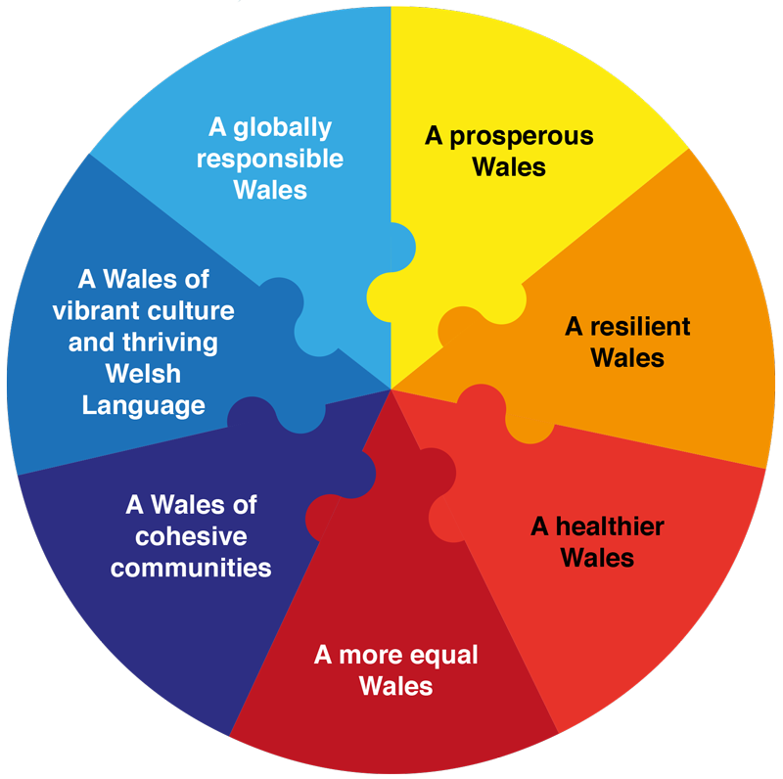
Well-being of future generations (wales) act 2015
The Well-being of future generations (Wales) act 2015 is about improving the social, economic, environmental and cultural well-being of Wales.
The act came into force on 1st April 2016 and is widely regarded as forward thinking and an example for other governments to follow.
Davies (2016).
This will help us create a Wales that we all want to live in, now and in the future.
Well-being Goals:
A Prosperous Wales
A Resilient Wales
A Healthier Wales
A More Equal Wales
A Wales of Cohesive Communities
A Wales of Vibrant Culture and Thriving Welsh Language
A Globally Responsible Wales

Slide 6
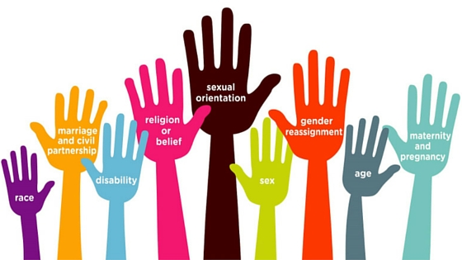
Equality
Equally is defined to mean “according to one and the same rule”
Oxford Dictionary (2012)
To treat people equally is to treat them in the same way. To treat people in the same way is to treat them according to a rule.
Hadjin (2018)
Everyone having the same chances to do what they can. Some people may need extra help to get the same chances.
People with the following characteristics should not be of disadvantage: Races, Gender, Sexual, Faith/belief and age.
Government Equalities Office (2020)

Slide 7
Well-being of future generations (wales) act 2015
A More Equal Wales - A society that enables people to fulfil their potential no matter what their background or circumstances.
Opportunity to be a Club Official (Chairman, Secretary, Treasurer)
Receive Valuable Training
Competitions
Various competitions to suit everyone
Different ages / gender competitions – Junior or senior / male or female
Competitions open to all – doesn’t matter their ability

Slide 8


COMMUNITY
Although Community means something different to everyone depending on their perspectives, they see a Community as a group of people living in one locality or a group of people having cultural, religious, ethnic, or other characteristics in common.
Harries and Nimmo and Holland (2013)
Community can be approached as a value, that it may be used as several elements such as commitment, solidarity, trust, and mutuality.
Smith (2001, 2002, 2013)

Slide 9
Well-being of future generations (wales) act 2015
A Wales of Cohesive Communities - Attractive, viable, safe and well-connected communities
YFC are an integral part of their local communities
Events or concerts
Clubs helping/ or out in their community
Covid 19 – Members/Clubs – shopping and collecting medicine
Open to all members within the communities

Slide 10
Well-being of future generations (wales) act 2015
A Wales of Vibrant Culture and Thriving Welsh Language - A society that promotes and protects culture, heritage and the Welsh language, and which encourages people to participate in the arts, and sports and recreation.
The Organisation offers a plethora of cultural and life skills to its members at a local (County level), Wales level and UK wide level.
The Organisation supports and provides opportunities for rural young people in the maintaining of cultural and heritage of rural Wales
Organisation has a strong history of talent development
Carmarthenshire YFC is run in the Welsh Language or bilingual on a County level, and the vast majority of the 22 Clubs operate through the medium of Welsh.

Slide 11
gOALS
Goal setting is a formal process during which you define an agenda for your business unit, group or team. This agenda may require you to collaborate with people outside your unit too – such as peers and people higher up in other parts of the Organisation.
Review (2009)
Goals are very relevant to Carmarthenshire YFC
Development Plan – Every three years
The WBFG 2015 Goals were added to the Organisations Development Plan in 2018
All Clubs have approved the development plan – goals to implement within their Club.

Slide 12
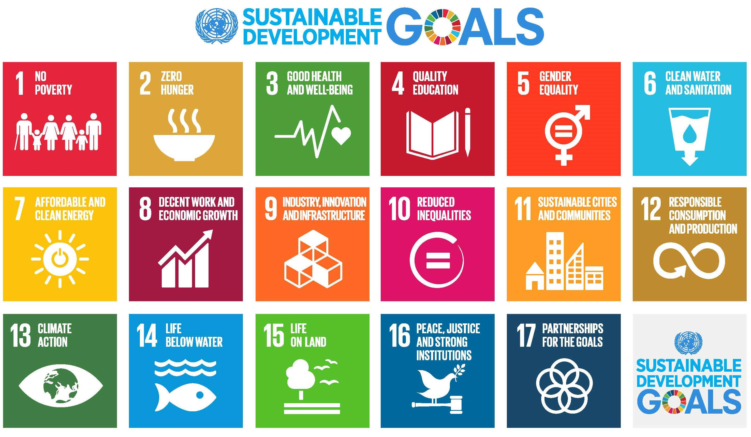
Other sustainable development gOALS
One of the main development goals that has been placed during the last decade is from the United Nations.
The 2030 Agenda for Sustainable Development, adopted by all United Nations Member States in 2015, provides a shared blueprint for peace and prosperity for people and the planet, now and into the future.
At its heart are the 17 Sustainable Development Goals (SDGs), which are an urgent call for action by all countries - developed and developing - in a global partnership.
United Nations (2020)

Slide 13
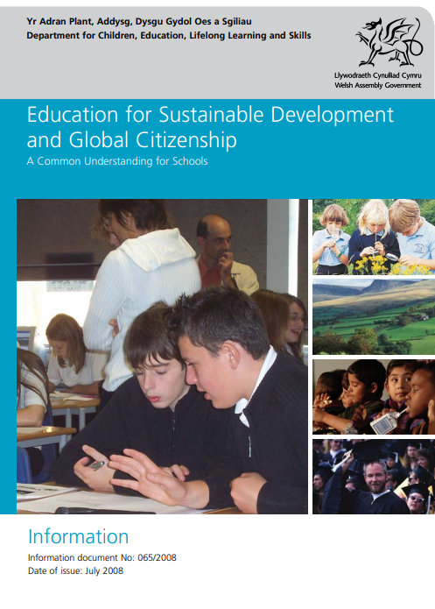
Other sustainable development gOALS
The Welsh Government “Education for Sustainable Development and Global Citizenship” (ESDGC) is a guidance document to aid delivery of education that will prepare young people for life in the 21st century in schools
Learns about values and attitudes, understanding and skills.
It is an ethos that can be embedded throughout schools, an attitude to be adopted, a value system and a way of life.
It recognises that the world is unjust and unequal, but that it can be shaped and changed by the attitudes, values and behaviour of the people who populate it.
Welsh Government (2018)

Slide 14
Other sustainable development goals
Secure a better future and to secure a world we want to live in Today, Tomorrow and for future years.
The WBG, ESDGC + United Nations Sustainable Goals link – All countries in the World are facing uncertain challenges now and in the future
All goals will secure:
To make people aware about the long term impact their decisions can make
Learn about different topics such as climate change and poverty
Make a difference to themselves and their community

Slide 15
Well-being of future generations (wales) act 2015
In 2015, the Welsh Assembly passed the Well-being of Future Generations (Wales) Act making it the first legislature in the world to enshrine in law a duty, falling on public bodies, to safeguard the well-being of future generations. Davies, (2016)
(1) Each public body must carry out sustainable development.
(2) The action a public body takes in carrying out sustainable development must include:
(a) setting and publishing objectives (‘‘well-being objectives’’) that are designed to maximise its contribution to achieving each of the well-being goals, and
(b) taking all reasonable steps (in exercising its functions) to meet those objectives. ...
The Future Generations Commissioner (FGC) was appointed by the Welsh Ministers, in consultation with the ‘responsible’ committee of the Welsh Assembly. Sophie Howe’s ‘general duty’ is to:
(a) to promote the sustainable development principle, in particular to–
(i) act as a guardian of the ability of future generations to meet their needs, and
(ii) encourage public bodies to take greater account of the long-term impact of the things that they do, and
(b) for that purpose, to monitor and assess the extent to which well-being objectives set by public bodies are being met.

Slide 16
Well-being of future generations (wales) act 2015
Positives:
Different Communities have different needs – Can use the Well-being act to make decisions themselves; altered to meet the needs of each individual Community.
Encouraging local authorities, local communities, local Clubs to take responsibilities on how their decision making impacts the environment around them.
Gives everyone the opportunity to express themselves, support and maintain their physical and mental health, access resources such as sports centres and libraries.
Negatives:
One negative and limitation is that the Future Generations Commissioner; Sophie Howe does not have the power to stop things happening, although can carry out reviews, with feedback to public bodies.
29% of children in Wales are still in poverty’s grip, despite successive Welsh Governments trying to loosen it. Evans (2019)
Poverty can lead to various scenarios such as no family car, low income can contribute to struggling to pay for membership or extra activities.
Divide in age – children and young people might have different views to the older generation, who have lived longer lives which could mean that things are being done in a traditional way; Hard to change tradition at times.

Slide 17
Conclusion
I do believe that the Well-being of future Generations (Wales) Act 2015 do promote a more Sustainable Community within my context, which is being a member at a Club with Carmarthenshire YFC.
The WBG give local authorities and many more public bodies including Carmarthenshire YFC the opportunity and guidance to follow various goals that can be altered to those individual needs.
Encouraging each Club and their members to take responsibility to make their own decisions for their future and their communities.
Following the WBG can also support members with their Physical and Mental Health.
The WBG can support the members to learn about various topics such as climate change or poverty, and can benefit understanding which could also benefit their decision making.
Although, I firmly believe that the WBG do promote a more sustainable community within Carmarthenshire YFC, I also agree that there could be various things that could be changed or be recommended within the Organisation. Two which include:
Secure more training/teaching on the WBG.
Secure all Members and leaders of Carmarthenshire YFC Clubs understand the importance of the WBG.

Slide 18
References
Carmarthenshire YFC (2020) Carmarthenshire Y.F.C | Home. [online] Available at: <https://www.carmsyfc.org.uk/> [Accessed 14 December 2020].
Davies, H (2016) The Well-being of Future Generations (Wales) Act 2015: Duties or aspirations? Birmingham City University, Birmingham, UK
Evans, S. (2019) ‘How can devolution loosen the hold of child poverty in Wales?’ https://www.jrf.org.uk/blog/how-can-devolution-loosen-hold-child-poverty-wales?gclid=EAIaIQobChMInKC7ze-s7QIV34BQBh2cbAWyEAAYASAAEgLjgfD_BwE [Accessed 29th December 2020].
Fowke R and Prasad D (1996) Sustainable development, cities, and local government. Australian Planner, 33, p61–6
Government Equalities Office 2020. The Equality Act, Making Equality Real. [ebook] London: Government Equalities Office. Available at: <https://assets.publishing.service.gov.uk/government/uploads/system/uploads/attachment_data/file/85039/easy-read.pdf> [Accessed 14 December 2020].
Hajdin, M., 2018. The Notion Of Equality. New York: Routledge, p.Part 1.
Harris, J., Nimmo, S. and Holland, K. (2013) Placement Learning In Community Nursing - E-Book. Elsevier Health Sciences, 2013, p.10.
Hornblower, S., Spawforth, A. and Eidinow, E., 2012. The Oxford Classical Dictionary. Oxford: Oxford University Press.
Review, H. B. (2009). Setting Goals. United States: Harvard Business Review Press. P4.
SDSG (2020). THE 17 GOALS | Sustainable Development. [online] Available at: <https://sdgs.un.org/goals> [Accessed 15 December 2020].
Smith, M. K. (2001, 2002, 2013). ‘Community’ in the encyclopaedia of pedagogy and informal education. [https://infed.org/mobi/community/. (Retrieved: 15-12-2020)
Welsh Government (2008) Education for Sustainable Development and Global Citizenship: A Common Understanding for the Youth Worker Sector. Available at: https://hwb.gov.wales/api/storage/eaf467e6-30fe-45c9-93ef-cb30f31f1c90/common-understanding-for-school.pdf
World Commission on Environment and Development (1987) Our Common Future, Oxford: Oxford University Press,

