Slide 1
SJIE6005
Classroom Management 2

Slide 2

Heddiw Today
Beth yw rheolaeth dosbarth?
What is classroom management?

Slide 3
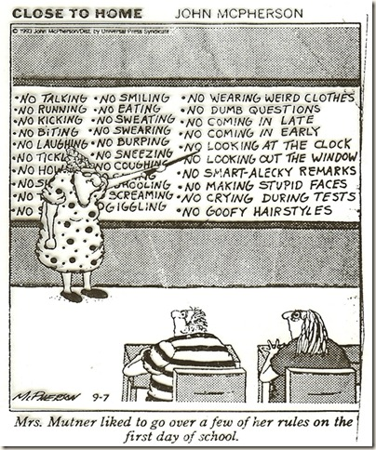
Deilliant Dysgu Learning Outcome
Dangos dadansoddiad beirniadol o sgiliau rheoli dosbarth fel elfen allweddol o amgylchedd dysgu cadarnhaol a chynhwysol yn cynnwys y defnydd o DGCh.
Demonstrate a critical analysis of classroom management skills as a key element of a positive and inclusive learning environment including the use of ICT.
Critically evaluate key psychological theories concerning effective classroom management.
Critically reflect on pupil behaviours and appreciate some of the challenges facing school staff in the contemporary context, suggesting appropriate responses.

Slide 4

Beth yw rheolaeth What is classroom dosbarth? management?
Traditional view – compliance( children following classroom/ school rules)
21st century interpretation – anything that educators do to support children learning
What could this include?
Y darlun traddodiadol – ufudd – dod (plant yn dilyn rheolau’r dosbarth/ysgol)
Dehongliadau’r 21Ganrif –unrhywbeth mae addysgwyr yn gwneud i gefnogi plant i ddysgu.
Beth allai hyn cynnwys?

Slide 5
Beth yw rheolaeth What is classroom dosbarth? management?
Amgylchedd
Disgwyliadau uchel
Profiadau dysgu sy’n symbylu
Adnoddau sy’n ysgogi
Ymddygiad cadarnhaol
Environment
High expectations
Stimulating learning experiences
Motivating resources
Positive behaviour

Slide 6

Beth yw rheolaeth What is classroom dosbarth? Management?
Diffiniad/Definition:
‘Classroom management refers to the wide variety of skills and techniques that teachers use to keep students organised, orderly, focused, attentive, on task, and academically productive during a class. When classroom-management strategies are executed effectively, teachers minimize the behaviours that impede learning for both individual students and groups of students, while maximizing the behaviours that facilitate or enhance learning.’
http://edglossary.org/classroom-management/

Slide 7
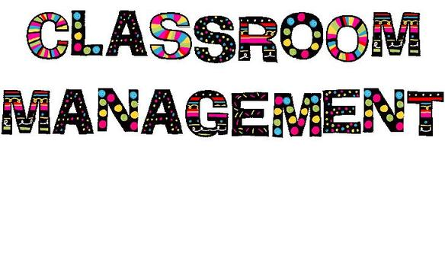
Impact of classroom management
Impact ar
reolaeth dosbarth
‘Deteriorating behaviour goes hand in hand with the decline in teaching ‘ (Ofsted, 2003)
Effaith ar gyflawniad disgyblion
Rheolaeth effeithiol yn arbed amser ac ymdrechion athrawon – angen i ddisgyblion weithio yr un mor galed.
Mewn rhai dosbarthiadau, mae’r athro a’r myfyriwr yn edrych ymlaen i gyrraedd yr ysgol yn y bore.
Bwriad y modiwl hyn yw dadansoddi sut i gynhyrchu’r math amodau yn y dosbarth
‘Deteriorating behaviour goes hand in hand with the decline in teaching ‘ (Ofsted, 2003)
Effect on pupils’ achievement
Effective management saves teachers time and effort – pupils need to be working just as hard
In some classrooms, both the teacher and the students look forward to getting to school in the morning.
This module will analyse how to produce such classrooms.

Slide 8

Impact of classroom management
Impact rheolaeth dosbarth
Mae holl ymdrechion y llywodraeth i wella addysg yn cael ei weithredu yn yr ystafell ddosbarth.
Mae polisiau addysg cenedlaethol yn cael eu gweithredu fel arfer da yn y dosbarth neu maent yn ddi – werth.
Mae lefel dysgu’r disgyblion yn dibynnu ar sgiliau’r athro.
Mae’r ffaith bod disgyblion ar dasg neu beidio yn dibynnu ar allu’r athro i reoli’r grwp.
All of the government’s efforts to improve education come down to the classroom.
National education policies must be translated into better teaching practices, or they are of no use.
Whether or not lessons come alive and students learn depends upon the teacher’s skill.
Whether or not the students are even on task depends on the teacher’s ability to manage the group

Slide 9
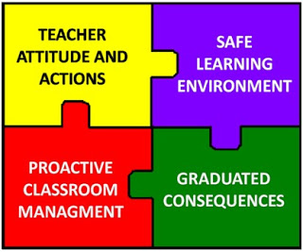
Effective classroom management
Rheolaeth
dosbarth
effeithiol
Mae rheolaeth effeithiol yn weledol.
Ni fyddwch yn gweld y mwyafrif o’r pethau rydym yn cysylltu gyda rheolaeth dosbarth yn yr ysgol:
Atgyfnerthu rheolau
Poeni
Disgyblion yn cael eu targedi
Yr ymchwil …
Effective management is invisible.
You will not see most of the things we associate with classroom management in school:
rule enforcement
nagging
students singled out
The research …..

Slide 10

Sutton Trust Report (2014):
’What makes great teaching –
A review of underpinning research’
Adroddiad yn adnabod 6 elfen sy’n gwneud ‘great teaching’:
Gwybodaeth am gynnwys iImpact uchel
Ansawdd cyfarwyddiadau Impactuchel
Rheolaeth dosbarth Cymhedrol
Hinsawdd yr ystafell ddosbarth Cymhedrol
Cred yr athro Peth tystiolaeth o impact
Ymddygiad profesiynol Peth tystiolaeth
Copi o’r adroddiad ar daflen Moodle
Report identifies 6 elements that make ‘great teaching’:
Content knowledge High impact
Quality of instruction High impact
Classroom management Moderate
Classroom climate Moderate
Teachers’ beliefs Some evidence of impact
Professional behaviours Some evidence http://www.suttontrust.com/wp-content/uploads/2014/10/What-Makes-Great-Teaching-REPORT.pdf

Slide 11

Sutton Trust
Rheolaeth dosbarth Classroom management
Gallu athro i wneud defnydd effeithiol o amser gwersi
I gyd – gysylltu adnoddau dosbarth a gofod
‘A teacher’s abilities to make efficient use of lesson time
To coordinate classroom resources and space

Slide 12
Sutton Trust
Rheolaeth dosbarth Classroom management
To manage students’ behaviour with clear rules that are consistently enforced, are all relevant to maximising the learning that can take place.
These environmental factors are necessary for good learning rather than its direct components’. (Sutton Trust, 2014)
I reoli ymddygiad y disgyblion gyda rheolau clir sy’n cael eu gweithredu’n gyson, oll yn berthnasol I macsimeiddio’r dysgu sy’n gallu cymryd lle.
These environmental factors are necessary for good learning rather than its direct components’. (Sutton Trust, 2014)

Slide 13

Sutton Trust overview of research
Rheolaeth dosbarth Classroom management
Ymddygiad/Rheolaeth/ rheolaeth dosbarth
Fframweithiau – cynnwys rhai elfennau o rheolaeth dosbarth
Gallu athrawon i wneud defnydd effeithiol o amser gwersi, i gyd – gysylltu adnoddau’r dosbarth a gofod, ac i reoli ymddygiad disgyblion gyda rheolau clir sy’n cael eu gweithredu’n gyson, sydd yn berthnasol i greu awyrgylch dysgu cadarnhaol.
Behaviour / control / classroom management
Empirically based frameworks (e.g. CLASS) include some element of classroom management.
A teacher’s abilities to make efficient use of lesson time, to coordinate classroom resources and space, and to manage students’ behaviour with clear rules that are consistently enforced, are all relevant to maximising the learning that can take place.

Slide 14
Sutton Trust overview of research
Rheolaeth dosbarth Classroom management
Serch hynny, nid yw’r ffactorau hyn yn hollol berthnasol i ddysgu; maent yn ffactorau sy’n arwain at ddysgu yn hytrach na bod yn rhan ohono.
However, these factors are mostly not directly related to learning; they are necessary factors to allow learning, rather than direct components of it.

Slide 15
Sutton Trust overview of research
Rheolaeth dosbarth Classroom management
Awgrymiadau am offeryn mesur
Offeryn i fesur amser disgyblion ar dasg yn y gwersi.
Gwnaeth Brophy a Good (dyfynnwyd yn Sutton Trust 2014) adnabod y berthynas rhwng amser ar dasg a llwyddiant disgybl fel un o’r elfennau allweddol mewn ystafell ddosbarth llwyddiannus
Suggestion of a measuring tool
A tool for measuring students’ time on task in lessons.
Brophy and Good (cited Sutton Trust 2014) identify the relationship between ‘academic engaged time’ and student achievement as one of the key elements of a successful classroom

Slide 16
Sutton Trust overview of research
Rheolaeth dosbarth Classroom management
I athro allu dracio’r mesur hyn dros amser a gyda dosbarthiadau gwahanol (o bosib yn gwneud cymhariaethau gyda athrawon eraill gyda’r run disgyblion), gallai bod yn ffordd effeithiol i gynyddu y cyfran o amser ar dasg yn y gwersi ac felly gwella dysgu.
For a teacher to track this measure over time and with different classes (possibly drawing comparisons with other teachers with the same pupils) could be an effective way to increase the percentage of time spent engaged in lessons and therefore improve learning.

Slide 17

System Genedlaethol ar gyfer Categoreiddio Ysgolion/
National School Categorisation System
http://gov.wales/docs/dcells/publications/150121-guidance-cy-v2.pdf
http://gov.wales/docs/dcells/publications/150121-guidance-en-v2.pdf

Slide 18
Sutton Trust overview of research
Rheolaeth dosbarth Classroom management
Fframwaith wedi selio ar dystiolaeth (e.e. CLASS - Classroom Assessment Scoring System) yn pwysleisio ansawdd y berthynas a rhyngweithio rhwng athrawon a myfyrwyr.
Disgwyliadau athrawon: yr angen i greu awyrgylch dosbarth cefnogol yng nghwyneb pwysau cynyddol.
Empirically based frameworks (e.g. CLASS - Classroom Assessment Scoring System) emphasise quality of relationships and interactions between teachers and students.
Teacher expectations: the need to create a classroom environment that is constantly demanding more and never satisfied, but still affirming to students’ self-worth.

Slide 19
Sutton Trust overview of research
Rheolaeth dosbarth Classroom management
Annog gwahanol mathau o golau ysgogol.
Gwahanol gred gan athrawon ynglyn a’r hyn sy’n creu llwyddiant a methiant (e.e.meddylfryd pennu yn erbyn twf, gwerth yn cael ei roi i ymdrech a strategaeth yn hytrach na gallu neu lwc; hyrwyddo awyrgylch sy’n gwrthwynebu methiant.)
Meddyliwch am eich profiad yn y dosbarth, meddyliwch am enghreifftiau I gefnogi’r ymchwil yma.
Promotion of different kinds of motivational goals
Different beliefs teachers have and encourage for success and failure (e.g. fixed versus growth mindset, value given to effort and strategy rather than ability or luck; valuing and promoting resilience to failure).
Based on your classroom experiences, think of examples to support this research

Slide 20

3 quick positive classroom management strategies
3 strategaeth rheolaeth dosbarth cadarnhaol
https://bouncyballs.org/
Adborth
‘Ask three before me’
https://bouncyballs.org/
http://www.ascd.org/publications/educational-leadership/nov09/vol67/num03/Feed-Up,-Back,-Forward.aspx
Feedforward
‘Ask three before me’

Slide 21
Rhestr gyfeirnodi Reference list
Glossary of Educational Reform. Available at http://edglossary.org/classroom-management/ [Accessed 07.06.18]
Ofsted (2003) Access and achievement in urban education: ten years on, London: The Stationery Office
Rogers, B. (2011) Classroom Behaviour (3rd edition), London: Sage
What makes great teaching – Professor Rob Coe. Available at http://www.suttontrust.com/wp-content/uploads/2014/10/What-Makes-Great-Teaching-REPORT.pdf [Accessed 07.06.18]

