Slide 1

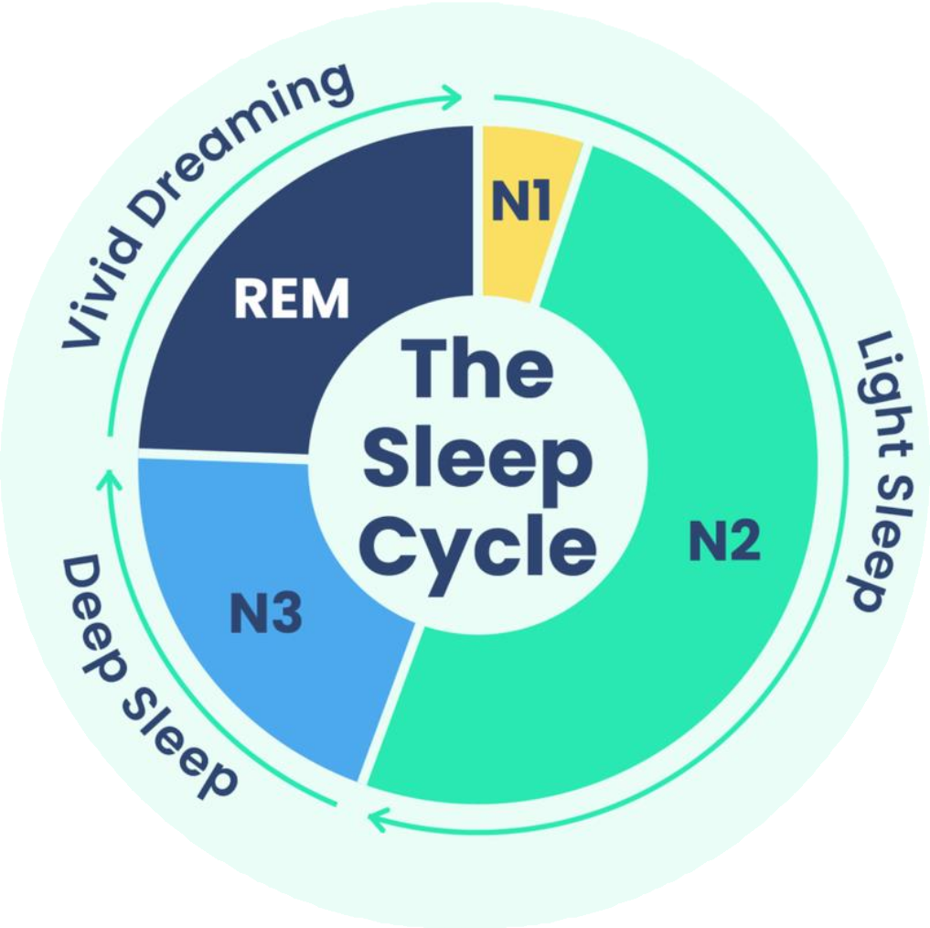
SLEEP SMART, LIVE SHARP
An eight-week sleep hygiene campaign for college and university students aged 17–23
Student name and ID: Yash Kapadiya (2518277) Module: Social Epidemiology and Public Health Development
Module code: LCHS7000

Slide 2

Eight weekly sessions turn advice into repeatable habits
Week one assesses sleep patterns and barriers, while week two explains cycles, duration, and deprivation consequences (NHS, 2024).
Week three creates regular sleep-wake schedules, while week four will practice screen-free bedtime routines and device limits (Student Minds, 2024).
Week five develops caffeine cut-offs, while week six
involves development of relaxation, worry-management skills and sleep-supportive bedroom environments (Gardiner et al., 2025).
Week seven is rehearsal of deadline coping, while week eight is review of progress and development of individualised twelve-week maintenance plans
(Saruhanjan et al., 2021).
Source: Canva template

Slide 3
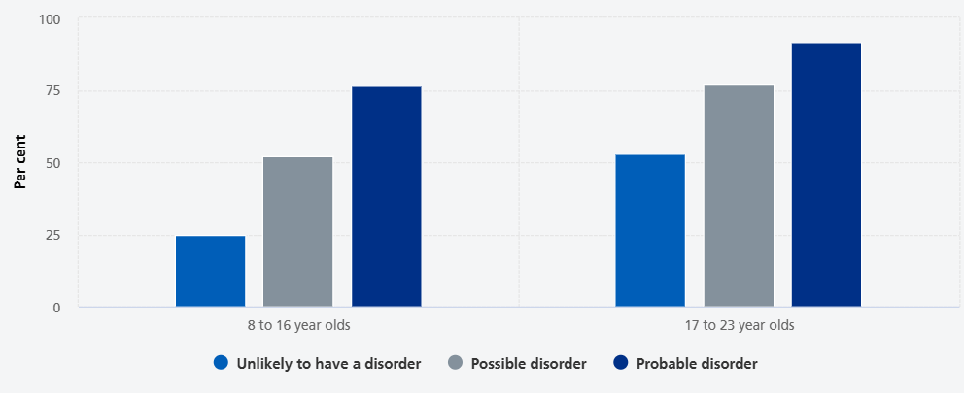
Rationale
Nationally, 64.9% of 17–23-year-olds experienced sleep problems at least three times during the previous week (NHS England Digital, 2023).
It was higher than 37.8% among children aged 8-16, which justifies prioritisation of young adults in the country.
The nationally reported rates stood at 74.7% of young women and 55.7% of young men in 2023.
91.4% of young people who had probable mental disorders had repeated sleep problems in that week.
According to NHS (2024), sleep-hygiene advice, the time to wake up should be regular, there should be
relaxation before sleep, caffeine should not be taken at least six hours before sleep and screen use should be avoided just before sleep.
Source: NHS England Digital, 2023

Slide 4
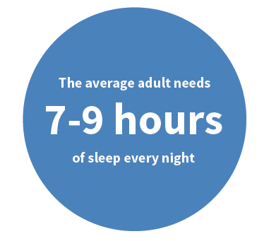
Three measurable aims
70% maintain their sleep-wake schedules within one hour 5 nights per week (NHS, 2024).
60% of them do not use interactive screens in the last hour before bedtime on most nights (Chkhaidze et al., 2025).
70% will abstain from caffeine during the six hours before planned bedtime on most nights.
The seven-day diaries evaluate the
targets at the baseline, week eight and twelve-week follow-up to evaluate
longer-term change.
Source: Stanford Center on Longevity, 2021

Slide 5
Short-term and Long-term Consequences
Short-term consequences: daily life
Consuming caffeine at night may shorten sleep by approximately 45 minutes, make sleep less restful and slow down falling asleep by approximately nine minutes (Gardiner et al., 2023).
A survey of UK university students found that 54% were depressed, 37% anxious and 47% had low wellbeing (Stores et al., 2023).
Long-term consequences: future health
An examination of over 1.4 million adults discovered that short sleep duration was associated with an increased risk of future mental health issues by 42% and a greater risk of depression by 43 percent (Zhang et al., 2024).
A study of the UK Biobank revealed that individuals with regular sleep habits were at a 20-48% reduced risk of premature death compared to those with irregular sleep habits (Windred et al., 2024).

Slide 6
Campaign poster

Slide 7

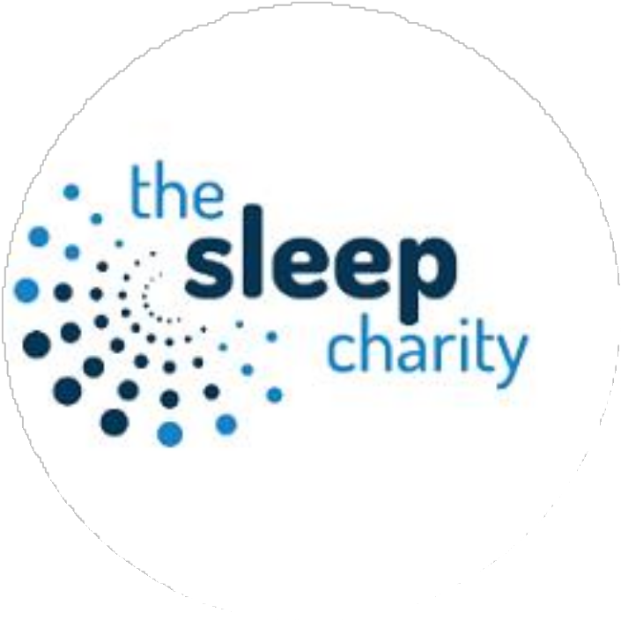
Local and national partners extend the campaign
The Sleep Charity offers expert advice, approved training, campaign resources and access to the National Sleep Helpline (The Sleep Charity, 2023).
Student Minds provides student-specific online guidance,
mental health expertise, a national platform, and nationally transferable campaign tools (Student Minds, 2024).
Source: Student Minds, 2026
Source: Family Fund, 2026

Slide 8
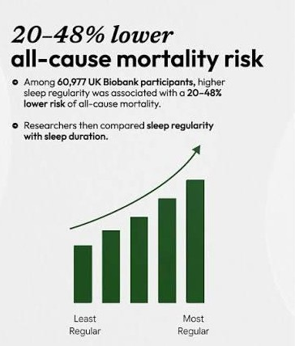
Benefits of Better Sleep
Regular sleepers showed 20-48% lower all-cause mortality risk in an observational UK Biobank cohort study (Windred et al., 2024).
54% of those in that sample were clinically significantly depressed, 37% anxious, and 47% with low wellbeing scores (Stores et al., 2023).
59% felt that sleep influenced wellbeing, while 62%
said that it had similar effects on their education and learning.
Among 153 undergraduates in UK, validated PSQI thresholds identified 75% of poor sleepers.
Source: AIWO, 2026

Slide 9
Practical Solutions
Knowledge barriers: Brief workshops and individual feedback can make students aware of healthy sleep habits and attainable goals.
Barriers to screen use: students put their phones aside and adhere to a screen-free routine in the last hour before bed.
Stress and routine obstacles: Students have individual coping strategies, relaxation techniques and peer support to organize deadlines, weekends and variable schedules.

Slide 10
Conclusion
Sleep problems are high in students aged 17 23 years and a university sleep campaign should be targeted.
The eight-week campaign builds useful habits with education,
screen-free practices, restricting caffeine, relaxation and individualised maintenance strategies.
Its three main goals are regular sleep–wake times, avoiding screens before bed and avoiding caffeine during the six hours before sleep.
The gains will be assessed using sleep diaries and a follow-up evaluation, whereas students with severe sleep issues will be enlisted to receive additional assistance.

Slide 11
References
AIWO (2026) AIWO (@aiwohealth) • Instagram photos and videos (no date). https://www.instagram.com/p/DbGFXTuFCLk
Family Fund (2026). The Sleep Charity. https://www.familyfund.org.uk/support/discover-more/the-sleep-charity
NHS (2024) Insomnia. https://www.nhs.uk/conditions/insomnia/
Stanford Center on Longevity (2021) Research Update on sleep - Stanford Center on Longevity. https://longevity.stanford.edu/research-update-on-sleep
Student Minds (2026) Mental health support – for UK university students | Student Minds. https://www.studentminds.org.uk
Chkhaidze, A., Millar, B.M., Revenson, T.A. and Mindlis, I. (2025) ‘Scrolling your sleep away: the effects of bedtime device use on sleep among young adults with poor sleep’, International Journal of Behavioral Medicine, 32(4), pp. 634–639. Available at: https://doi.org/10.1007/s12529-024-10326-x
Gardiner, C.L., Weakley, J., Burke, L.M., Fernandez, F., Johnston, R.D., Leota, J., Russell, S., Munteanu, G., Townshend, A. and Halson, S.L. (2025) ‘Dose and timing effects of caffeine on subsequent sleep: a randomized clinical crossover trial’, Sleep, 48(4), article zsae230. Available at: https://doi.org/10.1093/sleep/zsae230
National Health Service [NHS] (2024) Insomnia. Available at: https://www.nhs.uk/conditions/insomnia/ (Accessed: 2 August 2026).
NHS England Digital (2023) Mental Health of Children and Young People in England, 2023: Part 2 —sleep, loneliness, activities and health behaviours. Available at: https://digital.nhs.uk/data-and-information/publications/statistical/mental-health-of-children-and-young-people-in-england/2023-wave-4-follow-up/part-2-sleep-loneliness-activities-and- health-behaviours (Accessed: 2 August 2026).
Saruhanjan, K., Zarski, A.-C., Bauer, T., Baumeister, H., Cuijpers, P., Spiegelhalder, K., Auerbach, R.P., Kessler, R.C., Bruffaerts, R., Karyotaki, E., Berking, M. and Ebert, D.D. (2021) ‘Psychological interventions to improve sleep in college students: a meta-analysis of randomized controlled trials’, Journal of Sleep Research, 30(1), article e13097. Available at: https://doi.org/10.1111/jsr.13097
Stores, R., Linceviciute, S., Pilkington, K. and Ridge, D. (2023) ‘Sleep disturbance, mental health, wellbeing and educational impact in UK university students: a mixed methods study’, Journal of Further and Higher Education, 47(8), pp. 995–1008. Available at: https://doi.org/10.1080/0309877X.2023.2209777
Student Minds (2024) Improve your sleep. Available at: https://www.studentminds.org.uk/advice-and-info/improve-your-sleep/ (Accessed: 2 August 2026).
The Sleep Charity (2023) Student life and sleep—when getting Zs matters. Available at: https://thesleepcharity.org.uk/student-life-and-sleep-when-getting-zs-matters/ (Accessed: 2 August 2026).
University of Wales Trinity Saint David (2024) Groundbreaking wellbeing project for students at Carmarthen Campus. Available at: https://www.uwtsd.ac.uk/news/groundbreaking-
wellbeing-project-students-carmarthen-campus (Accessed: 2 August 2026).
Windred, D.P., Burns, A.C., Lane, J.M., Saxena, R., Rutter, M.K., Cain, S.W. and Phillips, A.J.K. (2024) ‘Sleep regularity is a stronger predictor of mortality risk than sleep duration: a prospective cohort study’, Sleep, 47(1), article zsad253. Available at: https://doi.org/10.1093/sleep/zsad253

