Slide 1


Introduction
Lesley Martin
Autism affects everyone differently
Think SMART:​
Specific​
Measurable​
Achievable/Attainable​
Relevant/Realistic​
Time-Bound/Framed
Person Centred Plan (PCP)
Review
Learn
Listen
(Google image, 2020)
(Debenham, 2018)

Slide 2


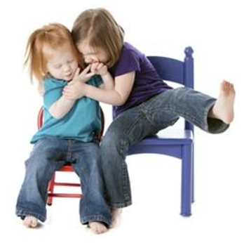

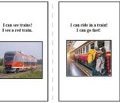
Triad of Impairments:
Social interaction
Social communication
Social imagination
Difficulties
Sensory Processing
Sensitivity Problems
Obsessions
Specific Interests
(Google images, 2020)

Slide 3
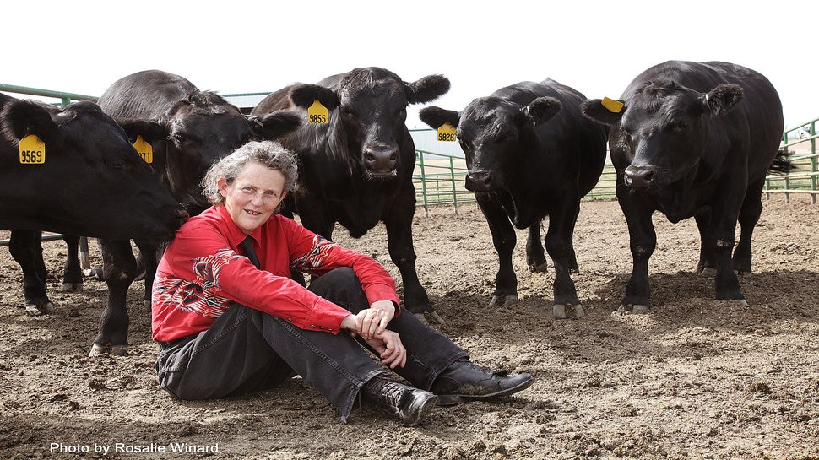
Dr Temple Grandin
Autism is:
An Ability not a handicap
An important part of a person's form, but not their primary identity
Time Magazine 2010: named her 1 of the top 100 most influential people
(Fischbach, 2007, Grandin, 2020, Hauser, 2010,
Poehler, 2015, Winard, 2020)

Slide 4
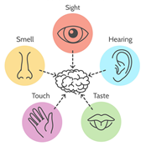
Sensory Processing Disorder (SPD)
Sometimes referred to as Sensory Integration Disorder (SID), occurs when someone has difficulty organising information received via their senses
(Google image, 2020)
(Child Mind Institute, 2020, NAS, 2020, Understood Team, 2020)

Slide 5
Hyper / Hypo-sensitivity:
Hyper-sensitivity: Causes sensory or information overload which others may not notice, but can trigger, stress, anxiety and physical pain. This results in withdrawal or meltdowns, which are difficult to manage and usually need to run their course.
https://www.youtube.com/watch?v=ycCN3qTYVyo
Hypo-sensitivity: Results in not enough information being received and what is, appears muffled or suppressed, so it doesn’t make sense. These children usually need physical contact or pressure and have higher pain thresholds, so do not always realise when they are hurting themselves or others.
https://www.youtube.com/watch?v=fKKrZSkzywI
Can happen together or separately, but by adulthood most have developed strategies to control them.
(Covington, 2012, NAS, 2014, Underwood Team, 2020)

Slide 6
Obsessions, Repetitive Behaviour and Routines
Used as coping mechanisms or to provide pleasure and comfort but can also restrict a person's involvement and exacerbate their anxiety or pain.
Specific Interests
Habitual features people with autism use to reduce stress. Previously children were deterred from using them other than as rewards, but more recent research has led to the recognition of their benefits, from a learning and social perspective at school and for successful careers in later life.
(NAS, 2020, Singer, 2020)

Slide 7

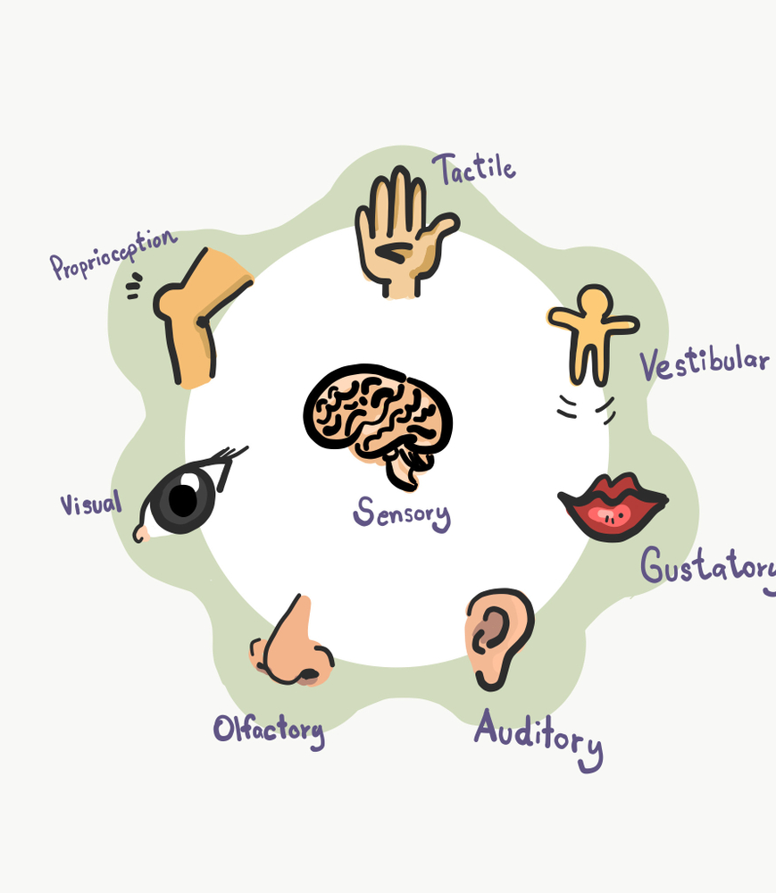
Self-stimulatory Behaviours
(Google image, 2020)

Slide 8
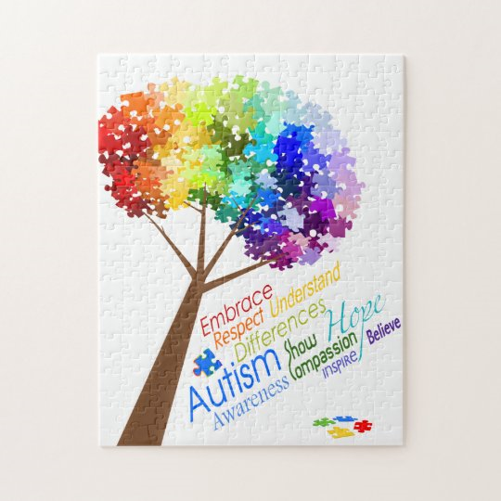
SPELL PHILOSOPHY
Structure
Positivity
Empathy
Low arousal
Links
Reduces anxiety from inflexible thoughts
Recognises and embraces autistic neurodiversity to increase self-regard
Ability to see the world from a person with autism's perspective
Reduce anxiety issues related to sensory association
To other interventions and relationships within society
(Google image, 2020)​
(NAS, 2020)

Slide 9
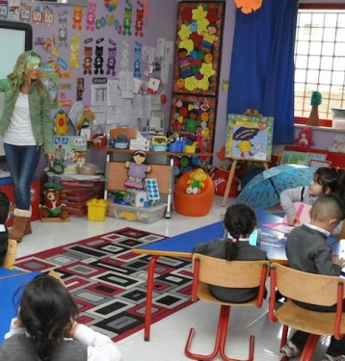
Structure
Environment:
Whole school approach
Safe
Structured / Boundaries
Predicatable
Accessible
Visual activity areas
Limited distractions
Benefits:
Promotes independence
Reduces anxiety
Regulates emotional behaviour
(Google image, 2020, Middleton Centre for Autism, 2020, NAS, 2020)​

Slide 10

Positivity
Use: ​
Accurate assessments​
Realistic expectations​
Support​
Rehearse
Benefits:​
Increased self-esteem​
Build on:​
Strengths​
Specific interests​
Knowledge​
Understanding​
Autistic intelligence
Acknowledge:
Barriers
(NAS, 2020)
(Google image, 2020)​

Slide 11

Empathy
Be:
Calm
Respectful
Understanding
Patient
Predictable
Approachable
Good-humoured
Methodical
Use simple language
Benefits:
Reduces anxiety
Provides reassurance
(Google image, 2020, NAS, 2020)​

Slide 12
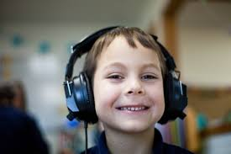
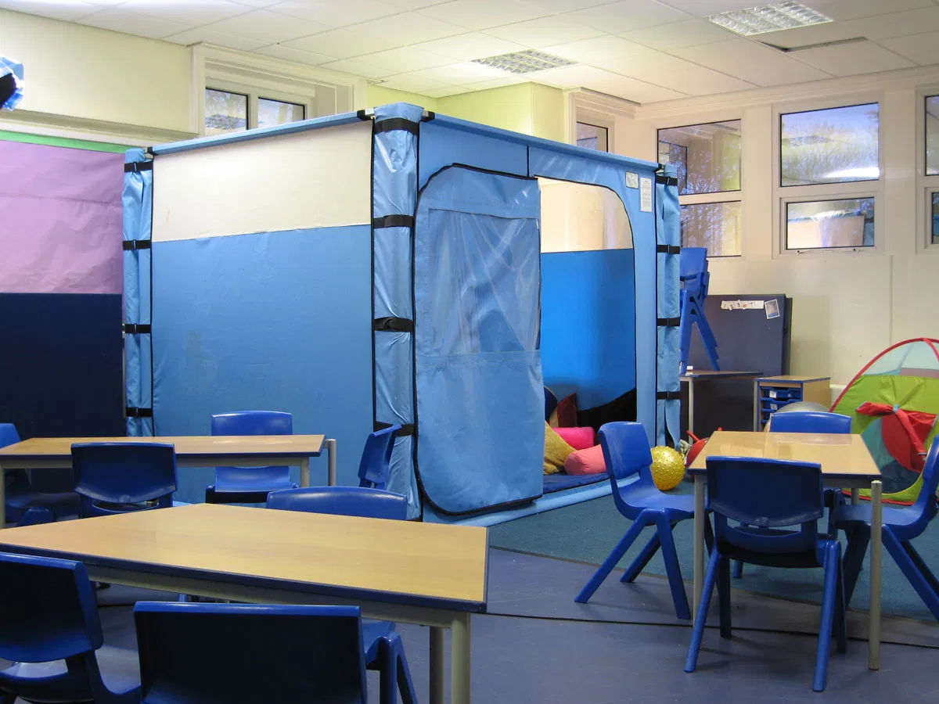
Low Arousal
Classroom:
Calm
Orderly
Individual work desk/cubicle
Reduced noise levels
Moderate lighting
Limited colours
Neutral odours
Soothing background music
Flooring
Sensory:
Room / Corner
Tent
Swing
Punch bag
Slam balls
Ropes
Crash pad
Light wall
Toolbox
Toys
Fidgets
Benefits:
Reduces anxiety
https://www.youtube.com/watch?v=T9j6rQ4rtQY
(Google image, 2020)​
(Edutopia, 2017, NAS, 2020)

Slide 13

Links
Parents/Carers
Advocates
Schools
Cluster schools
Charitable organisations
Professionals
Medical professionals
Wider community
Benefits:
Share information
Work together
Reduce misunderstandings
(Google image, 2020, NAS, 2020)​

Slide 14

Sensory Stories:
Are safe, fun, 4 dimentional and bring a book to life by using senses rather than words and pictures.
Benefits:
Develop communication
Increase concentration
Encourage interaction
Flexible
Creative
Simple
Suitable for all abilities
Can relate to specific interests/familiarity
Engage senses with new/old experiences to help make sense of the world
(Ryan, et al., 2014)

Slide 15
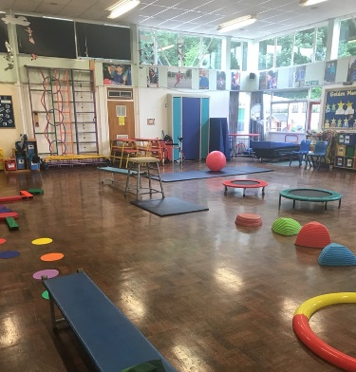
Sensory Circuits
Short alerting and calming activities used to stimulate the senses
Promotes:
Physical
Sensory
Develops:
Balance
Co-ordination
Bodily awareness
Includes:
Bouncing
Spinning
Wobble boards
Wall pushing
Benefits:
Promotes self-esteem
Reduces incidents
(Google image, 2020)​

Slide 16
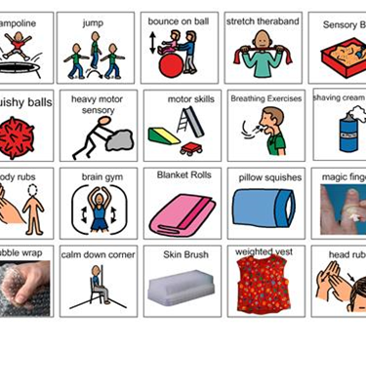
Sensory Diets
Restore balance
Usually designed by Occupational Therapists. Involves physical activities which can be scheduled into the school day to meet the individual's sensory needs:
Sessions: 10/15 minutes
Affects: Lasts hours
Helps:
Retain attention
Stimulate senses
Learn new skills
Encourage adaptive responses
Increase socialisation
Home and school life
(Google image, 2020)
(Morin, 2020)​​

Slide 17



Emotional self-regulation
The ability to adjust behaviours in situations where emotions may be overstretched:
Stress
Anxiety
Frustration
Distress
Nervousness
Pain
Anger
(Pepperdine Graduate School of Education & Psychology, 2018)
(Google image, 2020)​

Slide 18

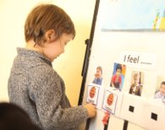
Advantages of emotional self-regulation skills: ​
Regulates emotional behaviour ​
Reduces anxiety ​
Considers consequences to reactions ​
Allows the application of coping strategies ​
Helps achieve realistic goals
Disadvantages of insufficient emotional
self-regulation:
Exaggerated responses to situations compared to other pupils
Negative emotions
Meltdowns
Low self-esteems
Insecurities
(Pepperdine Graduate School of Education & Psychology, 2018)​
(Google image, 2020)​

Slide 19

Yoga
Develops sensory and bodily awareness
Calms and energises the body
Increases self-regulation
Promote social interaction
Enhances speech, language and motor development
Reduces anxiety levels
Promotes independence
Improves self-esteem
https://www.youtube.com/watch?v=nVUF5fNGl0U
(Google image, 2020)​
(Good Health, 2018)

Slide 20
Obsessions, Routines or Repetitive Behaviours
If they do not restrict the child's learning, are safe and not causing them or their peers any distress or inconvenience, intervention may not be necessary.
However, if causing problems, support to modify or reduce their reliance may be required.
Identify its purpose and triggers and record the specific details over a set period: date, time, place; what happened before, during and after; how the child was feeling; how the other children reacted.
Contemplate if any changes have taken place to the child's routine or environment that may have affected their behaviour.
(NAS, 2020)

Slide 21

Specific Interests
Advantages:
Help engage
Support learning
Disadvantages:
Intense
Obsessive
Repetative
Be flexible unless causing distress or interferring with another child's learning
(Google image, 2020)
(Singer, 2020)

Slide 22
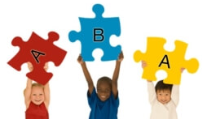
Applied Behaviour Analysis (ABA)
Helps understand why specific behaviours happen due to real life situations or the environment.​
To begin visual and/or verbal prompts are broken down into simple ABC steps:​
Antecedent > Behavior > Consequence​
Prompts are gradually withdrawn and replaced with positive reinforcements or incentives until the child recognises that something good will happen for them if they continue to repeat their pleasing behaviour.​
The aim: to replace negative behaviours with positive ones.
Benefits:
Increases good behaviour
Improves communication
Minimises disruptions
Teaches basic skills
(Ayers, et al., 2000, Child Mind Institute, 2020)

Slide 23
Practical Tasks
Group 1:
Group 2:
Group 3:
Create a Sensory Story around a Specific Interest for when the school bell rings
Design an Emoji System to support a child with their emotional needs
Design a classroom with a sensory corner to reduce the amount of time spent out of the class

Slide 24

Feedback Ideas from
Group Tasks
Group 1:
Sensory Story:
Could include something to replicate the noise of the school bell and give the child the opportunity to touch and control the sound in a real-life scenario, to raise their awareness and understanding of its purpose and when it is expected to help reduce anxiety.

Slide 25
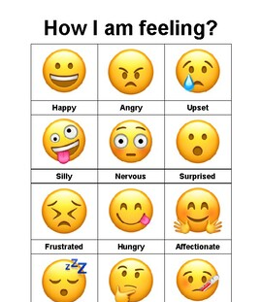
Group 2: ​
Emoji System:
To support Emotional needs. Think about text messaging and what emoji's you would use to express your feelings of sadness, fear, happiness, anger etc. ​Could be a wall chart they could hang by their individual work area or individual cards.

Slide 26

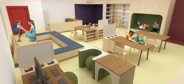
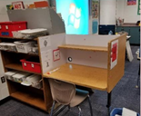
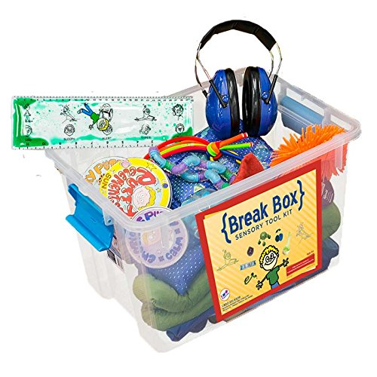

Group 3: ​
Design a classroom with a sensory corner. Include: Moderate lighting, soothing background music, fidget toys, senosory books & fidget spinners etc.

Slide 27
Advantages of Inclusive Education
Everyone gains access to a quality education
Children with autism are given the opportunity to learn important life skills, such as social, emotional and behavioural development in a more natural environment
Raises awareness of non-disabled children to learn about diversity and empathy
Prepares children for life in the community
Inspires children with autism to shine academically by presenting them with realistic challenges
Expectations are higher in mainstream classrooms which encourages children to perform better
Fulfills the legal obligations of Education Laws and Human Rights
(Lawrence, 2020, Reagan, 2012)

Slide 28
Disadvantages of Inclusive Education
Children learn at different speeds, therefore children with autism may not be able to keep up with the speed of the curriculum
Appropriateness of support provided
Teaching staff may have had little or no training in teaching children with autism and place unreasonable or impossible demands on them
More able children may receive less attention which can impact on their education and cause resentment
It is seen as a money saving practice rather than in the best interest of the child
(Lawrence, 2020, Reagan, 2012)​

Slide 29
Conclusion
Autism is not a life sentence, but it is lifelong and covers a full range of abilities​​
Appropriate interventions must be introduced and implemented to modulate reactive behaviours and enable pupils with ASD to flourish in congenial mainstream environments ​
It is the Governments responsibility to work in partnership with Local Authorities (LA’s), Schools, outside Agencies and Professionals to ensure this happens
Teachers may need to rethink the way they teach and recognise the importance of support staff to ensure all children received the same opportunities for inclusion to be a success
(Grandin, 2020, NAS, 2020 and Reagan, 2012) ​

Slide 30
The sooner it is recognised by everyone, the more chance there is for all children with autism to be fully accepted in society and succeed in life.
Temple Grandin:
Kids have to be exposed to different things in order to develop. A child’s not going to find out he likes to play a musical instrument if you never exposed him to it…
Stephen Shore:
If you’ve met one individual with autism, you’ve met one individual with autism.
Anthony Ianni:
At the end of the day, we don’t dream our lives…WE LIVE THEM!
(Grandin, Lanni and Shore, 2018)

