Slide 1

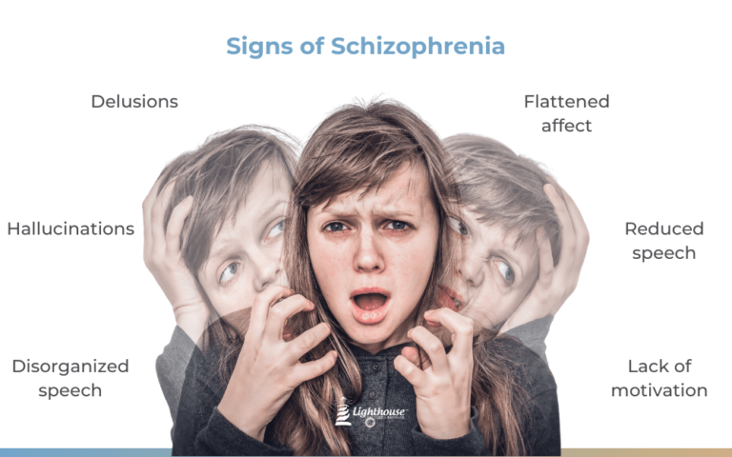
Title: Understanding Schizophrenia
Name: Nicole Jones
Student ID: 2246941
Unit: BMHP6029
Module name: Psychopathological Classifications and Provisions
University: University of Wales
Acknowledgement of the Use/Non-Use of AI:
I confirm that no artificial intelligence (AI) tools were used to generate, write, analyze, or edit the content of this dissertation. All research, analysis, interpretation, and writing were completed independently, in accordance with the academic integrity requirements of this institution.

Slide 2

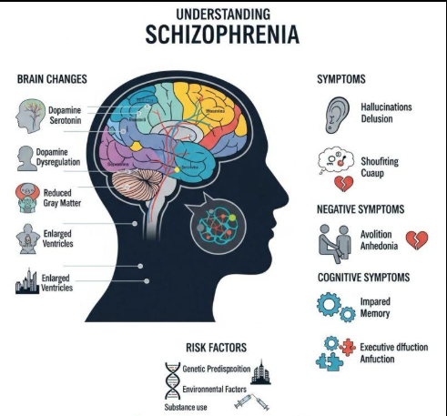
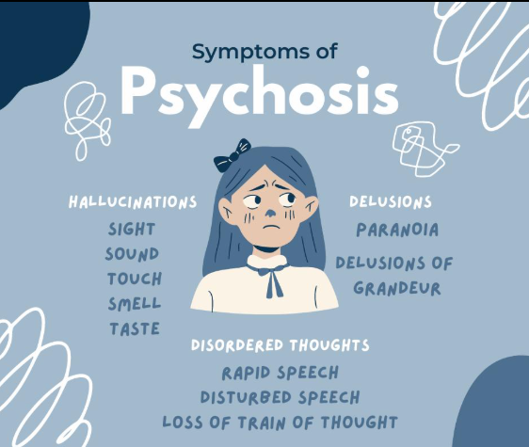
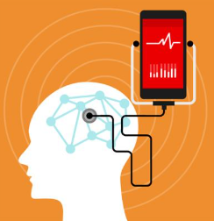
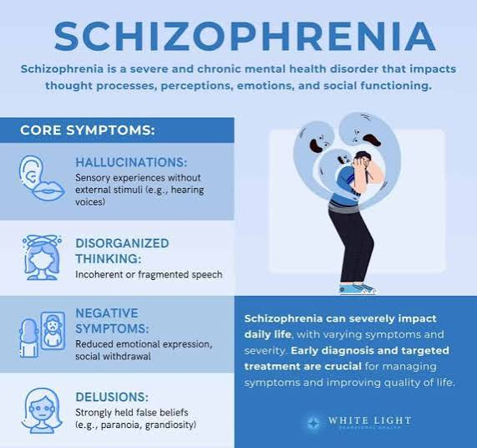
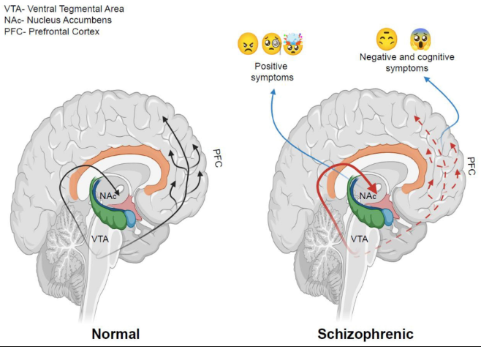
Understanding Schizophrenia
Introduction Classification: Schizophrenia is one of the most serious disorders amongst the mental illnesses categorised under the group of Psychotic Disorders. It is a condition that impacts thinking, experiencing real life, emotional expression and social interaction. In people with a psychotic disorder, there are problems with reality testing, such as hallucinations, delusions and disorganised thinking (NICE, 2020). How Common is the Disorder? Schizophrenia affects about 1% of the population at some point in their lifetime, and is one of the most disabling mental health conditions. Most people with schizophrenia develop symptoms when they are between 16 and 35 years old, and the illness manifests itself in the United Kingdom in young people. Of note, material inequalities and social and ethnic differences have been found to have a significant impact on recovery experiences after first episode psychosis, suggesting that there is significant variation between population groups (Griffiths et al., 2023). Historical perspectives and treatments In the past, a lack of understanding surrounding schizophrenia led to supernatural ideas or views, a moral weakness and dangerous behaviour sometimes being associated with the disease. In the 19th century, people with psychological/mental symptoms were locked up in mental asylums and shunned by society. Doctors saw major mental disorders as a lifelong disease, and not something that any amount of medicine could cure – it had to be institutionalised. Psychiatric Classification Systems were developed during the early part of the 20th century. The disease was called "dementia praecox" by Emil Kraepelin and, more commonly known in the era as Affectum Wasen Bleuler, as "schizophrenia. The treatment during most of the twentieth century was centred on institutionalisation, electroconvulsive therapy, insulin coma therapy and initiation of the use of early antipsychotic medications. There has been a tremendous change in attitude today. Today, schizophrenia is known as a complex biopsychosocial disorder, meaning that it is prone to being affected by various environmental, psychological and genetic factors. Modern treatment is focused on rehabilitation rather than ongoing institutionalisation (NICE, 2020), and on community-based, way-of-life approaches to care and on working with a person's wider family. UK mental health services, like those in the NHS today, aim to tackle stigma and enhance quality of life through a multidisciplinary approach (NHS England, 2024). |  | SCHIZOPHRENIA Definition Schizophrenia is a chronic psychiatric disorder with impairments in thinking, sensation, emotional trainability and behaviour. Individuals who suffer from the disorder have difficulties distinguishing between reality and distorted experiences, which affect their social, occupational and psychological functioning (NICE, 2020). |  | Current Services and Treatments Pharmacological Treatments: Antipsychotic drugs continue to be the most effective drugs used to diminish the psychotic aspects. They can be used to help control hallucinations, delusions and disorganised thinking and are an effective way of maintaining the stability of symptoms over the longer term (NICE, 2020) . Psychological Interventions: Psychological treatments (psychotherapy) are now playing a growing part in treatment. The approach to treatments recommended by UK mental health services includes Mental Health Services for CBTp, Family Interventions, Psychoeducation and Recovery Focused treatments (NHS England, 2024). NSH implementation guidance calls for psychological therapies to be rolled out for severely affected individuals with mental health issues, focuses on growth and personalisation of psychological therapies and better access to evidence-based interventions (NHS England, 2024). Rehabilitation Services: A rehabilitation programme to help people with complex psychosis recover and live independently, integrated into society, and in employment and being involved in their communities is recommended by NICE (2020). Early Intervention in Psychosis Services: Specialist early intervention during an early stage of illness is called ‘Early Intervention in Psychosis (EIP) services. These services aim to decrease the severity of symptoms, the likelihood of a successful recovery and minimise the long-term disability. Nevertheless, emerging signs that some service users experience harm – such as a sense of coercion, a lack of personalisation in the support offered and being subjected to an extreme of the stigma associated with their service – which indicates that there is a need for further service improvements (Hudson et al., 2026). Digital and Telemental Health Services: Digital technology has been a worthwhile asset to the COVID-19 pandemic, bringing rapid digital solutions to the UK in the field of mental health. Mental health professionals indicated that there was an increased frequency of remote consultations and the utilisation of telehealth technologies that provided increased access to mental health services and presented challenges in engagement and therapeutic relationships (Rains et al., 2022). Service Accessibility A study looking at mental health access to services across England demonstrated that there was considerable geographical variation in access to services and provision and that inequalities in access to services remain (Maconick et al., 2021). Recommendations 1. Reduce Health Inequalities In order to tackle ethnic and social inequalities in the effects of psychosis, targeted interventions will be provided using a culturally responsive service and improved community engagement, as described in Griffiths et al. (2023). 2. Expand Early Intervention Services Opportunities for recovery will be more numerous, and long term disability will be less, if more attention is focused on the link between early intervention in Psychosis and recovery. 3. Increase Access to Psychological Therapies Psychological interventions should be consistently delivered, across all regions of the NHS, to allow for whole person services and outcomes in line with a recovery agenda (NHS England, 2024). 4. Improve Service User Involvement Service users should be engaged in mental health services to play an active role in planning their care and designing the service to minimise any harms and augment the client's experience of the service (Hudson et al, 2026). 5. Address Regional Service Inequalities Geographic inequalities in service provision should be reduced as a priority in national strategies and specialised mental health services (Maconick et al, 2021) should be always available. 6. Invest in Predictive Technologies The development of genetic risk predictors coupled with machine learning could help identify and intervene earlier on high-risk individuals (Bracher-Smith et al., 2022). Conclusions Schizophrenia is considered a severe and complex type of psychosis, which is believed to be due to complex interactions between background genetic, biological, environmental and social factors. The findings from this recent UK research now show that inequalities related to access to services, ethnicity, social disadvantage and treatment are as significant as symptoms at recovery outcome. Whilst considerable progress is being undertaken in various areas such as community-based models of care, EIP, psychological interventions and rehabilitation programmes, inequities in access and service user experience are still a key issue. Reducing inequalities in health outcomes, using technology to enhance service provision, personalising service provision, and early detection of entry to the SUD should all be a priority if we are to improve the lives of people living with schizophrenia in the United Kingdom.
 |  | Causes No single cause of schizophrenia can be found. The present evidence upholds a view of several underlying factors, both genetic and neurobiological, environmental stressors and social influences. There is a strong genetic component in the illness of schizophrenia. The value of inherited susceptibility (genetic predisposition) was given special emphasis on the fact that genetic markers and polygenetic risk scores can make a contribution to schizophrenia prediction (Bracher-Smith et al., 2022). Likewise, studies based on large-scale genetics identified schizophrenia to have similar characteristics with some other mental disorders, suggesting that there are common biological mechanisms amongst mental disorders (Williams et al., 2024). However, environmental influences are also to a large extent responsible. The following factors have been linked to an increased risk: adverse childhood experiences, living in an urban environment, migrating from one country to another, living in poverty, social deprivation and discrimination. Studies following up patients into long-term treatment showed that social inequalities and ethnicity affect prognosis and outcome of first-episode psychosis (Griffiths et al., 2023). The other fact that is recognised is substance misuse. Cannabis, alcohol and drugs may increase the risk of psychotic symptoms and/or exacerbate clinical symptoms of schizophrenia (Mulligan et al., 2024). Symptoms Positive Symptoms: Positive symptoms are experiences that are added onto normal functions that include: Hallucinations Delusions Disorganised thinking Disorganised speech Thought interference The studies on thought interference and somatic passivity that analysed clinical records in South London indicated that they affected poor long-term outcomes in people with psychosis (Magrangeas et al., 2022). Negative Symptoms: Negative symptoms are a decrease in normal functioning that is manifested by: Emotional flattening Lack of motivation Social withdrawal Reduced speech Loss of pleasure in activities Cognitive Symptoms: Poor concentration Memory difficulties Impaired problem-solving Reduced executive functioning Some people with schizophrenia may also misuse substances and engage in self-harm behaviours, which can also pose a risk of suicide and negatively affect schizophrenia treatment outcomes (Mulligan et al., 2024). Diagnosis: A thorough clinical evaluation by mental health practitioners is the process to diagnose schizophrenia. Assessment will usually include a psychiatric history, examination and evaluation of the symptoms, mental state examination, physical health examination and risk assessment. A series of diagnostic criteria has been developed in either the International Classification of Diseases (ICD-11) or the Diagnostic and Statistical Manual of Mental Disorders (DSM-5), which are applied to make a diagnosis. The criteria involve having typical psychotic symptoms, impairment and lasting symptoms. In recent years, the self-report data has been found to have strong agreement with clinically diagnosed data (e.g. Woolway et al., 2024), which gives some weight to the information from the self-reporting of schizophrenia in research. Artificial intelligence/machine learning could be added to diagnostic predictive modelling in the future. However, genetic and demographic data can be added to and fitted in a predictive model, which has proven beneficial in identifying people who have a higher likelihood of having schizophrenia (Bracher-Smith et al., 2022).

Slide 3
References
Bracher-Smith, M., Rees, E., Menzies, G., Walters, J.T., O'Donovan, M.C., Owen, M.J., Kirov, G. and Escott-Price, V., 2022. Machine learning for prediction of schizophrenia using genetic and demographic factors in the UK biobank. Schizophrenia research, 246, pp.156-164.
Griffiths, S.L., Bogatsu, T., Longhi, M., Butler, E., Alexander, B., Bandawar, M., Everard, L., Jones, P.B., Fowler, D., Hodgekins, J. and Amos, T., 2023. Five-year illness trajectories across racial groups in the UK following a first episode psychosis. Social Psychiatry and Psychiatric Epidemiology, 58(4), pp.569-579.
Hudson, G., Francis‐Crossley, I., Mackie, C.S., Hiller, R., Kirkbride, J.B. and Powell, C., 2026. A scoping review of service user experiences of potential harm in early intervention in psychosis services in the UK. British Journal of Clinical Psychology.
Maconick, L., Sheridan Rains, L., Jones, R., Lloyd-Evans, B. and Johnson, S., 2021. Investigating geographical variation in the use of mental health services by area of England: a cross-sectional ecological study. BMC health services research, 21(1), p.951.
Magrangeas, T.T., Kolliakou, A., Sanyal, J., Patel, R. and Stewart, R., 2022. Investigating the relationship between thought interference, somatic passivity and outcomes in patients with psychosis: a natural language processing approach using a clinical records search platform in south london. BMJ open, 12(8), p.e057433.
Mulligan, L.D., Bojanić, L., Hunt, I.M., Baird, A., Turnbull, P., Kapur, N., Appleby, L. and Shaw, J., 2024. Substance use and self-poisoning in schizophrenia: 11-year findings from a national clinical survey of suicide in mental health patients in the UK. Schizophrenia Research, 267, pp.254-260.
NHS England. 2024. Implementation guidance 2024 – psychological therapies for severe mental health problems. Available at: https://www.england.nhs.uk/long-read/implementation-guidance-2024-psychological-therapies-for-severe-mental-health-problems/
NICE. 2020. Rehabilitation for adults with complex psychosis. Available at: https://www.nice.org.uk/guidance/ng181/resources/rehabilitation-for-adults-with-complex-psychosis-pdf-66142016643013
Rains, L.S., Dalton-Locke, C., Landau, S., Needle, J.J. and Johnson, S., 2022. Variations in the uptake of telemental health technologies in community and crisis mental health services during the early pandemic: a survey of mental health professionals in the UK. BMC psychiatry, 22(1), p.776.
Williams, C.M., Peyre, H., Wolfram, T., Lee, Y.H., Seidlitz, J., Ge, T., Smoller, J.W., Mallard, T.T. and Ramus, F., 2024. Characterizing the phenotypic and genetic structure of psychopathology in UK Biobank. Nature Mental Health, 2(8), pp.960-974.
Woolway, G.E., Legge, S.E., Lynham, A.J., Smart, S.E., Hubbard, L., Daniel, E.R., Pardiñas, A.F., Escott-Price, V., O’Donovan, M.C., Owen, M.J. and Jones, I.R., 2024. Assessing the validity of a self-reported clinical diagnosis of schizophrenia. Schizophrenia, 10(1), p.99.

