Slide 1

ECDE 7017 Exploring Contemporary Issues in Education: Policy Review and Critical Analysis
Whose Chinese? Whose Policy?
Critical gaps in UK Mandarin education policy
Longxiao Yi

Slide 2
Introduction
THE ISSUE
THE AIM
To look at this policy with a critical eye.
Who does it help? Who does it leave out?
This talk opens questions — it does not close them.
UK policy treats Mandarin as an economic tool — a language for native English speakers to do business with China.
It says almost nothing about British-born Chinese children, or the Chinese teachers who already live and work here.
One question runs through this talk: who is Mandarin policy really for?

Slide 3
WHY THIS TOPIC
Who is affected by this policy?
I am a Chinese language teacher. I see this gap between policy and real life every week.
1
Heritage students — British-born Chinese children
Policy plans courses for beginners. It ignores their home language and their identity needs.
2
Migrant Chinese teachers (without UK QTS)
Visa rules and QTS rules keep them out of state schools, even with years of experience.
3
Schools and the curriculum
Chinese is marketed as an elite subject for the best students, so few schools offer it to all.

Slide 4
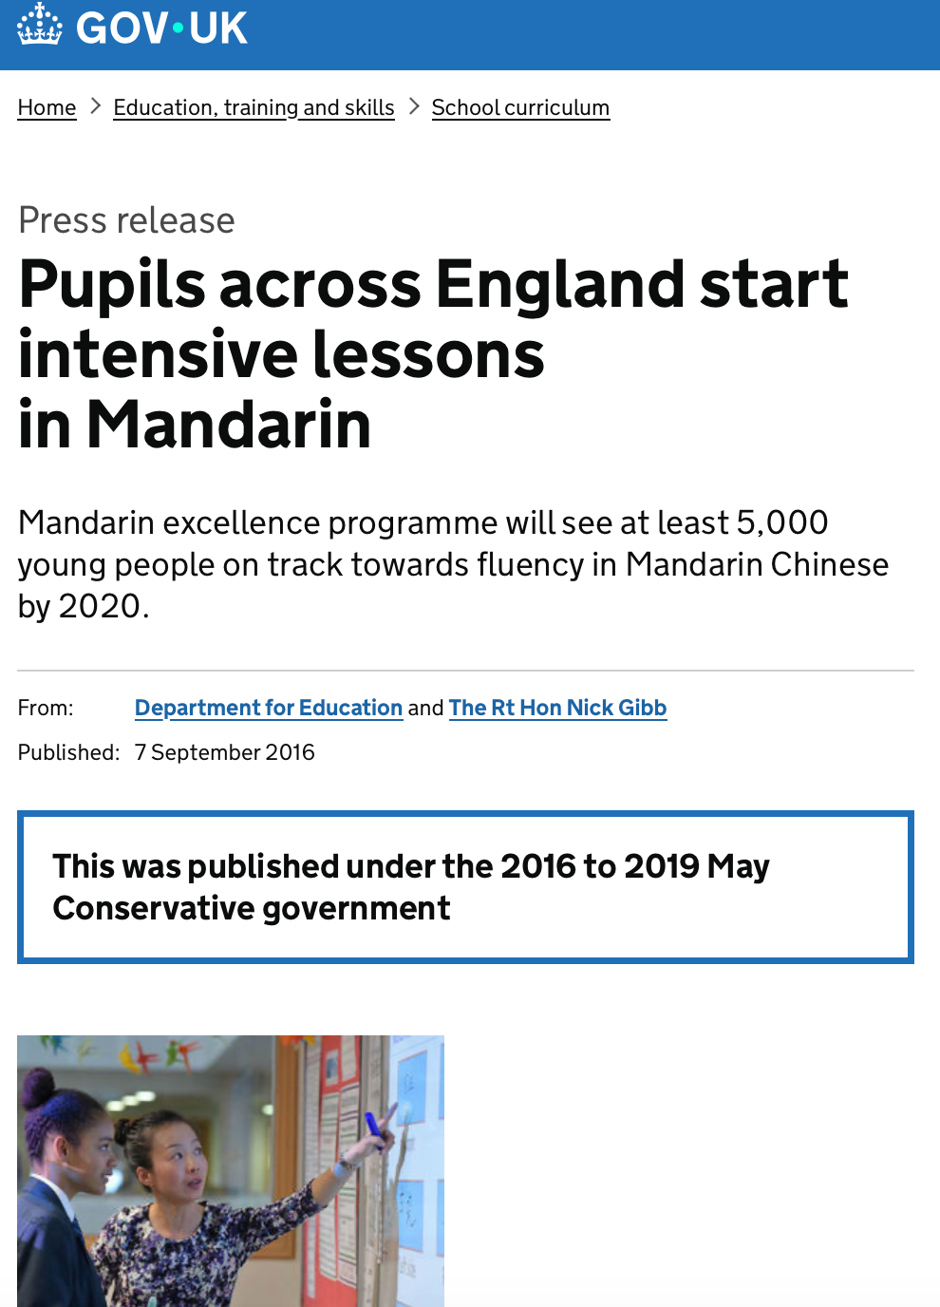
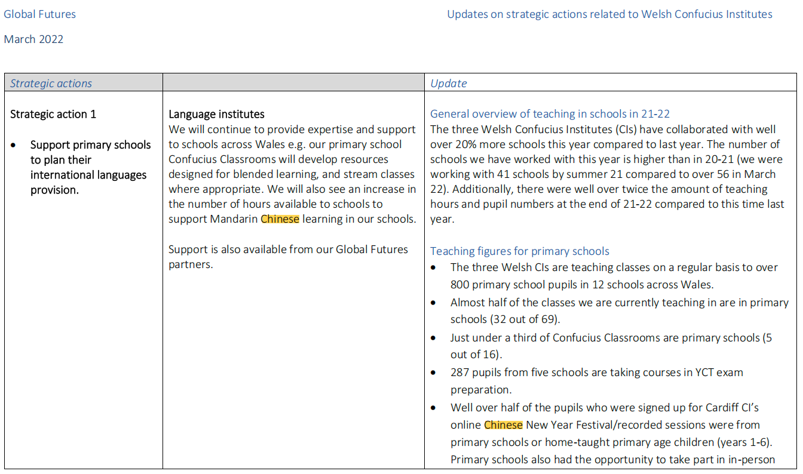

GOVERNMENT POLICY
What the policy says — and why it matters
DfE (2016) — Mandarin Excellence Programme
£10 million, 5,000 pupils, 8 hours of Mandarin a week — for pupils in England's state schools.
Welsh Government (2022) — Global Futures
From age 7, every pupil learns two foreign languages. Mandarin is named a priority.

Slide 5
CRITICAL EVALUATION
One official document, read with Ozga
Document: DfE (2016) news release — 'Pupils across England start intensive lessons in Mandarin'
WHAT PROBLEM DOES IT BUILD?
Mandarin is framed as a skill for British pupils, to help the UK win in the global economy.
WHAT DOES IT LEAVE OUT? (THE SILENCES)
No word about heritage learners, Saturday community schools, or migrant Chinese teachers.
WHY THIS MATTERS
The silences show who policy imagines as 'the learner' — and who it forgets.
Ozga (2000): policy texts are not neutral — they build problems and leave some voices out.

Slide 6
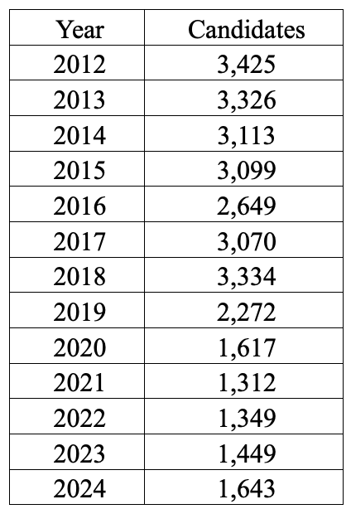
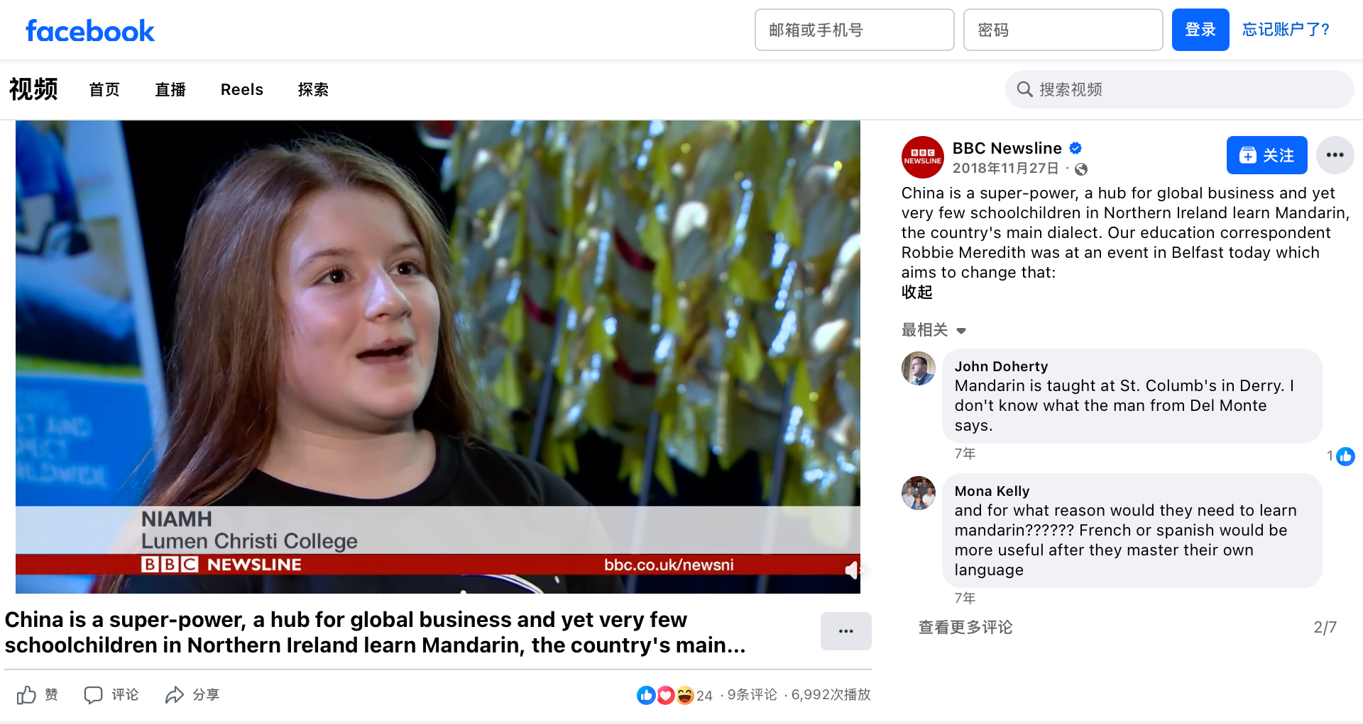
MEDIA TREATMENT · INTERNATIONAL CONTEXT
What the media says — and what the data shows
THE MEDIA SAYS
THE DATA SHOWS
'Mandarin is the language of the future.'
— BBC, The Guardian, 2015–2025
71% of A-level Mandarin entries come from private schools (Alcantara, 2014).
A-level Mandarin entries fell by about half from 2012 to 2024 (British Council, 2025).
INTERNATIONAL CONTEXT
Australia has funded community language schools since the 1990s. The UK has no such plan — this is a choice, not a lack of resources.

Slide 7
STAKEHOLDERS
Who cares about this issue? Four groups, four views
Government: economic advantage
Migrant teachers: recognition and work rights
Chinese learning in the UK
School leaders: a prestige subject for parents
Heritage families: identity and family ties
The four groups do not want the same things — that conflict is part of the problem.

Slide 8
QUESTIONS I HAVE STARTED TO ASK
Three questions for my study
01
How do UK and Welsh policy texts build an 'ideal' Mandarin learner — and who is left out?
02
What gaps do we see between policy talk and the real lives of heritage students and migrant teachers?
03
What would fairer policy look like, so more people can learn — and teach — Chinese?
Research I can build on: Alcantara (2014) on Chinese teaching in the UK; Li Wei (2011) on community schools; British Council (2025) on A-level Mandarin.

Slide 9
SAY WHAT YOU HAVE SAID
Conclusion
UK Mandarin policy is not neutral. It writes some people in — and others out.
WHAT I SAID
Aim: to look at Mandarin policy with a critical eye — who it helps, and who it leaves out.
Questions asked: who is the 'ideal' learner? What is left out? What would fairer policy look like?
NEXT STEPS
Read more policy texts with Ozga (2000). Talk to heritage students and migrant Chinese teachers.

Slide 10
References
1. Alcantara Communications. (2014). The teaching of Chinese in the UK. London: British Council.
2. Ozga, J. (2000). Policy research in educational settings: Contested terrain. Buckingham: Open University Press.
3. Bowe, R. & Ball, S. J. (1992). Reforming education and changing schools. London: Routledge.
4. Welsh Government. (2022). Global Futures, Our Languages. Cardiff: Welsh Government.
5. Chen, S. (2019). Motivations for pursuing postgraduate study in the UK: Perspectives of Chinese graduates of a Sino‑British cooperative university. (MSc dissertation). University of Oxford.
6. Liu, J. (2025). [Thesis on Chinese‑heritage young people’s language‑learning experiences in Britain]. Unpublished doctoral thesis.
7. Meng. (2026). Mandarin language policy in England: tensions between foreign‑language promotion and heritage‑speaker needs. Unpublished PhD thesis.
8. Xu, M. (2020). Time, class and privilege in career imagination: exploring study‑to‑work transition of Chinese international students. Journal of Youth Studies.
9. Tu, Y. (2019). Remain, return or re‑migrate: The mobility trajectory of mainland Chinese graduates in the UK. Journal of Ethnic and Migration Studies.
10. Marginson, S. (2014). Student self‑formation in international education. Journal of Studies in International Education, 18(1), pp.6‑22.

