Slide 1

Compassionate Management

Slide 2

Learning Outcomes for this session
The main principles of compassionate management
The importance of
self-compassion

Slide 3
Definition- Compassionate Leadership
Leaders who listen, understand and help
This creates a supportive environment that encourages the greater wellbeing of staff, leading to higher levels of innovation, engagement and ultimately performance
(West, 2019)
A good source – www.kingsfund.org.uk
Notes:
Move from top-down, controlling leadership to compassionate, collaborate leadership.

Slide 4
Four Behaviours of Compassionate Leaders
Attending (listening with fascination)
Understanding (needs of staff)
Empathising (caring for staff)
Helping (enabling staff to do their jobs)
The most important skill is listening and the most important task is helping staff to do their jobs.
Emotional Intelligence skills!

Slide 5
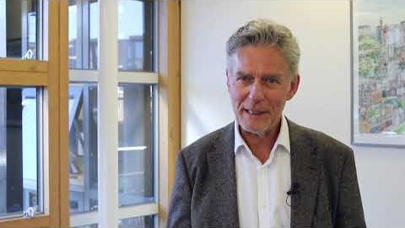
Michael West on Compassionate Leadership

Slide 6
Group Discussion
What issues might there be in the NHS that affect wellbeing?
How might compassionate leadership help?
Notes:
Long hours
Stress
Not having time to attend to basic needs – eating, toilet
Dealing with aggressive patients
Afraid of speaking up
Command and control leadership
Blame culture
Dealing with negative patient outcomes such as death and disability
Presenteeism
Absenteeism
High turnover of staff
Bullying
Harassment

Slide 7
The ABC of Staff Needs (based on Self-Determination theory)
Autonomy and control over what you do
Belonging (part of a team, feeling cared for)
Contribution (being able to do your job)
Notes:
Nurse and midwives have three core work needs that must be met to ensure wellbeing and motivation at work, and to minimise workplace stress.

Slide 8
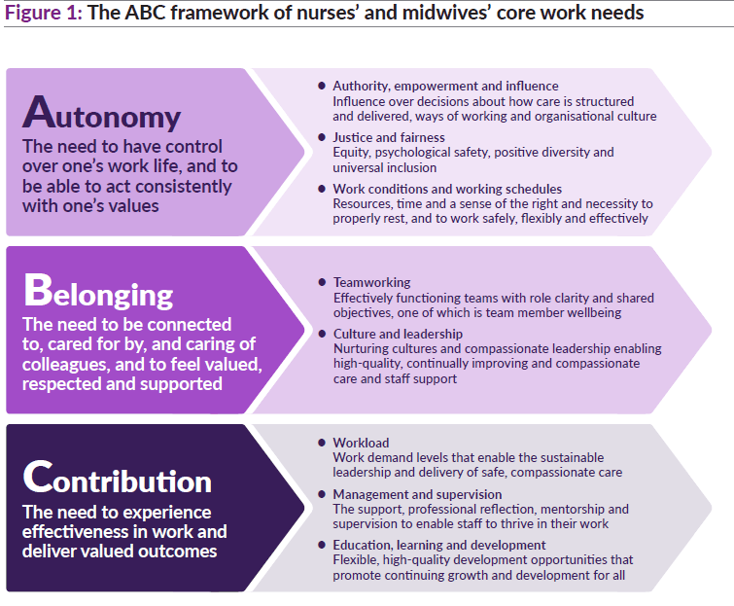
Notes:
Compassionate leadership provides an environment in which these staff needs can be met.

Slide 9
Recommendations (The KingsFund, 2020)
1: Authority, empowerment and influence
2: Justice and fairness
3: Work conditions and working schedules
4: Teamworking
5: Culture and leadership
6: Workload
7: Management and supervision
8: Learning, education and development
Notes:
Key recommendation 1: Authority, empowerment and influence
Introduce mechanisms for nursing and midwifery staff to shape the cultures and processes of their organisations and influence decisions about how care is structured and delivered.
Key recommendation 2: Justice and fairness
Nurture and sustain just, fair and psychologically safe cultures and ensure equity, proactive and positive approaches to diversity and universal inclusion.
Key recommendation 3: Work conditions and working schedules
Introduce minimum standards for facilities and working conditions for nursing and midwifery staff in all health and care organisations.
Key recommendation 4: Teamworking
Develop and support effective multidisciplinary teamworking for all nursing and midwifery staff across health and care services.
Key recommendation 5: Culture and leadership
Ensure health and care environments have compassionate leadership and nurturing cultures that enable both care and staff support to be high-quality, continually improving and compassionate.
Key recommendation 6: Workload
Tackle chronic excessive work demands in nursing and midwifery, which exceed the capacity of nurses and midwives to sustainably lead and deliver safe, high-quality care and which damage their health and wellbeing.
Key recommendation 7: Management and supervision
Ensure all nursing and midwifery staff have the effective support, professional reflection, mentorship and supervision needed to thrive in their roles.
Key recommendation 8: Learning, education and development.
Ensure the right systems, frameworks and processes are in place for nurses’ and midwives’ learning, education and development throughout their careers. These must promote fair and equitable outcomes.

Slide 10
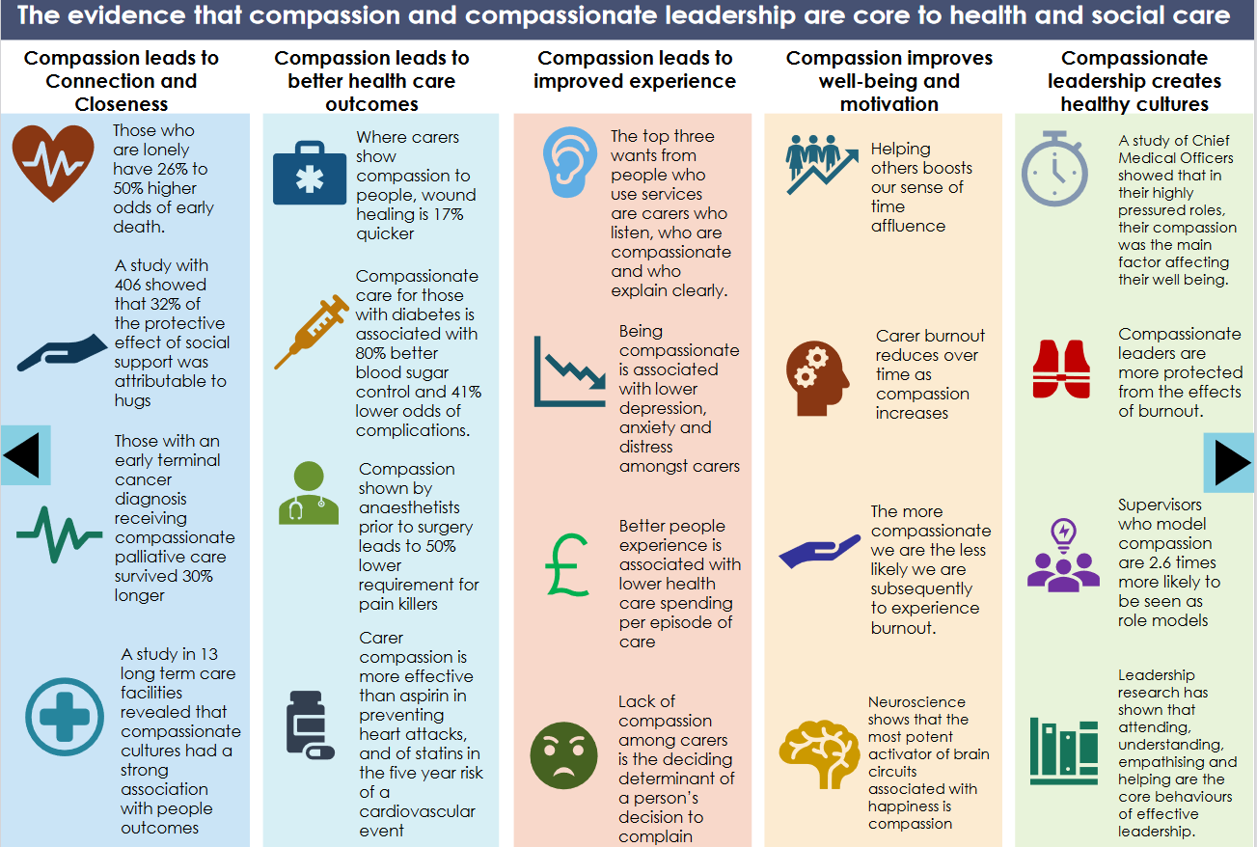
Notes:
Taken from the Draft leadership principles for health and social care in Wales.

Slide 11
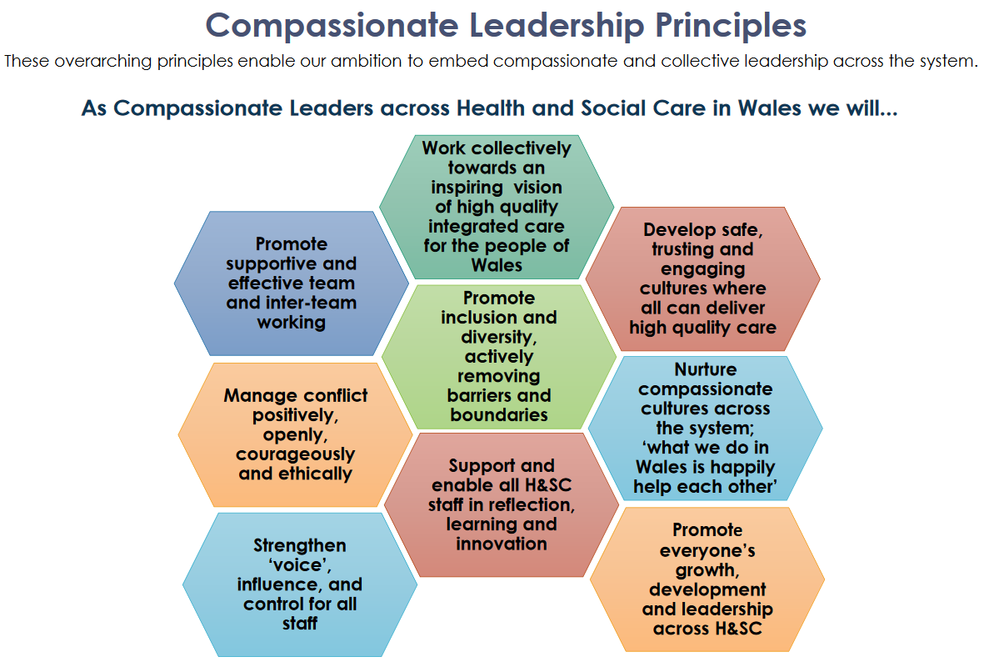
Notes:
HEIW, 2020
For more information, please visit the HEIW website.

Slide 12
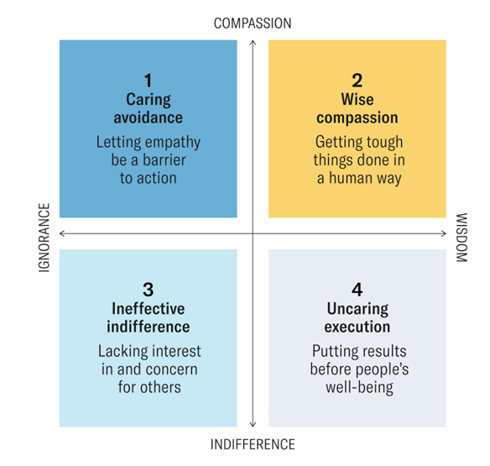
The Wise Compassion
Leadership Matrix
Notes:
‘It’s important to understand that these styles or modes of leadership do not necessarily indicate permanent, hardwired characteristics of a leader, but more often are indicative of a particular mood or mindset or context that a leader is operating in. In quadrant 1, at the top left, leaders care for people – which is great – but they tend to avoid the tough parts of leadership like giving hard feedback. In quadrant 3, bottom left, leaders are ineffective and indifferent, operating in a mode that is the opposite of mindful. Lacking both compassion and wisdom, these leaders appear to their followers as uncaring and unprofessional. In quadrant 4, at the bottom right, leaders are effectively executing on their business objectives, but have little compassion. Finally, in quadrant 2, at the top right – wise compassion – leaders deliver the best results. Leaders operating in this mode are balancing concern for their people with the need to move their organizations forward in an efficient, productive manner. When tough action is needed, they get it done with genuine caring for people’s feelings and well-being (Hougaard, Carter and Hobson, 2020).

Slide 13
Activity
Remember - Compassionate leadership involves noticing distress, interpreting it accurately, feeling empathic concern, and taking wise, boundaried action to support the person.
It is not ‘being nice’, rescuing, or avoiding accountability.
Consider the following scenarios in groups and answer the questions.

Slide 14
Scenarios
Performance Dip:
A high‑performing employee’s work quality suddenly drops. They seem withdrawn but insist they’re ‘fine’.
Overload:
A team member is overwhelmed and tearful. The leader wants to help but is under pressure to deliver results.
Boundary Blur:
A leader becomes the ‘go‑to’ emotional support for a team member, and it’s starting to affect the leader’s own wellbeing.
Fairness Tension:
One employee needs flexible working due to a personal crisis. Others feel this is ‘special treatment’.

Slide 15
Questions
What compassionate leadership behaviours are needed here?
Attending (listening with fascination)
Understanding (needs of staff)
Empathising (caring for staff)
Helping (enabling staff to do their jobs)
What risks or unintended consequences might arise?
What would a wise compassionate action look like in this situation?

Slide 16
Reflection
Which element of compassionate leadership do you find most challenging (attending, understanding, empathising, helping)?
How could you develop this capacity as future leaders?

Slide 17
Leaders need to start with Self-compassion
What are your stressors?
What are your needs?
You need to be a good role model and also be in a good place yourself to lead others
Also important to show vulnerability, which breeds trust

Slide 18
Activity – Self-Compassion
How could you be more self-compassionate?
In pairs, think of a few phrases you could say to yourself the next time you make a mistake or feel guilty about something that may have been your fault.
What phrases could you say to yourself to motivate yourself to get through a hard or challenging time?

Slide 19
Activity
Form pairs
Play one round of ‘rock, paper, scissors’ in your pair
If you lose, your job is to support (cheer on!) the winner in the next round
Winners keep on playing each other and losers keep on supporting the winners, until there is an overall winner
Purpose of activity – to practice healthy competition and an overall supportive culture which supports wellbeing.

Slide 20
Rules of the Game – 3 rounds
Scissors and paper – scissors wins
Scissors and rock – rock wins
Rock and paper – paper wins

Slide 21

Avoidable Employee Harm

Slide 22
What is ‘Avoidable Employee Harm?’
Avoidable employee harm refers to the unnecessary psychological, professional and organisational damage caused by poorly designed or poorly delivered organisational processes—especially disciplinary investigations.
Traditional disciplinary and investigation processes can unintentionally cause significant harm to employees, witnesses, managers and HR practitioners.
Harm includes stress, anxiety, reputational damage, isolation, loss of trust, and long‑term wellbeing impacts.
Harm is often process‑driven, not misconduct‑driven—meaning it is preventable.
Avoidable harm arises when organisations prioritise procedural compliance over human experience.

Slide 23
From Avoidable Patient Harm to Avoidable Employee Harm
Patient Harm – medication errors, unhygienic practices, diagnosis errors, radiation, removing incorrect organs
Employee Harm – investigations, organisational change, speaking up, retraumatising employees, performance management . . . .

Slide 24


Slide 25
Where in your own work or placement experience have you seen a process cause more harm than the original issue?

Slide 26
Why Investigations Cause Harm
Investigations are inherently stressful, but the way they are conducted determines whether harm is minimised or amplified.
Investigations often create a ‘climate of fear’, where employees feel scrutinised rather than supported.
Common harm‑creating factors:
  Excessive formality and legalism
  Long delays and lack of communication
  Poorly trained investigators
  Over‑reliance on punitive frameworks
Harm can also spread to managers, HR teams and organisational culture, not just the employee under investigation.
Activity - Identify which of the above factors you think is most harmful and justify your reasoning.

Slide 27
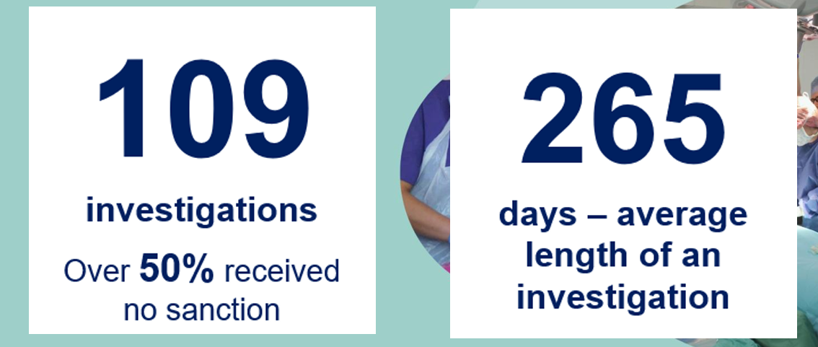
Aneurin Bevan University Health Board Statistics

Slide 28
The Ripple Effects: Individual, Team and Organisational Harm
Avoidable harm is not contained to one person—it radiates across the organisation.
Individual harm: emotional distress, reduced confidence, sickness absence, long‑term wellbeing issues.
Team harm: mistrust, fear of speaking up, reduced collaboration, ‘us vs them’ dynamics.
Organisational harm: reputational damage, financial cost, increased turnover, weakened psychological safety.
Harm can become cultural, embedding fear and risk‑aversion.
How might avoidable harm undermine an organisation’s stated values (e.g., compassion, inclusion, integrity)?

Slide 29
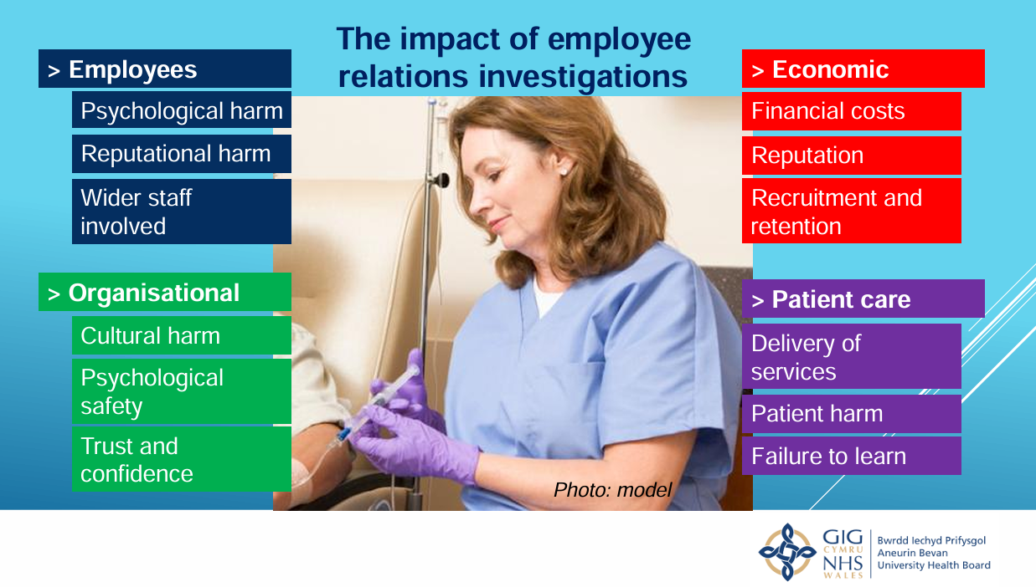

Slide 30
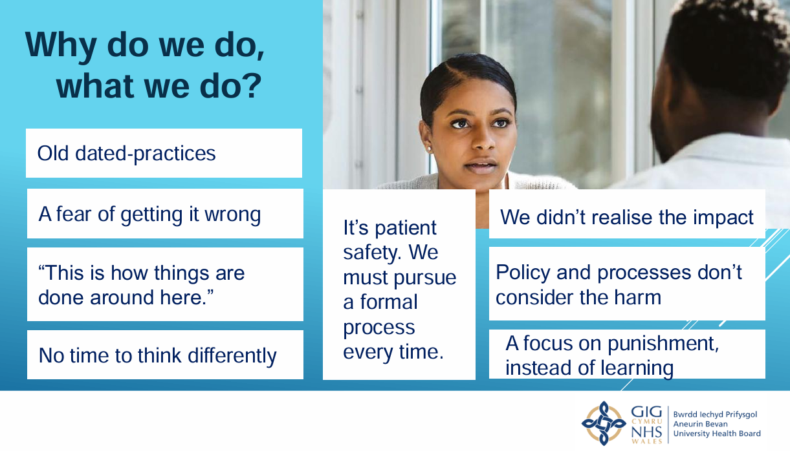

Slide 31
What Good Looks Like: A Wellbeing‑Centred Investigation Approach
The book ‘Under Investigation’ calls for a mindset shift—from process‑first to wellbeing‑first.
A wellbeing‑centred approach includes:
  Early triage to determine whether a full investigation is necessary
  Proportionate responses rather than defaulting to formal processes
  Trauma‑informed communication and transparency
  Skilled, impartial investigators trained in empathy and fairness
HPMA guidance stresses the importance of support mechanisms for all parties, including managers and HR.

Slide 32

Activity
Rewrite a traditional investigation step (invite to formal meeting) in a people‑centred way (see handout).

Slide 33
Reducing Avoidable Harm: Practical Strategies for Managers
Harm reduction is a deliberate practice requiring capability, culture and courage.
Before an investigation:
  Use alternative resolution methods (mediation, facilitated conversations).
  Assess risk of harm and plan mitigations.
During an investigation:
  Maintain regular communication; avoid ‘information black outs’.
  Provide psychological support and signposting.
  Ensure timelines are reasonable and transparent.
After an investigation:
  Debrief all parties.
  Repair relationships and rebuild trust.
  Review the process for learning and improvement.
Reflection Question Which stage—before, during or after—do you think organisations most often neglect?

Slide 34
A Call for Professional Change
Harm reduction is a professional responsibility for people managers, not an optional extra.
The book ‘Under Investigation’ calls on HR to transform disciplinary practice, embedding compassion and evidence‑based decision‑making.
HPMA’s stance: HR must lead the shift from procedural guardians to wellbeing‑centred practitioners.
Avoidable harm reduction aligns with:
  Psychological safety
  Just culture principles
  Modern people‑centred HR practice
Harm is not just an ethical issue—it is a strategic and organisational performance issue.

Slide 35

Questions for Mark Stevenson – Chief People Officer, South Wales Police

Slide 36
Useful Sources
Leading with Compassion Has Research-Backed Benefits (hbr.org)
See Moodle for reports on Trauma Informed Management
Under Investigation

Slide 37
What have we learnt?
Compassionate management is a key component of trauma informed management
It is a relational style of management, that is people-centred
It involves attending, understanding, empathising and helping
Wise compassion means decisions are people centred and avoid harm
Self-compassion is the foundation of compassionate management
The NHS has coined the phrase ‘avoidable employee harm’
A compassionate, people-centred approach helps to mitigate harm

