Slide 1







Use of Assistive Living Technology to Promote the Independence of Older Adults in the Digital Age
Charlotte Reed
2109016
27/02/2023
Organisational Change – Pobl Group Case Study
Notes:
Introduction

Slide 2
What is ‘change?’
“make (someone or something) different; alter or modify”
“replace (something) with something else, especially something of the same kind that is newer or better; substitute one thing for (another)”
[Oxford Languages & Google, n.d.]
“delivery of a new asset, process, structure or system”
“key drivers include strategic direction, new products and services, technology, regulatory requirements and the need to improve efficiency”
[Association for Project Management, 2017]
Charlotte Reed
2109016
27/02/2023
Notes:
Generally and in relation to business

Slide 3






= People [Pobl, 2020]
Charlotte Reed
2109016
27/02/2023
Notes:
Pobl – not for profit committed to supporting individuals in low income areas
Started out as a collective of social landlords, providing affordable housing to vulnerable people – expanded: throughout Wales, West England. Lower income areas, accommodation care and support including accommodation support and guidance, drop in support centres and floating support
Values – identify as PCC
Ambitions 2020 – 2030
Focus on care and support – residential services [4 homes in Wales]

Slide 4

Assistive Living Technology [ALT]
Assistive technology: “maintain or improve an individual’s functioning and independence, thereby promoting their well-being” [World Health Organization, 2018]
Isolating consequences of pandemic led for an increased need for assistive technology, particularly digital technology
Charlotte Reed
2109016
27/02/2023
Notes:
Give examples

Slide 5
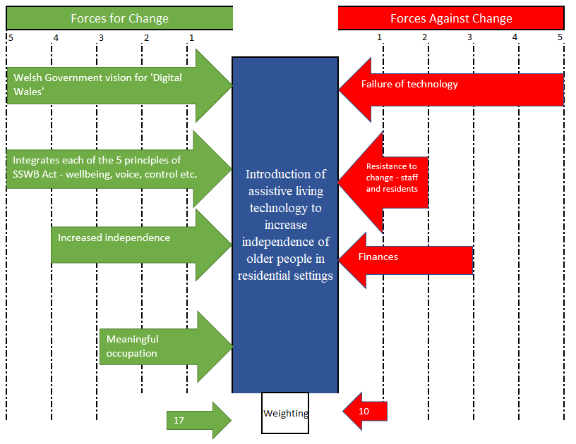
Kurt Lewin’s
Force Field Analysis
Prior to Pandemic
[model sourced from Cameron and Green, 2009]
Originally a planned and incremental change, in line with expectations outlined in the Social Services and Well-being Act, 2014
[Care Council for Wales, 2017]
Charlotte Reed
2109016
27/02/2023
Notes:
Planned change - Reliant on stable conditions (Burnes, 2004)
Driver of change – social/cultural, based on social model of disability
SSWB Act – consequences of an aging population, increased emphasis on citizen engagement, prevention and early intervention of care to avoid need for costly long-term care, well-being and co-production

Slide 6
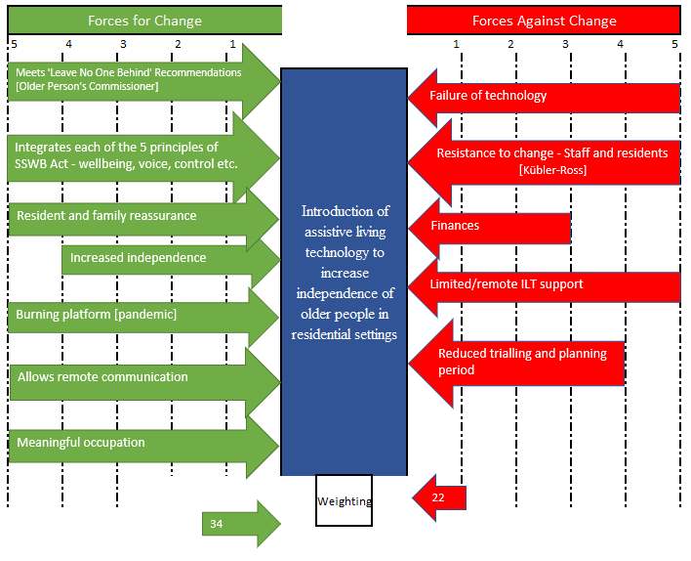

Planned to Emergent
Enabled creation of a ‘burning platform’
Increased resistance from staff and residents [change curve cited from Esther, 2020]
Kurt Lewin’s
Force Field Analysis
During Pandemic
Charlotte Reed
2109016
27/02/2023
Notes:
Emergent Change
Driver for change became crisis management, unplanned and rapid change. Needed to redirect resources and processes – firstly PPE and safety, then mental health and wellbeing long-term
Burning platform

Slide 7
Kotter x Lewin [sourced from Esther, 2020]
Kurt Lewin | John Kotter | Pobl
Unfreeze | Urgency [burning platform] Guiding coalition Vision and strategy Communicate the change | Closed residential services 2 weeks prior to national lockdown Set out new expectations regarding health and safety, infection control Priority = safeguarding, even through use of restriction
Change | Empower action Short-term wins Consolidate gains & make more change | Ensured staff had the training, equipment and resources Invested in well-being services Pobl stories ALT – inside activities
Refreeze | New culture – anchor approaches | The ‘new normal’
Notes:
Change models Unfreeze, make the change, refreeze new policies/procedures/processes etc.
Eight accelerators

Slide 8
PESTLE Analysis [Weighted based on impact 1 – 10]
Political
Economic
In 2016, adult social care’s GVA was approximately £1.2 billion, most of which was estimated to be residential care (£328 million). Representing 1.9% of total GVA in Wales [ICF Consulting Limited, 2018] [7]
WG currently dealing with £1.1 billion shortfall due to Brexit [Welsh Government, 2022] [9]
Social
“…higher proportion of digitally excluded people in older age groups…” [Digital Communities Wales, 2021] [5]
Globally, one billion more people will require ALT by 2050 [Gilbert, 2022] [8]
CSR: emphasis on accountability and moral practices [4]
Regulated by Welsh Government and Care Inspectorate Wales [8]
Technology
Environment
Legal
Only 1 in 10 people with a need have access to ALT [ATLAS, 2022] [8]
Commitment to net zero by 2050, although Welsh public sector aim to be by 2030 [Heaney, 2022] [8]
Human Rights Act, 1998 [10]
Post-pandemic - “Digital access now needs to be considered as a right and as an essential utility [for older people] in the same way we consider the need for gas and electricity” [Older People's Commissioner for Wales, 2020] [10]
SSWB (Wales) Act 2014 – voice and control, co-production, well-being, prevention and early intervention, multi-agency [10]
Multi-agency: “…the availability of ALT on its own cannot fully maximise any impact it might have – it needs to be successfully embedded into a supportive service…” [Skills for Care, 2013] [8]
Digital Communities Wales: aim to improve access to digital ALT and the internet for older adults – as outlined in WG national strategy [Digital Communities Wales, 2021] [10]
Global ALT market estimated at £19.2 billion in 2021, set to increase to £26.7 billion in 5 years [ATLAS, 2022] [6]
HSC budget with Welsh Government has increased year on year [Welsh Government, 2023] however, avoidable hospital admissions are high. suggesting insufficient funding in primary services [OECD, 2021] [8]
General cultural shift toward inclusive societies – social model, holistic/person-centred support, Humanistic approach, least restrictive option etc. [7]
Digital divide – older people lack confidence when using digital technology alone [Older People’s Commissioner for Wales, 2020] [5]
Greater emphasis on remote communications and working since pandemic, including remote health and support consultations [Business Wales, 2023] [10]
Estimated annual emissions from care sector as of 2020 ~460,000 tCO2e [5]
Equality Act, 2010 [10]
Mental Capacity Act, 2005 [10]
UN Convention on the Rights of Persons with Disabilities, 2006 [10]
Charlotte Reed
2109016
27/02/2023
Notes:
Current times, focus on more impactful factors

Slide 9
SWOT Analysis [Weighted based on impact 1 – 10]
Strengths | Weaknesses
- Experienced and knowledgeable staff and management teams with low turnover [10] - Strong capital and investment opportunities [10] - Access to multiple revenue streams [10] - Individualised support based on customer needs and abilities [10] - Large value in tangible and intangible assets [10] - Varied flexible working options [8] - Largest registered social landlord [10] | - Gender pay gap – female dominated care and support [6] - Large reliance on WG funding [10] - Customer satisfaction scores have reduced [6] - Compliance issues due to social distancing measures during pandemic [6] - Resulting backlog of work [10] - Reduced morale following pandemic [8] - Co-productive plan reviews [10]
Opportunities | Threats
- Phase 2 of TAPPI Project [Housing LIN, 2021] [10] - Co-production of care and support packages = individualised consumer experience [10] - Networking events to attract local businesses to ‘green training’ initiative and regenerative building activities – revenue generation [9] - Strong links with local authorities, training providers and Welsh Housing Partnership [10] - Pobl Zero Carbon Cutting Strategy [10] - Digital First strategy, including increased use of ALT [10] | - Funding decarbonisation is a financial risk [8] - Cost of living crisis may put many tenants/customers at financial risk [10] - Cyber threats due to increased use of cloud based systems (remote working) [6] - HSC labour shortages/ increased dependence on agency workers [10]
Charlotte Reed
2109016
27/02/2023
Sourced from Pobl’s Annual Report [Pobl, 2022] & Care Inspectorate Wales Reports for Pobl’s Residential Services
Notes:
Internal factors affecting the change, based on findings from CIW reports and Pobl’s annual report –
00011052-ryxx_c_30112022_e.pdf (careinspectorate.wales)
00011049-wpsf_c_19012022_e.pdf (careinspectorate.wales)
00011050-tncw_c_05072022_e.pdf (careinspectorate.wales)
00011051-xnfh_c_22082022_e.pdf (careinspectorate.wales)
Annual Report- 2022 - 10 August (poblgroup.co.uk)

Slide 10
Conclusion
Pobl has successfully passed Phase 1 of TAPPI research initiative and received funding for Phase 2
Low staff turnover and increased spending in employee well-being services
Compliance and best practice – SSWB Act, UN Convention, Equality Act, cultural shifts [social model of disability]
What next?
Bespoke equipment funded by TAPPI
‘Library of things’ – bespoke, person-centred

Slide 11
References
Association for Project Management, 2017. In: Introduction to Managing Change. Buckinghamshire: APM, pp. 2, 5, 28.
ATLAS, 2022. AssistiveTech in the UK 2022. [Online] Available at: https://analytics.dkv.global/AssistiveTech-in-UK-2022.pdf [Accessed 20 02 2023].
Burnes, B., 2004. Kurt Lewin and the Planned Approach to Change:. Journal of Management Studies, 41(6), pp. 977-1002.
Business Wales, 2023. Digital services introduced in NHS Wales during coronavirus are here to stay. [Online] Available at: https://businesswales.gov.wales/walesruralnetwork/news-events-and-case-studies/news/digital-services-introduced-nhs-wales-during-coronavirus-are-here [Accessed 20 02 2023].
Cameron, E. & Green, M., 2009. In: Making Sense of Change Management 2nd Edition. London: Kogan Page Limited, pp. 110 - 113.
Care Council for Wales, 2017. The main principles underpinning the Act: voice and control, prevention and early intervention, well-being, co-production and multi agency. [Online] Available at: https://socialcare.wales/cms-assets/documents/hub-downloads/Principles-Resource-Guide_March-17.pdf [Accessed 17 02 2022].
Digital Communities Wales, 2021. Digital inclusion in Wales. [Online] Available at: https://www.digitalcommunities.gov.wales/digital-inclusion-in-wales-2/ [Accessed 20 02 2023].
Esther, C., 2020. In: Making sense of change management : a complete guide to the models, tools and techniques of organizational change. 5th ed. London; New York: Kogan Page, pp. 134 - 137, 256 - 258.
Gilbert, C., 2022. WHO: One billion more people will need assistive technology by 2050. [Online] Available at: https://abilitynet.org.uk/news-blogs/who-one-billion-more-people-will-need-assistive-technology-2050 [Accessed 20 02 2023].
Heaney, A., 2022. Decarbonising Social Care in Wales. [Online] Available at: https://www.gov.wales/sites/default/files/publications/2022-07/decarbonising-social-care-in-wales.pdf [Accessed 20 02 2023].
Housing LIN, 2021. The TAPPI Inquiry Report: Technology for our Ageing Population: Panel for Innovation – Phase One. [Online] Available at: https://www.housinglin.org.uk/Topics/type/The-TAPPI-Inquiry-Report-Technology-for-our-Ageing-Population-Panel-for-Innovation-Phase-One/ [Accessed 23 02 2023].
ICF Consulting Limited, 2018. The Economic Value of the Adult Social Care sector - Wales: Final Report, London: Skills for Care and Development.

Slide 12
References
OECD, 2021. Avoidable Hospital Admissions. [Online] Available at: https://www.oecd-ilibrary.org/sites/eeeae3eb-en/index.html?itemId=/content/component/eeeae3eb-en#:~:text=The%20average%20rate%20for%20OECD,100%20000%20population%20in%202019. [Accessed 20 02 2023].
Older People's Commissioner for Wales, 2020. Leave no-one behind. [Online] Available at: https://olderpeople.wales/library/Leave_no-one_behind_-_Action_for_an_age-friendly_recovery.pdf [Accessed 17 02 2023].
Oxford Languages & Google, n.d.. Google search - What is Change?. [Online] Available at: https://www.google.com/search?q=what+is+change&sxsrf=AJOqlzUpZ8cRDCvefdYJoR15mQfvPmBpxQ%3A1676990386314&source=hp&ei=stf0Y7axEZK6gQaelb3wBQ&iflsig=AK50M_UAAAAAY_TlwjSlNa9mxH0ofsA7EqdZQst3_2Un&ved=0ahUKEwi20pCC7Kb9AhUSXcAKHZ5KD14Q4dUDCAo&uact=5&oq=what+is+ [Accessed 17 02 2023].
Pobl, 2020. Our Pobl Ambitions. [Online] Available at: https://www.poblgroup.co.uk/about-us/poblambitions/#:~:text=Our%20Pobl%20Ambitions%20sets%20out%20our%20vision%20for,making%20an%20even%20bigger%20di%C2%ADfference%20to%20people%E2%80%99s%20lives. [Accessed 20 02 2023].
Pobl, 2022. Pobl Annual Report. [Online] Available at: https://www.poblgroup.co.uk/wp-content/uploads/2022/09/Pobl-Group-Annual-Report-2022.pdf [Accessed 20 02 2023].
Skills for Care, 2013. Assisted living technology and services: A learning and development framework. [Online] Available at: https://www.skillsforcare.org.uk/resources/documents/Developing-your-workforce/Care-topics/Assisted-living-technology-ALT/ALT-learning-and-development-framework-full-document.pdf [Accessed 19 02 2023].
Welsh Government, 2022. Budget to “protect public services and the most vulnerable”. [Online] Available at: https://www.gov.wales/budget-to-protect-public-services-and-the-most-vulnerable#:~:text=An%20extra%20%C2%A3165%20million,Living%20Wage%20in%20social%20care. [Accessed 20 02 2023].
Welsh Government, 2023. Welsh Government budgets. [Online] Available at: https://www.gov.wales/welsh-government-budgets#id_2023to2024 [Accessed 20 02 2023].
World Health Organization, 2018. Assistive Technology. [Online] Available at: https://www.who.int/news-room/fact-sheets/detail/assistive-technology [Accessed 17 02 2023].

