Slide 1
BMBM5024
Marketing In Practice
SOSTAC – Action and Control

Slide 2
Lesson Objectives
At the end of the session students should be able to
Explain each component of the “Action” Stage – Looking specifically at task allocation and the use of a Gantt chart
Identify what metrics will be used in the “Control” Stage to monitor progress and what metrics can be used
Apply the different metrics used in the “Control” Stage in an activity
After the taught lecture – the lesson time will be used as an assignment workshop

Slide 3
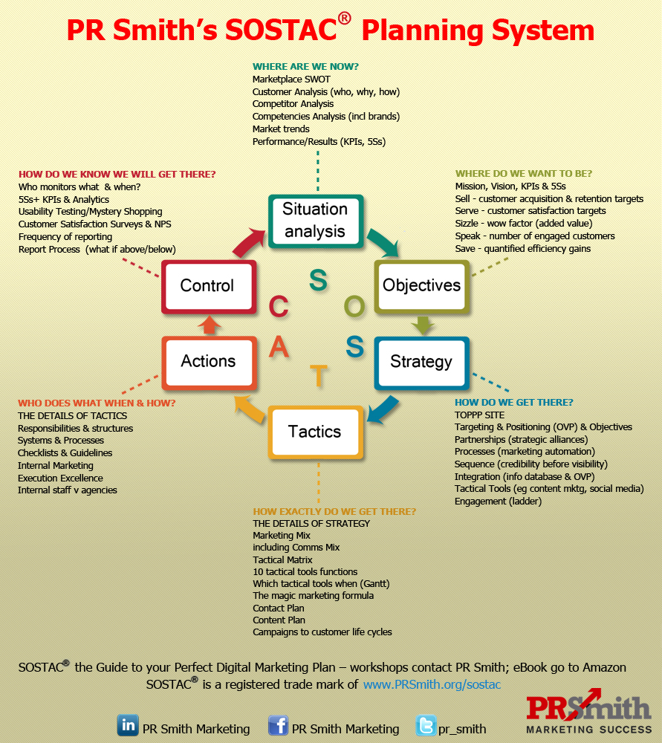

Slide 4
‘Action’ Stage of SOSTAC
The ‘Action’ stage covers responsibilities and scheduling of the tasks detailed in the ‘Tactics’ of the marketing plan.
  Who does what?
  When does it happen?
Tasks can be clearly and effectively scheduled using a GANTT CHART
A Gantt chart is a visual presentation which breaks down project tasks over a time period using coloured bars .
  The horizontal axis represents the total time span and task sequence based on daily, weekly or monthly frequency.
  The vertical axis shows the specific tasks that need to be completed.
  Project managers use such charts to update and monitor resources and team members along the way to achieve the final goal.
This can be easily designed in Microsoft Excel or using a Gantt Chart template.

Slide 5
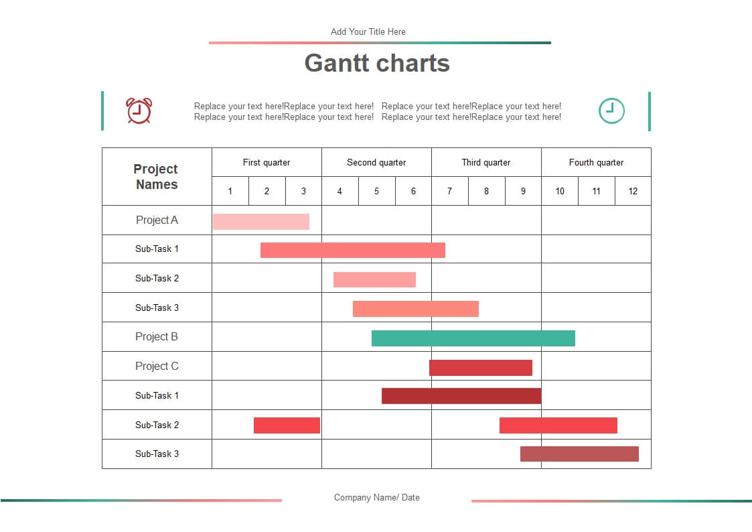
Gantt Chart

Slide 6
Useful Resources
Summary Article on Gantt Charts - https://www.investopedia.com/terms/g/gantt-chart.asp
Building a Gantt Chart in Excel - https://youtu.be/aQnp31VWESs?si=MwlXfC_rZLdR-yfF

Slide 7


‘Control’ Stage of SOSTAC
You should NEVER run a marketing campaign without tracking progress along the duration of the plan. – Why should we track progress?
The ‘Control’ element of SOSTAC covers what you are going to measure to track the implementation of your plan against objectives.
Marketers use ‘Marketing Metrics’ to monitor, record, and measure progress over time. The metrics themselves are varied and can change depending on the objectives of the plan.
Marketers must focus on their objectives and choose the metrics that will track their successes and failures. Although there are many working metrics you could keep track of, you need to select specific metrics for key elements of each plan.

Slide 8

Why Should You Track Progress?
According to a Google study in partnership with MIT, 89% of leading marketers use strategic metrics, like gross revenue, market share, or CLV, to measure the effectiveness of their campaigns. Some of the benefits of using these and other metrics include:
Having data to support informed decision making
Knowing which channels provide the highest ROI (Return on Investment)
Justifying marketing spend and overall budget allocations
Increasing results across the board
Identifying where and how to optimise conversion rates

Slide 9

What Should You Measure?
What you measure will relate directly to the objective of your marketing plan.
You should specify exactly what metric you will measure
When you will measure it e.g. weekly, monthly etc
Who is responsible for measuring and reporting each metric
What will you do with the information?
How will you report it?
How will it change decisions?

Slide 10

Selecting Your Key Metrics – What should you be measuring?
You should choose metrics that are directly connected to:
  Your marketing plan objectives
  Your desired outcomes
  Your chosen strategy
It is not necessary to chase every metric, so choose your metrics carefully and justify why they are critical to success.
KPIs (Key Performance Indicators) can be used to measure progress toward an intended result.

Slide 11

Key Metrics – Return on Investment (ROI)
ROI is a versatile metric that measures how much money your company earns compared to how much it invests. – You can all use this – What does ROI show?
Once you measure if the funds you devoted to a marketing campaign benefited the company, you can decide how much money to allocate toward future projects.
For instance, a high ROI can indicate that a brand spending a lot of money marketing is also receiving a lot of money in return.

Slide 12
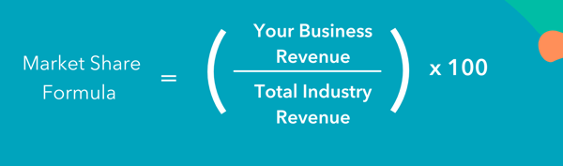
Key Metrics – Market Share
How could this be useful?
Market share is the percentage of an industry's sales that a particular company owns
Market share is typically calculated for a specific period, e.g. yearly or quarterly sales, and is sometimes separated by region.
Market share can be calculated by volume (number of units sold) or value (sales revenue)
What Is Market Share & How Do You Calculate It? (hubspot.com)

Slide 13
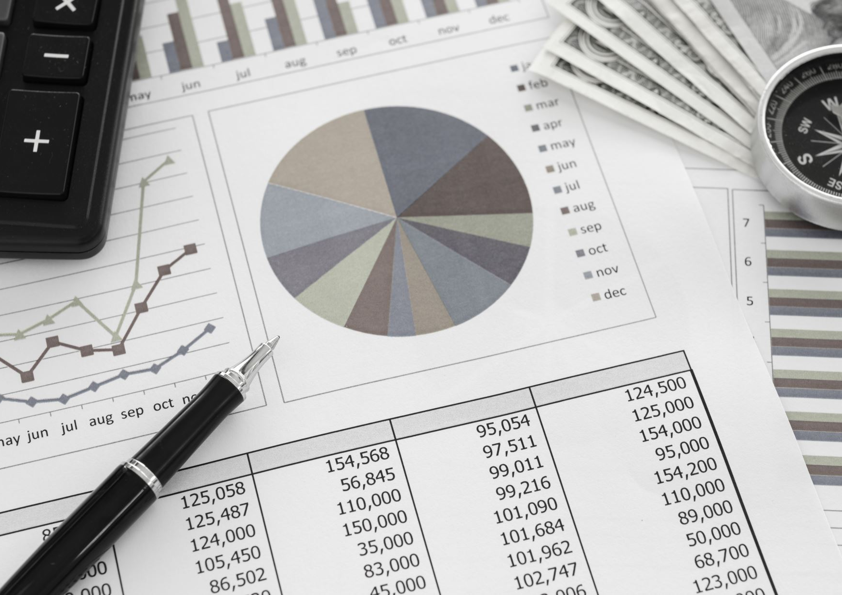
Key Metrics – Cost Per Acquisition (CPA)
Cost per Acquisition – How much you spend to gain each new customer
  CPA = Campaign Cost / Number of conversions
  Why is this useful?
You can calculate your overall CPA as an indicator of your overall success with your marketing budget.
Channel level CPA is routinely utilised to optimise the budget allocations to different marketing channels.

Slide 14
Key Metrics - Cost per Lead (CPL)
Cost per lead measures the £ amount of each new lead by campaign, channel, or overall spending.
This sales and marketing metric helps users create better goals, track ROI, and adjust budgets accordingly. Budgets related to CPL include items such as paid ad placements and social media monitoring platforms.
Formula:
Calculations like these are useful to do on a monthly or quarterly basis.
Total £ Spent on Marketing / Total No. of new leads (in x period)

Slide 15

Key Metrics – Click Through Rate (CTR)
Click-through rate (CTR) is the number of times an ad, link, or website is clicked on, compared to the number of impressions. – What do you think this shows us?
High click-through rates (around 4%) mean the copy displayed is persuasive and well-placed. Once a user has clicked through, however, the rest of their experience has to line up with their expectations for taking the action in the first place.
How to measure it: Paid ad platforms like Facebook offer this data for free within the platform. You can use a calculator like the one created by WebFX by manually entering your total number of clicks and impressions.

Slide 16
There are many more metrics you could select depending on the objective and strategy you have selected for your marketing plan
A Complete Guide to Marketing Metrics | Wrike
20 Examples of Marketing Metrics and KPIs (With Definitions) | Indeed.com

Slide 17
Activity
Using the companies you have chosen for your assignments
Choose 2 KPIs you believe would be suitable in measuring your campaign/ an aspect of your campaign
Justify your choices
25 minutes

Slide 18

Feedback
What did you find? – Please share your answers.

Slide 19
Break
Please take a well-deserved break and rejoin in 20 minutes

Slide 20
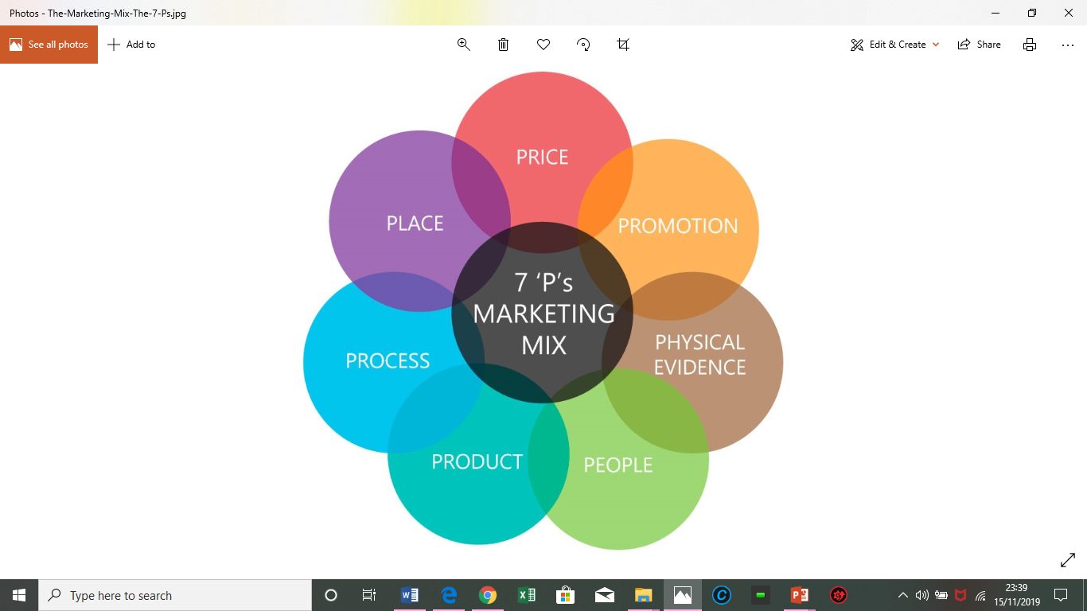
The Marketing Mix (7Ps)
Remember – The 7Ps make up the tactical stage

Slide 21
Assignment 2
Develop a strategic marketing plan that contains marketing objectives and a new marketing mix that will deliver the new strategic marketing direction.
Follow the SOSTAC planning framework

Slide 22
Situation Analysis
Situation – Briefly summary of the situation analysis – a few key points
Identify and justify the new strategic marketing direction for your organisation.
  Ansoff Matrix – select a clear growth strategy
  Identify details of the new direction
  Justify – reasons for this choice supported by referenced data

Slide 23
Objectives
Briefly explain the role of marketing objectives theoretically – with reference
Identify clear SMART objectives for your marketing plan
  Two or three objectives
Justify why these objectives were selected

Slide 24
Strategy
Clearly define the target market for the marketing campaign
  justify your choice with marketing theory and research data support
Define the broad marketing strategy that you will follow.
  Positioning
  Broad overview of marketing mix decisions

Slide 25
Tactics
The details of the marketing mix – specific decisions for each of the 7Ps.
Focus on the 7P areas most relevant to your new direction and objectives.
Justify decisions made with support from marketing theory and market research data.
You may use tables to succinctly present information

Slide 26
Action
Scheduling of activities and tasks.
  GANTT chart is useful
  Briefly explain and justify allocation.

Slide 27
Control
Briefly explain the role of marketing metrics with reference
Identify clear metrics for your plan
  What will you measure?
  When?
  Why?
  How will this support the implementation of the plan?

