Slide 1
Corporate Governance
Governance and management, and
Shareholders role
Dr Konstantina Mari

Slide 2
Governance and management
Defining corporate governance—relationship
The relationship among various participants in determining the
direction and performance of corporations. The primary
participants are the shareholders, the management, and the
board of directors.
The corporate governance structure specifies the distribution of
rights and responsibilities among the different participants in the
organization—such as the board, managers, shareholders, and
other stakeholders—and lays down the rules and procedures
for decision-making.

Slide 3
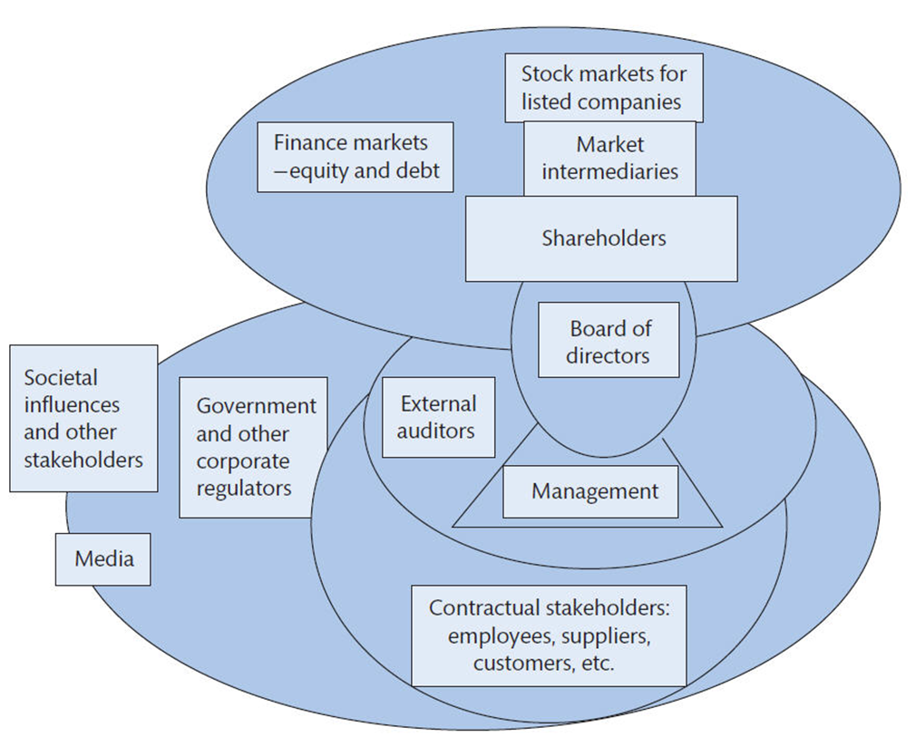
The spheres of corporate governance
Figure 2.1: The scope of corporate governance

Slide 4
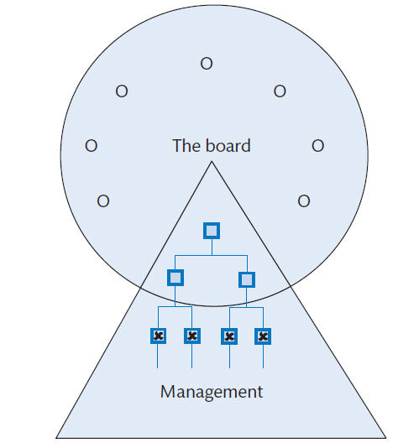
Governance and management
The essence of governance
Figure 2.2: The board and management

Slide 5
Governance and management

Slide 6






Governance and management
Board Structure
INED
ED
Co. Secretary
Investment
(Compliance
Manager
Officer)
General
Manager

Slide 7
Governance and management
Management runs the business:
The board ensures that the business is well run
and running in the right direction.

Slide 8
Kinds of board structures
  All executive board
  Majority executive board
  Majority non-executive board
  All non-executive board

Slide 9
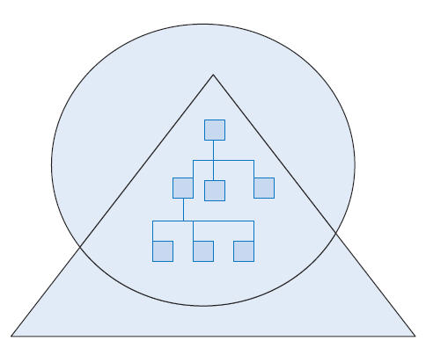
The all-executive board
Figure 2.3: The all-executive director board (Unitary Board)

Slide 10

The majority executive board
Figure 2.4: The majority executive director board (Unitary Board)

Slide 11

The majority non-executive board
Figure 2.5: The majority non-executive director board (Unitary Board)

Slide 12
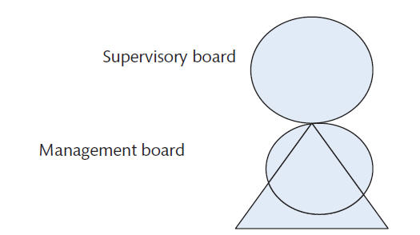
Dual Board
Figure 2.6: The Dual Board

Slide 13
The governance partnership
Shareholder rights
determined by company law and a company’s articles of association
share ownership typically gives the right
  to receive notice, attend, and vote at shareholders’ meeting
  to inspect the shareholder register and the register of directors and officers
  to regular information
But, having elected directors to govern the company, shareholders do not have the right to be involved in the day-to-day management of the business, nor to inspect company records or management accounts.

Slide 14
The governance partnership
Shareholder stewardship and activism
Advocates of shareholder democracy equate rights of share ownership with responsibilities
Shareholders, particularly institutional shareholders, they argue, have a duty to be a watchdog over corporate activities and possible excesses, for example:
  challenging excessive director remuneration
  opposing schemes to protect the company and the directors from predators
  highlighting unsatisfactory performance
Some corporate governance codes call for such a commitment.

Slide 15
The governance partnership
Shareholder information
Most company law and corporate governance codes encourage transparency in corporate matters and require the reporting of specific information.
The OECD corporate governance principles call for timely and accurate disclosure of:
  all material matters regarding the company
  its financial situation, performance, ownership, and governance.
Such transparency requires:
  accurate accounting methods
  full and prompt disclosure of information regarding the company
  disclosure of conflicts of interest of directors or controlling shareholders.

Slide 16
The governance partnership
Shareholder information
Most company law and corporate governance codes encourage transparency in corporate matters and require the reporting of specific information
The OECD corporate governance principles call for timely and accurate disclosure of:
  all material matters regarding the company
  its financial situation, performance, ownership, and governance.
Such transparency requires:
  accurate accounting methods
  full and prompt disclosure of information regarding the company
  disclosure of conflicts of interest of directors or controlling shareholders.

Slide 17
The governance partnership
Some listed companies use road shows, conference calls, webcasts, and other internet opportunities to communicate with shareholders and the public
Some companies have developed online tools for readers to build their own reports
An online stock exchange announcement by a company can now trigger email alerts; media feeds; and possible updating of Facebook, YouTube, and Twitter pages.

Slide 18
The governance partnership
Regularly updated standing information about the company, its activities, and personalities can be used to simplify the annual company report.

