Slide 1
Certificate of Higer Education in Employability Skills
Level 4
Managing Enterprise
(Bmsw4011)
Sergiu Vranceanu
(2435824)
2025 - 2026
1.

Slide 2
Contents page:
1-introduction
2-the opportunity
3-the product
4-Business model
5-Market research & Competitors
6-Swot analysis
7-hmr strategy
8-financial overview
9-Brand identity
10-how I will use the 100k (months 12-24 expansion)
11-Growth roadmap (months 12-24)
12-why invest
13-Reference list
14-Ai statement
2.

Slide 3
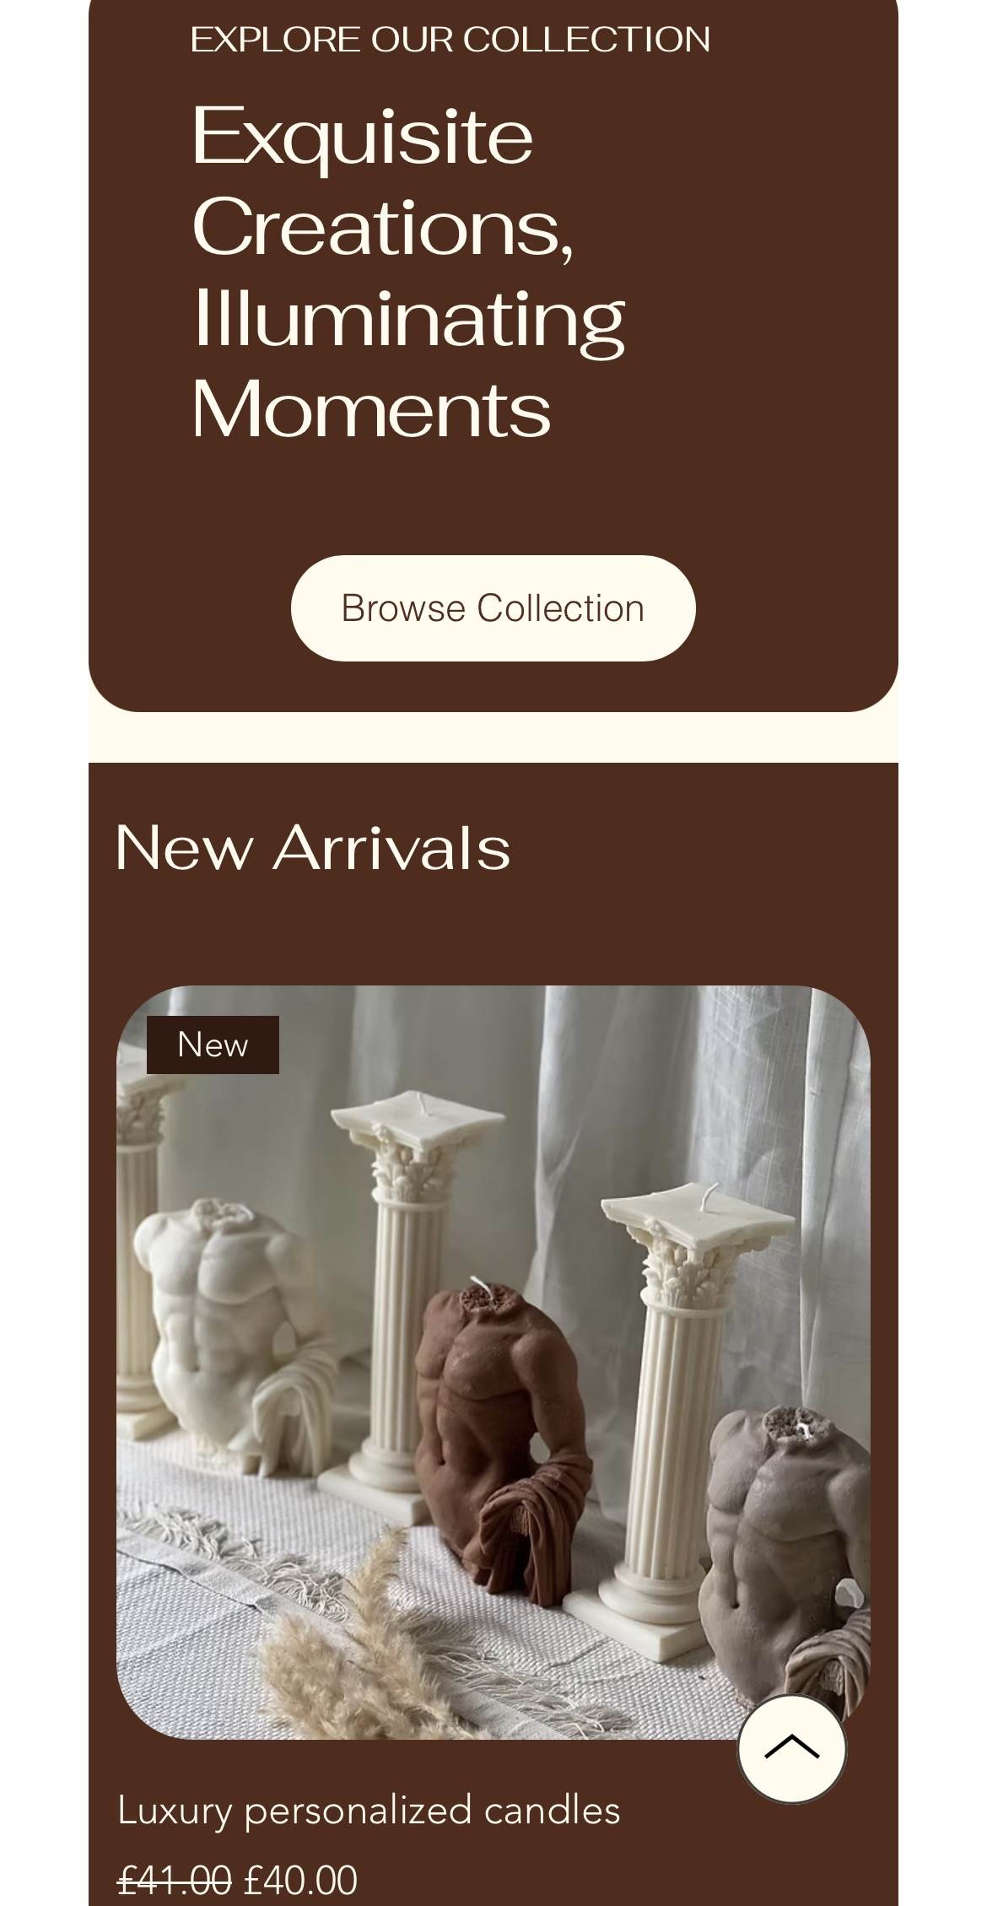
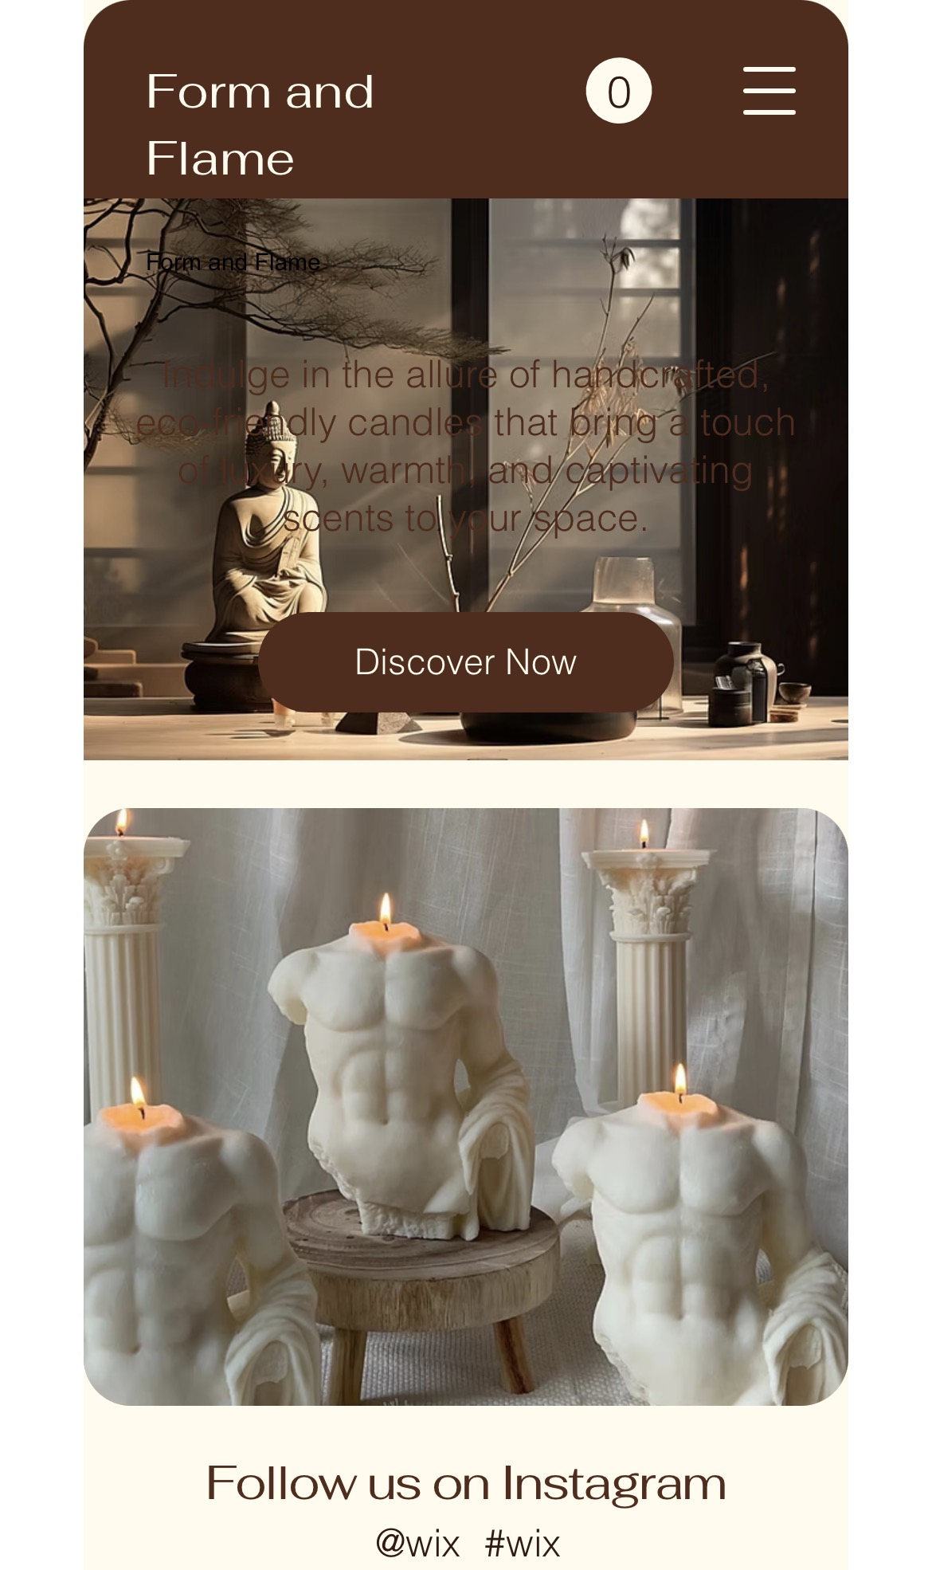
Introduction
Form & Flame.com
Premium sculptural candles combining modern art, interior design and sustainable home fragrance.
Mission Statement:
To transform everyday spaces through design-led, eco-friendly candles that are as beautiful unlit as they are burning.
Today I am pitching for £100,000 investment to scale Form & Flame into a nationally recognised luxury home brand.
3.

Slide 4
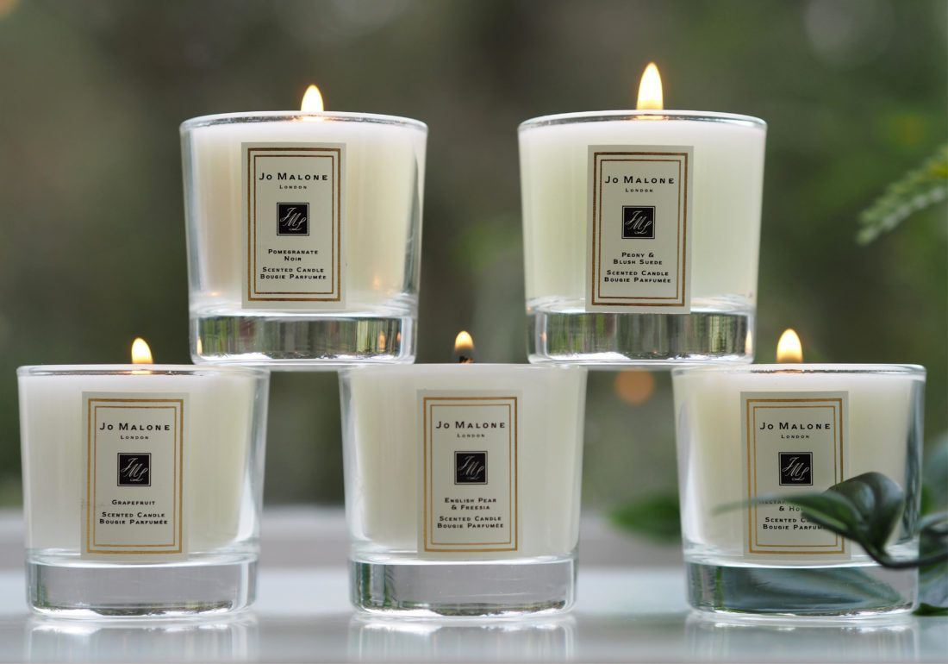
The Opportunity
The UK home fragrance market is growing steadily, driven by:
• Increased home decor spending post-pandemic
• Growth in self-care culture
• Social media interior trends
The UK candle market is projected to grow consistently through 2027 (Statista, 2024).
Additionally, 68% of consumers prefer sustainable home products (Mintel, 2023).
There is clear demand for design-led, sustainable candles sold online.
4.

Slide 5
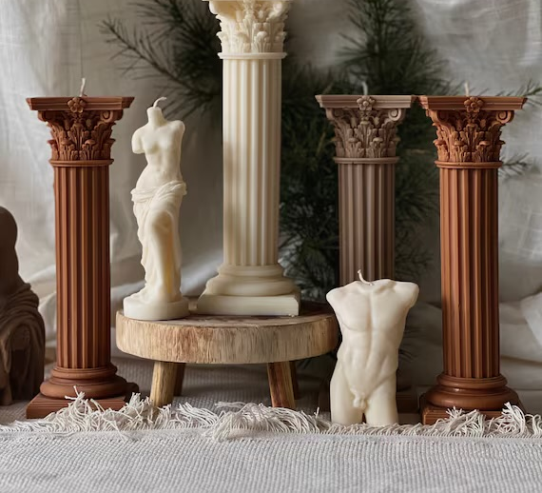
The Product
Form & Flame offers:
Sculptural soy wax candles
Vegan, cruelty-free ingredients
Minimalist, architectural designs
Plastic-free packaging
Product categories:
• Abstract torso candles
• Geometric pillar candles
• Statement centrepieces
• Limited seasonal collections
USP:
We sit between home decor and fragrance selling art you can burn.
Unlike mass-market brands, our candles are statement pieces designed for Instagram-worthy interiors.
5.

Slide 6
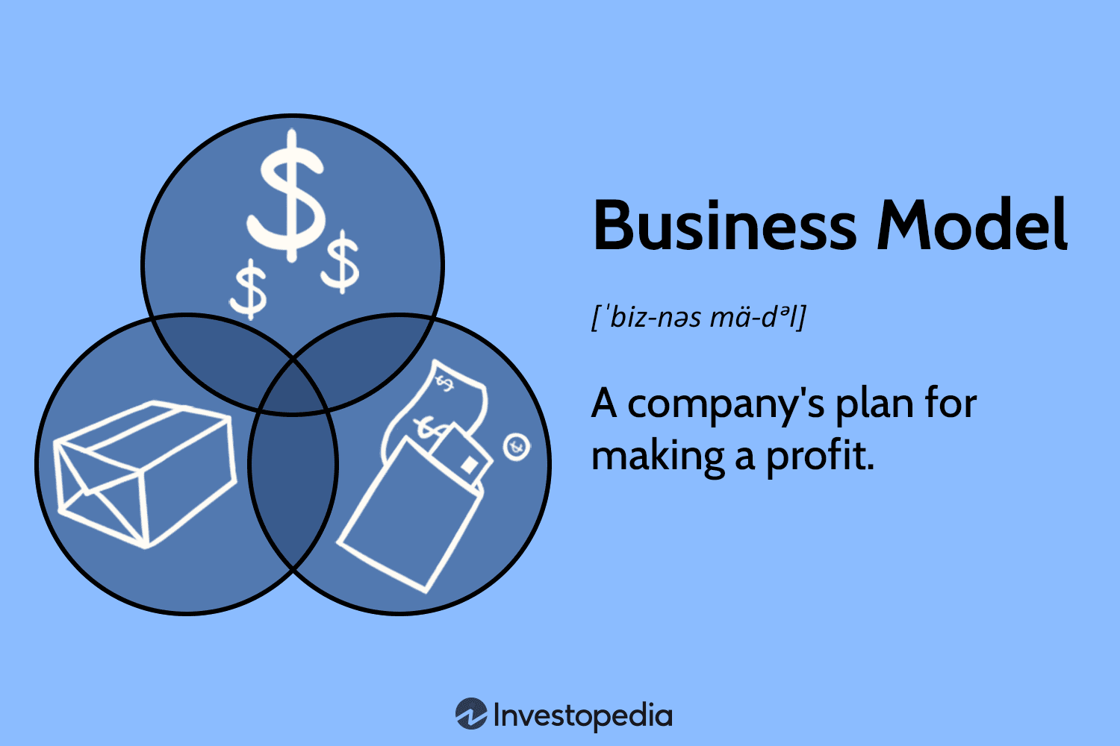

Business Model
Legal Structure: Sole Treader
Sales Channel:
• Direct-to-consumer via website
• Instagram & TikTok Shop integration
• Etsy marketplace (traffic generation)
Revenue Streams:
• Individual candle sales (£25–£45)
• Gift bundles
• Limited edition drops
• Subscription scent box (planned)
Target Market:
• 18–40 year old interior-conscious consumers
• Predominantly female demographic
• Urban UK audience
6.

Slide 7
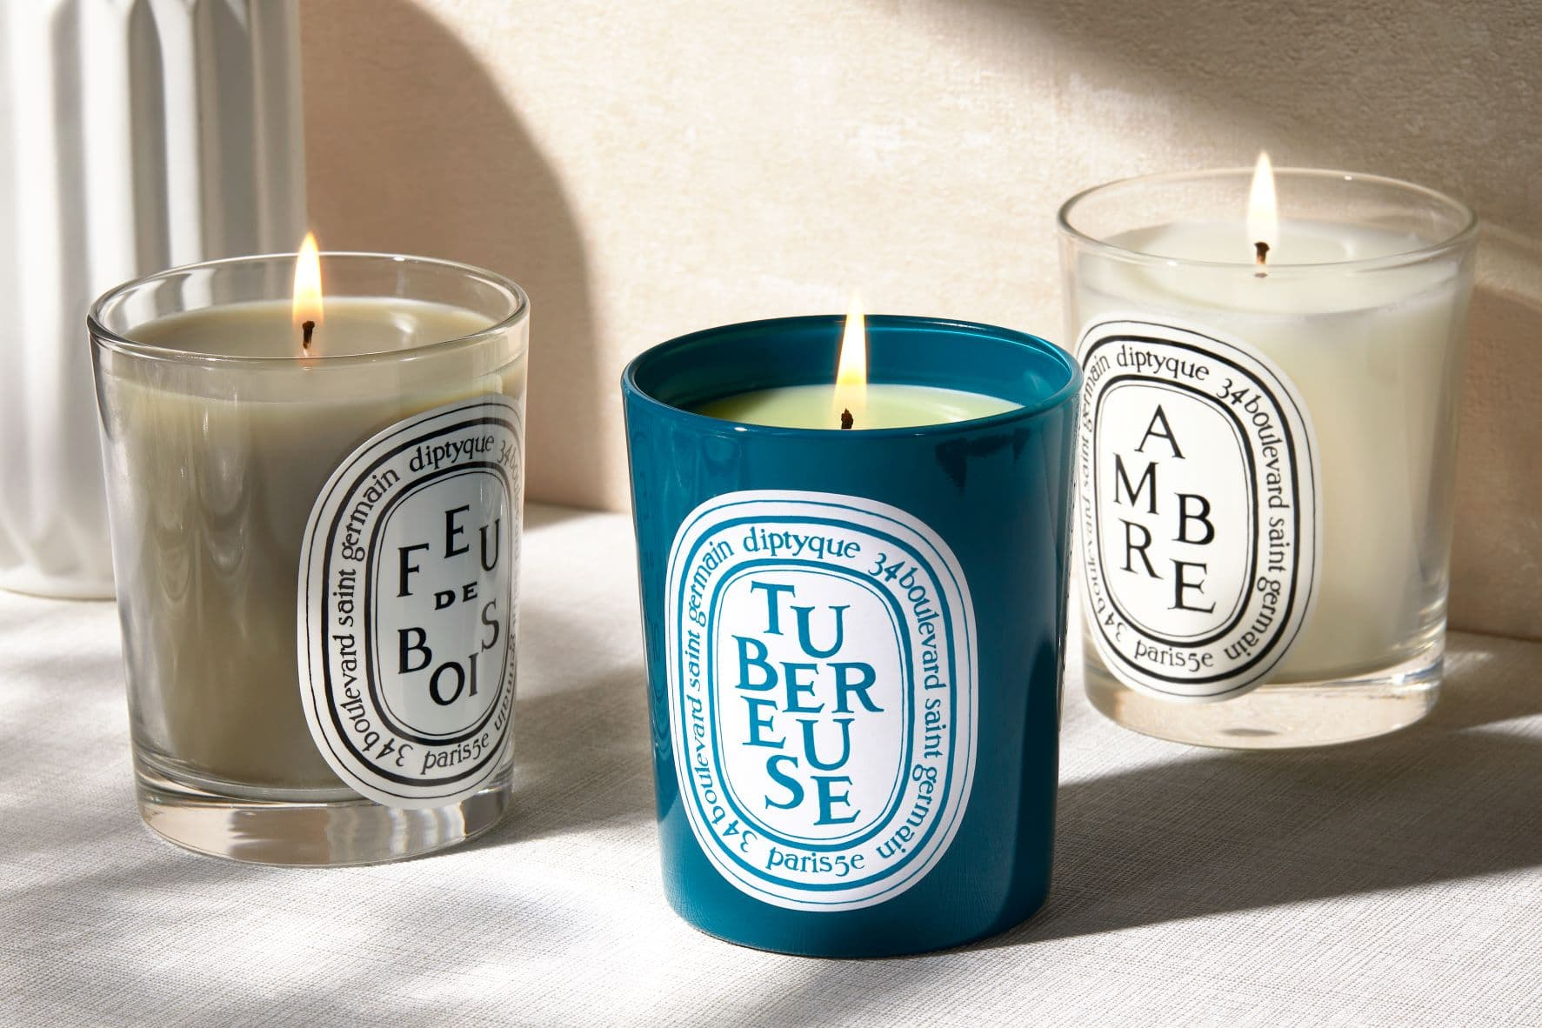
Market Research & Competitors
Competitors include:
• Diptyque
• Jo Malone
• Etsy independent sellers
However:
• Large brands focus on fragrance, not sculptural design
• Etsy sellers lack strong branding and scale
Porter (2008) highlights differentiation as key to competitive advantage, Form & Flame competes on design identity and brand storytelling.
7.

Slide 8
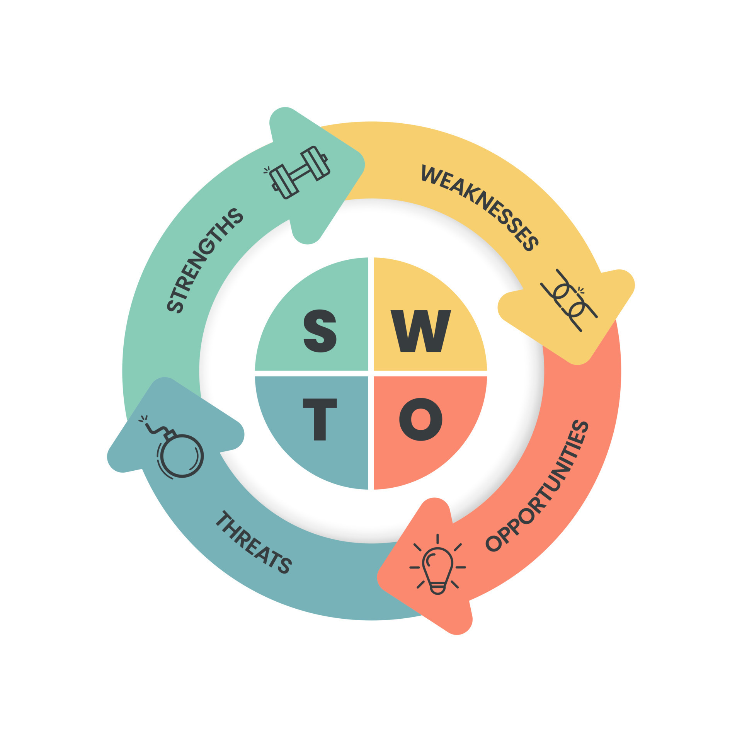
SWOT Analysis
Strengths:
• Strong visual branding potential
• High profit margins (approx. 65%)
• Low overhead (online model)
Weaknesses:
• Highly competitive market
• Brand awareness still developing
Opportunities:
• Influencer collaborations
• Corporate gifting
• International shipping
Threats:
• Rising wax/raw material costs
• Trend-based purchasing behaviour
8.

Slide 9

HRM Strategy
Year 1 Structure:
• Founder (Creative Director & Operations)
• 1 Part-time Production Assistant
• Freelance Social Media Manager
As Armstrong & Taylor (2023) emphasise, small businesses must invest in skills development to retain talent.
Culture Focus:
• Creativity
• Sustainability
• Flexibility
• Remote-friendly roles
9.

Slide 10
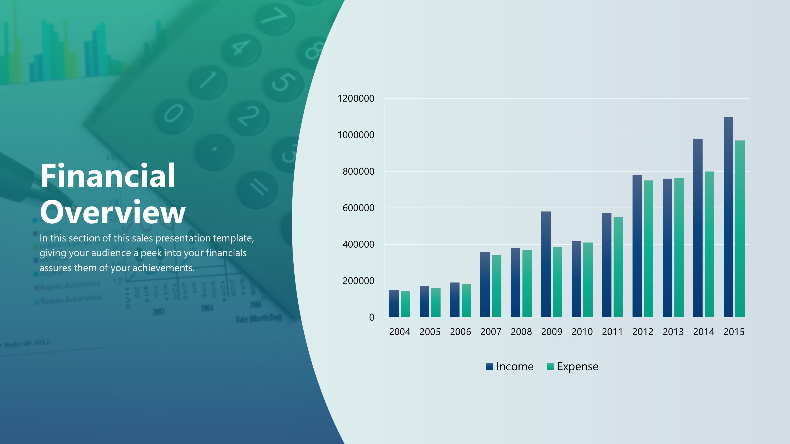
Financial Overview
Startup Costs So Far: £6,500
Average Cost per Candle: £6
Average Selling Price: £25
Gross Profit Margin: ~65%
Projected Year 1 Revenue: £20,000
Projected Year 2 Revenue (with investment): £150,000
Break-even: Month 7
Scarborough (2022) highlights that scalable online businesses benefit from low fixed overheads supporting our profitability model.
10.

Slide 11
Brand Identity
Brand Personality:
• Modern
• Minimal
• Artistic
• Sustainable
Tagline:
“Where Design Meets Flame.”
Visual Identity:
• Neutral colour palette
• Matte textures
• Clean typography
• Strong product photography
Marketing strategy follows AIDA model (Kotler & Keller, 2016).
11.

Slide 12
How I Will Use the £100k (Months 12–24 Expansion)
The £100,000 will be used strategically to scale:
£30,000 – Professional production studio setup
£20,000 – Large-scale digital marketing campaign
£15,000 – Website redesign & UX optimisation
£10,000 – Hire full-time Marketing Manager
£10,000 – Inventory expansion & bulk material purchasing
£10,000 – PR agency & influencer partnerships
£5,000 – Working capital buffer
12.

Slide 13
Growth Roadmap (Months 12–24)
Month 12–15:
• Launch subscription scent service
• Introduce wholesale model
Month 16–18:
• Secure partnerships with 5 UK boutiques
• Reach 50k Instagram followers
Month 19–24:
• Launch European shipping
• Revenue target: £500,000 annually
Long-term vision:
Position Form & Flame for acquisition or national lifestyle brand expansion.
13.

Slide 14
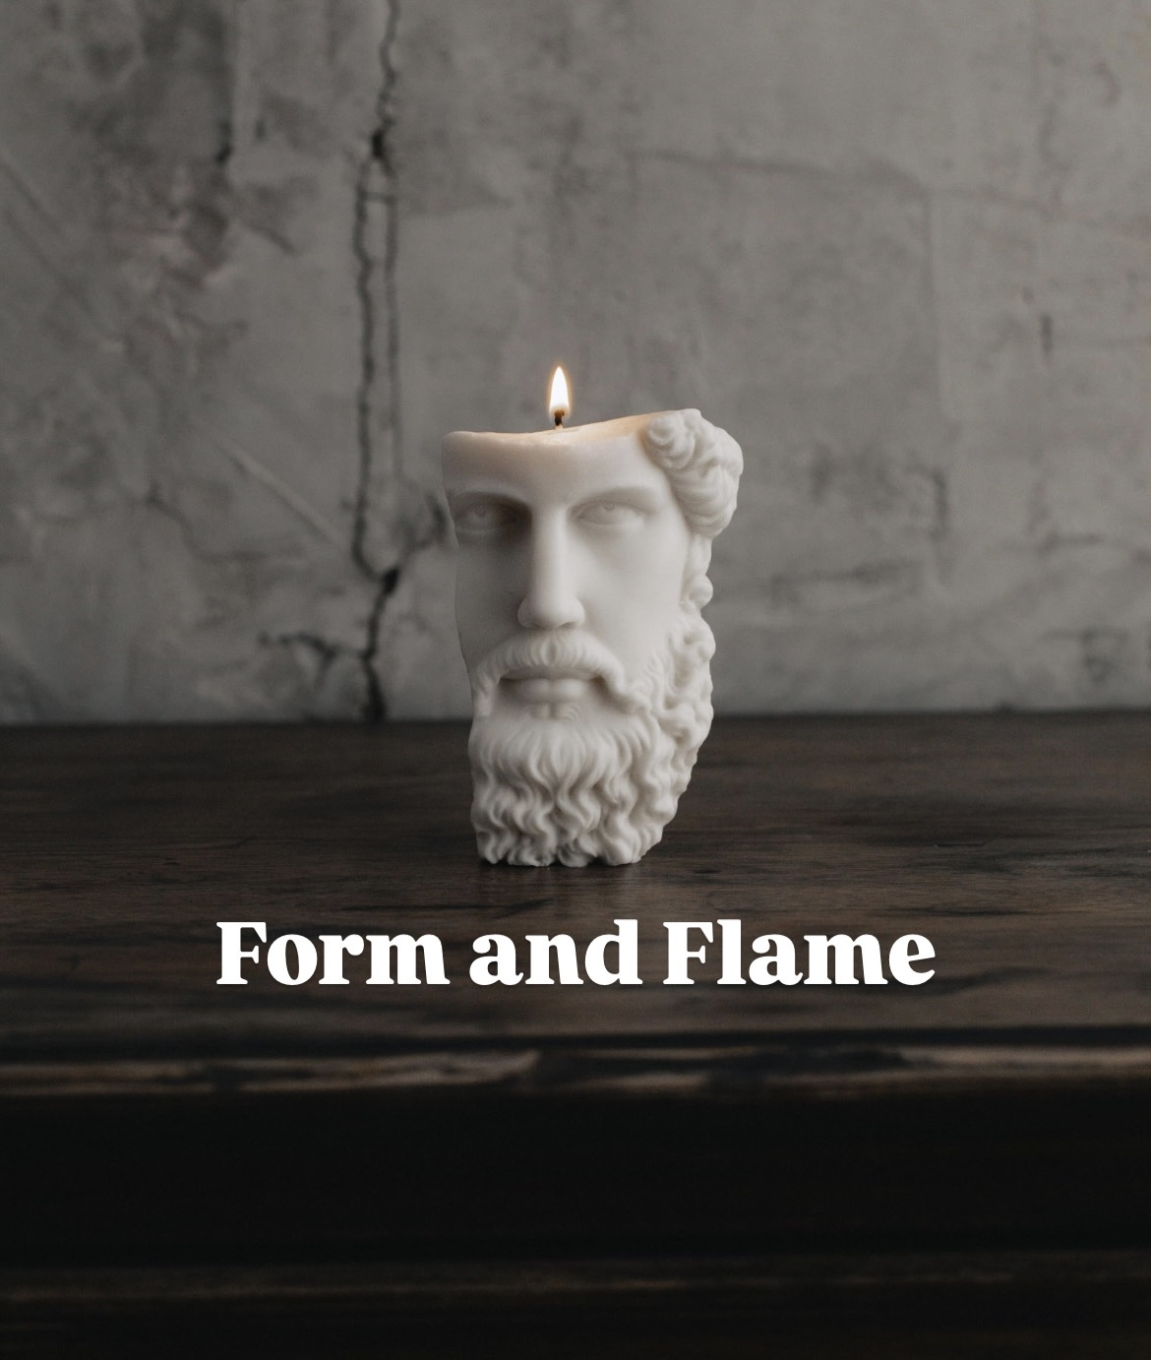

Why Invest?
High-margin product
Scalable online model
Strong branding potential
Growing home décor market
Clear 24-month expansion plan
Form & Flame is not just a candle business it is a design-led lifestyle brand ready to scale.
14.

Slide 15

Harvard References
1. Armstrong, M. and Taylor, S. (2023) Armstrong’s Handbook of Human Resource Management Practice.
2. Kotler, P. and Keller, K. (2016) Marketing Management.
3. Mintel (2023) UK Home Fragrance Market Report.
4. Porter, M.E. (2008) ‘The Five Competitive Forces That Shape Strategy’, Harvard Business Review.
5. Scarborough, N.M. (2022) Essentials of Entrepreneurship and Small Business Management.
6. Statista (2024) UK Candle Market Revenue Data
15.

Slide 16
Ai statement
I Confirm that I have not presented any AI generated text as my own work, I confirm I have copies of my drafts, notes, and other resources I have used.

