Slide 1
11
Amarna period
AHAR4001
Pharaohs, Phoenicians and Peoples of the Sea
Dr. Katharina Zinn

Slide 2
Readings:
Kemp, Barry (1989). Egypt in Microcosm: The City of ElAmarna. In: Ancient Egypt: Anatomy of a Civilisation. London: Routledge. 261-317. (Moodle)
Redford, Donald (1987). Akhenaten: The Heretic King. Princeton: Princeton University Pr. (Moodle)
Silverman,David, Wegner, Joseph and Wegner, Jennifer. (2006). Akhenaten and Tutankhamun: Revolution and Restoration. Philadelphia: University of Pennsylvania Museum of Archaeology & Anthropology.
Dodson, Aidan (2009). Amarna Sunset: Nefertiti, Tutankhamun, Ay, Horemheb, and the Egyptian Counter-reformation . Cairo: The American University of Cairo Press. (Moodle)
Montserrat, Dominic (2000). Akhenaten: History, Fantasy and Ancient Egypt. London: Routledge.

Slide 3
What is the Amarna Period?
Approx. 30 years long
From end of the reign of Amenhotep III until the beginning of Horemhab
Egypt was at its imperial height
Focused around the ancient city of Akhetaten (new foundation)

Slide 4
The people
Notes:
4

Slide 5
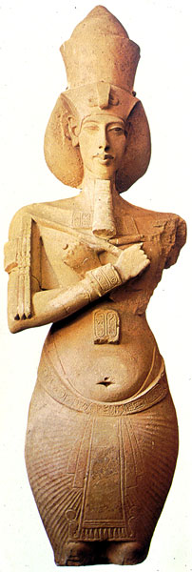
The King
Amenhotep IV / Akhenaten
10th king of 18th dyn., son and successor of AIII
Notes:
Arnold: Royal Woman of Amarna, 19

Slide 6
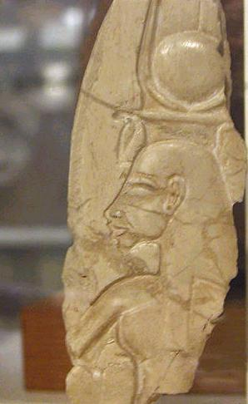
Queen Nefertiti:
Chief consort
Thought to be the daughter of Aye (Noble family with origin in Akhmim)
Bore AIV at least 6 daughters
Notes:
http://wysinger.homestead.com/nefertiti.html

Slide 7
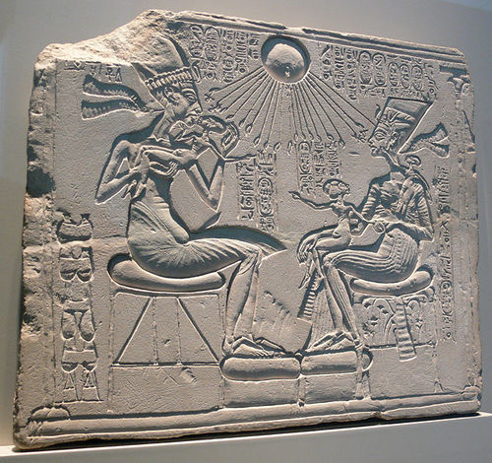
House altar Amarna (Berlin)
Notes:
http://ancienthistory.about.com/od/egypt/ig/Ancient-Egypt/Akhenaten-and-Nefertiti.htm
7

Slide 8
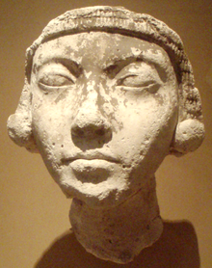
Queen Kiya:
Other consort, favored compared with other minor consorts
Little known about her, poorly documented in the historical record
Mitanni princess?
Mother of Tutankhamun?
Notes:
http://en.wikipedia.org/wiki/File:FaceOfAYoungAmarnaWoman-ThutmoseWorkshop_MetropolitanMuseum.png
8

Slide 9
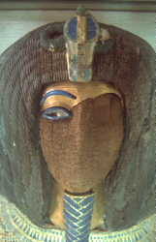
Semenkhkare
?
Coffin or mummy from KV55?
New king or Nefertiti? (same throne name Neferneferuaten)
Notes:
http://en.wikipedia.org/wiki/File:FaceOfAYoungAmarnaWoman-ThutmoseWorkshop_MetropolitanMuseum.png
9

Slide 10
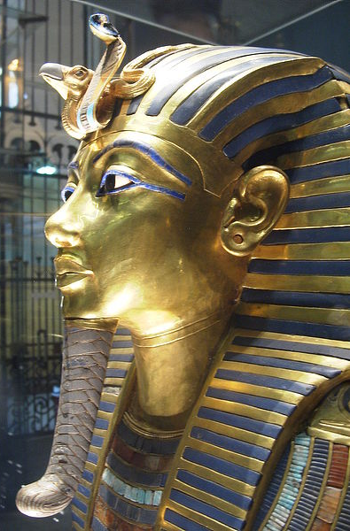
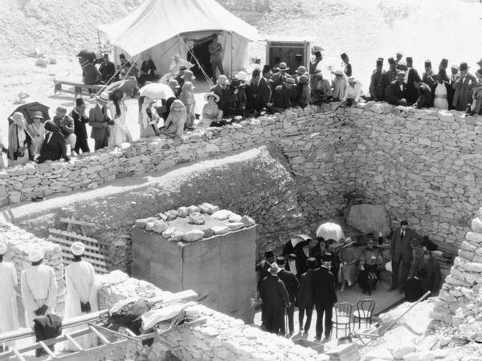
Tutankhamun: son of Akhenaten and Kiya?
1922: Visit of the Egyptian Sultana shortly before opening on 26 Nov 1922
Notes:
Original Page: http://www.egyptological.com/2011/04/eye-of-ra-eye-of-horus-1155
http://images.search.conduit.com/ImagePreview/?q=tutankhamun+tomb+opened&ctid=CT2856415&SearchSource=2&FollowOn=true&PageSource=ImagePreview&start=0&pos=1

Slide 11
The Coregency Problem
Did Amenhotep III share the throne with his son, Amenhotep IV (Akhenaten)?
Practice of senior king sharing the throne with a junior
Intended for a smooth transition of power
Often suggestion for chronological reasons but difficult to prove
General during time of coregency: no usurpation!
Overlap between Amenhotep III and Akhenaten?

Slide 12
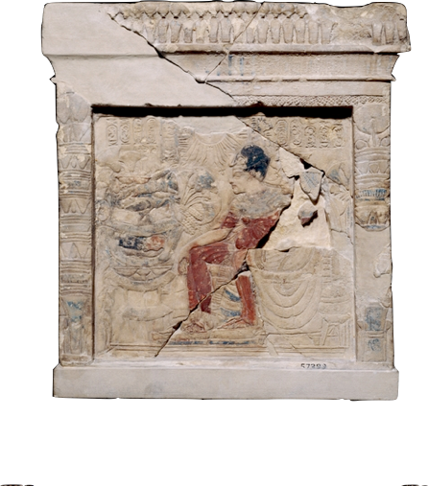
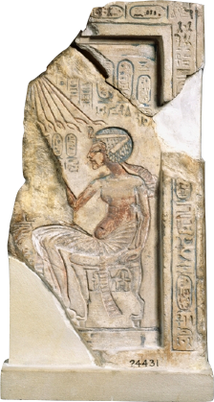
Amarna coregency
Long argued, both pro and contra
Pro: mainly art historians (object-based)
Contra: mainly historians (text-based)

Slide 13
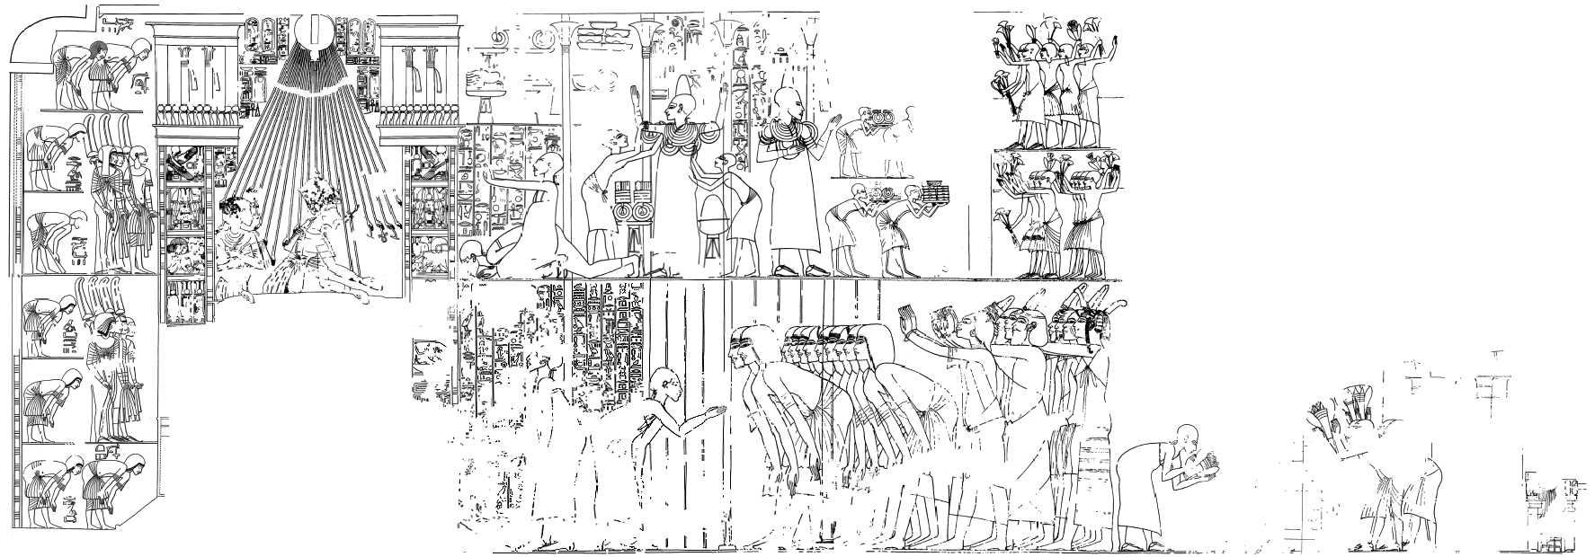
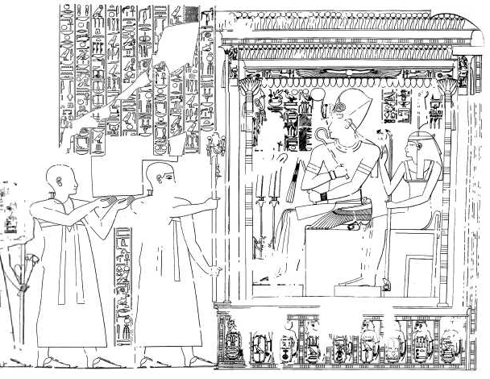
TT55: Ramose
King new style
King old style
Notes:
http://www.osirisnet.net/tombes/nobles/ramose/e_ramose_02.htm

Slide 14
TT55: Ramose
King new style: Artist was familiar with “Amarna” style art quite early in reign of Amenhotep IV, Ramose did not move to Amarna; died before name change, Somehow “proof” of coregency
Notes:
http://www.osirisnet.net/tombes/nobles/ramose/e_ramose_02.htm

Slide 15
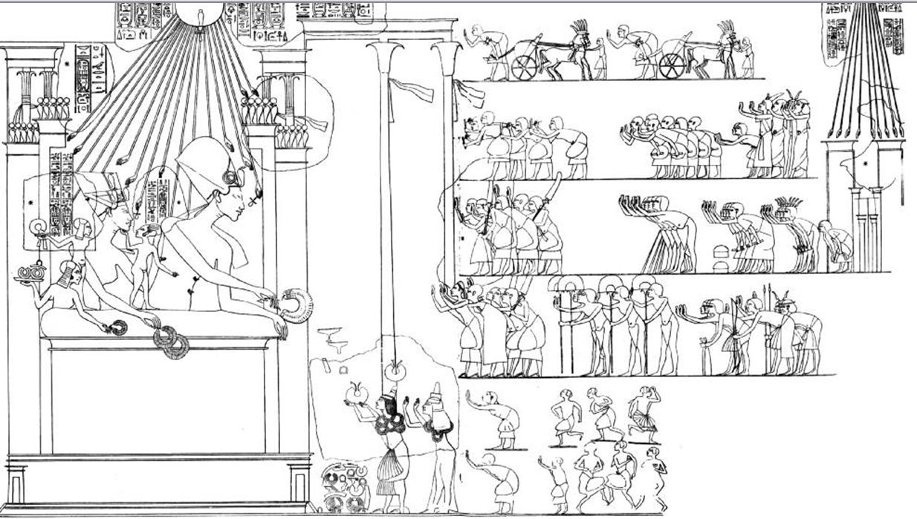
Window of appearance reward scene – Tomb of Ay, Amarna
Notes:
http://www.osirisnet.net/tombes/amarna/ay_amarna/e_ay_amarna.htm

Slide 16
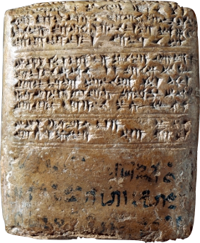
Historical Arguments
History based on textual sources
Amarna Letter 27: letter of Tišratta of Mittani to Akhenaten on the death of Amenhotep III
Hieratic docket in Egyptian

Slide 17
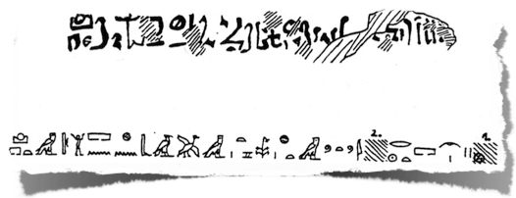
Historical Arguments
Regnal Year [///]2, 1st month of peret, [day ///], when one [= the king] was in the southern city, in the fortress of “Rejoicing on the Horizon.” Copy of the letter that the messenger Pirizzi and the messenger [Tulubri] brought.

Slide 18
Historical Arguments
If “Regnal Year 2,” then absolutely no chance for a coregency longer than a few months
If “Regnal Year 12,” then a coregency is assured
Bulk of the evidence points to “Regnal Year 2”
Regnal Year [///]2, 1st month of peret, [day ///], when one [= the king] was in the southern city, in the fortress of “Rejoicing on the Horizon.” Copy of the letter that the messenger Pirizzi and the messenger [Tulubri] brought.

Slide 19

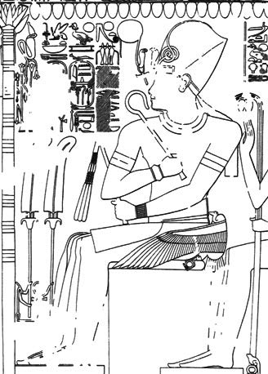
Amenhotep IV
Nefer-kheperu-Re wa-en-Re [“Perfect are the manifestations of Re, the one of Re”]
Amenhotep Netjer Heqa-Iunu [Amen is satisfied, God, Ruler of Waset”]

Slide 20
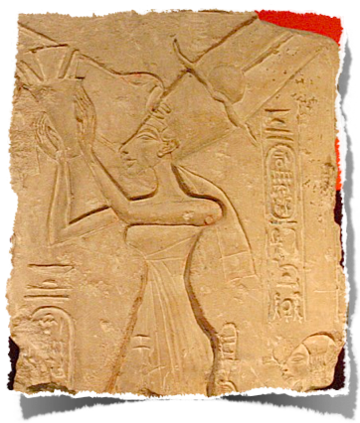
Amenhotep IV
Was married to Nefertiti before becoming king
Possibly fathered Meritaten and (less likely) Meketaten by Regnal Year 1
Seems to have resided at Malqata

Slide 21
Importance
So what? Why is this even important?
Chronological implications within Egypt:
  If long, Amenhotep III could potentially be the father of Tutankhamun, something impossible if short
  Aldred’s idea of a 12± coregency would suggest that Akhenaten only reigned about 5 years on his own
  If short—or none—this is all impossible

Slide 22
What is happening?
first two years of the reign: nothing seems to change
king crowned in Thebes
Adopted traditional titulatur (clear reference to Amun, kept birth name of Imen-htp
rare representations adopting traditional cannon
→ lintel of entry of tomb of Kheruef (TT192, Amenhotep III and IV): sees king (cartouches hacked out) making a classic offering to Amon

Slide 23
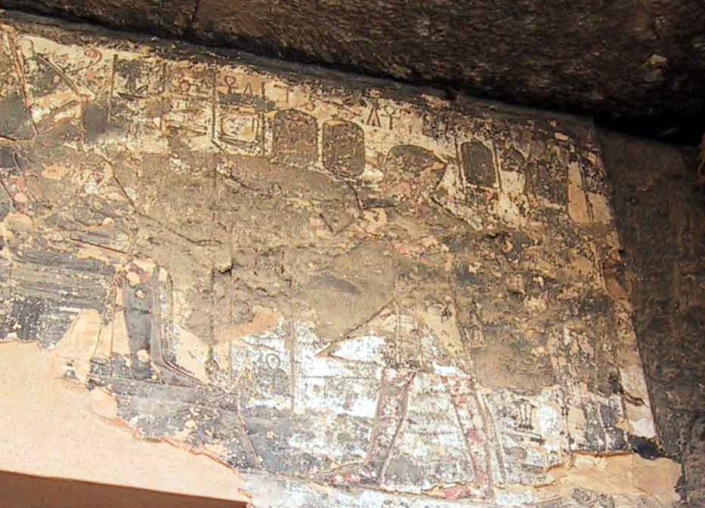
Notes:
http://www.osirisnet.net/docu/akhenat/e_akhen1.htm

Slide 24
From year 2
introduces a new solar divine entity based on Horus of the horizon (Horakhty) which he/it names "Ra-Horakhty in his nature of solar light which emanates from the Aten disk", thus making of Ra a "sovereign of the horizon", thus establishing his proximity to the terrestrial royalty
Keeps this imagery, but calls god Aten

Slide 25
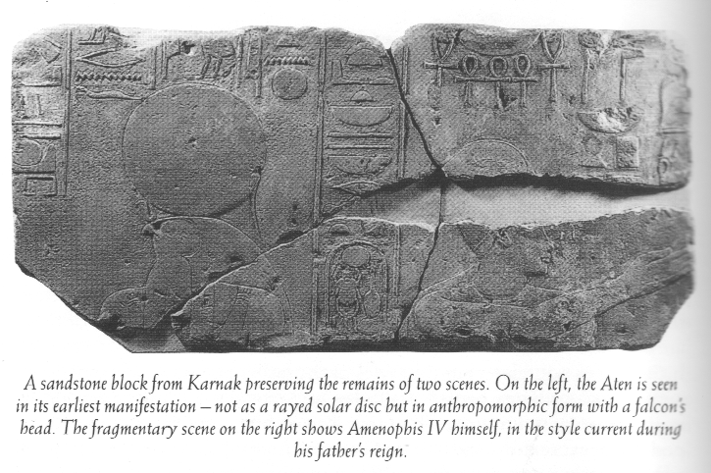
Notes:
Reeves: Akhenaten, p. 100

Slide 26
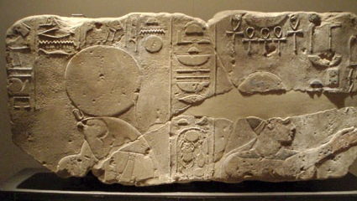
Berlin Museum
Notes:
http://www.captmondo.com/weblog/labels/Amarna.php

Slide 27
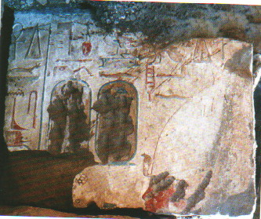
AIV in Karnak (Aton Temple), dismantled and reused as filling for pylon on Horemhab (10th pylon)
Notes:
Tietze: Amarna, p. 257

Slide 28
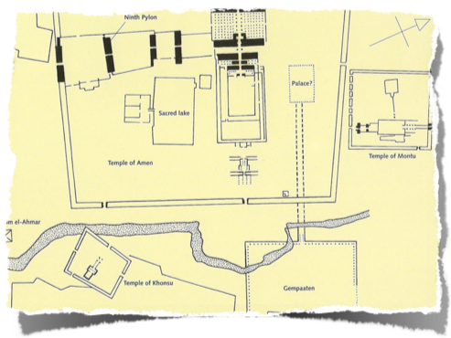
Karnak
Completed monuments left unfinished by his father
By Regnal Year 3, construction had begun on temple(s) of the Aten at east Karnak
Built in anticipation of a very early sed-festival

Slide 29
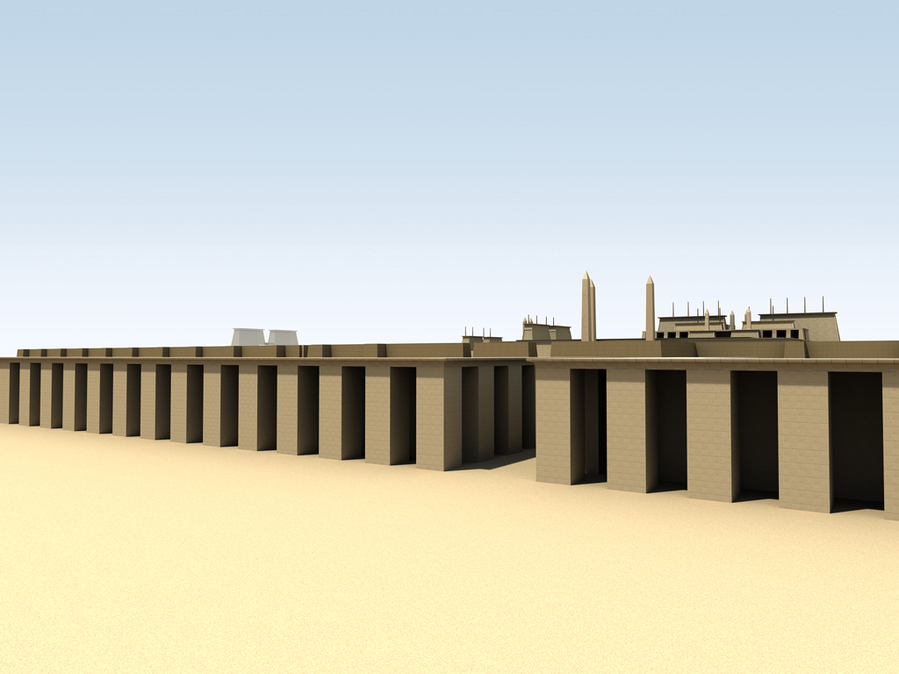
Notes:
http://dlib.etc.ucla.edu/projects/Karnak/assets/media/resources/AtenTemples/highres/ts_s20ba.jpg

Slide 30
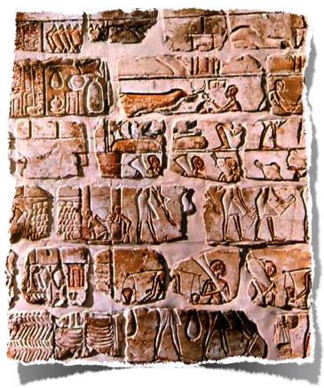
Talatat
Built from talatat (from Italian tagliata “cut-masonry”), standardized building blocks
½ x ½ x 1 ancient Egyptian cubits (ca. 27 x 27 x 54 cm
Not used after Amarna period
Standardized, relatively small size allowed for quick building methods
Each block could be moved by one man
Most found reused as fill within the 2nd, 9th, and 10th pylons at Karnak; also Luxor

Slide 31
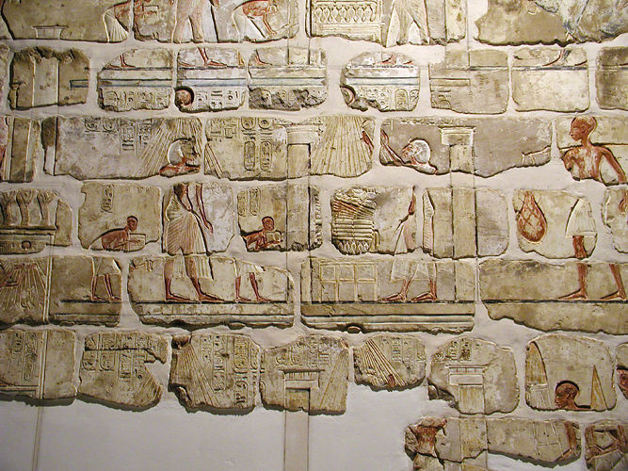
Notes:
http://commons.wikimedia.org/wiki/File:Gempaaten_talatats.jpg

Slide 32
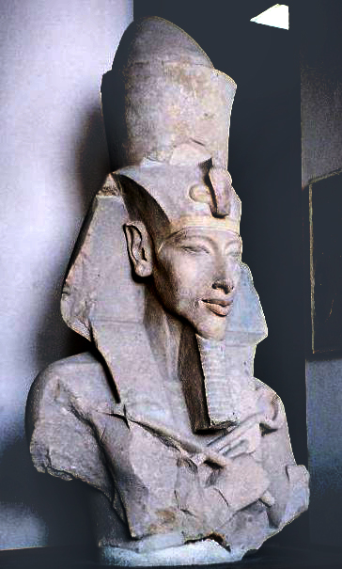
Cairo museum
Early style (Karnak) and early Amarna, king’s third and eighth regnal year)
Notes:
http://upload.wikimedia.org/wikipedia/commons/f/f7/Pharaoh_Akhenaten.jpg

Slide 33
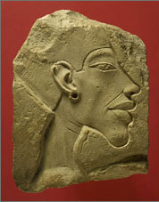
Boston
Notes:
http://www.mfa.org/egypt/amarna/sift_amarna/sift_amarna_images/style_intro_07.jpg

Slide 34
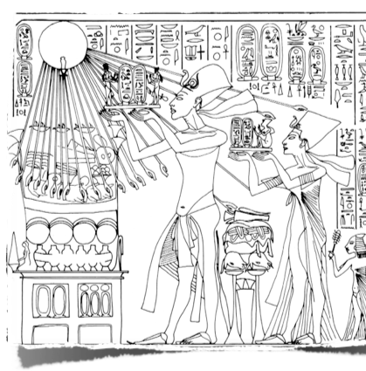
The Aten & Akhenaten
Between RY 3 & 4, there was a complete revolution
The Aten was given a “didactic” [teaching] name: Re-Horakhty, who rejoices in the horizon in his name of Shu, who is the Aten”, written in cartouche

Slide 35
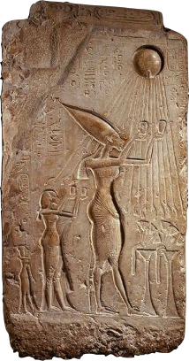
The Aten & Akhenaten
The Aten is hereafter depicted solely as a solar disk with human hands emanating from it
Amenhotep IV changes his name to Akhenaten, “(one who is) Beneficial for the Aten”

Slide 36
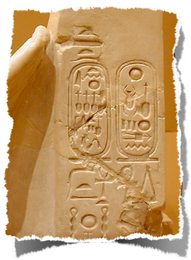
The Aten & Akhenaten
Often added the epithet, “Beautiful Child of the Living Aten”
Nefertiti given an additional name: Neferneferuaten “Aten is most perfect”

Slide 37
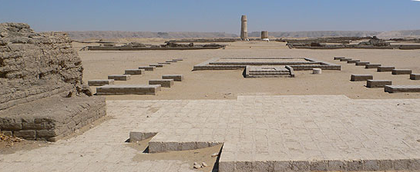
Founded Amarna
Notes:
http://www.amarnaproject.com/

Slide 38
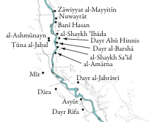
Location of Amarna
Middle Egypt
402 km north of Thebes, 312 km south of Memphis
Quarries for construction located to the north

Slide 39
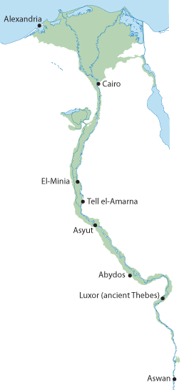
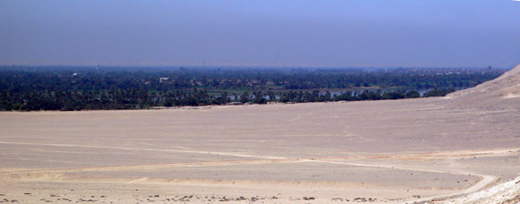
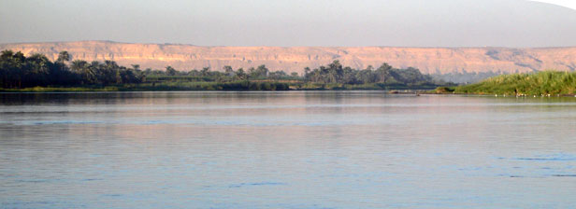
Notes:
http://www.amarnaproject.com/pages/accessing_the_site/index.shtml

Slide 40


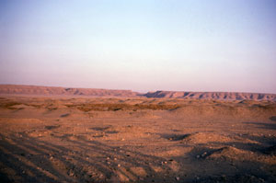

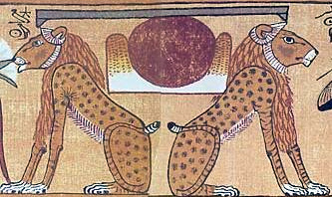
Theological motivations for the site
Topography
  large, flat area in the desert; plenty of room to build
  close to Nile and farming
Solar symbolism: Akhet-Aten = “Horizon of the Solar Disk”

Slide 41

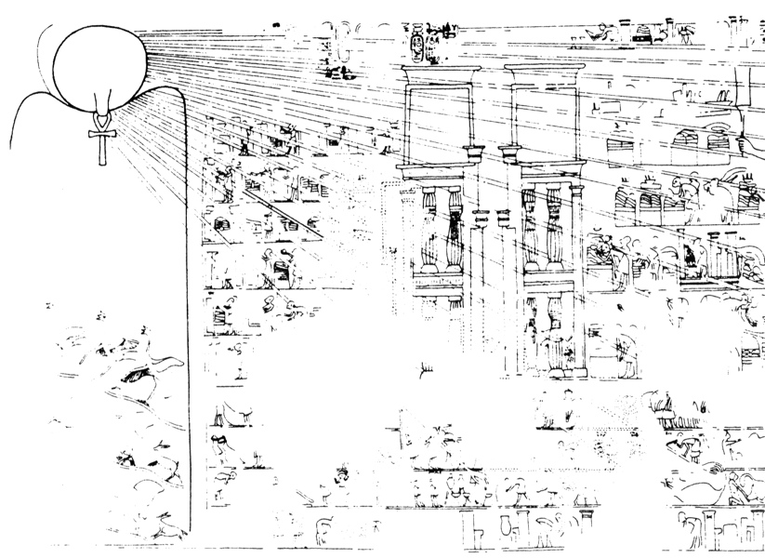
THe Akhet of the Aten

Slide 42

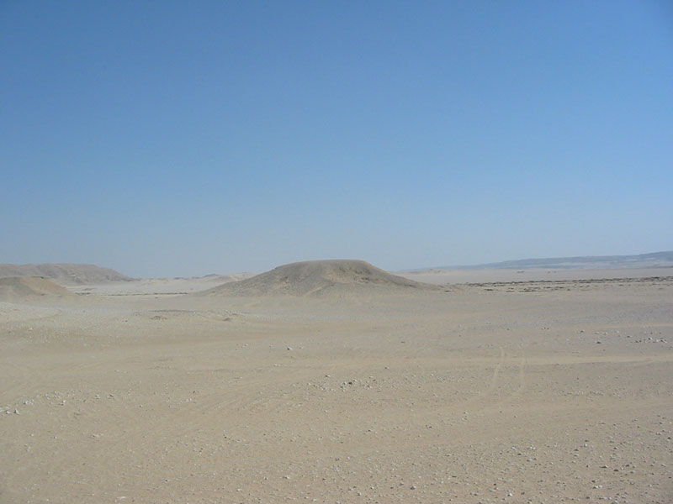
Theological motivations for the site
Politically neutral due to absence of occupation
No deity associated with the site
  15th UE Nome: Thoth (Ashmunayn)
Geographically practical: Memphis & Thebes equidistant

Slide 43
Motivation
King’s command to relocate in RY 5/6 → Boundary Stelae
Assassination Attempt? (suggested by Reeves)
  Thin evidence but suggestive
Attempt to “outflank” the Theban priesthood?

Slide 44

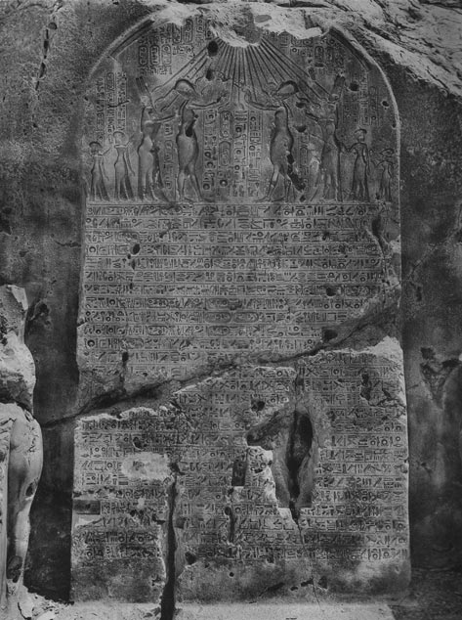
The Boundary Stelæ
15 rock-cut stelæ recording proclamations made by Akhenaten, RY 5, 6, and 8
Stelæ M and X are the earliest
Text describes the “discovery” of the akhet of the Aten
Notes:
LocationsTexts

Slide 45
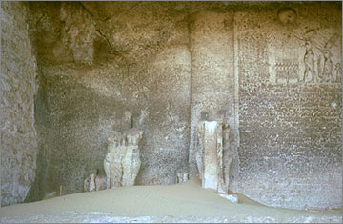
Notes:
http://www.amarnaproject.com/pages/amarna_the_place/boundary_stelae/index.shtml

Slide 46

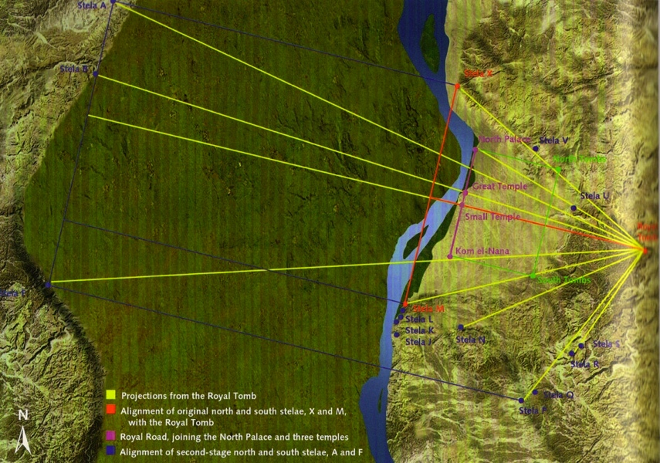
Sacred Landscape

Slide 47
Boundary Stela
Now, as for my father, Hor-Aten lives! As for the [. . .] in Akhet-Aten, it was worse that those which I heard in Regnal Year 4; it was worse that those which I heard in Regnal Year 3; it was worse that those which I heard in Regnal Year 2; it was worse that those which I heard in Regnal Year 1; it was worse that those which king [Amenhotep III] heard; [. . .] it was worse than those heart by any kings who had assumed the White Crown [. . .]

Slide 48
Boundary Stela
I did not leave (?) [. . . saying], “it was offensive,” until it would not be offensive. As for the offensive things [. . .] in every mouth, saying “I will commit an offense” [against the lord of Akhet]-Aten, my father, Horus-Aten [. . .] arisen (?) [. . .] any [ ... ], nor shall I hear the [ ... ] from it either.

Slide 49
King vs. Priesthood
General loss of royal power to the priesthood over the centuries
Imperial donations to the domains of Amen were extensive
Economically powerful, rivaling the king
Tens of thousands of priests, farmers, labors, etc., supported by the temple cult, and dependent on it
Huge swathes of farm land part of the temple domains

Slide 50
Return to Solar Orientation
Conservative: return to Old Kingdom fundamentals; in the case of Akhenaten, one could argue for “fundamentalistic”
King as absolute authority with a divine nature
Form of “solar” Horus
Akhenaten continues this with the addition of an “ancestor cult” based on the worship of his “solar” father (Aten ≈ Amenhotep III)

Slide 51
Conclusion
Akhenaten, by adopting a solar deity—or even more radically, a divine form of his father, Amenhotep III—
  Completely marginalized the cults of non-solar deities, especially Amen of Thebes
  With the loss of royal support, the priesthood was “out of work,” as well as completely losing their economic powerbase
  Akhenaten’s presence in Thebes would been disruptive and potentially dangerous

Slide 52
Historical events
Known activities of the king and his retinue at Akhet-Aten:
  Regnal Year 5: Akhet-Aten established
  Regnal Year 6: Akhenaten moves to Amarna; lives in a tent
  Regnal Year 8: Confirms the boundaries of the city

Slide 53

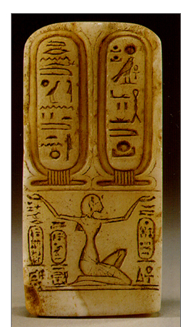
Events
Regnal Year 9 (?): name of the Aten changed
Old “didactic” name: Live Re-Horakhty, who appears in the horizon in his name of Shu, who is the Aten”
New: Live Re, ruler of the two horizons, who appears in his name as Re, the father who returns as Aten

Slide 54
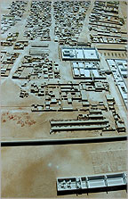
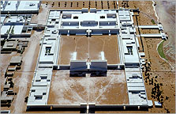
Small Aton temple – worship of Akhenaton
Gem-pa-Aton, belonging to the Aton temple, worshipping Aton
Notes:
http://www.amarnaproject.com/pages/model_of_the_city/index.shtml

Slide 55
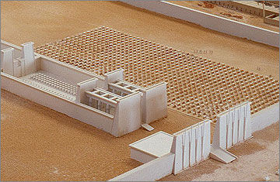
Aton temple, worshipping Aton
Notes:
http://www.amarnaproject.com/pages/amarna_the_place/central_city/index.shtml

Slide 56
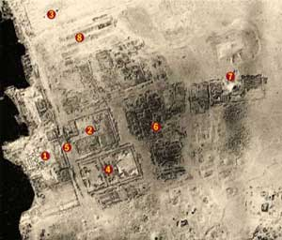
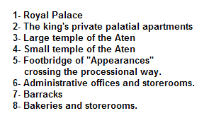
Amarna

Slide 57
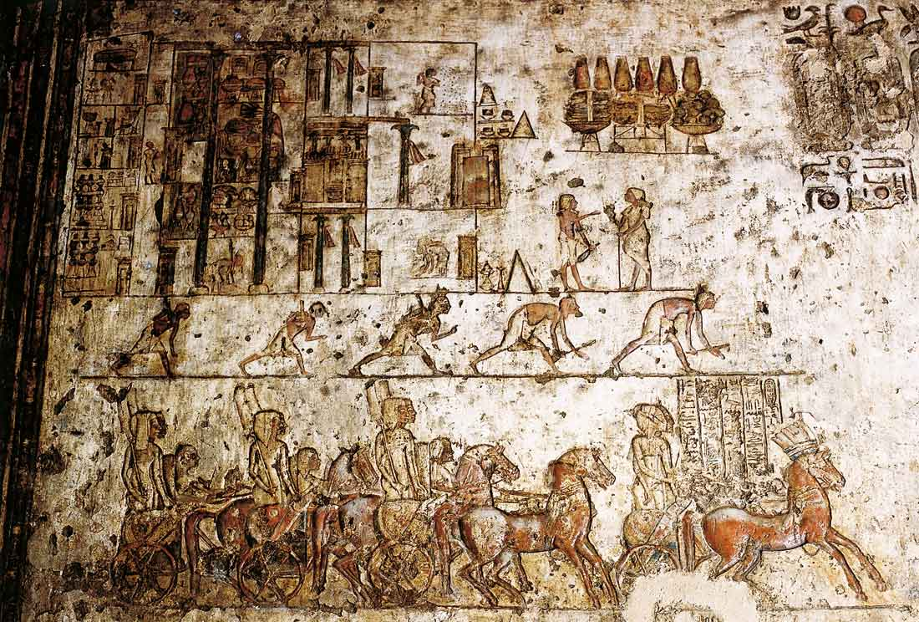
Royal Palace

Slide 58
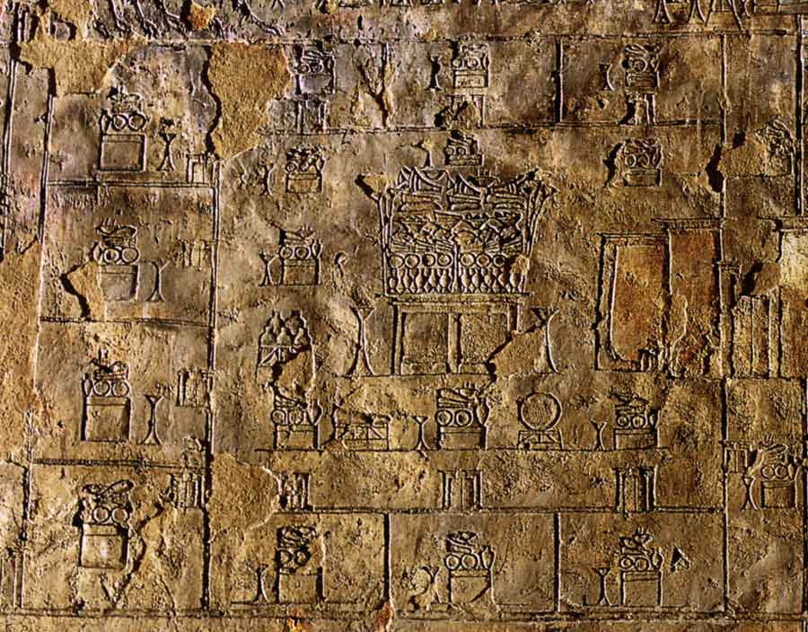
Aten Temple: Sanctuar
Notes:
http://www.osirisnet.net/tombes/amarna/meryra/e_meryra_02.htm#

Slide 59
Supporters
Military
Foreign troops more evident
“New men” personally favored by the king

Slide 60
The End?
In his 17th regnal year Akhenaten dies
Successor Semenkhare?
  Who is it?
Tutankhaten → Tutankhamun return to Thebes and tradition
Ay

Slide 61
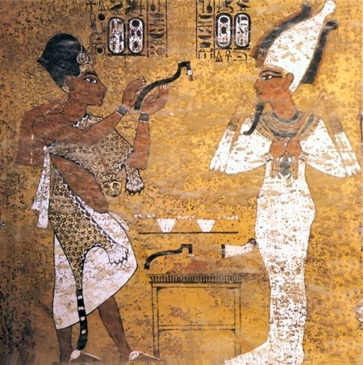
Ay (in KV62)
Notes:
http://www.squidoo.com/kv62

Slide 62
The End?
In his 17th regnal year Akhenaten dies
Successor Semenkhare?
Tutankhaten → Tutankhamun return to Thebes and tradition
Ay
  Father of Nefertiti?
  Mentor of Tutankhamun, reigned for him, Vezir
Horemhab

Slide 63

Horemheb
His private Sakkara tomb
Receiving gold of honour (from Tutankhamun or Ay?)
Military
Maybe Paatenemheb (Aten is in the festival) → tomb in Amarna ???
Known since reign of Tutankhamun, but immediately high offices, next to Ay (rivalries?)
Notes:
http://www.michellemoran.com/books/heretic/behind-the-story/Horemheb.html

Slide 64


Horemheb
Royal tomb (KV57, east Valley)
Usurped Restoration Stela Tutankhamun’s, renewal of Karnak Temple
Notes:
http://prophetess.lstc.edu/~rklein/images/horemheb.jpg
http://www.archaeowiki.org/Image:Restoration_Stela.jpg

