Slide 1

The reflective practitioner
This Photo by Unknown Author is licensed under CC BY-SA
Image 1

Slide 2
What is reflective practice
Learning new insights through experience
Being self aware
Critically analysing own work
Examining assumptions of everyday practice
Trying new ways
(Boud, Keogh and Walker, 2015)

Slide 3
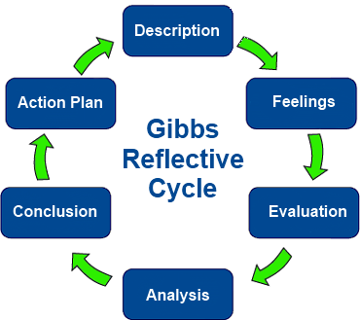
Gibbs reflective cycle
This Photo by Unknown Author is licensed under CC BY-SA-NC
Image 2

Slide 4
Why is reflective practice important
When good ideas become popular can become automatic
Maximises productiveness
Positive contribution to continuous professional development
Maximises learning
Maximises quality of practise
(Thompson and Thompson, 2018).

Slide 5
Suffered from Diabetes , Renal failure, emotionally unstable behaviour
Uncontrolled diabetes can lead to serious health complications
People with mental health conditions die 15- 20 years earlier than other people
Two thirds are from avoidable physical illness
More focus is needed to target people with mental illness to improve outcomes.
(NICE,2018).

Slide 6
Presented as stable but had
Previously presented challenging behaviours
Emotionally unstable
Behaviour could change
policy the CHMT has is to be interlinked with other health services
(Southernhealth.nhs.uk, 2018)
Care workers must assume that someone has the mental capacity to make their own decisions unless it is proven otherwise (GOV.UK, 2009).

Slide 7
Housing not prioritised as she had physical needs
Policies include try and get people to be independent
Encourage self management
Policy to not discriminate due to health condition
(Southernhealth.nhs.uk, 2018).

Slide 8
Had been violent towards multi-disciplinary teams
Including verbal and physical incidents
Risk of someone being hurt
Individuals with emotionally unstable personality disorder require a safety plan
(Southernhealth.nhs.uk, 2018).

Slide 9
Reference list
Boud, D., Keogh, R. and Walker, D. (2015). Reflection turning experience into learning. London: Taylor & Francis Ltd.
Nhs, (2018). Adult community mental health operational policy. [online] Available at: https://www.nhft.nhs.uk/ [Accessed 10 Jan. 2020].
Gov. uk, (2005).Health and social care workers: mental capacity act. (2005) .
Southernhealth.nhs.uk. (2018). Adult mental health community mental health team standard operation procedure. [online] Available at: https://www.southernhealth.nhs.uk/_resources/assets/inline/full/0/104609.pdf [Accessed 10 Jan. 2020].
Thompson, S. and Thompson, N. (2018). The critically reflective practitioner. 2nd ed. London: Palgrave Macmillan.
Image 1 Anon, (2020). [image] Available at: http://1.bp.blogspot.com/-
Image 2 Gibbs reflective cycle. (2014). [image] Available at: http://prehospitalresearch.eu/?p=1550 [Accessed 10 Jan. 2020].

