Slide 1

Benefits of multilingualism and the importance
of language awareness skills for hotel staff.
Recording: Recording-20231026_170126.webm
Student Name: VICTORIA CHILIANU
Student ID Number: 2208500
The Module Title: Foreign Languages and Cultural Awareness BMIH5003
Lecturer’s Name: LISA BASSLER

Slide 2
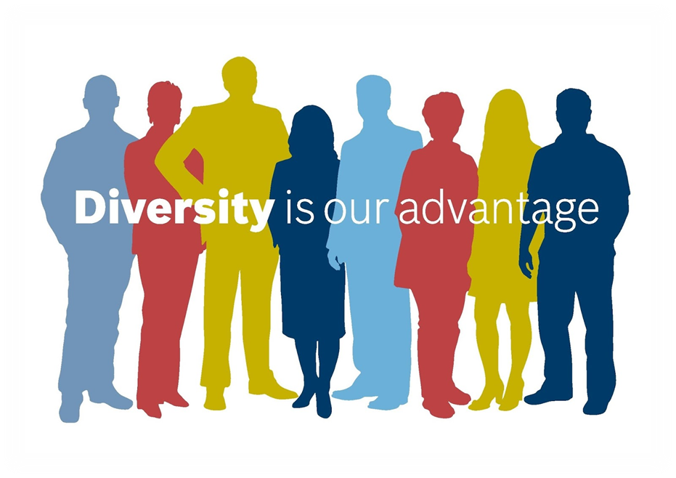
Multilingualism Benefits
at DIVERSITY Hotel and Spa London
Multilingualism allows an intercultural understanding as well as developed working memory (Benzehaf, 2023).
(Nanu, 2019)

Slide 3
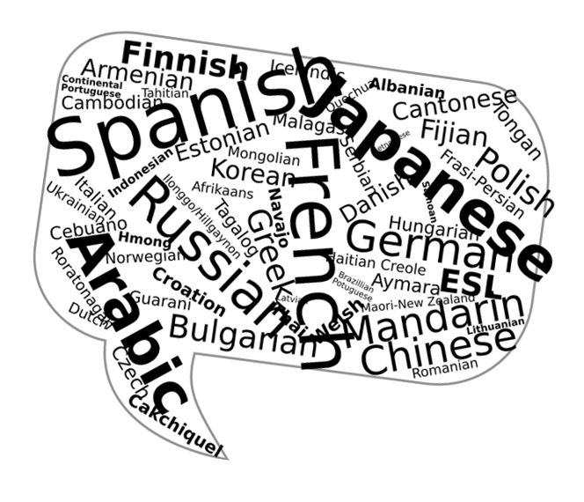
Importance of Language Awareness
The importance of language awareness represents the way interaction is carried out in order to transmit a message (Swart et al., 2019).
Ability to use correct grammar expressions, with the ability to use these sentences with considerations to common understanding among the language users (Kardena et.al, 2019).
(Barnettusu, 2014)

Slide 4
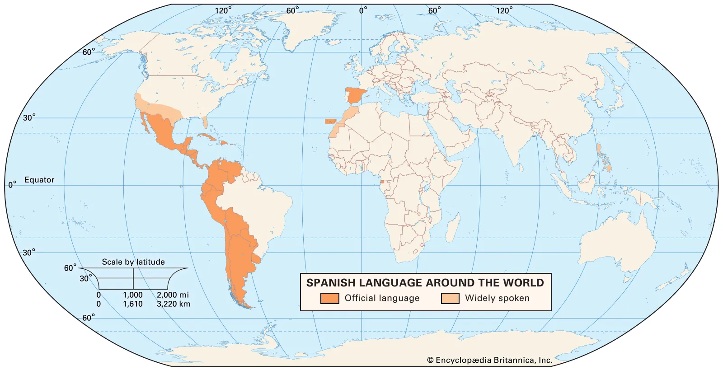
Modern European Language – Spanish
By the number of total speakers, the Spanish language is the fourth-biggest in the world (Julian, 2020).
The importance of using Spanish as another language besides English is that people from other countries speak Spanish as well such as those from South and Central America and the Caribbean, Southeast Asia, and even Africa.
(Posner and Sala, 2023)

Slide 5
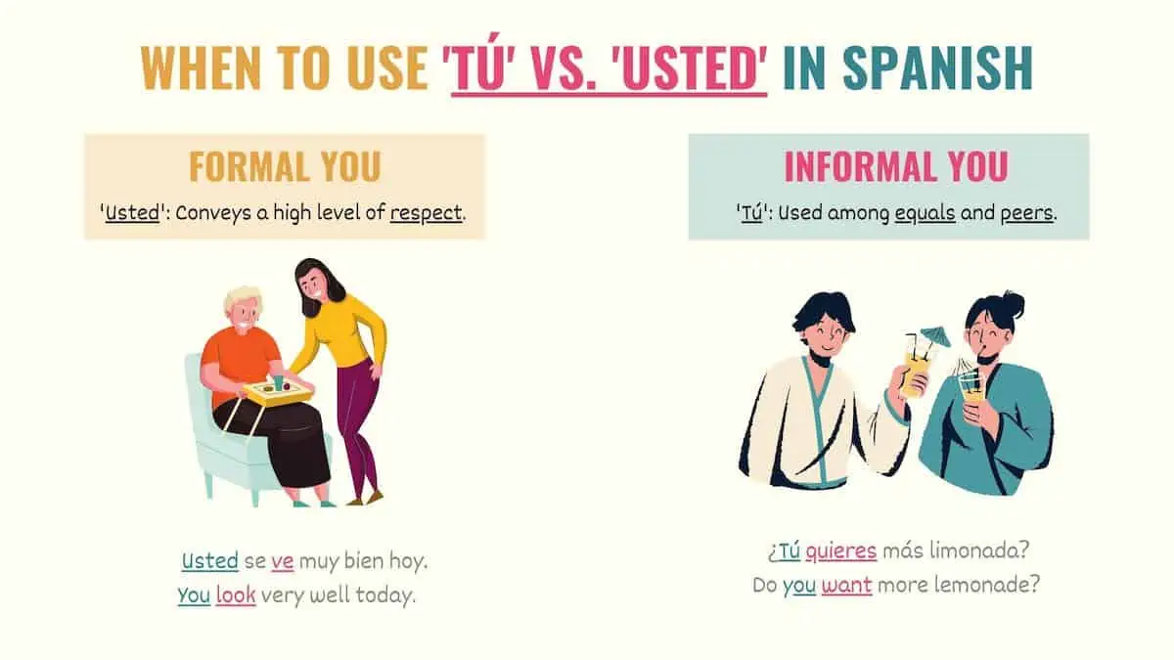
Formal and Informal Spanish
(Sanchez, 2023)

Slide 6
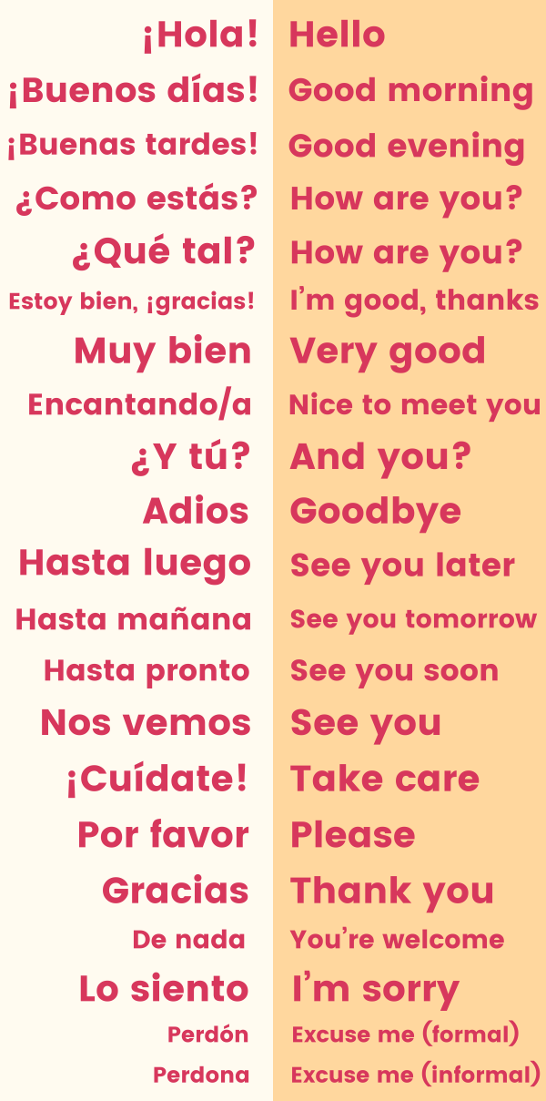
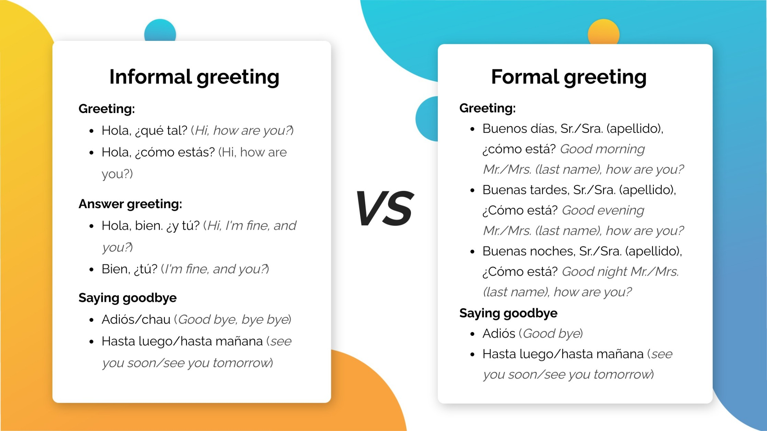
Basic Spanish words
Formal and Informal Spanish
(Cont’d)
(Mascarell, 2022)
(Rose, 2022)

Slide 7
References
Barnettusu, R. (2014) Pixabay. Available at: https://pixabay.com/users/ryantbarnettusu-459475/ (Accessed: 22nd October 2023).
Benzehaf, B. (2023) ‘Multilingualism and its role in identity construction: a study of English students’ perceptions’, International Journal of Multilingualism, 20(3), pp.1145-1163. Available at: https://doi.org/10.1080/14790718.2021.2003369 (Accessed: 21st October 2023).
Canva (2023) ‘Gold luxury real estate agency logo’. Available at: https://www.canva.com/design/DAFX30EVjL4/kzAKM411mzJ6zEGu2ALKTA/edit?utm_content=DAFX30EVjL4&utm_campaign=designshare&utm_medium=link2&utm_source=sharebutton (Accessed: 21st October 2023).
Julian, G. (2020) ‘What are the most spoken languages in the world’, Retrieved May, 31(2020), p.38. Available at: https://www.fluentin3months.com/most-spoken-languages/ (Accessed: 22nd October 2023).
Kardena, A., Hamzah, H., Syarif, H. and Zaim, M. (2019) ‘The view of intercultural competence in the context of communicative-based in English Language teaching’, In Proceedings of the 1st EAI Bukittinggi International Conference on Education, BICED 2019, 17-18 October 2019, Bukititinggi, West Sumatera, Indonesia. Available at: https://eudl.eu/pdf/10.4108/eai.17-10-2019.2289731 (Accessed: 22nd October 2023).
Mascarell, C. (2022) ‘Formal and informal greetings in Spanish’. [LinkedIn profile]. LinkedIn. Published June 26, 2022. Available at: https://www.linkedin.com/pulse/formal-informal-greetings-spanish-cinthia-mascarell (Accessed: 23rd October 2023).
Nanu, L. (2019) ‘Cultural Diversity in Hospitality’, Hotech blog, 29th March. Available at: https://blog.hotech.com.tr/cultural-diversity-in-hospitality/ (Accessed: 21st October 2023).
Posner, R. and Sala, M. (2023) ‘Spanish language’, Encyclopedia Britannica, 14th September. Available at: https://www.britannica.com/topic/Spanish-language (Accessed: 22nd October 2023).
Rose, E. (2022) ‘Common Spanish words and phrases every beginner should know’, Lingodeer blog, 2nd March. Available at: https://blog.lingodeer.com/common-spanish-words/ (Accessed: 23rd October 2023).
Sanchez, D. (2023) ‘‘Tú’ vs ‘Usted’: Master Informal & Formal ‘You’ in Spanish’, Tell me in spanish.com: grammar. Available at: https://www.tellmeinspanish.com/grammar/formal-vs-informal-you-in-spanish/ (Accessed: 23rd October 2023).
Swart, F., Knèzic, D., Onstenk, J., and Graaff, R. D. (2019). ‘Evaluating and improving teacher educators’ language-oriented performance in content-based teaching’, International Journal of Educational Methodology, 5(1), 71-86. Available at: https://doi.org/10.12973/ijem.5.1.71 (Accessed: 22nd October 2023).

