Slide 1
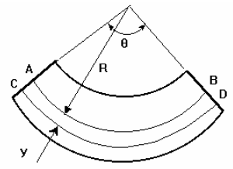
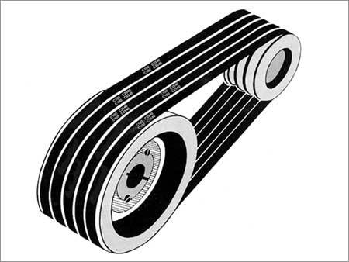
Mechanical Principles
Level : BSc 2 / HND 2
Lecturer :Tim Tudor
Email : timothy.tudor@smu.ac.uk

Slide 2
Outcome 2
Topics we will cover
Outcome 1 (3-4 Weeks)
      Elastic constants and their relationships
      Two and three-dimensional loading
      Volumetric strain
      Other Elastic constants
Outcome 2 (8-9 Weeks)
      Loaded beams
      Pressure in thin walled vessels
      Pressure in thick walled vessels
Outcome 3 (9-10 Weeks)
      Friction Clutches
      Gear Trains
      Pulleys / Belts
Outcome 4 (4-5 Weeks)
      Flywheels
      Balancing

Slide 3
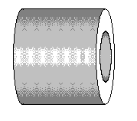
Thick Walled Vessels
Thick Walled Cylinder
The difference between a thin cylinder and a thick cylinder is that a thick cylinder has a stress in the radial direction as well as a circumferential stress and longitudinal stress.
A rule of thumb is that radial stress becomes important when the wall thickness exceeds 1/20th of the diameter.

Slide 4
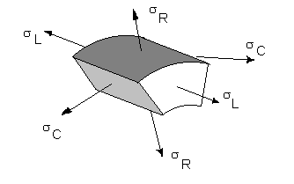
Thick Walled Vessels
Thick Walled Cylinder
By considering a small section of the wall, applying the governing three dimensional stress equations and integrating it can be shown that;
Where a and b are constants of integration.
These are Lame’s Equations
L = Longitudinal stress
R = Radial stress
C = Circumferential stress

Slide 5
Thick Walled Vessels
Thick Walled Cylinder
In order to solve problems, the constants a and b must be found from boundary conditions
Remember: a boundary condition is a known answer such as knowing what the pressure or stress is at a given radius.
When atmospheric pressure acts on one side of the wall, it is best to use gauge pressure in the calculations. This makes atmospheric pressure zero and all other pressures are relative to it.
Remember: absolute pressure = gauge pressure + atmospheric pressure.

Slide 6
Thick Walled Vessels
Thick Walled Cylinder
Strains can be calculated following the calculation of stresses using the 3D strain equations applied to the circumferential, radial and longitudinal stresses.

Slide 7
Thick Walled Vessels
Example
A hydraulic cylinder is 100 mm internal diameter and 140 mm external diameter. It is pressurised internally to 100 MPa gauge. Take E = 205 GPa and v = 0.25
Determine the radial and circumferential stress at the inner and outer surfaces.

Slide 8
Thick Walled Vessels
Example
Id = 100 mm
Od =140 mm
P = 100 MPa internal
E = 205 Gpa
v = 0.25
Find a and b using boundary conditions:
@ Inner surface r = 50 mm σ_{R} = -100 Mpa (Compressive)
@ Outer surface r = 70 mm σ_{R} = 0 MPa
Substituting into Lame's equation we have
Solving simultaneous equations a = 104.17 x 10⁶ b = 510.43 x 10³

Slide 9
Thick Walled Vessels
Example
Id = 100 mm
Od =140 mm
P = 100 MPa internal
E = 205 Gpa
v = 0.25
Now solve circumferential stress at r=50
and r=70mm.

Slide 10
Thick Walled Vessels
Example 2
A hydraulic cylinder has an 80 mm internal diameter and a wall thickness of 20mm . It is pressurised internally to 120 Bar gauge. Take E = 205 GPa and v = 0.25
Determine the radial and circumferential stress at the inner and outer surfaces.

Slide 11
Thick Walled Vessels
Example 3
A hydraulic cylinder has a 90 mm internal diameter and a 130mm outside diameter. It is pressurised internally to 200 Bar gauge.
Determine the circumferential stress at the inner surface.

Slide 12
Thick Walled Vessels
Example 4
A thick cylinder is 100 mm outer diameter and 50 mm inner diameter. It is pressurised to 112 MPa gauge on the inside. Calculate the following.
The circumferential stress on the outside layer (74.64 MPa)
The circumferential stress on the inside layer (186.67 MPa)
The longitudinal stress (37.33 MPa)
The circumferential strain in the outside layer (314.9 με)
The circumferential strain in the inside layer (1.008 x 10⁻³)
The change in the inner diameter (0.05 mm)
The change in the outer diameter (0.031 mm)
Take E = 205 GPa and = 0.27

