Slide 1

How the URDD has significantly impacted on the role of the Welsh language in education.
Croeso I'r cyflwyniad ar sut mae'r Urdd wedi effeithio'n sylweddol ar rôl yr iaith Gymraeg ym myd addysg.
(Crump, 2017 Welsh Government, 2011).
2205543 – KATIE WILLIAMS
Notes:
Welcome to my presentation on how the Urdd has significantly impacted on the role of the Welsh language in education. Croeso I'r cyflwyniad ar sut mae'r Urdd wedi eefeithio'n sylweddol ar rol yr iaith Gymraeg ym myd addysg.

Slide 2
Brief History of URDD Gobaith Cymru
1922 - Syr Ifan ab Owen Edwards
1929 - First Eistedfordd held
1932 - Construction of LLangranog
2022 – Jambori, supporting 'Team Wales' at FIFA World Cup
1939 - First Welsh medium School built in Aberystwyth - 1939
2004 – Cardiff Bay residential Centre opened
2000 – over 100,000 visitors to eistedfordd
2205543 – Katie Williams
(Urdd, n,d; Urdd, 2022; 2022b; Dewey & Small 1897; Barec et al., p. 701, as cited in, Mohr et al., 2016; Kolb, 2014; School A, 2015; Welsh Government, 2015; 2023b).
Notes:
The URDD Gobaith Cymru is a Welsh language youth orgnisation was founded by Sir Ifan Ab Owen Edwards in 1922, his vision was to preserve, revitalise and inspire the Welsh Language for all welsh citizens. The first Eisteddfordd took place at Corwen in 1929, this became to be an annual event in the Welsh calendar. In 1932 construction of the Urdd residential centre in LLangranog took place which accommodated up to 150 children in its opening summer to enhance their fluency in their Welsh linguistics through enjoyable real life experiences. According to research “Speaking two languages on a daily basis has consequences for how higher cognitive processes operate and results in more precocious development of inhibition and attentional abilities” (Barec et al., p. 701 as cited in Mohr et al., 2016). Sir Edwards influential characteristics saw the first Welsh school erected in Aberystwyth in 1939. The year 2000 saw over 100,000 visitors to the eistedfodd. The URDD jambori (known as Wales World Singalong ) of 2022 welcomed 238,000 children participating remotely in schools through out Wales including singing ' Yma O Hyd' which has become a popular Welsh football anthem. Singing enriches children's knowledge of their country's struggles and promotes the 7 well-being goals of the Future Generations Act (2015).
Finally in 2004 Cardiff Bay residential Centre opened in the capital.

Slide 3

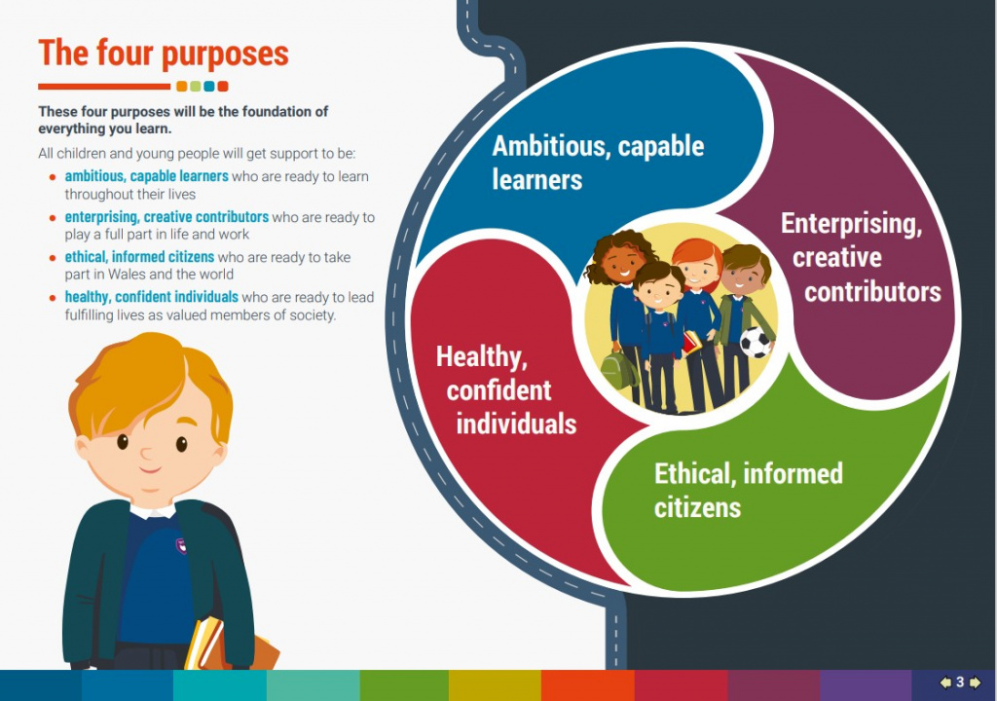


New Curriculum for Wales
(Welsh Government, 2022; 2023b).
(Lewis, 2023; Urdd,n,db ).
(School B, n,d)
(Mckeown, 2023).
2205543 – Katie Williams
(Dewey & Small, 1897; Donaldson, p.6 ; Welsh Government, 2015; 2022; 2023a; 2023b ; n,d).
Notes:
After decades of adjudigation and assimilation the Welsh language has since become an important aspect of Welsh education with the reform of the New Welsh curriculum for Wales (2022). The reformed curriculum places a strong emphasis on Welsh as a vital part of Welsh identity and culture. Welsh is not only taught as a subject but intergrated across all areas of learning including real-life experiences. As Professor Graham Donaldson notes children should be offered real life experiences outside the classroom p. 71 Welsh Government, (2015).
The Urdd offer an abundance of and activities for this which inevitably promotes bilingualism and "ethically Informed Citizens" also alligned with the Welsh Governments 'Cymraeg 2050" recent pledge to reach "one million Welsh speakers by the year 2050" will ensure children are proud of their language and culture (Welsh Government 2023b). In education the Welsh Language is supported by "Siarter Iaith" (the Welsh charter) with their overall aim being to inspire and encourage all to use Welsh n all aspects of life.

Slide 4
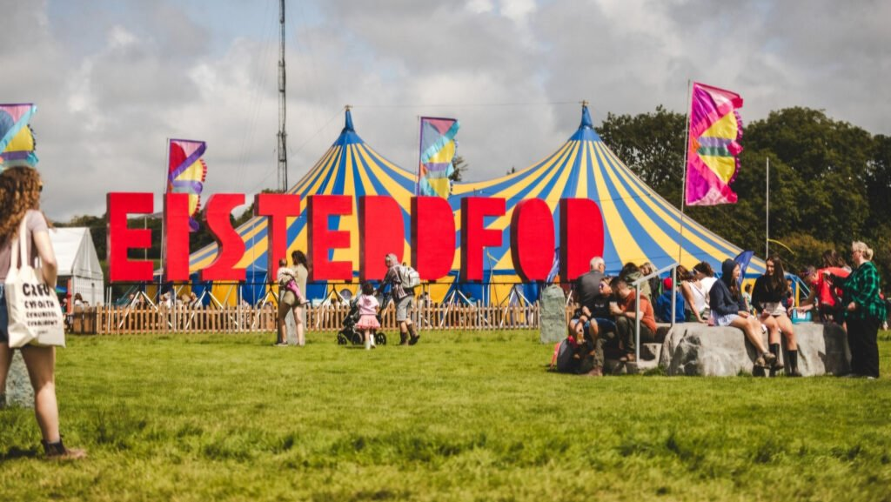
Eisteddford - annual event at different locations through-out Wales
(South Wales Life, 2024; Welsh Government, n,d; 2015; 2023; 2023b; Dewey & Small, 1897; Cummins, 2021; UNICEF, 2024; Urdd, n,db; Arad Research, 2023; School, A, 2023).
2205543 – Katie Williams
Notes:
The Urdd National Eisteddfod attracts children, young people, families and communities to join them in their annual festival of Welsh culture. It is held across different locations in Wales each year to assist the economy in all Welsh regions and to enable all areas of Wales to attend. Competitiors can enter various competitions exclusively for young people such as dancing, singing, acting, poetry, and many more through the medium of Welsh. There really is something for everyone to take part which ensures inclusivity. Local Vendors boast their talents in various food and retail stalls to facilitate the Welsh language cultutre and heritage. It is important to note in 2023 a massive 270,000 children, young people and families were involved in the Eistedfodd in some way which brought significant expenditure to the local economy.

Slide 5
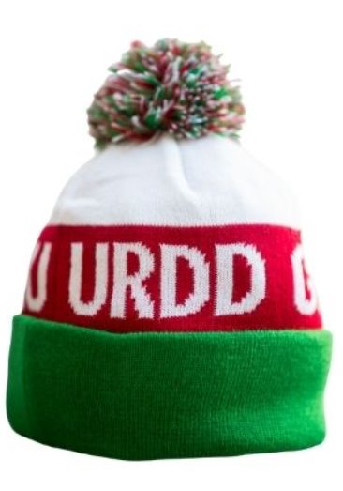


Impact of Covid-19
(Urdd, n,d).
(Admin, 2021).
(Rodriguez, 2020).
(Gal, 2023; UNICEF, 2024; Welsh Government, 2022; 2023b; 2024; Urdd, n,db; Urdd, 2023; 2025; Slaughter 2009, p.16, as cited in, Williams, et al, 2017; School, A, 2015; 2023).
2205543 – Katie Williams
Notes:
The Urdd reported significant revenue loss during Covid –19 pandemic, due to the cancelled live events and the impact on membership fees. Citizens were advised to stay home and isolate, the Urdd Eistedfodd reverted to online submissions which undoubtedley depleted the whole community atmosphere of the Eistedfordd but given the rules and restrictions the virtual event saw approximately 8000 participants. The remote format reflected the resilience of Welsh culture and community spirit during unprecedented times. As Slaughter (2007) posits "Our world today has become the electronic world" p.16 as cited in Williams et al, 2017 with many children preferring the virtual competition. However, with school closures in Wales children coming from non-Welsh homes felt the lack of exposure to the Welsh language was problematic despite the Urdd offering virtual support for participants to create an inclusive approach. The Urdd advertised the 'Hat to help' campaign encouraging people to buy a hat and support the Urdd in the most challenging year in history. With 29% children of Wales living in poverty the urdd offer a "Fund For All" scheme which was contributed to by various sponsors to enable impoverished children of Wales to enjoy a holiday at one of Urdd's residential Centres, to offer opportunities of meaningful experiences outside of the classroom for all children despite their background or financial situation. The Urdd membership costs £10 per annum however, they offer a reduced rate for families and a fee of £1 for low- income parents of Wales.

Slide 6
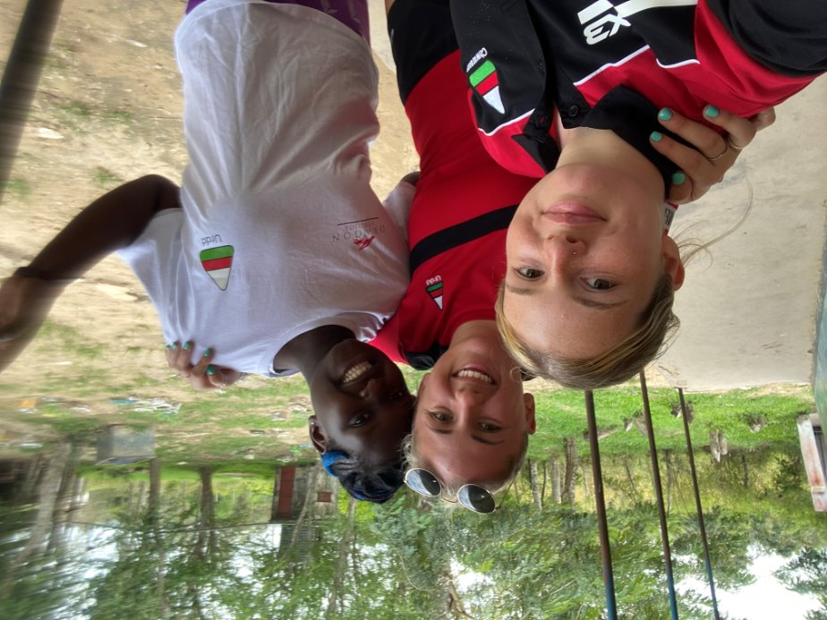
Apprenticeships
Urdd, n,da; Dewey & Small ,1897; Cummins, 2021; Welsh Government, 2015; Arad Research, 2023).
2205543 – Katie Williams
Notes:
Apprenticeships with the Urdd has become very popular in recent years, with149 apprenticeships enrolled at present. This scheme is funded by the Welsh Government and gives opportunities for young people age, 16 or above with an interest in working with children and young people via implementing fun sports, games and activities, to successfully complete a qualification which is recognised throughout the UK. Urdd deliver their apprenticeships through the medium of Welsh or bilingual, receiving a wage in return which is a great incentive for doing something you love whilst simultaneously promoting the Welsh language and developing your own career. Currently there are over 8000 children taking part in these sport clubs. It is important to note that 80% of apprenticeship learners conducted through the Urdd have successfully gone on to full time employment with the Urdd. According to Arad Research a massive 98% of apprentices reported they often use Welsh in their course or workplace and their over-all well-being and social skills had increased.

Slide 7
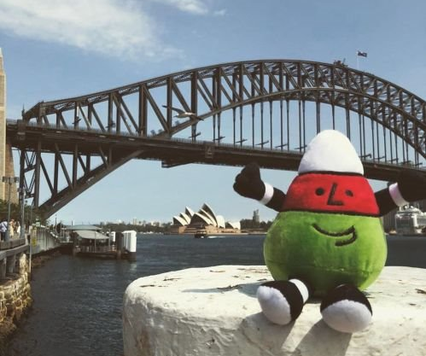
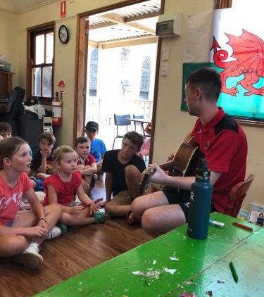
URDD goes International
(Kolb, 2014; Wales International, 2021; Urdd, n,d; UNICEF, 2023; Welsh Government, 2015; 2022; 2023a; Davies, 2013, p.60, as cited in Welsh Government, 2015).
2205543 – Katie Williams
Notes:
January 2020 saw many staff and apprentices visit Austrailia to advocate the Welsh language and allow Welsh children living in Sydney to enjoy activities, games and stories through the medium of Welsh. Funded by the Wales international the Urdd facilitate unique experiences to advance for future generations. It is Important children learn about their heritage and culture despite where they live in the world. Staff described the trip as an "unforgettable experience". Professor Sionedd Davies (2013) proposes "The future of Welsh and Welsh culture is wholly dependent on transmitting the language to our young people as cited in Donaldson successful future report p.60.

Slide 8
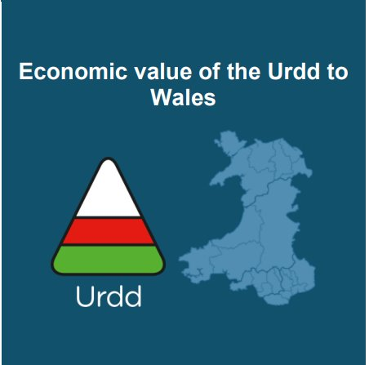
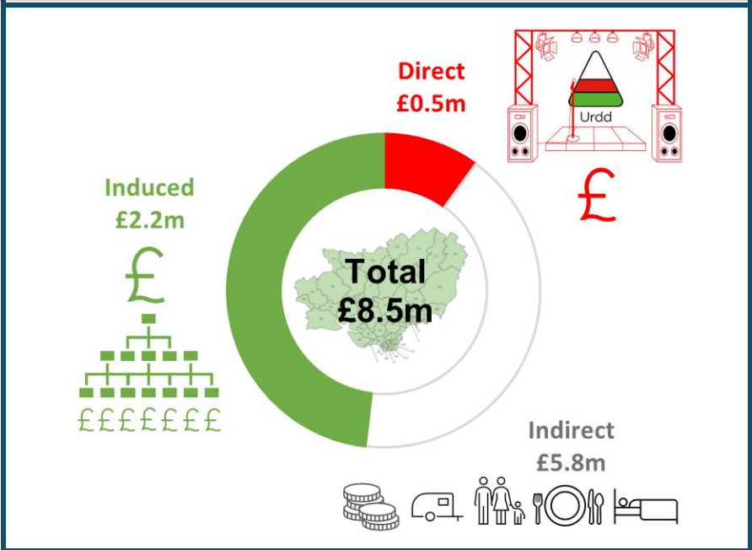
Carmarthenshire 2023 Eisteddford
#(Arad Reasearch, 2023)
2205543 – Katie Williams
Notes:
Based on the data from Arad Researh 2023, the Carmarthenshire area is expected to have created £8.5 million in economic value from the 2023 Urdd Eisteddfod with £3.8 million for lodging in the area and £0.6 million with companies in Carmarthenshire on the Eisteddfod site.

Slide 9
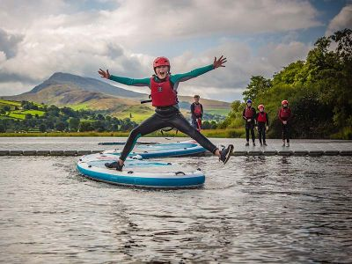
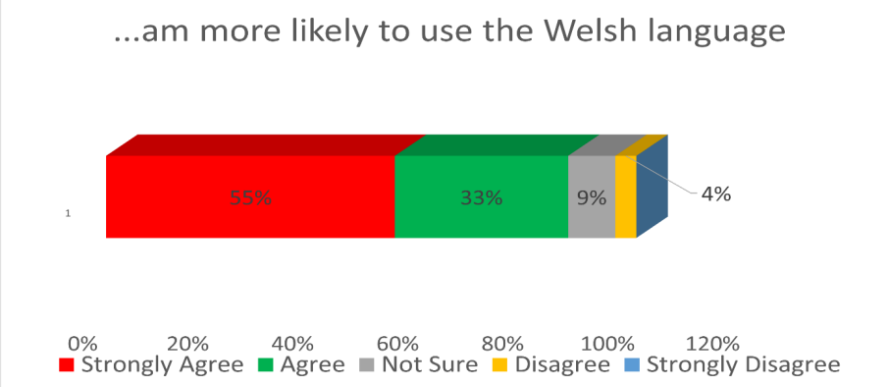
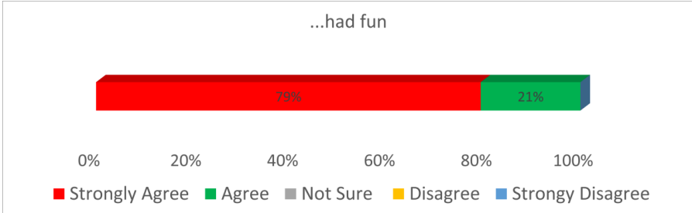

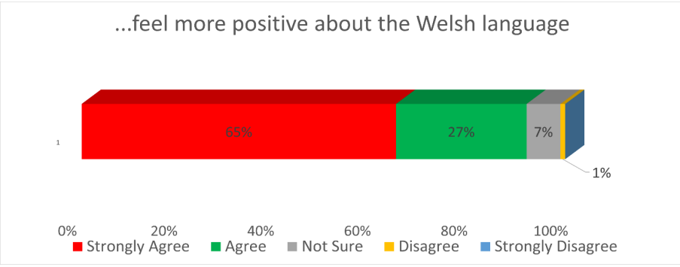
Impact of Urdd activities
(Lewis, 2023; Urdd,n,db; Arad Research, 2023 ).
2205543 – Katie Williams
Notes:
The Urdd has been running for over 100 years with their mission is to ensure all children have fun and enjoy whilst developing their fluency in the Welsh language. Arad Research highlighted results of this with 55% of children are more likely to use the Welsh language. 79% had fun and 65% feel more positive about the Welsh language.

Slide 10
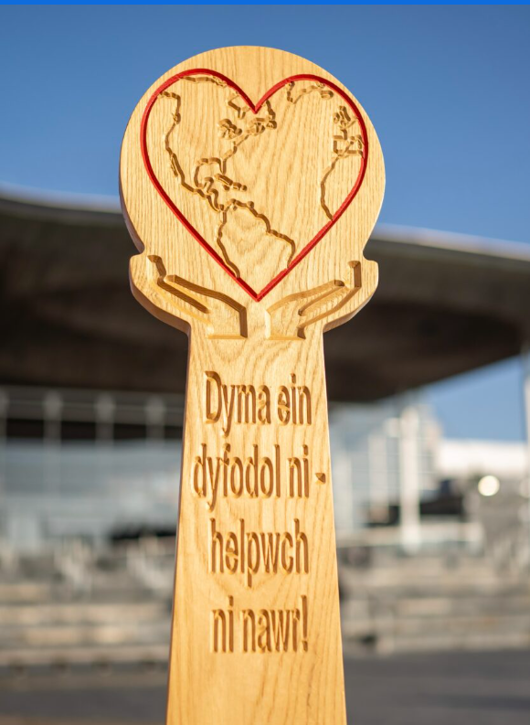
"Acting today for a better tomorrow"
2205543 – Katie Williams
"This is our future – help us now!"
(Cymru Can, 2025; School, A 2015; 2023; Welsh Government, 2015; 2021; 2022; 2023a; UNICEF, 2024; Kolb, 2014).
Notes:
The Urdd is a fundamental contributor to the economy, language, culture and education in all parts of Wales. Providing Ample opportunities for All children and young people up to the age of 25 in Wales to engage, learn, and enjoy Welsh in a variety of settings, including sports, arts, camps, and competitions which can support and promote a positive ethos towards the Welsh language and identities. These positive engagements equip children with Welsh linguistics and fluency, increase instrinsic motivation to enable them to become "Ambitious, Healthy, Confident, Ethical individuals. Developing strong Welsh proficiencies at a young age can ensure a smoother transition into adulthood where these skills are currently essential for both personal and professional success within Wales and the economy. Learning Welsh is a powerful way to connect within communities and beyond. Every word counts whether you're just starting out or you're brushing up on your fluency. Please embrace the Welsh language and be proud of our culture and identity. This can encompass everyone feeling valued and understood fostering a sense of belonging. As Future Generations Commissioner for Wales highlights "Acting today for a better tomorrow - This is our future, help us now. " . Diolch yn fawr!

