Slide 1
LCHS4001
Academic and Employability Skills
Reflective writing

Slide 2
Discussion
Discuss and answer these questions with a partner.
What is reflection?
Is there a “good” (e.g. effective) way to reflect? Is there a “bad” (e.g. ineffective) way to reflect?
Why is reflection important in personal, academic, and professional life?
Have you ever reflected on something before? If so, what was it? What did you learn?
What is reflective writing?

Slide 3
What is reflection?
Reflection is a purposeful activity in which you analyse experiences, or your own practice/skills/responses, in order to learn and improve.

Slide 4
What is reflective writing?
Reflective writing is evidence of reflective thinking.
In an academic context, reflective thinking usually involves:
1. Looking back at something (often an event/idea, something that happened).

Slide 5
2. Analysing the event or idea (thinking in depth and from different perspectives, and trying to explain, often with reference to a model or theory from your subject).
3. Thinking carefully about what the event or idea means for you and your ongoing progress as a learner and/or practising professional.

Slide 6

Why Reflect?
“It is not sufficient simply to have an experience in order to learn. Without reflecting upon this experience, it may quickly be forgotten, or its learning potential lost. It is from the feelings and thoughts emerging from this reflection that generalisations or concepts can be generated.”
(Gibbs, 1988)

Slide 7
Common Frameworks (models) of Reflection
Gibb’s ‘Reflective Cycle’ (1988)
Kolb’s ‘Experiential Learning Cycle’ (1984)
…..there are more reflective frameworks! For this course, you will use Kolb’s 1984 Learning Cycle
Notes:
Give out handouts (Gibb’s Reflective Cycle, Kolb’s Experiential Learning Cycle, Driscoll’s What Model) - https://www.repository.cam.ac.uk/bitstream/handle/1810/265159/MEM_ReflectivePracticeHandout_V4_20170616.pdf?sequence=1

Slide 8
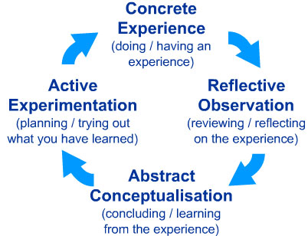
Kolb’s ‘Experiential Learning Cycle’ (1984)
Image source: http://cei.ust.hk/files/public/simplypsychology_kolb_learning_styles.pdf

Slide 9
Concrete experience
The “Description Stage”
In this part, you describe an experience from the past. Consider the questions: who, what, where, when, why, how
At this stage you simply describe what happened.
(Kolb, 1984)

Slide 10
Reflective Observation
This is the stage in which you reflect deeply on what has happened in that situation.
You can talk about your feelings and answer questions such as:
What worked?
What failed?
Why did others and I behave in a certain way?
(Kolb, 1984)

Slide 11
Abstract Conceptualisation
This is the stage in which you try to understand a situation better.
Questions to answer include:
What could have I done better or differently? Why?
How can I improve?
(Kolb, 1984)

Slide 12
Active Experimentation
In this stage you answer the following questions:
What will I do differently in the future?
How can I improve my performance in the future?
  (Kolb, 1984)
  This should be specific steps. Instead of “I should have practiced more, so I will practice more in the future”, consider what needed to be practiced more (e.g. timings? Tone? Specific content? More practice with notes? More practice in front of people? How much more should you practice in the future? How much earlier should you start practising than this time?)

Slide 13
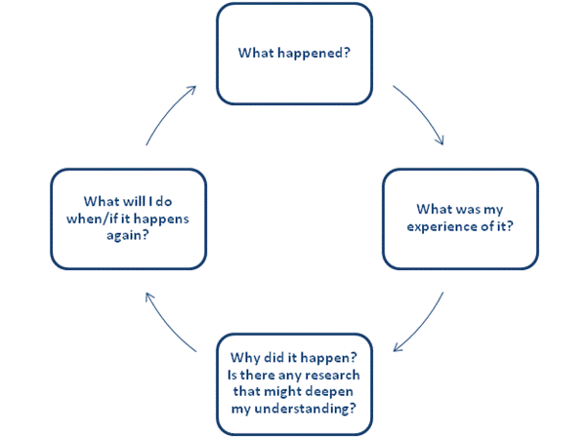
Basically…
Image source: https://www.bradford.ac.uk/wimba-files/skill-space/Reflective_Writing_HTML/page_04.htm

Slide 14
Why is Reflection Important...
...for university students:
Improves understanding and retention – solidifies knowledge and connects theory to real life.
Enhances academic skills – identifies strengths and areas to improve (e.g., writing, time management).
Promotes personal growth – builds self-awareness, resilience, and adaptability.
Prepares for professional life – develops critical thinking and self-evaluation for future careers.
Example: A student who receives feedback on an essay could reflect on where they lost marks, think about how to avoid similar mistakes in future assignments, and develop a more effective writing process for upcoming projects.

Slide 15
Why is Reflection Important...
For those who work in health and social care...
Improves patient care – refines practice for safer, more effective care.
Supports ethical and empathic practice – ensures respectful, sensitive treatment.
Facilitates ongoing learning – encourages adapting to new evidence and techniques.
Builds resilience and well-being – helps manage stress and avoid burnout.
Example: A nurse who faced a difficult patient interaction might reflect on their response and consider how to handle similar situations in the future. By identifying alternative approaches or recognizing any personal biases that came into play, the nurse can be better prepared to manage similar encounters empathetically and professionally.

Slide 16
Individual task
Think about your first few weeks at UWTSD
Write a short reflection (2-3 paragraphs)
Ideas:
  Comment on the lessons/topics so far: did you know about them before? Did you find them useful/difficult/challenging/boring? Why?
  Try to remember how you felt about this module at the beginning of term 1: compare with how you feel about it now
  Briefly summarise and comment on the usefulness of topics covered so far this term

Slide 17
References
Gibbs, G. (1988) Learning by doing: a guide to teaching and learning methods. [London]: FEU.
Leeds Beckett University (2015) Content Preview: Models for structuring reflection. Available at: https://skillsforlearning.leedsbeckett.ac.uk/preview/content/models/02.shtml (Accessed: 8th July 2019).
Kolb, D. A. (1984) Experiential learning: experience as the source of learning and development. Englewood Cliffs; London: Prentice-Hall.

