Slide 1
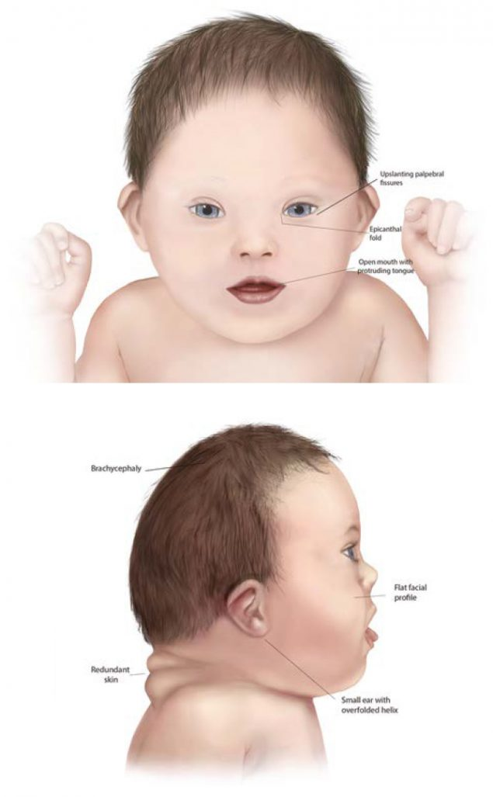
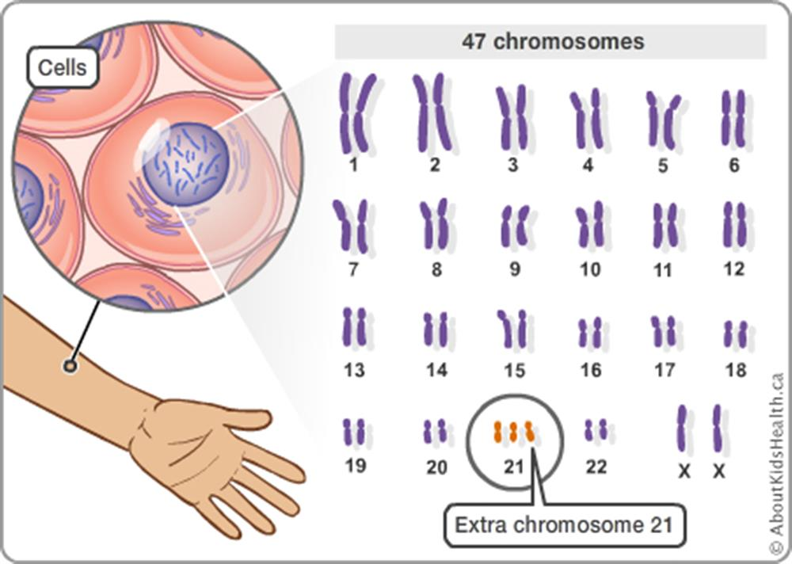
Ethical Issues of Diagnosis
This also leads to a number of ethical points relating to the choices a mother makes regarding the discovery of Down syndrome. According to Wattson 2021 at the beginning of the 21st century medical and social advances mean that for people with Down syndrome it has never been a better time to be alive. As she says that a generation ago children who were born with Down syndrome would have been encouraged to be institutionalized and that their lives would not worth living however the life expectancy of someone with Down syndrome is now around 60 and is likely to increase with better health care and social acceptance and their ability to access mainstream schooling is now the norm.
However Gaffney 2018 says that societal attitudes to disability's in the UK remain problematic and the United nations has identified a wide range of improvements that are needed to improve the lives of people with Down Syndrome.
the 2017 Nuffield report examined the ethics in parental screening and draws attention to the need to improve information given to mothers when offering the tests for Down syndrome as well as after the results have been given and to ensure that parents are made aware of the support and help that is available to them.
According to Gordy 2017 having Down syndrome can now be considered as not having a disease but as a variation that is a part of human diversity. She says that going forward the best-case scenario regarding screening dilemmas could be that this is the required catalyst for social change to recognise and urgently address issues of inadequate care and rights as well as the ability to change negative attitudes regarding Down syndrome.
Down Syndrome
What is Down Syndrome?
Down syndrome is a condition in which a person has an extra chromosome. Chromosomes are defined as small packages of genes inside a person’s body. They determine how a baby’s body forms and functions as it grows during pregnancy and after birth. Typically, a baby is born with 46 chromosomes. However, babies with Down syndrome have an extra copy of one of these chromosomes. Chromosome 21. A medical term for having an extra copy of a chromosome is Trisomy. Down syndrome is also often referred to as trisomy 21. This extra copy of a chromosome changes how babies’ bodies and brains develop which can cause both mental and physical challenges for a baby.
Even though people with Down syndrome might act and look similar each person has different abilities. People with Down syndrome usually have an IQ in the mildly to moderately low range and tend to learn to speak slower than other children.
Some common physical features of Down syndrome include a flattened face especially the bridge of the nose, small ears, poor muscle tone or loose joints and tend to be shorter than most as children and adults.
There are three types of Down syndrome.
Supporting Children with Down Syndrome.
One way of supporting children with Down syndrome is ensuring that they have an individual education plan. An IEP is created through collaboration with the child and their parent or carer in partnership with wider agencies that may be involved with the child such as health and social care professionals.
The individual development plan will say what the child needs to be able to learn and it also ensures that what is important to the child is shared with everyone as well as a description of their learning needs and what will be done to ensure that they are properly supported in school.
As every child with Down syndrome is unique it is important that the support that they receive is unique for them and is tailored specifically to support their individual needs therefore there isn't one specific way to support a child with Down syndrome. Therefore, it is important that they are correctly supported in school and that any additional learning provision that they receive are meeting their needs.
Source: Centre For Disease and Control Prevention 2022
Challenges That Children With Down Syndrome Face
There are a number of challenges that children with Down syndrome have to face. According to Down syndrome UK children with Down syndrome experienced learning difficulties that can lead to delays in many areas of development however not all areas of development are affected equally and that there are particular patterns of learning difficulties. Children with Down syndrome usually learn and progress more slowly than most other children.
Downing 2019 Says that there is a specific pattern of cognitive and behavioural features that have been observed among children with Down syndrome that differs from that seen in typically developing children. This pattern of characteristic strengths and weaknesses is known as a developmental profile.
Every child who has Down syndrome is an individual which means that there are considerable variations in every person who has it however there are a number of common features. These include:
intellectual disability
cranio facial anomalies
speech a language impairment
low muscle tone and
increased incidents of various medical and sensory issues including hearing, vision, heart, and thyroid disorders.
These are aspects of Down syndrome that will likely impact on a child's ability to access the correct support needed for them to access school and education.
How and When is Down Syndrome Diagnosed?
In the UK there are screening tests that can be used when a woman is pregnant to find out whether they have a higher chance of their baby being born with Down syndrome. This means that a woman can get earlier information to allow them to make informed decisions regarding their pregnancy. The screening tests that are offered during pregnancy are either ultrasound scans or blood tests. According to NHS UK these screening tests cannot harm the mother or baby in any way however the results of these tests can lead to difficult decisions for the mother to make such as if the test come back as a higher risk of Down syndrome the mother then has to decide whether then to have a diagnosis test such as a amniocentesis. Where they take a sample of fluid from around the baby to test whether there are sign that the baby has down syndrome, however this test carries a risk of miscarriage and this is estimated to happen in around one out of every hundred women who have the test.
Source: About Kids Health 2022

Slide 2
Reference List
About Kids Health (2019). Chromosomal Problems in Newborns. Available at: https://www.aboutkidshealth.ca/Article?contentid=468&language=English (Accessed 1/5/2022).
Action Medical Research for Children (no year). Down Syndrome Research Available at: https://action.org.uk/research/research-we-fund/down-syndrome?gclid=EAIaIQobChMIgYrU1_TK9wIVB-rtCh29lgLPEAMYAiAAEgLLevD_BwE (Accessed 26/04/2022).
Blaenau Gwent County Council (no year). Additional Learning Needs Provision. Available at: https://www.blaenau-gwent.gov.uk/en/resident/schools-learning/additional-learning-needs-aln/school-support/role-of-aln-coordinator/#:~:text=All%20schools%20have%20an%20Additional,and%20provision%20in%20the%20school. (Accessed 02/05/2022).
Centre For Disease Control and Prevention (2017). Down Syndrome. Available at: https://www.cdc.gov/ncbddd/birthdefects/downsyndrome.html#:~:text=is%20Down%20Syndrome%3F-,Down%20syndrome%20is%20a%20condition%20in%20which%20a%20person%20has,is%20born%20with%2046%20chromosomes (Accessed 01/05/2022).
Centre For Disease Control and Prevention (2018). Birth Defects. Available at: https://www.cdc.gov/ncbddd/birthdefects/downsyndrome.html (Accessed 28/04/2022).
Down Syndrome Association (no year). Down Syndrome Available at: https://www.downs-syndrome.org.uk/ (Accessed 06/05/2022).
Down Syndrome Ireland (no year) Supporting Children With Down Syndrome in primary School Available at: https://downsyndrome.ie/wp-content/uploads/2018/03/Supporting-Children-with-Down-syndrome-in-Primary-School.pdf /9Accessed 27/04/2022).
DSE (No Year) Development and Learning. Available at: https://www.down-syndrome.org/en-gb/about-down-syndrome/development (Accessed 01/05/2022).
Global Down Syndrome Foundation (no year) Facts About Down Syndrome. Available at: https://www.globaldownsyndrome.org/about-down-syndrome/facts-about-down-syndrome/#hurdle (Accessed 02/05/2022).
Journal of Public Health (no year). Public Health and Ethics Available at: https://academic.oup.com/jpubhealth/article/43/3/e493/5816021 (Accessed 02/05/2022).

Slide 3
Reference List
Mayo Clinic (2019). Symptoms and Cause Available at: https://www.mayoclinic.org/diseases-conditions/down-syndrome/symptoms-causes/syc-20355977 (Accessed 28/04/2022).
Mencap (no year) Down Syndrome. Available at: https://www.mencap.org.uk/learning-disability-explained/conditions-linked-learning-disability/downs-syndrome?gclid=EAIaIQobChMI2q2ho4mv9wIVAmHmCh32Pgm6EAAYASAAEgKzfPD_BwE (Accessed 06/05/2022).
Merthyr Tydfil County Council ( no year). Individual Development Plan Available at: https://www.merthyr.gov.uk/resident/learning-in-merthyr-tydfil/additional-learning-needs/the-special-educational-needs-system-is-changing/what-is-an-individual-development-plan/#:~:text=The%20individual%20development%20plan%20will,of%20their%20learning%20needs%3B%20and (Accessed 06/05/2022).
National Downs Syndrome Society (2018). How common is Down Syndrome Available at: https://www.ndss.org/about-down-syndrome/down-syndrome/ (Accessed 02/05/2022).
NHS Wales (2018) Amniocentesis Available at: https://www.nhs.uk/conditions/amniocentesis/ (Accessed 27/04/2022).
Positive About Down Syndrome (2020). Help and Support Available at: https://positiveaboutdownsyndrome.co.uk/?gclid=EAIaIQobChMIgYrU1_TK9wIVB-rtCh29lgLPEAMYASAAEgL1MvD_BwE (Accessed 29/04/2022).
Very Well Health (2021). What are the causes of Down Syndrome Available at: https://www.verywellhealth.com/what-are-the-causes-of-down-syndrome-2633265 (Accessed 04/05/2022).
Welsh Government (2021) The Additional Learning needs code for Wales. Available at: https://gov.wales/sites/default/files/publications/2021-03/210326-the-additional-learning-needs-code-for-wales-2021.pdf (Accessed 5/05/2022).

