Slide 1

Identifying ALN among ESOL Learners in Wales: A Critical Evaluation of Policy, Practice and Educational Equity
Snizhana Oliinichenko
Doctorate in Education (EdD)
University of Wales Trinity Saint David /2026
Module: ECDE7017

Slide 2

Why Does This Matter?
Language Difference or Additional Learning Need?
• English language acquisition
• Previous educational experience
• Literacy development
• Disrupted education
• Additional Learning Needs
• A combination of these factors
CENTRAL QUESTION
How can colleges distinguish language difference from ALN fairly?
AIM: Critically evaluate Welsh ALN policy and its identification and support of multilingual learners.
(Goodrich et al., 2023; Kangas, 2021)

Slide 3

What Does Welsh Policy Say?
The Welsh ALN Framework
• Additional Learning Needs and Education Tribunal (Wales) Act 2018
• Additional Learning Needs Code for Wales 2021
• Early identification
• Person-centred practice
• Individual Development Plans (IDPs)
• Appropriate Additional Learning Provision
Additional language ≠ Additional Learning Need
Policy principle ≠ evidence of consistent implementation.
(Welsh Government, 2021; Additional Learning Needs and Education Tribunal (Wales) Act 2018)

Slide 4
Policy versus Practice
Where Can Identification Go Wrong?
UNDER-IDENTIFICATION
ALN attributed
to limited English
MISIDENTIFICATION Language development interpreted as ALN
These are potential identification risks, not evidence of widespread failure in Welsh FE.
Policy clarity does not guarantee consistent practice.
(Goodrich et al., 2023; Kangas, 2021)— US research; not Welsh prevalence evidence

Slide 5
Welsh ALN Policy: Emerging Questions
Evidence from Further Education
PROGRESS
Established IDP structures in nearly all colleges
More effective transition collaboration
CONTINUING PRESSURES
Unidentified support needs on entry
Higher-than-expected workloads
No pan-Wales IDP platform
What does existing evidence tell us about ALN reform — and what remains unknown about ESOL learners?
(Estyn, 2024; Estyn, 2025), thematic reports on ALN in further education

Slide 6
Official Discourse vs Media Discourse
The Same System — Two Narratives
OFFICIAL DISCOURSE
Rights and inclusion
Person-centred provision
System transformation
Policy intentions
MEDIA EXAMPLE: ITV WALES (2024)
“Postcode lottery” framing
Family testimony and delays
Senedd committee concerns
Critical question: whose voices, evidence and settings are represented?
(ITV News Wales, 2024; Welsh Government, 2021)— general ALN coverage

Slide 7

International Perspective
Wales and the United States: Different Systems, Shared Challenges
US research warns against a simple “language or disability?” binary
Assessment requires language and literacy evidence
Interdisciplinary expertise can reduce error
US school evidence cannot be generalised to Welsh FE
Similar challenges do not mean identical legal systems or outcomes.
(Goodrich et al., 2023; Kangas, 2021) - US school-based literature

Slide 8
Stakeholder Perspectives — Different Needs, Shared Challenges
ESOL Learners
Fair assessment, appropriate support and learner voice
ESOL Lecturers and ALN Staff
Professional judgement, assessment tools and collaboration
FE Leaders and Policymakers
Consistent provision, resources and accountability
How might these different perspectives influence ALN identification?
(Estyn, 2025; Welsh Government, 2021)

Slide 9
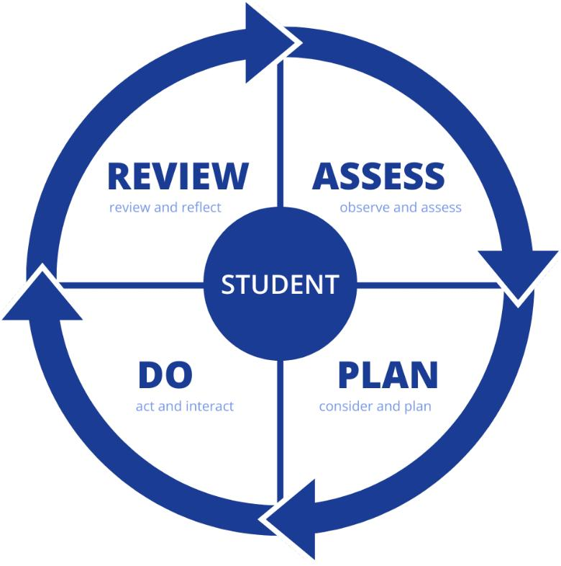
Emerging Questions for Policy and Practice
1. IDENTIFICATION
How can educators distinguish language difference from ALN?
2. STAKEHOLDER VOICE
Whose perspectives shape identification decisions?
3. EVIDENCE GAP
What do we know about ESOL learners in Welsh FE?
4. INTERNATIONAL LEARNING
What can Wales learn from international research?
Critical engagement raises questions for future enquiry, rather than providing final answers.
(Estyn, 2024; Estyn, 2025; Goodrich et al., 2023; Kangas, 2021; Welsh Government, 2021)

Slide 10
Conclusion— What Have I Learned?
Welsh ALN policy distinguishes language difference from additional learning needs.
Academic literature highlights the complexity of identifying ALN among multilingual learners.
Official, media and stakeholder perspectives raise different questions about fairness and support.
Further research is needed to understand ESOL learners' experiences in Welsh FE.
How can Welsh FE institutions ensure fair and inclusive ALN identification for multilingual learners?

Slide 11
References
Additional Learning Needs and Education Tribunal (Wales) Act 2018 (anaw 2). Available at: https://www.legislation.gov.uk/anaw/2018/2/contents (Accessed: 9 October 2026).
Estyn (2024) Additional Learning Needs in Further Education Colleges. Available at: https://estyn.gov.wales/improvement-resources/additional-learning-needs-in-further-education-colleges/ (Accessed: 10 October 2026).
Estyn (2025) Implementation of post-16 aspects of Additional Learning Needs (ALN) reform in FEIs. Available at: https://estyn.gov.wales/improvement-resources/implementation-of-post-16-aspects-of-additional-learning-needs/ (Accessed: 10 October 2026).
Goodrich, J.M., Fitton, L., Chan, J. and Davis, C.J. (2023) ‘Assessing oral language when screening multilingual children for learning disabilities in reading’, Intervention in School and Clinic , 58(3), pp. 164–172. Available at: https://doi.org/10.1177/10534512221081264
ITV News Wales (2024) ‘Children with ALN and disabilities in Wales being “let down” over “postcode lottery”’, ITV News, 16 July. Available at: https://www.itv.com/news/wales/2024-07-16/children-with-aln-and-disabilities-in-wales-let-down-over-postcode-lottery (Accessed: 8 October 2026).
Kangas, S.E.N. (2021) ‘“Is it language or disability?”: An ableist and monolingual filter for English learners with disabilities’, TESOL Quarterly, 55(3), pp. 673–683. Available at: https://doi.org/10.1002/tesq.3029
Welsh Government (2021) The additional learning needs code for Wales 2021. Available at: https://www.gov.wales/additional-learning-needs-code (Accessed: 10 October 2026).

