Slide 1
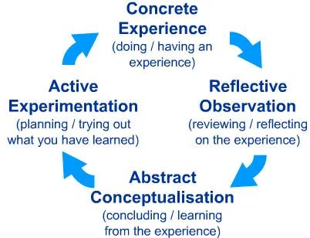
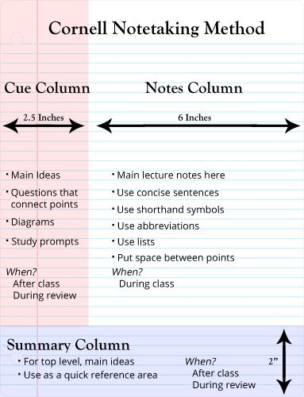
Unit: ECGE4003P Name: Chloe Louise Thomas Student :2100587
Critical Thinking
Defining Critical Thinking
Critical thinking is when one take responsibility in improving their thinking by analysing, assessing, and reconstructing it based upon what situation they are in.
How Can Critical Thinking Be Used?
A critical thinker will look for evidence to back up the hypotheses they have considered.
A hypothesis is a prediction or assumption in which you make based upon an idea or concept. Both perspectives are then considered and researched carried out allowing for a growth in your knowledge and understanding. That can be formed into an overall personal belief that helps within you determining your own opinion with facts that, support your belief.
When a hypothesis is considered, you should ensure that you are not bias and that you involve and acknowledge all perspectives or opinions that can be related to the hypothesis that you are making. A hypothesis can be developed through research or the usage of books in order, to have multiple areas that can be considered in your overall belief and provide factual and reliable when presenting such, hypothesis.
Reflection
Practitioners must learn how to integrate reflection with also the usage of critical thinking in order for it to become a manageable skill that can be utilised effectively within day to day activities and occurrences. These can include the usage of polices and procedures or looking back upon activities that have been carried out. A.Price (2004). Reflection can be defined differently amongst individuals, as the reflection strategy chosen can prove effective to one individual whilst another may considered it to be unhelpful and therefore opt for another strategy.
Experiential learning is the name given to Kolb's reflective approach. Our personal experience serves as the foundation for this concept and is the building block of how we learn and intellectually developed throughout life.
Kolb's theory is heavily influenced by the learner's own cognitive processes and considering the building blocks that are formed within what they have carried out. Considering the variables will help within positive progress in the future and providing the best possible outcomes. As it allows one to reflect upon their work. During this reflection process it ensures that key areas are identified, this involves what they need to improve upon in the future and what they have done well.
Kolb’s believes a person's chosen style is influenced significantly, by a variety of variables and factors that have been experienced. These factors can include, the individual's social surroundings such as, livelihood, educational experiences, or underlying cognitive structure. Kolb (1984)
Likewise, many other theorists believe that reflection is a fundamental part in critical thinking. Moon (2004), recognise that students can implement a variety of strategies involving reflective learning into their own practice. Yet Moon especially highlights, reflection in the written form. ‘Reflection lies somewhere around the notion of learning and thinking. We reflect in order to learn something, or we learn as a result of reflecting’ Moon (2004)
When we create a reflection representation, we shape and model the content of our reflection based on external factors and internal factors. Such factors are then portrayed in ones writing and what they present, this can include writing for a attended audience and therefore, ensuring that it is formally written. Moon (2004)
However, if reflecting upon your day in a diary in can contain informal writing that may focus on the good points and ensuring that they are visible, or if there were negative point within the day this can be written down so that they can reflect upon it but, having the tendency to miss segments that cause a negative reaction when thought about or are too painful. Therefore, they choosing to skim over it and only include brief points.
Skills Used In Critical Thinking
Critical Thinking is formed of key sills that helps shape the way in which we think and therefore, what we dictate to the world.
The key skills that tend to form the intellectual stability for thinking critically. Specifically we ought to be able to, think about a topic that is going to arise in a critically formed way. This includes, identifying diverse arguments that can be made in connection to a specific issue.
Recognising any weaknesses or negative focuses that there are in the evidence or argument can help within evaluating a point to see to decide how strong or substantial it is. Through such evaluations it can help provide a structured and organised argument with key points being arise and evidence to support and provide reliability of such points.
‘When we reach a tentative conclusion, we pause and consider the impact on the people and activities around us’. Skills You Need (2011)
Goal Setting
Setting a goal, helps a person visualise what the outcome, of there thought process. As setting a goal for the future or one at that present time helps one in vision what they need to do, how they intend to do it and decide upon a time scale which is appropriate and achievable. Goals ultimately assist you in deciding where you want to go in your life and what the next step is.
According to Rader (2005), when students create goals for themselves, they are compelled to concentrate on themselves and their ambitions. Whether it is earning the highest mark or spending time concentrating on their grammar.
Goals that are met create a sense of achievement and higher self-esteem. The act of deciding on the goal you strive to reach should cause the sense of enthusiasm when met and empower and encourage one to keep on going in order to reach it. .
Note Taking
Note taking is identifying key points to look back upon at a later date if required.
An example of an effective way to take notes is by using the Cornell Style of note taking involves, dividing a piece of paper into three unequal segments consisting of a questions column, a note column, and a summary space. Pauk (1962)
Pauk method is believe to help within effective note taking as it allows the brain to understand the information being wrote therefore, providing the brain with the ability to start retaining the information.
Pauk (1962) breaks down his method into fiver parts:
First, record your notes using the three columns as a outline.
Secondly reduce your notes, this ensures that only the key points are recorded and consequently, provides information which is required rather than information that is wrote yet, not understood.
The third step is to, recite your notes from memory, as this allows you to see how much you have actually acknowledged. If you are able to recollect the note easily this could mean you have not wrote enough such as, key dates and legalisation. If it felt extremely hard then you may need to revisit your notes and identify the areas which you deem are key.
The fourth step is to, reflect on the material and the way in which you decide to conduct your note taking and whether it is any areas that you believe need to be focused upon.
The fifth and final step is to review your notes when carrying out assignments to ensure key information is included. However note taking can be used as a source that can be revisited at any point during your studies.
Simply Psychology
E.Williams (2021)
Conclusion
To conclude there are numerous ways that you can enhance, your critical thinking. Whether it is through note taking and using the Cornell Style to provide yourself with a organised layout to follow. Setting goals as highlighted by Rader (2005) .Or reflecting upon your work method linked to enhancing your critical thinking and focused upon by Moon (2004) and Kolb (1984)

Slide 2
References
Academic Skills Specialists, Cardiff Metropolitan University. (Date Unkown). Reflective writing: applying Kolb’s (1984) learning cycle. Retrieved from https://study.cardiffmet.ac.uk/AcSkills/Documents/Guides/AS_Guide_Reflective_writing_Kolb.pdf (Accessed 19th September 2021)
Anita Welch, S. D. (2012). The Impact of the Cornell Note-Taking Method on Students’ Performance in . Journal of Family & Consumer Sciences Education. Accessed (20th September 2021)
Cornell University. (2019). The Cornell Note Taking System. Retrieved from Cornell University: https://www.youtube.com/watch?v=nX-xshA_0m8 https://lsc.cornell.edu/how-to-study/taking-notes/cornell-note-taking-system/ (Accessed 19th September 2021)
McLeod, S. (2017). Kolb's Learning Styles and Experiential Learning Cycle. Retrieved from Simply Psychology: https://www.simplypsychology.org/learning-kolb.html (Accessed 12th September 2021)
Moon, J. (2004). Resources for Reflective Learning. In M. J, Reflective and Experiential Learning. Routledge Falmer, London. (Accessed 20th September 2021)
Price, A. (2004). Encouraging reflection and critical thinking in practice. Encouraging reflection and critical thinking in practice, (Vol. 18, Issue 47). (Accessed 20th September 2021)
Rader,L.A.(2005) The clearing house: A Journal of Educational Goal setting for students and teachers: six steps to success Vol78 p123-126 (Accessed 22nd September 2021).
Scriven, M., & Paul, R. (1987). Defining Critical Thinking. Retrieved from The Foundation For Critical Thinking: https://www.criticalthinking.org/pages/defining-critical-thinking/766 (Accessed 18th September 2021)
Skills You Need. (2011). Critical Thinking Skills. Retrieved from Skills You Need: https://www.skillsyouneed.com/learn/critical-thinking.html (Accessed 22nd September 2021)
Skills You Need. (No Date). Note-Taking. Retrieved from Skills You Need: https://www.skillsyouneed.com/write/notes-verbal.html (Accessed 19th September 2021)
The Foundation Of Critical Thinking. ((Date Unkown)). Our Concept and Definition of Critical Thinking. Retrieved from The Foundation Of Critical Thinking: http://www.criticalthinking.org/pages/our-conception-of-critical-thinking/411 (Accessed 18th September 2021)
Williams, E. (2021). What Is Cornell Note Taking System and How to Use It. Retrieved from Wonder Share: https://pdf.wondershare.com/mobile-app/cornell-note-taking-system.html (Accessed 22nd September 2021)

