Slide 1



Optimizing Team Performance:
Cleaning Checklist Training
Aligning with Brand Standards and Employee Engagement
Student Name: Loredana Leonte
Student No: 2234690
Module Title: Operating Hotel Facilities
Module Code: BMIH4006
Lecturer: Natalie Brailsford

Slide 2
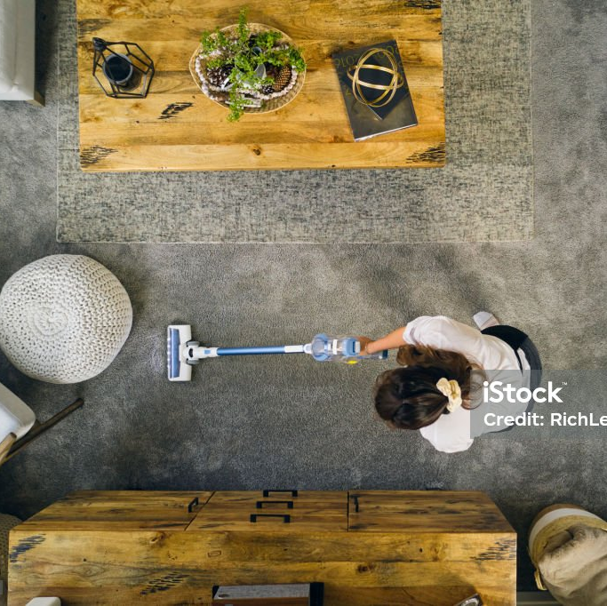
consistency is the cornerstone of excellence
guest satisfaction relies on cleanliness of rooms
“…guests expect the same high level of service quality every time they interact with a hospitality establishment”¹, Harun Ar Rashid
This presentation outlines a basic room cleaning training designed to elevate our standards, following guestroom complaints reflecting lack of consistency in housekeeping services

Slide 3
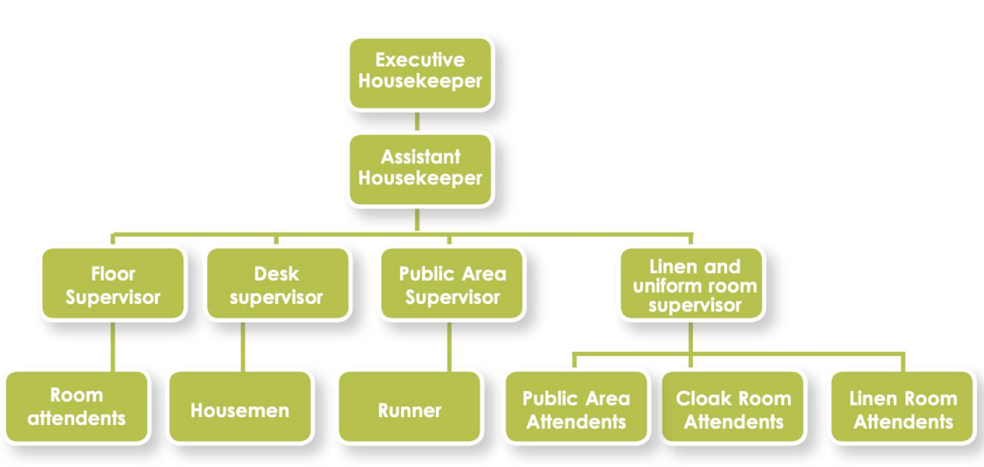
Positions in the Housekeeping Department²

Slide 4
Agenda
Cleaning checklist overview:
Surface Cleaning
Bedding and Linens
Bathroom Sanitation
Floor Maintenance
Restocking Amenities
To ensure rooms are consistently cleaned to brand standards, this checklist will be exhaustive and will cover all aspects of room cleanliness
Measures to Improve Team Effectiveness:
Training
Quality Control Inspections
Communication and Feedback
Performance Recognition
“A hotel housekeeping checklist is a tool used by hotel housekeeping staff, hotel managers, and other cleaning employees to ensure that all guest rooms, amenities, facilities, and common areas are cleaned and maintained according to required standards.”³

Slide 5
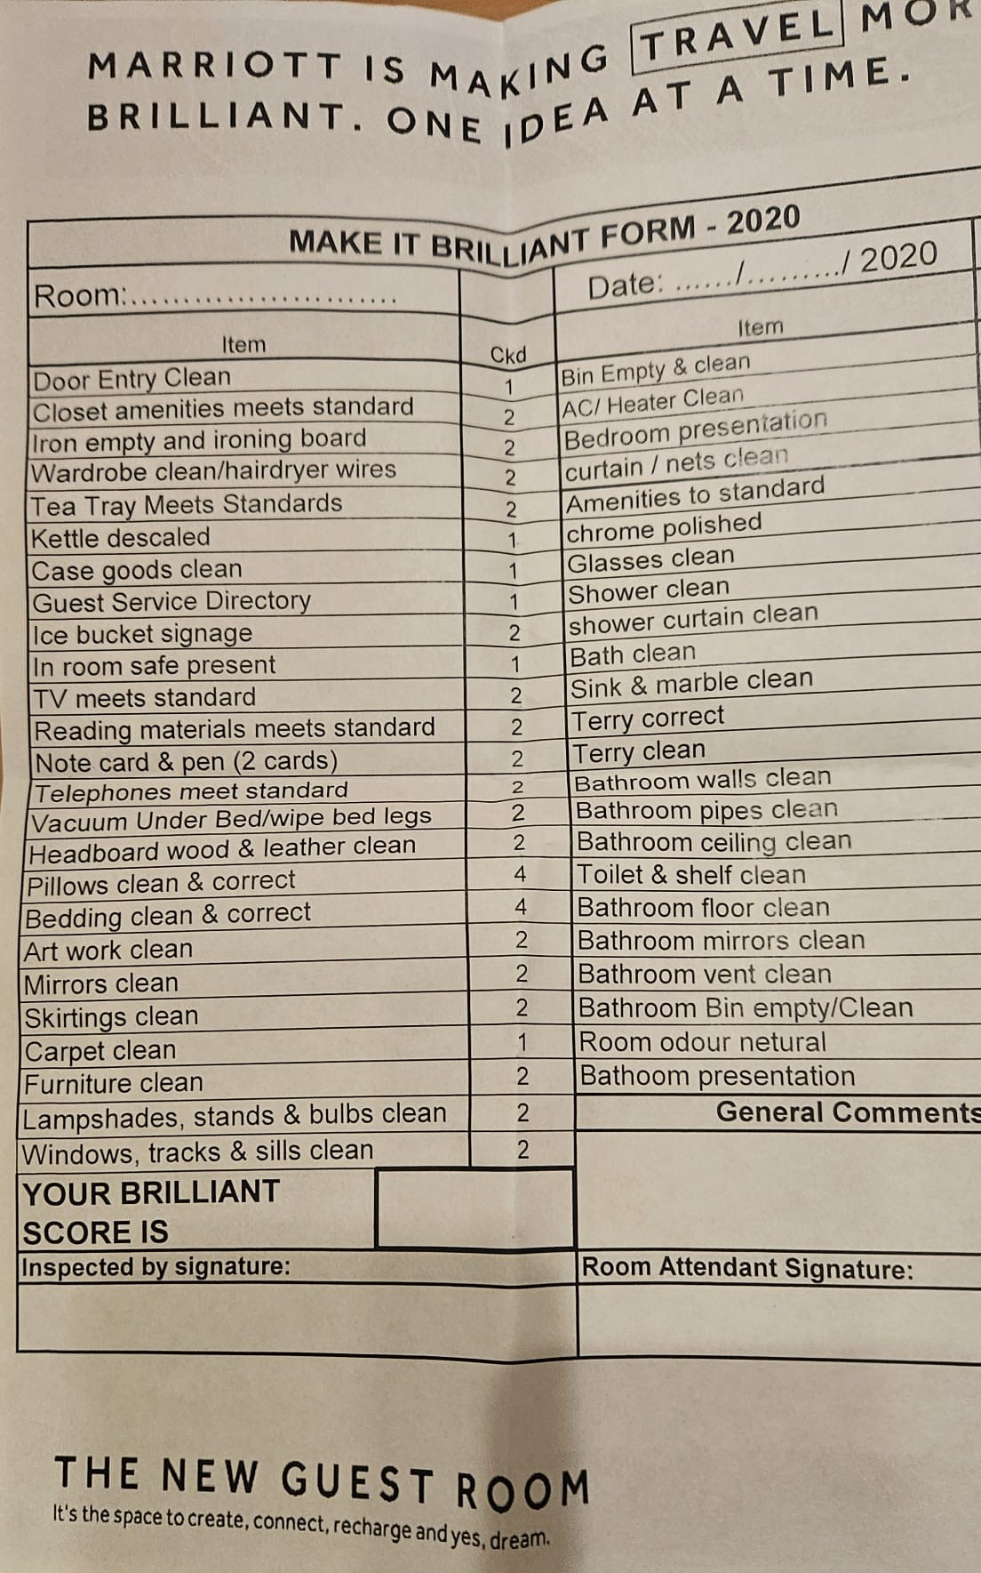





Cleaning checklist overview
Guest’s satisfaction is measured by the quality of their sleep; a cleaned bed with fresh linen will ensure this
Bedroom and Beds
Doors
Windows
Furniture
Bathroom
Guest belongings
Especially after COVID 19, cleaning doors and door handles is essential to providing guests with the level of hygiene needed for their safety and health
A clean window is the pinnacle of a clean room
Clean furniture offers guests trust in using hotel amenities
According to studies, the bathroom is even more important to guests than the bedroom is
Arranging and caring for a guest’s belongings proves that hotel staff cares for the guest

Slide 6
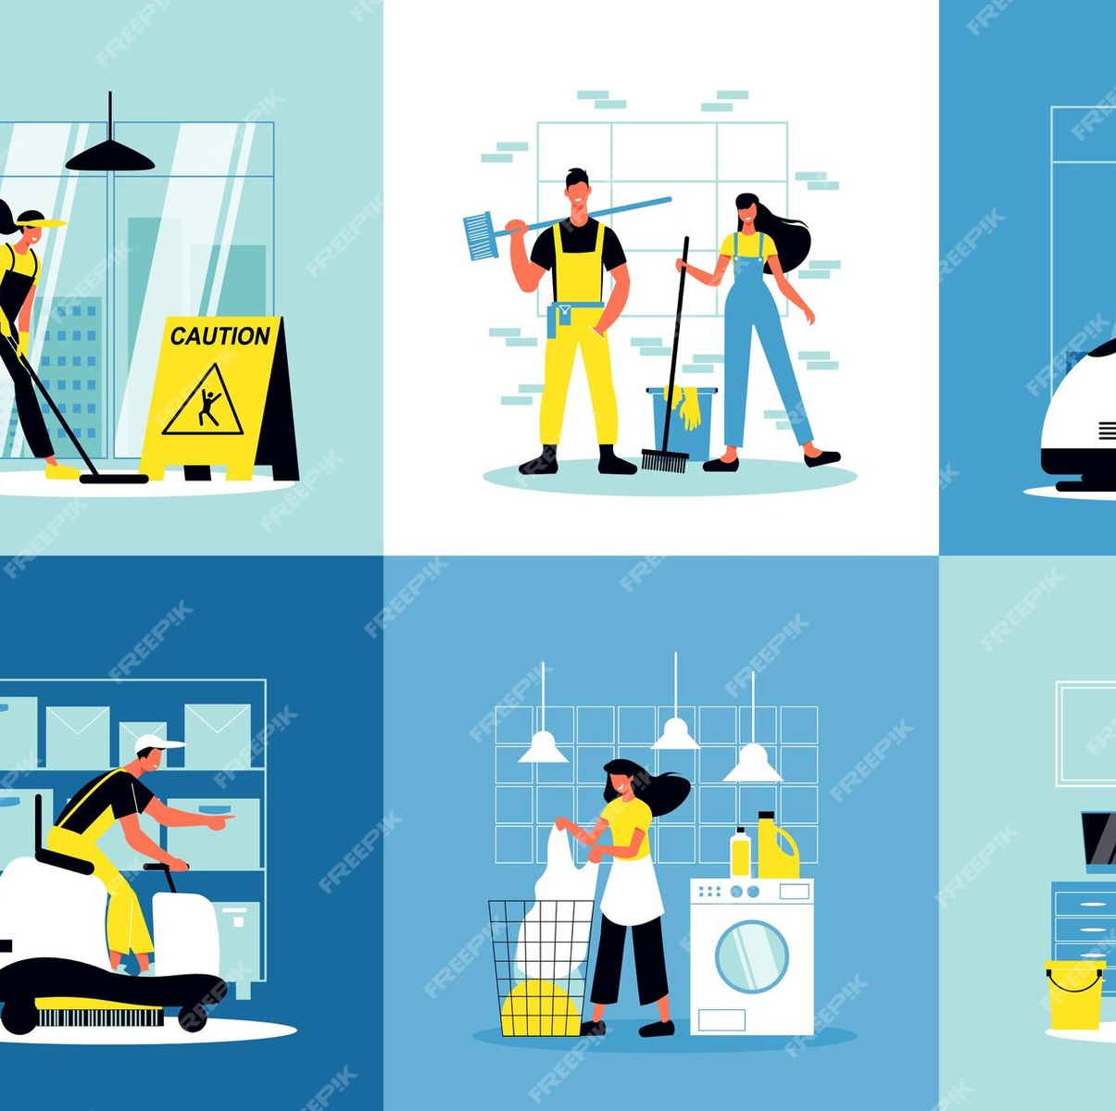
Training plan for cleaning checklist
Introduce the cleaning checklist to the team and explain its importance.
Walk the team through the checklist and demonstrate how to complete each task.
Answer any questions that the team may have.
Have the team practice using the checklist to clean the workspace.
Monitor the team's use of the checklist and provide feedback as needed.
Before leaving the room, check that all windows are closed, and doors shut. […] Finally, check that there’s no remaining rubbish and that the furniture is tidy, and that all the supplies have been restocked. Now is also the time to check guest requests.⁴

Slide 7
Additional training aids
Make the cleaning checklist visible and accessible to all team members.
Encourage team members to provide feedback on the cleaning checklist and suggest improvements.
Create a reward system for the team members and their participation.
Celebrate the team's success in using the cleaning checklist to improve their workspace.
“The simulation-based training changed the behaviour of the cleaners, as they became more confident and understanding in performing their work.”⁵

Slide 8

Basic training for housekeeping staff
”…the presence of cleaning staff is perceived as a social cue which implies the presence of other positive traits in the environment”⁶
Staff hygiene and grooming
Uniform
Methods of housekeeping and cleaning
Greeting a guest
Answering guest questions
Entering a guest room
Servicing an occupied room
Servicing a vacant room
Making the beds
Cleaning mirrors and windows
Cleaning toilets and sinks
Dusting methods
Finding lost items

Slide 9
Personal hygiene and grooming training
“Grooming is closely related to hygiene but is not strictly the same thing. For example, while keeping the hair clean would count as hygiene, shaving and styling preferences are to do with grooming.”⁷
Staff hygiene and grooming
Staff need to present themselves in a professional manner, shower and brush their teeth daily, groom their nails and hair
Uniform
The uniform has to be complete, always clean and a name badge needs to be displayed in plain sight

Slide 10
Structure of training
“Training may be defined as those activities that are designed to help an employee begin performing tasks for which he or she is hired or to help the employee improve performance in a job already assigned”⁸
Training for cleaning rooms and other spaces should be done on site, by specialized staff, and should include at least one shadow shift in order for the trainee to understand the workload and its importance.
Guest oriented training can be provided online or in a class, without the trainee’s involvement in the hotel’s business areas.
Methods of housekeeping and cleaning
Servicing an occupied room
Servicing a vacant room
Making the beds
Cleaning mirrors and windows
Cleaning toilets and sinks
Dusting methods
Greeting a guest
Answering guest questions
Entering a guest room
Finding lost items

Slide 11
References
¹ Md. Harun Ar Rashid, “Elevating Customer Satisfaction Through Service Excellence in the Hospitality Industry”, Sep 23, 2023, https://limbd.org/elevating-customer-satisfaction-through-service-excellence-in-the-hospitality-industry/, Library & Information Management Academic Blog, accessed on 11 November 2023, 13:34
⁷ Vos et al, “The Importance of Hygiene and Grooming”, https://ecampusontario.pressbooks.pub/personalcareassistant/chapter/5-1-2-the-importance-of-hygiene-and-grooming/, OpenLibrary, accessed on 07 November 2023, 10:13
⁸ Thomas J. A. Jones, “Professional Management of Housekeeping Operations”, William F. Harrah College of Hotel Administration, University of Nevada, Las Vegas, John Wiley & Sons, Inc., 2005, fourth edition
²https://moodle.uwtsd.ac.uk/pluginfile.php/714870/mod_resource/content/1/Summer%2023%20OHF%20Week%203%2C%20Housekeeping%20KF%20PDF.pdf, accessed on 10 November 2023, 19:11
³ What is a Hotel Housekeeping Checklist?, 15 Aug 2023, https://safetyculture.com/checklists/hotel-housekeeping/, accessed on 11 November 2023, 10:31
⁴ Menilik, “Hotel Housekeeping: Tips & Tricks for Cleaning Hotel Rooms”, https://prenohq.com/blog/hotel-housekeeping-tips-tricks-for-cleaning-hotel-rooms/, Preno, accessed on 12 November 2023, 12:30
Picture on slide 2: https://www.istockphoto.com/photo/professional-housecleaner-at-work-gm1369817796-439509082
⁵ Battan et al, “The effectiveness of simulation-based training on KAU hospital housekeeping staff performance”, August 2023, https://www.sciencedirect.com/science/article/pii/S2468045123000123, ScienceDirect, accessed on 12 November 2023, 20:30
Picture on slide 6: https://www.freepik.com/premium-vector/cleaning-service-compositions-set_13740849.htm#query=housekeeping&position=7&from_view=keyword&track=sph
⁶ Vos et al, “Into the Light: Effects of the Presence of Cleaning Staff on Customer Experience”, August 2023, https://ris.utwente.nl/ws/portalfiles/portal/91401189/, University of Twente, accessed on 07 November 2023, 10:13
Picture on slide 5: Delta Hotels by Marriott Swindon, housekeeping checklist, obtained on 03 November 2023, 14:00

