Slide 1
Enhanced Interior Gateway Routing Protocol (EIGRP)

Slide 2
Objectives
EIGRP Characteristics
  The features and characteristics of EIGRP.
    The basic features of EIGRP.
    The types of packets
Implement EIGRP for IPv4
  Implement EIGRP for IPv4 in a small to medium-sized business network.
    Configure EIGRP for IPv4 in a small routed network.
EIGRP Operation
  Metrics used
  DUAL
Implement EIGRP for IPv6
Notes:
2

Slide 3
EIGRP Characteristics

Slide 4
EIGRP Features
EIGRP was a Cisco-proprietary distance-vector protocol with link-state features.
EIGRP features include:
  Advanced distance vector
  Fast convergence
  Partial updates
  Multiple network layer support
  Use of multicast and unicast communication
  Variable-length subnet masking (VLSM) support
Notes:
Fast convergence—EIGRP uses DUAL to achieve rapid convergence. A router running EIGRP stores its neighbors’ routing tables so that it can quickly adapt to changes in the network. If no appropriate route or backup route exists in the local routing table, EIGRP queries its neighbors to discover an alternative route. These queries are propagated until an alternative route is found, or it is determined that no alternative route exists.
Partial updates—EIGRP sends partial triggered updates instead of periodic updates. These updates are sent only when the path or the metric for a route changes; they contain information about only that changed link rather than the entire routing table. Propagation of these partial updates is automatically bounded so that only those routers that require the information are updated. As a result, EIGRP consumes significantly less bandwidth than IGRP. This behavior is also different than link-state protocol operation, which sends a change update to all routers within an area.
Multiple network layer support—EIGRP supports IP version 4 (IPv4), IP version 6 (IPv6), AppleTalk, and Novell NetWare Internetwork Packet Exchange (IPX) using protocol-dependent modules that are responsible for protocol requirements specific to the network layer. EIGRP’s rapid convergence and sophisticated metric offer superior performance and stability when implemented in IP, IPv6, IPX, and AppleTalk networks.
Use of multicast and unicast—EIGRP uses multicast and unicast for communication between routers, rather than broadcast. As a result, end stations are unaffected by routing updates or queries. The multicast address used for EIGRP is 224.0.0.10.
Other EIGRP features include the following:
Variable-length subnet masking (VLSM) support—EIGRP is a classless routing protocol, which means that it advertises a subnet mask for each destination network; this enables EIGRP to support discontinuous subnetworks and VLSM.
Seamless connectivity across all data link layer protocols and topologies—EIGRP does not require special configuration to work across any Layer 2 protocols. Other routing protocols, such as Open Shortest Path First (OSPF), require different configurations for different Layer 2 protocols, such as Ethernet and Frame Relay (as you will see in Chapter 3, “Implementing an OSPF-based Solution”). EIGRP was designed to operate effectively in both local-area network (LAN) and wide-area network (WAN) environments. In multiaccess topologies, such as Ethernet, neighbor relationships (also known as neighborships) are formed and maintained using reliable multicasting. EIGRP supports all WAN topologies: dedicated links, point-to-point links, and nonbroadcast multiaccess (NBMA) topologies. EIGRP accommodates differences in media types and speeds when neighbor adjacencies form across WAN links. The amount of bandwidth that EIGRP uses on WAN links can be limited.
Sophisticated metric—EIGRP uses the same algorithm for metric calculation as IGRP, but represents values in a 32-bit format, rather than IGRP’s 24-bit format, to give additional granularity (thus, the EIGRP metric is the IGRP metric multiplied by 256). A significant advantage of EIGRP (and IGRP) over other protocols is its support for unequal metric load balancing that allows administrators to better distribute traffic flow in their networks.

Slide 5
EIGRP Features
  Seamless connectivity across all data link layer protocols and topologies
  By default, it performs automatic route summarization at major network boundaries (can be disabled) but can also be configured to summarize on interfaces.
  Manual summarization at any point
  100% loop-free classless routing
  Easy configuration for WANs and LANs
  Load balancing across equal and unequal cost pathways

Slide 6
EIGRP Key Components
Protocol-dependent modules
  Supports IP, Apple talk, Novell NetWare
  Each protocol has its own EIGRP module and operates independently from any of the others that may be running
Neighbors Discovery/Recovery
  Uses hello packets between neighbors

Slide 7
EIGRP Key Components
Diffusing Update Algorithm (DUAL) finite-state machine
  Selects lowest cost, loop-free paths to each destination.
Reliable Transport Protocol (RTP)
  Guaranteed, ordered delivery of EIGRP packets to all neighbors
  EIGRP can call on RTP to provide reliable or unreliable service as the situation warrants
  With RTP, EIGRP can multicast and unicast to different peers simultaneously allowing for maximum efficiency.

Slide 8
EIGRP Terminology
Neighbor table
Topology table
Routing table
Advertised Distance (AD)
Feasible Distance (FD)
Successor
Feasible successor (FS)
Passive Versus Active Routes

Slide 9
EIGRP Tables
Neighbor table
  Contains EIGRP neighbor addresses and the interface through which they can be reached.
Topology table
  Contains all destinations advertised by neighboring routers.
Routing table
  Contains EIGRP successor routes.
Notes:
Neighbor table
EIGRP routers use hello packets to discover neighbors. When a router discovers and forms an adjacency with a new neighbor, it includes the neighbor’s address and the interface through which it can be reached in an entry in the neighbor table. This table is comparable to the neighborship (adjacency) database used by link-state routing protocols (as described in Chapter 3). It serves the same purpose—ensuring bidirectional communication between each of the directly connected neighbors. EIGRP keeps a neighbor table for each network protocol supported; in other words, the following tables could exist: an IP neighbor table, an IPv6 neighbor table, an IPX neighbor table, and an AppleTalk neighbor table.
Topology table
When the router dynamically discovers a new neighbor, it sends an update about the routes it knows to its new neighbor and receives the same from the new neighbor. These updates populate the topology table. The topology table contains all destinations advertised by neighboring routers; in other words, each router stores its neighbors’ routing tables in its EIGRP topology table. If a neighbor is advertising a destination, it must be using that route to forward packets; this rule must be strictly followed by all distance vector protocols. An EIGRP router maintains a topology table for each network protocol configured (IP, IPv6, IPX, and AppleTalk).
Routing table
The routing table holds the best routes to each destination and is used for forwarding packets; EIGRP successor routes are offered to the routing table. As discussed in Chapter 1, “Routing Services,” if a router learns more than one route to exactly the same destination from different routing sources, it uses the administrative distance to determine which route to keep in the routing table. By default, up to 4 routes to the same destination with the same metric can be added to the routing table (recall that the router can be configured to accept up to 16 per destination). The router maintains one routing table for each network protocol configured.

Slide 10
AD versus FD
Advertised Distance (AD)
  Advertised distance (AD), also referred to as the Reported Distance, is the cost between the next-hop router and the destination.
Feasible Distance (FD)
  Feasible distance (FD) is the cost between the local router and the next-hop router plus the next-hop router’s AD to the destination network.

Slide 11
Successor and Feasible Successor
Successor
  A successor is a neighboring router that has a least-cost path to a destination (the lowest FD) that is guaranteed not to be part of a routing loop.
  Successor routes are offered to the routing table to be used for forwarding packets.
  Multiple successors can exist if they have the same FD.
Feasible successor (FS)
  A feasible successor is a neighbor that is closer to the destination, but it is not the least-cost path.
  A feasible successor ensures a loop-free topology because it must have an AD less than the FD of the current successor route.
  Feasible successors are selected at the same time as successors but are kept in the topology table as backups to the successor routes.
  The topology table can maintain multiple feasible successors for a destination.

Slide 12
EIGRP Packet Types
EIGRP uses these 5 packet types to maintain its various tables and establish complex relationships with neighbor routers:
  Hello
  Acknowledgment
  Update
  Query
  Reply

Slide 13
Packet Types
Packet Type | Use
Hello | Used to discover other EIGRP routers in the network.
Acknowledgement | Used to acknowledge the receipt of any EIGRP packet.
Update | Convey routing information to known destinations.
Query | Used to get specific information from a neighbor router.
Reply | Used to respond to a query.

Slide 14
EIGRP Operation

Slide 15
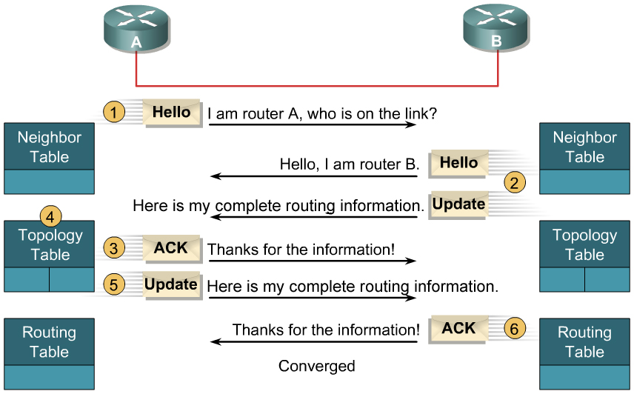
Initial Route Discovery
Notes:
Process to establish and discover neighbor routes occurs simultaneously in EIGRP:
A new router (router A) comes up on the link and sends a hello packet through all of its EIGRP-configured interfaces.
Routers receiving the hello packet (router B) on one interface reply with update packets that contain all the routes they have in their routing tables, except those learned through that interface (split horizon). Router B sends an update packet to router A, but a neighbor relationship is not established until router B sends a hello packet to router A. The update packet from router B has the initialization bit set, indicating that this is the initialization process. The update packet includes information about the routes that the neighbor (router B) is aware of, including the metric that the neighbor is advertising for each destination.
After both routers have exchanged hellos, and the neighbor adjacency is established, router A replies to router B with an ACK packet, indicating that it received the update information.
Router A assimilates all update packets in its topology table. The topology table includes all destinations advertised by neighboring (adjacent) routers. It lists each destination, all the neighbors that can reach the destination, and their associated metric.
Router A then sends an update packet to router B.
Upon receiving the update packet, router B sends an ACK packet to router A.
After router A and router B successfully receive the update packets from each other, they are ready to update their routing tables with the successor routes from the topology table.

Slide 16
EIGRP Operations
EIGRP selects primary (successor) and backup (feasible successor) routes and injects those into the topology table.
The primary (successor) routes are then moved to the routing table.
IP EIGRP Neighbor Table
Neighbor IP Address | Local router exit interface to neighbor
List of directly connected adjacent EIGRP neighbor routers and the local interface to exit to reach it.
IP EIGRP Topology Table
Destination 1 | FD / AD via each neighbor
List of all routes learned from each EIGRP neighbor and identifies successor routes and feasible successor routes.
IP Routing Table
Destination 1 | Best route
List of the best (successor) routes from the EIGRP topology table and other routing processes.
Notes:
When a router discovers a new neighbor, an update is sent to and received from its new neighbor populating the topology table (containing destinations advertised by all neighbors)
The topology table:
Updated when a directly connected route or interface changes or when a neighboring router reports a change to a route
Entry for a destination exists in either active or passive state:
Passive state: router is not performing a recomputation
Active state: router is performing a recomputation
Recomputation occurs when the destination has no feasible successors (initiated by sending a query packet to each of the neighboring routers

Slide 17
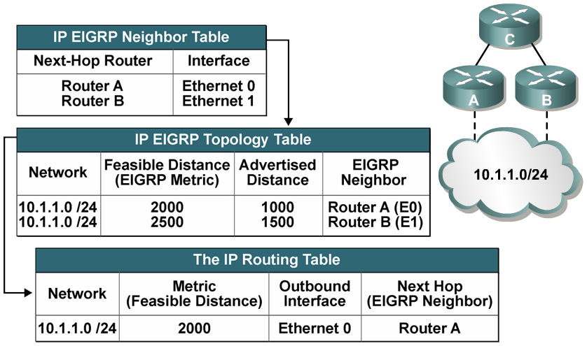
Example: EIGRP Tables
Router C’s tables:
Notes:
The network shown illustrates router C’s EIGRP tables. Routers A and B have established a neighbor relationship with router C. Both routers A and B have paths to network 10.1.1.0/24, among many others that are not shown.
Router A has an EIGRP metric of 1000 for 10.1.1.0/24, so router A advertises 10.1.1.0/24 to router C with a metric of 1000. Router C installs the route to 10.1.1.0/24 via router A in its EIGRP topology table with an advertised distance of 1000.
Router B has network 10.1.1.0/24 with a metric of 1500 in its IP routing table, so router B advertises 10.1.1.0/24 to router C with an advertised distance of 1500. Router C places the route to 10.1.1.0/24 network via router B in the EIGRP topology table with an advertised distance of 1500.
Router C has two entries to reach 10.1.1.0/24 in its topology table. The EIGRP metric for router C to reach both routers A and B is 1000. This cost (1000) is added to the respective advertised distance from each router, resulting in the feasible distances from router C to reach network 10.1.1.0/24 shown in the figure.
Router C chooses the least-cost feasible distance, which is 2000, via router A, and installs it in the IP routing table as the best route to reach 10.1.1.0/24. The EIGRP metric in the routing table is equal to the feasible distance from the EIGRP topology table. Router A is the successor for the route to 10.1.1.0/24.

Slide 18
EIGRP Neighbor Table
SRTT (Smooth Round Trip Timer) and RTO (Retransmit Interval) are used by RTP to manage reliable EIGRP packets.
SRTT indicates how long it takes for this neighbor to respond to reliable packets.
RTO indicates how long to wait before retransmitting if no ACK is received.
R1# show ip eigrp neighbors
IP-EIGRP neighbors for process 100
H Address Interface Hold Uptime SRTT RTO Q Seq
(sec) (ms) Cnt Num
0 192.168.1.102 Se0/0/1 11 00:07:22 10 2280 0 5
R1#
Neighbor’s IP address
Queue count should always be zero otherwise there’s congestion on the link.
Amount of time since this neighbor was added to the neighbor table.
The sequence number of the last update, query, or reply packet that was received from this neighbor.
Local interface receiving EIGRP Hello packets.
Lists the order in which a peering session was established with the specified neighbor, starting with 0.
Seconds remaining before declaring neighbor down.
The current hold time and is reset to the maximum hold time whenever a Hello packet is received.
Notes:
How EIGRP uses these tables:
EIGRP uses the Neighbor table to list adjacent routers.
Topology table lists all learned routes to each destination
Routing table contains the best route (successor route) and backup route (feasible successor route)
When a neighbor adjacency is formed, it records the neighbor’s address and the interface through which it can be reached as an entry in the neighbor table.
One neighbor table exists for each protocol-dependent module.
The EIGRP neighbor table is comparable to the adjacencies database that link-state routing protocols use and serves the same purpose: to ensure bidirectional communication between each of the directly connected neighbors.
When the hello packet is sent, it advertises a hold time (time a router reports a neighbor as reachable and operational). If a hello packet from a neighboring router is not received within the hold time, it expires, and DUAL is informed of the topology change.
The neighbor-table includes information required by RTP.
Sequence numbers are used to match acknowledgments with data packets (helping to check out-of-order packets).
transmission list is used to queue packets for possible retransmission on a per-neighbor basis.
Round-trip timers are kept in the neighbor-table entry to estimate an optimal retransmission interval.

Slide 19
EIGRP Topology Table
Destination network.
Number of successors
Feasible distance (FD) to the successor
R1# show ip eigrp topology
IP-EIGRP Topology Table for AS(100)/ID(192.168.1.101)
Codes: P - Passive, A - Active, U - Update, Q - Query, R - Reply,
r - reply Status, s - sia Status
P 172.17.0.0/16, 1 successors, FD is 40514560
via 192.168.1.102 (40514560/28160), Serial0/0/1
R1#
Indicates if the route is in passive or active state.
Next-hop address for successor.
Feasible distance (FD) to the successor
Advertised distance (AD) from the successor
Outbound interface to reach the network.
Notes:
The command output also lists the networks known by this router through the EIGRP routing process. The codes used in the first column of this output indicate the state of the entry. Passive and Active refer to the EIGRP state with respect to this destination. Update, Query, and Reply refer to the type of packet being sent. The codes are as follows:
Passive (P)—This network is available, and installation can occur in the routing table. Passive is the correct state for a stable network, indicating that no EIGRP computations are being performed for this route.
Active (A)—This network is currently unavailable, and installation cannot occur in the routing table. Being active means that outstanding queries exist for this network, indicating that EIGRP computations are being performed for this route.
Update (U)—This network is being updated (indicating that an update packet is being sent). This code also applies if the router is waiting for an acknowledgment for this update packet.
Query (Q)—There is an outstanding query packet for this network, indicating that a query packet was sent. This code also applies if the router is waiting for an acknowledgment for a query packet.
Reply (R)—The router is generating a reply for this network, indicating that a reply packet was sent, or is waiting for an acknowledgment for the reply packet.
Stuck-in-active (S)—There is an EIGRP convergence problem for this network.

Slide 20
EIGRP Routing Table
Local router exit interface to destination network
EIGRP route
Destination network
Next-hop address to reach the network
Time indicating the last update packet received
Administrative distance
Feasible distance
R1# show ip route
<output omitted>
Gateway of last resort is not set
D 172.17.0.0/16 [90/40514560] via 192.168.1.102, 00:02:22, Serial0/0/1
172.16.0.0/16 is variably subnetted, 2 subnets, 2 masks
D 172.16.0.0/16 is a summary, 00:31:31, Null0
C 172.16.1.0/24 is directly connected, FastEthernet0/0
R1#
Summary route automatically created as the result of the default classful behavior of EIGRP.
Notes:
Notice that the routing table includes routes, to null0, for the advertised (summarized) routes. Cisco IOS Software automatically puts these routes in the table; they are called summary routes. Null 0 is a directly connected, software-only interface. The use of the null0 interface prevents the router from trying to forward traffic to other routers in search of a more precise, longer match. For example, if the R1 router in Figure 2-20 receives a packet to an unknown subnet that is part of the summarized range—172.16.3.5 for example—the packet matches the summary route based on the longest match. The packet is forwarded to the null0 interface (in other words, it is dropped, or sent to the bit bucket), which prevents the router from forwarding the packet to a default route and possibly creating a routing loop.

Slide 21
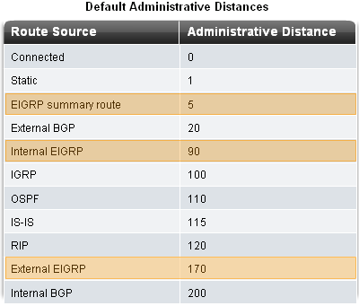
EIGRP Administrative Distance (AD)
Routes manually summarized.
Routes redistributed into EIGRP.

Slide 22
EIGRP Metric Calculation
EIGRP uses a composite metric which can be based on the following metrics:
  Bandwidth
  Delay
  Reliability
  Load
Only Bandwidth and Delay are used by default.
Note: It is often incorrectly stated that EIGRP can also use the smallest MTU in the path. In actual fact, the MTU is included in the EIGRP routing update, but is not actually used in the metric calculation.

Slide 23
DUAL Example
10.1.1.0 /24
A
Router D
(1)
EIGRP | FD | AD | Topology
10.1.1.0 /24 | 2 |  | ***** Passive *****
via B | 2 | 1 | Successor
via C | 5 | 3
(1)
B
D
(2)
(2)
(1)
Router E
Router C
EIGRP | FD | AD | Topology
10.1.1.0 /24 | 3 |  | ***** Passive *****
via D | 3 | 2 | Successor
via C | 4 | 3
(1)
C
E
EIGRP | FD | AD | Topology
10.1.1.0 /24 | 3 |  | ***** Passive *****
via B | 3 | 1 | Successor
via D | 4 | 2 | Feasible Successor
via E | 4 | 3
Notes:
The following example examines partial entries for network 10.1.1.0/24 in the topology tables for Routers C, D, and E, to give you a better understanding of EIGRP behavior.
The partial topology tables indicate the following:
AD—The advertised distance is equal to the cost of the path to network 10.1.1.0/24 as advertised by neighboring routers. For example, consider Router E's neighbors: Router D has an AD of 2 and Router C has an AD of 3, for 10.1.1.0/24.
FD—The feasible distance is equal to the sum of the AD for a neighbor to reach 10.1.1.0/24, plus the metric to reach that neighbor. For example, again consider Router E: The FD of the route to 10.1.1.0/24 via Router D is Router D's AD (2) plus the metric to reach Router D from Router E (1), for a total of 3. The FD of the route to 10.1.1.0/24 via Router C is Router C's AD (3) plus the metric to reach Router C from Router E (1), for a total of 4.
Successor—The successor is the forwarding path used to reach network 10.1.1.0/24. The cost of this path is equal to the FD. For example, Router E chooses the path to 10.1.1.0/24 with the lowest FD, which is via Router D. This is the route that Router E puts in its routing table.
FS—The feasible successor is an alternative loop-free path to reach network 10.1.1.0/24. For example, in Router C, the path via Router D is an FS because the AD (2) is less than the FD (3) via the successor Router B. Routers D and E do not have any FSs because the AD of the alternate routes are not less than the FD of their current successors.

Slide 24
DUAL Example
10.1.1.0 /24
Router D
A
EIGRP | FD | AD | Topology
10.1.1.0 /24 | 2 |  | ***** Passive *****
via B | 2 | 1 | Successor
via C | 5 | 3
(1)
(1)
B
D
(2)
(2)
(1)
(1)
Router E
Router C
C
E
EIGRP | FD | AD | Topology
10.1.1.0 /24 | 3 |  | ***** Passive *****
via B | 3 | 1 | Successor
via D | 4 | 2 | Feasible Successor
via E | 4 | 3
EIGRP | FD | AD | Topology
10.1.1.0 /24 | 3 |  | ***** Passive *****
via D | 3 | 2 | Successor
via C | 4 | 3
Notes:
Routers B and D detect a link failure. After being notified of the link failure, DUAL does the following:
At Router D, it marks the path to network 10.1.1.0/24 through Router B as unusable.

Slide 25
DUAL Example
10.1.1.0 /24
Router D
A
EIGRP | FD | AD | Topology
10.1.1.0 /24 | -1 |  | ***** ACTIVE ******
via E |  |  | (Q) Query
via C | 5 | 3 | (Q) Query
(1)
B
Q
D
Q
Q
= Query
(2)
(2)
(1)
Router C
(1)
C
E
EIGRP | FD | AD | Topology
10.1.1.0 /24 | 3 |  | ***** Passive *****
via B | 3 | 1 | Successor
via D | 4 | 2 | Feasible Successor
via E | 4 | 3
Router E
EIGRP | FD | AD | Topology
10.1.1.0 /24 | 3 |  | ***** Passive *****
via D | 3 | 2 | Successor
via C | 4 | 3
Notes:
The following steps then occur:
At Router D, there is no FS to network 10.1.1.0/24, because the AD via Router C (3) is greater than the FD via Router B (2).
Therefore, DUAL does the following:
Sets the metric to network 10.1.1.0/24 as unreachable (–1 is unreachable).
Because an FS cannot be found in the topology table, the route changes from the passive state to the active state. In the active state, the router sends out queries to neighboring routers looking for a new successor.
Sends a query to Routers C and E for an alternative path to network 10.1.1.0/24.
Marks Routers C and E as having a query pending (Q).
At Router E, DUAL marks the path to network 10.1.1.0/24 through Router D as unusable.
At Router C, DUAL marks the path to network 10.1.1.0/24 through Router D as unusable.

Slide 26
DUAL Example
10.1.1.0 /24
Router D
A
EIGRP | FD | AD | Topology
10.1.1.0 /24 | -1 |  | ***** ACTIVE ******
via E |  |  | (Q) Query
via C | 5 | 3
(1)
B
D
Q
= Query
(2)
(2)
(1)
R
= Reply
R
(1)
C
E
Router C
Q
Router E
EIGRP | FD | AD | Topology
10.1.1.0 /24 | 3 |  | ***** Passive *****
via B | 3 | 1 | Successor
via D
via E | 4 | 3
EIGRP | FD | AD | Topology
10.1.1.0 /24 | -1 |  | ***** ACTIVE ******
via D
via C | 4 | 3 | (Q) Query
Notes:
The following steps then occur:
At Router D:
DUAL receives a reply from Router C that indicates no change to the path to network 10.1.1.0/24.
DUAL removes the query flag from Router C.
DUAL stays active on network 10.1.1.0/24, awaiting a reply from Router E to its query (Q).
At Router E, there is no FS to network 10.1.1.0/24, because the AD from Router C (3) is not less than the original FD (also 3).
DUAL generates a query to Router C.
DUAL marks Router C as query pending (Q).
At Router C, DUAL marks the path to network 10.1.1.0/24 through Router E as unusable.

Slide 27
DUAL Example
10.1.1.0 /24
Router D
A
EIGRP | FD | AD | Topology
10.1.1.0 /24 | -1 |  | ***** ACTIVE ******
via E |  |  | (Q) Query
via C | 5 | 3
(1)
B
D
Q
= Query
(2)
(2)
(1)
R
= Reply
(1)
C
E
Router C
R
Router E
EIGRP | FD | AD | Topology
10.1.1.0 /24 | 3 |  | ***** Passive *****
via B | 3 | 1 | Successor
via D
via E
EIGRP | FD | AD | Topology
10.1.1.0 /24 | 4 |  | ***** Passive *****
via C | 4 | 3 | Successor
via D
Notes:
The following steps then occur:
At Router D:
DUAL stays active on network 10.1.1.0/24, awaiting a reply from Router E (q).
At Router E:
DUAL receives a reply from Router C indicating no change.
It removes the query flag from Router C.
It calculates a new FD and installs a new successor route in the topology table.
It changes the route to network 10.1.1.0/24 from active to passive (converged).

Slide 28
DUAL Example
10.1.1.0 /24
Router D
A
EIGRP | FD | AD | Topology
10.1.1.0 /24 | 5 |  | ***** Passive *****
via C | 5 | 3 | Successor
via E | 5 | 4 | Successor
(1)
B
D
Q
= Query
(2)
(2)
(1)
R
= Reply
R
(1)
C
E
Router C
Router E
EIGRP | FD | AD | Topology
10.1.1.0 /24 | 3 |  | ***** Passive *****
via B | 3 | 1 | Successor
via D
via E
EIGRP | FD | AD | Topology
10.1.1.0 /24 | 4 |  | ***** Passive *****
via C | 4 | 3 | Successor
via D
Notes:
The following steps then occur:
At Router D
DUAL receives a reply from Router E.
It removes the query flag from Router E.
It calculates a new FD.
It installs new successor routes in the topology table. Two routes (through Routers C and E) have the same FD, and both are marked as successors.
It changes the route to network 10.1.1.0/24 from active to passive (converged).
At Router D, two successor routes are in the topology table for network 10.1.1.0/24. Both successor routes are listed in the routing table, and equal-cost load balancing is in effect.
The network is stable and converged.

Slide 29
DUAL Example
10.1.1.0 /24
Router D
A
EIGRP | FD | AD | Topology
10.1.1.0 /24 | 5 |  | ***** Passive *****
via C | 5 | 3 | Successor
via E | 5 | 4 | Successor
(1)
B
D
(2)
(2)
(1)
(1)
C
E
Router C
Router E
EIGRP | FD | AD | Topology
10.1.1.0 /24 | 3 |  | ***** Passive *****
via B | 3 | 1 | Successor
via D
via E
EIGRP | FD | AD | Topology
10.1.1.0 /24 | 4 |  | ***** Passive *****
via C | 4 | 3 | Successor
via D
Notes:
At Router D, two successor routes are in the topology table for network 10.1.1.0/24. Both successor routes are listed in the routing table, and equal-cost load balancing is in effect.
The network is stable and converged.

Slide 30
Implement EIGRP for IPv4

Slide 31
Configure EIGRP with IPv4
To configure EIGRP, use the router eigrp AS-# command.
  The AS-# functions as a process ID.
  The AS number used for EIGRP configuration is only significant to the EIGRP routing domain.
  All routers in the EIGRP routing domain must use the same AS number (process ID number).
Note:
  Do NOT configure multiple instances of EIGRP on the same router.

Slide 32
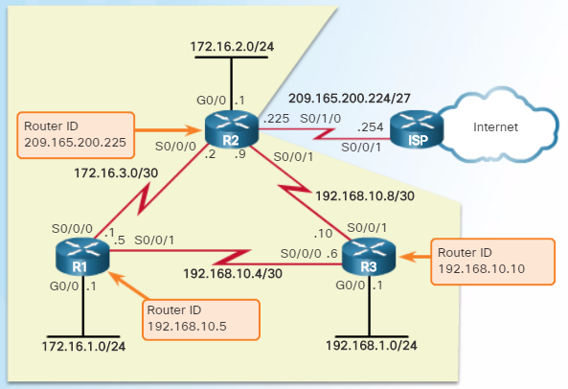
Configure EIGRP with IPv4
The EIGRP router ID is used to uniquely identify each router in the EIGRP routing domain.
Routers use the following three criteria to determine its router ID:
  Use the address configured with the eigrp router-id ipv4-address router config command.
  If the router ID is not configured, choose the highest IPv4 address of any of its loopback interfaces.
  If no loopback interfaces are configured, choose the highest active IPv4 address of any of its physical interfaces.

Slide 33


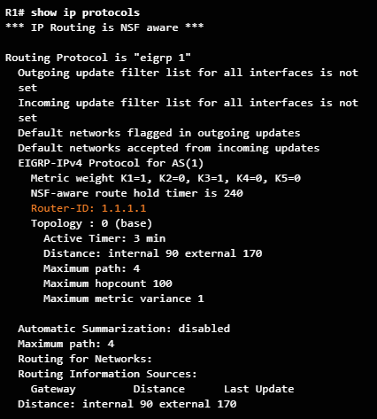
Configure EIGRP with IPv4

Slide 34
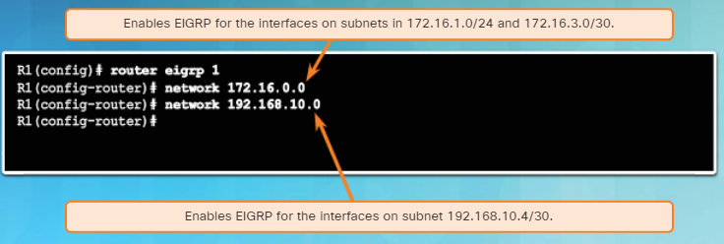
Configure EIGRP with IPv4
Use the network network-number [wildcard-mask] router config command to enable and advertise a network in EIGRP.
  It enables the interfaces configured for that network address to begin transmitting & receiving EIGRP updates
  Includes network or subnet in EIGRP updates

Slide 35
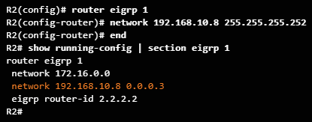
Configure EIGRP with IPv4
A wildcard mask is similar to a subnet mask but is calculated by subtracting a SNM from 255.255.255.255.
For example, if the SNM is 255.255.255.252:
  255.255.255.255
  - 255.255.255.252
  0. 0. 0. 3 Wildcard mask
EIGRP also automatically converts a subnet mask to its wildcard mask equivalent.
  E.g., entering 192.168.10.8 255.255.255.252 automatically converts to 192.168.10.8 0.0.0.3

Slide 36

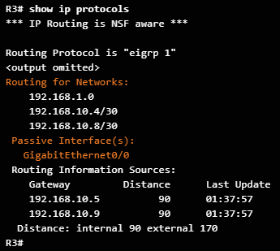
Configure EIGRP with IPv4
Passive interfaces prevent EIGRP updates out a specified router interface.
Set a particular interface or all router interfaces to passive.
  The default option sets all router interfaces to passive.
  Prevents neighbor relationships from being established.
  Routing updates from a neighbor are ignored.
Router(config-router)#
passive-interface type number [default]

Slide 37
Fine Tuning

Slide 38
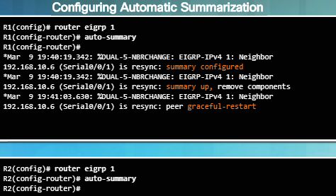
Configuring EIGRP Automatic Summarization
Automatic summarization is disabled by default for EIGRP IPv4 beginning with Cisco IOS Release 15.0(1)M and 12.2(33).
Use the show ip protocols command to determine if EIGRP automatic summarization is disabled.
To enable automatic summarization for EIGRP, use the auto-summary command in router configuration mode as shown in the figure to the left.
Use the command no auto-summary to disable automatic summarization

Slide 39
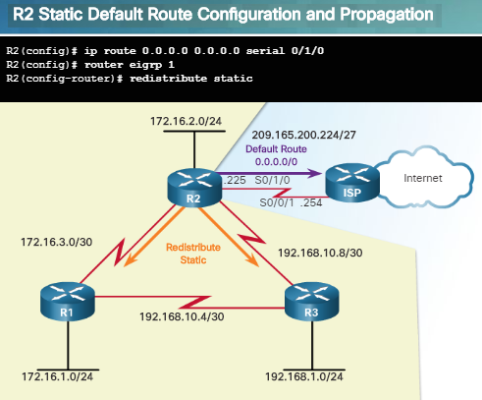
Propagating a Default Static Route
Using a static route to 0.0.0.0/0 as a default route is not routing protocol-dependent.
The “quad zero” default static route can be used with any currently supported routing protocols.
The default static route is typically configured on the router that has a connection to a network out of the EIGRP routing domain; for example, to an ISP.
The redistribute static command as shown in the figure to the left tells EIGRP to include static routes in its EIGRP updates to other routers.
Use the show ip protocols command to verify.

Slide 40
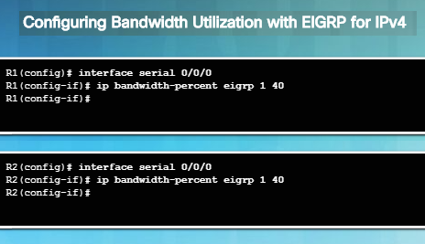
EIGRP Bandwidth Utilization
By default, EIGRP uses only up to 50 percent of an interface’s bandwidth for EIGRP information in order to prevent it from over-utilizing a link.
In interface config mode, use the ip bandwidth-percent eigrp as-number percent command to configure the percentage of bandwidth that can be used by EIGRP on an interface.
To restore the default value, use the no form of this command.
To configure the percentage of bandwidth that can be used by EIGRP for IPv6 on an interface, use the ipv6 bandwidth-percent eigrp command.

Slide 41
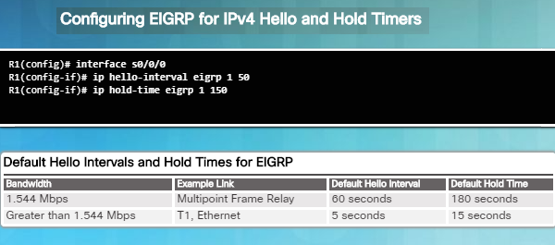
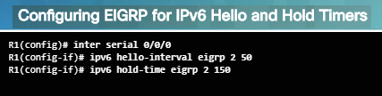
Hello and Hold Timers
EIGRP uses a lightweight Hello protocol to establish and monitor the connection status of its neighbor.
The hold time tells the router the maximum time the router should wait to receive the next Hello before declaring that neighbor unreachable.
Use the ip hello-interval eigrp as-number seconds command to configure a different Hello interval.
Use the ip hold-time eigrp as-number seconds command to configure a different hold time.
Hello intervals and hold times are configured on a per-interface basis and do not have to match with other EIGRP routers to establish or maintain adjacencies

Slide 42
EIGRP for IPv6

Slide 43
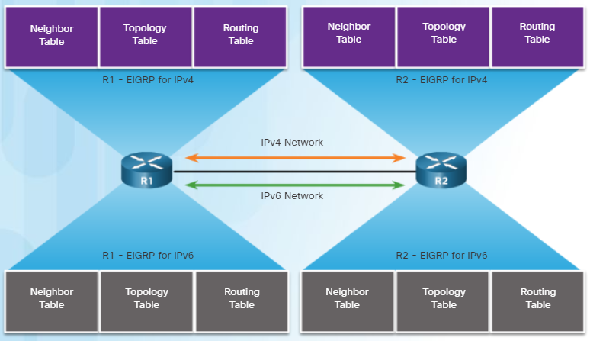
EIGRP for IPv6
EIGRP for IPv6 is a distance-vector routing protocol.
  The configuration and operation is similar to EIGRP for IPv4.
The following remained the same as EIGRP for IPv4:
  Uses the same protocol number (88)
  Maintains a topology table and queries if no feasible successors are available.
  Uses DUAL to calculate the successor routes

Slide 44
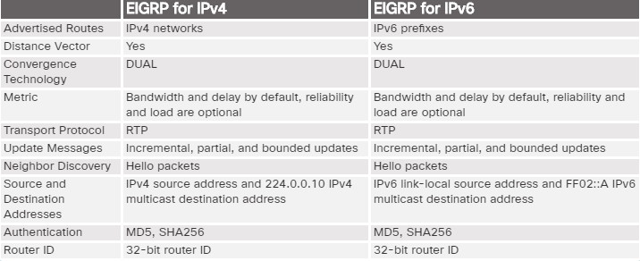
EIGRP for IPv6

Slide 45

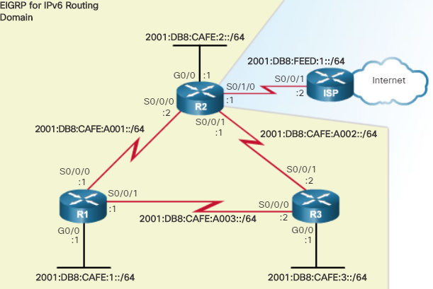
Configure EIGRP for IPv6
The ipv6 unicast-routing global config mode command enables IPv6 routing on the router.
Use the ipv6 router eigrp autonomous-system to enter EIGRP for IPv6 router configuration mode.
Use the eigrp router-id router-id command is used to configure the router ID.
By default, the EIGRP for IPv6 process is in a shutdown state and the no shutdown command is required to activate the EIGRP for IPv6 process.

Slide 46
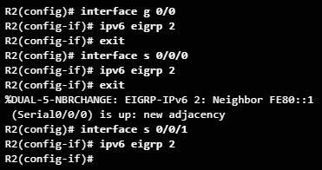
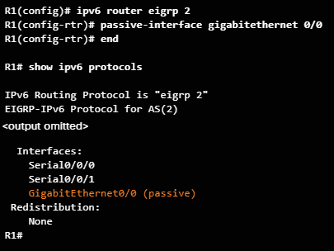
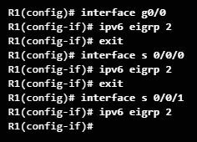
Configure EIGRP for IPv6
Unlike EIGRP for IPv4 which uses the network command, EIGRP for IPv6 is configured directly on the interface using the ipv6 eigrp autonomous-system interface configuration command.
The same passive-interface command used for IPv4 is used with EIGRP for IPv6.

Slide 47
Summary

