Slide 1

Assessment Component 1
Presentation
Student Name: Audrey Asantewaa Boansi
Student ID: 2018137
Module Name: Mental Disorders And Psychopathology
Module Code: (BMHP6006)
Lecturer: Dr. Samuel Abah

Slide 2

TOPIC: Mood [affective] disorders (Dysthymia)

Slide 3
Dysthymia within the ICD-10 Manual
Group: Persistent mood [affective] disorders
(F30-F39)
Classification: F34

Slide 4
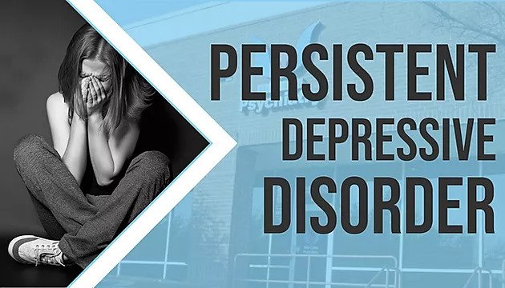
Definition of Dysthymia
A form of mild chronic depression
Less severe than major depressive disorder but can have a negative impact on everyday life.
Experienced by 1.5% of the UK population (Morken et.,2023)

Slide 5
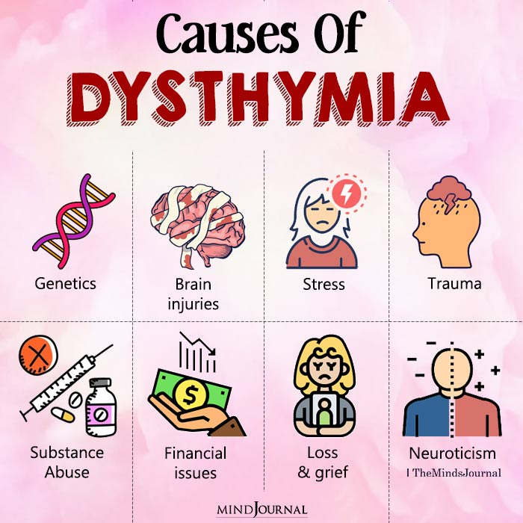
Causes
A mix of genetic, environmental, and psychological factors contribute to dysthymia.
Long-term stress, trauma, and childhood adversity are environmental elements linked to a higher likelihood of dysthymia development.
Low self-esteem, destructive thought habits, and a pessimistic attitude.
Medical ailments, including chronic pain, sleep issues, and hormonal imbalances have also been associated with a higher chance of developing dysthymia (Lu,2021).

Slide 6
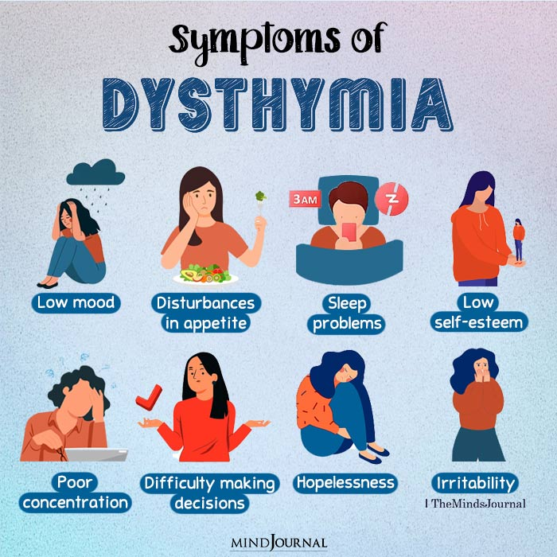
Symptoms/signs of dysthymia
Low mood, irritability, exhaustion, changes in eating and sleep patterns, low self-esteem, decision-making challenges, and a lack of enthusiasm or enjoyment in activities are some symptoms
Physical symptoms include migraines, stomach aches, and persistent pain
Symptoms cannot be brought on by a medical condition or substance addiction Symptoms must significantly impair the individual's ability to function in daily life (Tromans et al., 2020)

Slide 7
Diagnosis of Dysthymia
According to (Luty, 20202) this outlines the requirements for making a dysthymia diagnosis
A physical examination and a battery of laboratory tests are usually
conducted first to rule out any underlying medical disorders
A diagnostic interview is then conducted by a mental health specialist to assess the person's emotional state, thought patterns, and behaviours
Symptoms must be present most of the time and for at least two years with no longer than two months without them to meet the diagnostic criteria
Symptoms must significantly impair the individual's ability to function in daily life

Slide 8
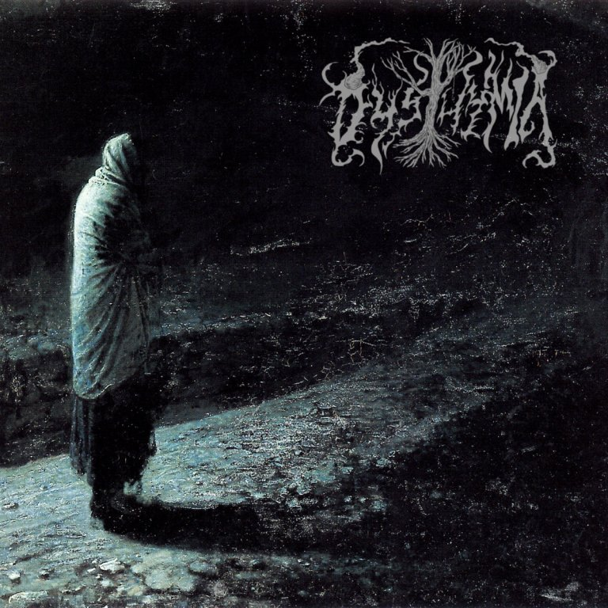
Historical view and treatments for dysthymia
Dysthymia was poorly understood in the past and was primarily treated with moral and religious instruction
Psychoanalysis and other forms of psychotherapy were used in the middle of the 20th century
The development of imipramine, the first antidepressant, represented a substantial improvement in the management of dysthymia in the 1950s
The stigma associated with mental illness and lack of access to care remain important barriers to proper diagnosis and treatment of dysthymia
(Schramm et al.,2020)

Slide 9

Current treatments for dysthymia (NHS)
Antidepressant drugs such as tricyclic antidepressants and selective serotonin reuptake inhibitors are prescribed to manage symptoms and regulate mood
Self-help techniques like exercise, mindfulness, and a good diet may also be advised
Individuals with dysthymia may be referred to specialised services or community mental health teams for additional assistant.
Psychotherapy such as cognitive-behavioural therapy assists people in recognising and altering harmful thought patterns and actions that contribute to their symptoms (Bone et al., 2021)

Slide 10
Principles when working with people with dysthymia
Maintain a person-centred approach
Develop a strong therapeutic alliance base on mutual respect, trust, and empathy
Adhere to best practice guidelines
Consider cultural, linguistic, and religious diversity
Take a collaborative approach to treatment (Ekkekakis, 2020).
The NHS Provide a comprehensive service available to all

Slide 11

Recommendations and Conclusion
Support legislation that prioritises mental health and wellbeing
Create a welcoming, judgment-free environment when working with individuals with dysthymia
Collaborate with patients to create a personalised treatment plan
Raise awareness and reduce stigma surrounding mental health (Kaiya et al., 2021).

Slide 12
References
•Bone, C., Simmonds-Buckley, M., Thwaites, R., Sandford, D., Merzhvynska, M., Rubel, J., Deisenhofer, A.K., Lutz, W. and Delgadillo, J., 2021. Dynamic prediction of psychological treatment outcomes: development and validation of a prediction model using routinely collected symptom data. The Lancet Digital Health, 3(4), pp.e231-e240.
•Ekkekakis, P., 2020. Why Is exercise underutilized in clinical practice despite evidence it is effective? Lessons in pragmatism from the inclusion of exercise in guidelines for the treatment of depression in the British National Health Service. Kinesiology Review, 10(1), pp.29-50.
•Kaiya, H., Hasegawa, A., Komatsu, C., Noda, S., Minami, F., Goldin, P. and Hasegawa, Y., 2021. Mindfulness Training led to Catharsis and Mindfulness-To-Meaning in a Patient with Social Anxiety Disorder Comorbid with Persistent Depressive Disorder (Dysthymia)-A Case Report with Patient's Personal Note.
•Lu, J., 2021, December. A Systematic Review of the History, Cause, and Treatment of Persistent Depressive Disorder. In 2021 4th International Conference on Humanities Education and Social Sciences (ICHESS 2021) (pp. 2329-2334). Atlantis Press.
•Luty, J., 2020. Bordering on the bipolar: a review of criteria for ICD-11 and DSM-5 persistent mood disorders. BJPsych Advances, 26(1), pp.50-57.
•Morken, I.S., Viddal, K.R., Von Soest, T. and Wichstrøm, L., 2023. Explaining the Female Preponderance in Adolescent Depression—A Four-Wave Cohort Study. Research on Child and Adolescent Psychopathology, pp.1-11.
•Schramm, E., Klein, D.N., Elsaesser, M., Furukawa, T.A. and Domschke, K., 2020. Review of dysthymia and persistent depressive disorder: history, correlates, and clinical implications. The Lancet Psychiatry, 7(9), pp.801-812.
•Tromans, S., Umar, A., Torr, J., Alexander, R. and Bhaumik, S., 2020. Depressive disorders in people with intellectual disability. Oxford Textbook of the Psychiatry of Intellectual Disability, pp.105-116

Slide 13


