Slide 1


Health and social Care
Level 5
Module Title: Children, Young People and Families.
Module Code: BMHP5004
Lecturer Name: Chrisford Chogugudza
This Photo by Unknown author is licensed under CC BY-NC.

Slide 2
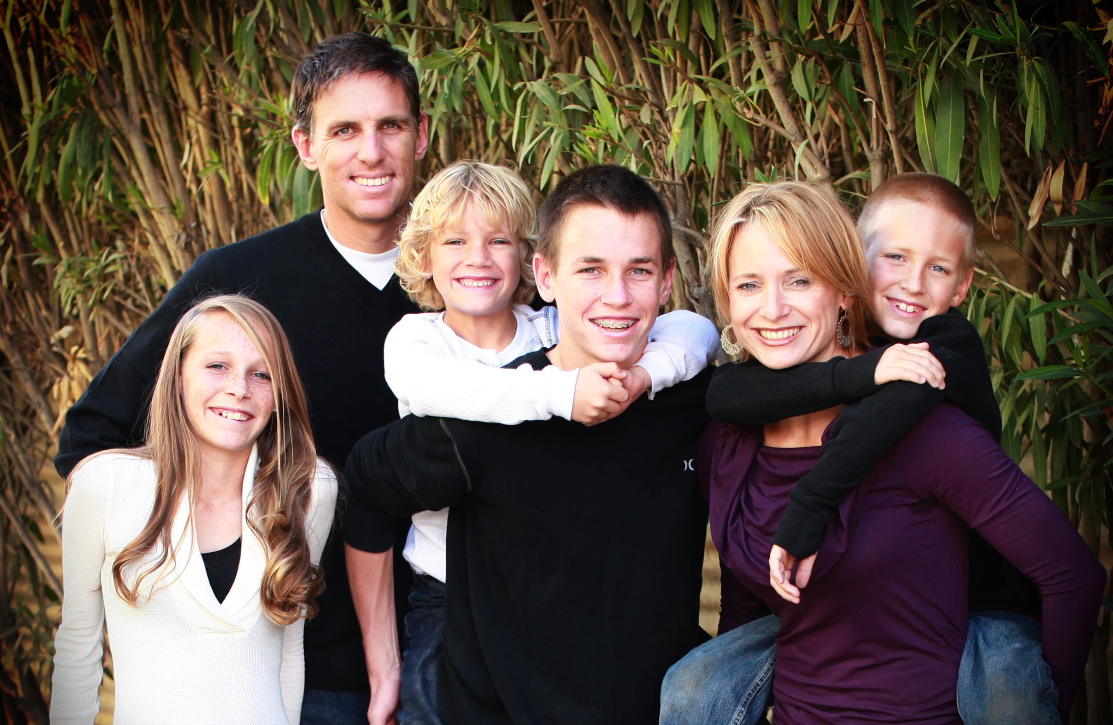

Rezia Razzaque 1711140
Nazia Khan 2010554
Carmen Birlogeanu 1817357
Riee Tushaan 19123558
FAMILY E
This Photo by Unknown author is licensed under CC BY-SA-NC.
This Photo by Unknown author is licensed under CC BY-SA-NC.

Slide 3

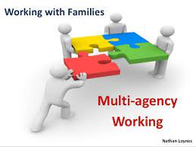



Introduction
In this presentation our group members will discuss about case study of family A, which is referred to anti-social behavior team by school.
(Nathan Loynes, 2021)
Notes:
Comprehensive strategies to prevent Alcohol-Related Violence (Bellis and Huges 2008)
Counselling, Parenting and personal development classes.

Slide 4
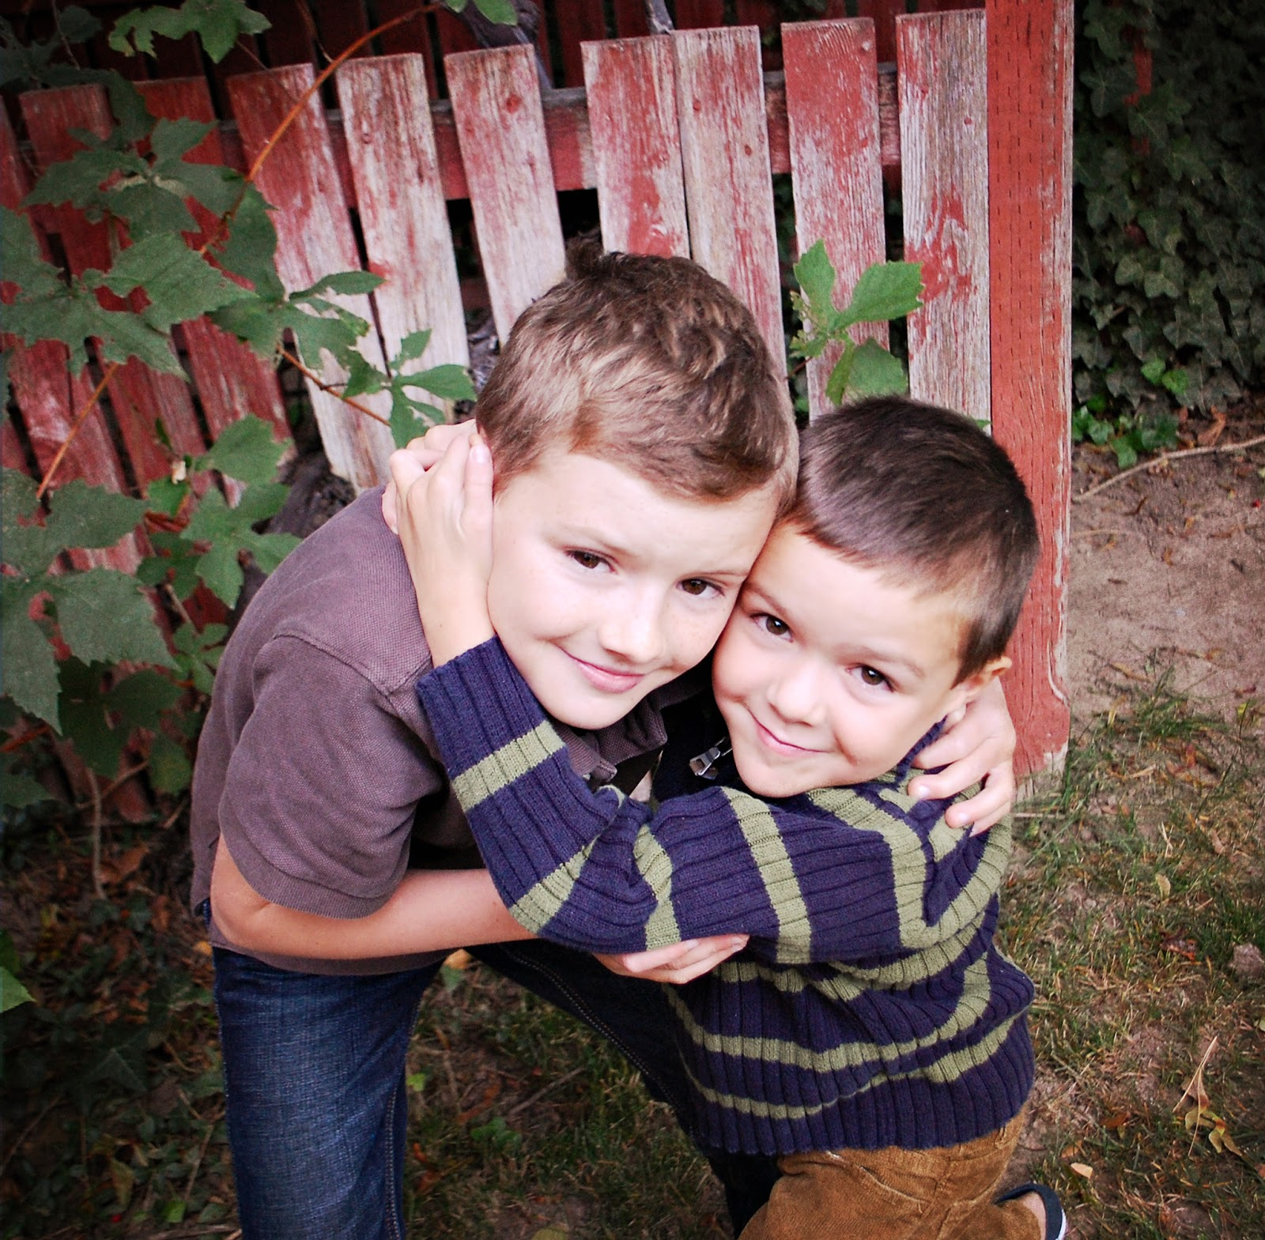
INTRODUCTION
Case Study
Family E
Family have two boys, one in primary school and one in secondary school.
Mother are father are separated
Mother lives with a new partner
Children live with father
There is verbal and emotional abuse towards the children by the father, antisocial behaviour by the two boys, nonattendance in school, the mother may have alcohol problems and she is grieving. Mother is in rent arrears.
dreamtime.com (No date).

Slide 5
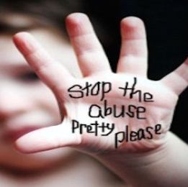
Identify risk factors contributing to the vulnerability of the child/young person, family and their impact.
By Rezia Razzaque.
Domestic abuse, verbal and emotional by their father.
They will always be on guard wondering when the next time they will be abused.
Fearful
Whining
Increased Crying
Signs of terror
Difficulty falling asleep
Bed Wetting
Stuttering
Learnt behaviour, inpact what they do with other people, when older will do the same to loved ones or other people (basile, 2019).
Dreamtime (No date)

Slide 6

The family are in rent arrears
financially unstable. emotionally, physically and phycologically affect them.
Judged by Society
Increases selft pity
Hatred, anger( Ruiz, 2011).

Slide 7
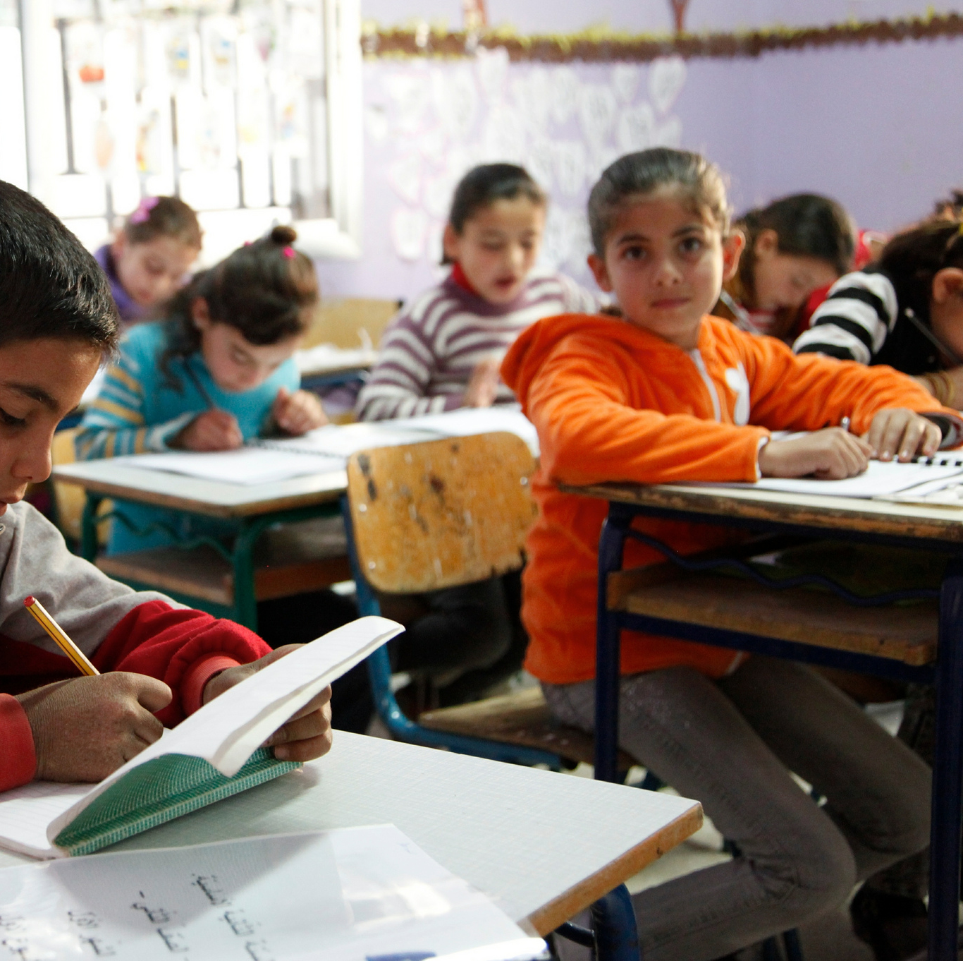
Childrens non-attendance at school
Antisocial behaviour
Anxiety
Academically poor
Slow progression
Poor mental and emotional wellbeing
Social and emotional development
Reinforcing stereotype and increasing isolation
This will affect their future, worst prospects for future employment (Education and schools,2020).
Dreamtime (No date).

Slide 8
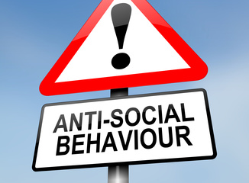


Antisocial behaviour of the two boys
Communication problems
Lack of social empathy
Aggression and violent tendencies
Arrogance
Lack of remorse (Gill,K 2021).
Concerns around mother's alcoholism
Unable to establish sense of normality and not knowing when the next time mother will be drunk.
Trust issues
Neglect
Unloved
Physical and mental abuse
Emotional abuse (Janssen ,A 2020)
This Dreamtime (No date)

Slide 9
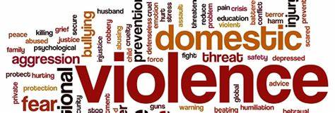
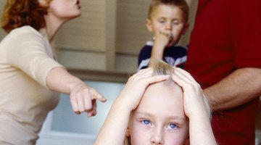
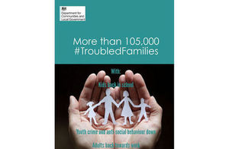
Analysis of the rationale
By Nazia khan
Family E was referred by the anti-social team due to their current circumstances which raised concerns for the safety and wellbeing of their young children.
Separated parents of two young boys of school age.
Domestic violence between mother and her new partner.
Mothers possible Alcohol problem.
Verbal and emotional abuse of both children by their father.
Anti-social behavior of the boys.
Nonattendance of school.
Housing needs
Gov. U.K, (2017)
This Photo by Unknown author is licensed under CC BY-NC-ND.

Slide 10
How to prevent and manage risks for the family E
Mini projects are designed by the core team to help families deal with issues affecting their lives and reduce and manage risks. Sessions providing specialist support for community and voluntry programmes, interventions included:
Personal development training workshops- which focus on developing confidence.
Dealing with conflict
Parents group training workshops.
Pamper days for mothers to help improve levels of self-esteem.
Classes for adult males try to tackle domestic violence issues.

Slide 11
PROFESIONAL INTERVENTIONS IN PLACE TO HELP FAMILY E
Bereavement counselling for the mother.
Youth offending team.
Neighborhood services.
Children's services
Anti -social behavior team
Youth inclusion and support panel.
Anti-social behavior team.
Health services
Substances misuse engagement team.
Improving family relationships

Slide 12

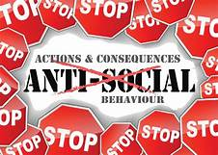
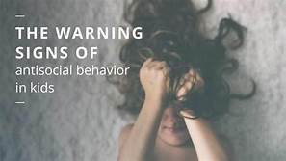
Anti -social behavior
Antisocial behaviour risk factors include:
Genetics and family history, as well as the school and local environment
poor and unhealthy parenting techniques
Home life that is violent, chaotic, or unstable
According to Gaik, (2010) Behavioural disorders, impulsiveness, theft, vandalism violence, abuse, and disobedience are all examples of antisocial behaviour in children and adolescents.
Scaccia, (2016).

Slide 13
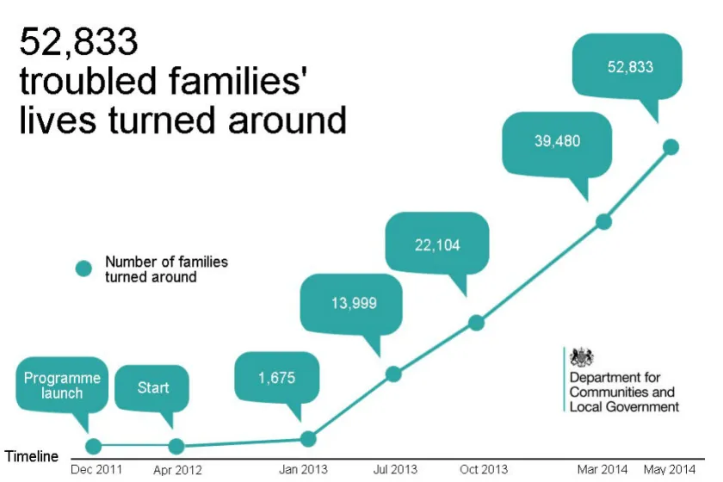
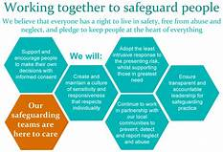
Thompson, (2017)
The Troubled Families Programme was established in December 2011 to help prime minister David Cameron achieve his goal of 'changing around' the lives of 120,000 'troubled families.'
As stated by MacLehose, (2014.) The 'Troubled Families Agenda' (TFA), a nationwide project introduced by the British Government in 2011, intended to identify and engage with families defined as 'troubled' in order to reduce 'anti-social behavior,' help children return to school, and assist parents in finding jobs.

Slide 14

Policies
a definite course or method of action selected from among alternatives addition given conditions to guide and determine present and future decisions
Notes:
Polices are a structure, which different departments in the health social care departments follow. Addition also allows limits on what can be done to support a person or a child or family.

Slide 15

Children act 1989
Laws implemented across England
Safeguards and protects children rights

Slide 16

Plan of action
Local support services
DOMESTIC VIOLENEC
Evidence of intentional infliction
To take to court.
Protection order
Verbal and emotional abuse
Notes:
This section is about reactive and response on how policies can be handled for current case study's or for future case study's.

Slide 17

Policies and procedures
Improving family relationships – identify behaviour and family strengths.
Mental health and wellbeing – counselling therapy and overall health.
Housing needs assessment – rent and income interview.
Domestic violence and addiction – prevention.
(McColgan & McLaughlin, 2021)

Slide 18
Professional interventions
Youth offending team – have a significant role on helping young people and families with law issues, such as police, probation officers, housing, health and children services, education and charities. (GOV, 2021)
Neighbourhood services helps maintaining healthy and safe homes.
Children services are there for children, young people and families to support change their life in a positive way.
(Birmingham City Council, 2021)
Youth Inclusion and Support Panel – helps young people aged 8 to 13 and their families, protecting them from crime and anti - social behaviour. (Gov, 2007)

Slide 19
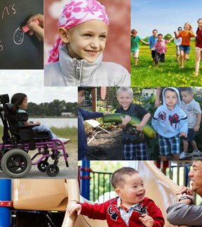
Professional interventions
Anti - Social Behaviour Team – will intervenes when there are concerns of abuse, violence or noise.
Substance Misuse Engagement team helps individuals with drug and alcohol addiction.
Health Services plays a key role within the society, improving and delivering health. (WHO, 2021)

Slide 20

Meeting the needs
The plan of action for the family has ended with no further recommendations due to change of circumstances and non-engagement of the mother.

Slide 21
CONCLUSION
Family E have many problems which can affect the children's behaviour. The issues will affect them in later life as their upbringing is negative and abusive.
Many professional interventions was involved in order to meet the needs of the family. However, the project has been closed due to change of circumstances.

Slide 22
REFERENCES
Bazile, C, et.al (2019) Effects of Domestic violence on children. Available at: Effects of domestic violence on children | Office on Women's Health (womenshealth.gov) Accessed on 16th October 2021.
Education and schools (2020) Children missing education. Available at: Children missing education | Local Government Association Accessed 16th October 2021.
Birmingham City Council (2021). Children, young people and families. Available at: https://www.birmingham.gov.uk/info/20019/children_young_people_and_families (Accessed: 23 October 2021).
Gaik, L.P., Abdullah, M.C., Elias, H. and Uli, J., (2010. ) Development of antisocial behaviour. Procedia-social and behavioural sciences, 7, pp.383-388.
Dreamstime.com (No date). Images

Slide 23
Reference
Gill,K (2021) How to identify and treat antisocial behaviour in children. Available at: Antisocial Behavior: In Children (healthline.com) Acessed on 16th October 2021
Gov.UK (2010) https://www.gov.uk/government/publications/2010-to-2015-government-policy-violence-against-women-and-girls/2010-to-2015-government-policy-violence-against-women-and-girls cited 2371072021
Government (2021) Youth offending teams. Available at: https://www.gov.uk/youth-offending-team ( Accessed: 23 October 2021)
Government (2007) Youth inclusion and support panels: preventing crime and anti- social behaviour- executive summary. Available at: https://www.gov.uk/government/publications/youth-inclusion-and-support-panels-preventing-crime-and-anti-social-behaviour-executive-summary (Accessed: 23 October 2021)
Jassen,A (2020) The Affects of alcolism on children. Available at: The Effects of Parental Alcoholism on Children (verywellmind.com) Accessed on: 16th October 2021.
Ley, A., Fokdal, J., Rahman, M. A. U., Rolnik, R., & Sioufi, M. E. (2020). Housing and human settlements in a world of change. Available at: https://doi.org/10.14361/9783839449424 (Accessed: 23 October 2021).

Slide 24
References
McColgan, M., & McLaughlin, E. (2021). When happiness had a holiday : helping families improve and strengthen their relationships : a therapeutic storybook. Routledge. Government (2007) Youth inclusion and support panels: preventing crime and anti- social behaviour- executive summary. Available at: https://www.gov.uk/government/publications/youth-inclusion-and-support-panels-preventing-crime-and-anti-social-behaviour-executive-summary (Accessed: 23 October 2021)
Ruiz, R (2011) Finacial instability affects children too. Available at:financial_instability_kids.pdf (uconn.edu) Accessed on: 14th October 2021.
Scaccia, A , (2016). How to identify anti -social behavior in children Available at: https://www.healthline.com/health/parenting/antisocial-behavior-in-children Accessed: 01 November 2021
Thompson, K, (2017) The troubled families programme available at https://revisesociology.com/2017/01/09/the-troubled-families-programme/ Accessed on 01 November 2021
https://www.legalmatch.com/law-library/article/emotional-abuse-laws.html cited 2371072021
“Policy.” Merriam-Webster.com Dictionary, Merriam-Webster, https://www.merriam-webster.com/dictionary/policy. Accessed 18 Oct. 2021.
World Health Organization (2021). Integrated Health Services. Available at: https://www.who.int/teams/integrated-health-services
(Accessed: 23 October 2021)
Gov, U.K ,(2015)Guidance and support , Available at: https://www.gov.uk/government/news/more-than-105000-troubled-families-turned-around-saving-taxpayers-an-estimated-12-billion.

