Slide 1
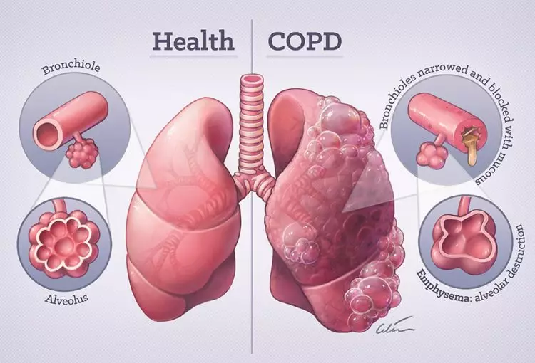
Programme: MSc Public Health and Social Care in Practice
Module: Community Care and Management of Longer-term Conditions for COPD
Module code: LCHS7003
Lecturer: Muhammed Khan Internal Verifier: Dr Hamdi Hussain
Assignment Title: Component 2 Individual Presentation
Patience Edo
Student ID: 2220883
This presentation is for respiratory nurses, general practitioners and allied health professionals caring for people with chronic respiratory conditions such as COPD.

Slide 2
Overview
What is Chronic Obstructive Pulmonary Disease?
Aetiology (Causes)
Symptoms
Diagnosis
Management and model of frameworks
Treatment Options
Comorbidities
Personalised Care Model
self-management support
UK and worldwide
Economic and Social Burden
Initial Assessment
Prevention
skills, values and behaviours
Co-productive care
SIx evidence-based components
Management

Slide 3
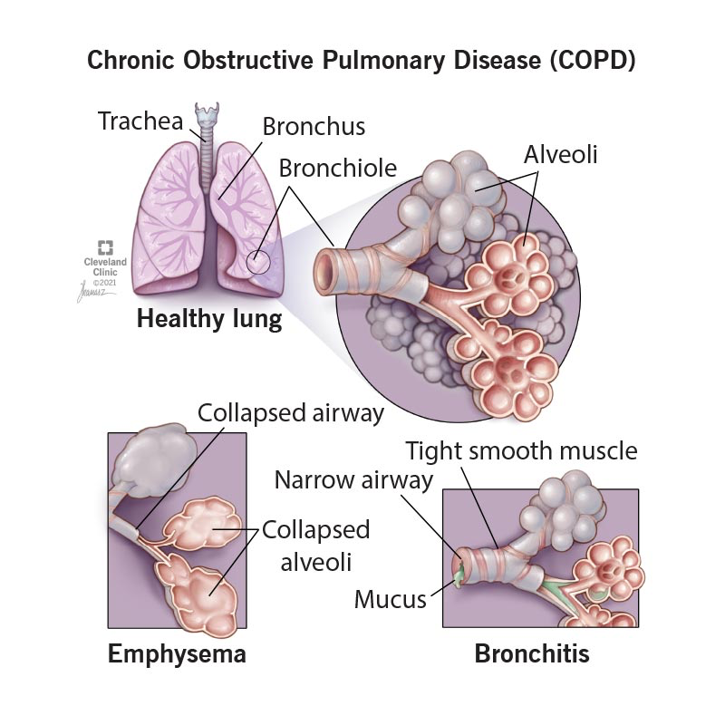
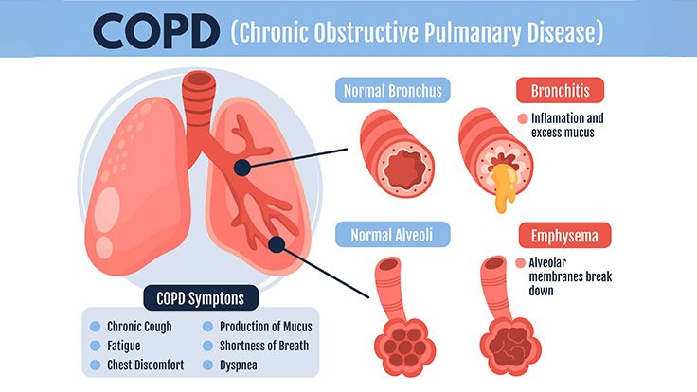
Definition
Chronic Obstructive Pulmonary Disease (COPD) is a progressive inflammatory lung disease characterised by persistent airflow limitation and respiratory symptoms such as dyspnoea, cough and sputum production (NICE, 2019; Gold, 2024).
Figure 1: COPD definition (Cleveland Clinic, 2024)
Figure1: Clinical definition of (Springfieldmedicalclinic.com, 2023)

Slide 4
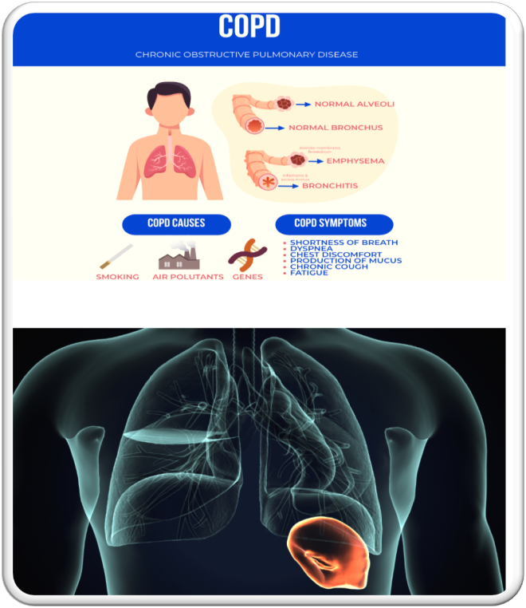
Symptoms
Progressive breathlessness (dyspnoea) (Cleveland 2024).
Chronic cough and persistent sputum production (Lance Respiratory Medicine, 2021).
Wheeze, chest tightness and swelling feet and ankle called edema (Christiansen, 2023)
Fatigue and reduced exercise tolerance impact daily functioning (Spandidos Publications, 2025).
Systemic features: weight loss, muscle weakness, peripheral edema. Cleveland, 2024)
Psychosocial impact: anxiety, depression and reduced quality of life (CAT) (NHS, 2024; GOLD, 2023).
Figure 2: Symptom burden and impact of COPD on quality of life (COPD, 2024)

Slide 5
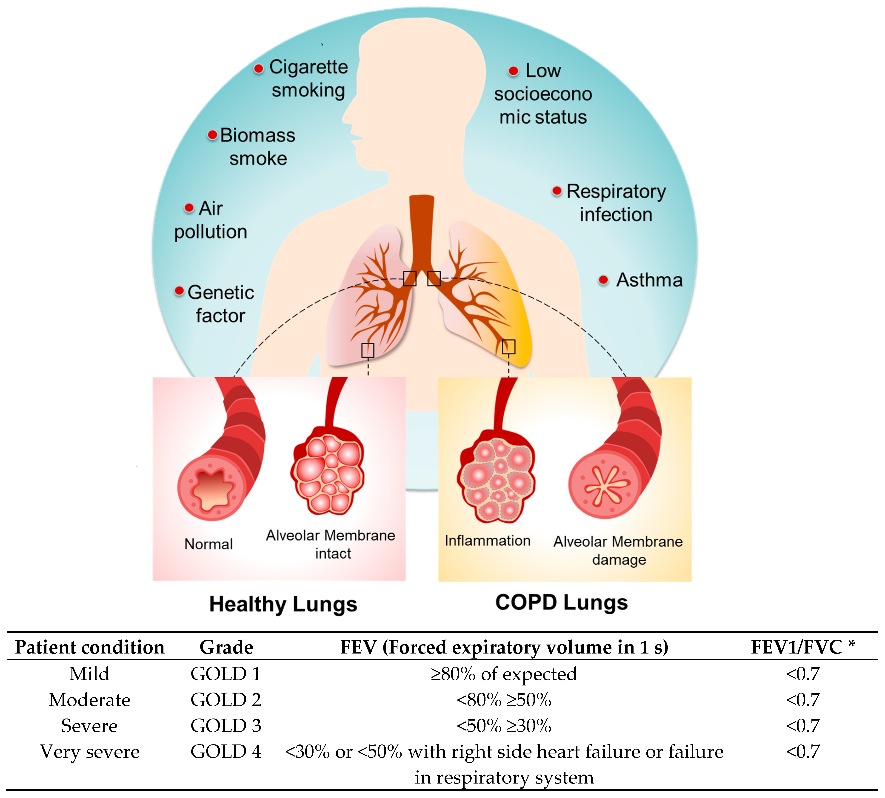
Aetiology and Causes
Smoking (primary risk factor) (WHO, 2024).
Long term exposure to environmental pollution, dust, chemical, - responsible for 75—90% cases and airway inflammation (Ambrosino & Bertella, 2018).
Pathophysiology
Chronic inflammation
Genetic factors (alpha-1 antitrypsin deficiency), increase susceptibility (Gold, 2023)
Age and cumulative exposure
Early-life lung damage (infections, passive smoke), (NICE, 2019)
(Figure 3:contributing factors and pathological manifestations in copd ( Pankush et al., 2025)
Notes:
Figure 1. Contributing factors and pathological manifestations in COPD: a schematic representation of factors and inflammatory response in the pulmonary alveolar membrane in COPD with a standard GOLD criterion [29]. * FEV1: forced expiratory volume in 1 sec, FVC: forced vital capacity.
https://my.clevelandclinic.org/health/diseases/8709-chronic-obstructive-pulmonary-disease-copd

Slide 6
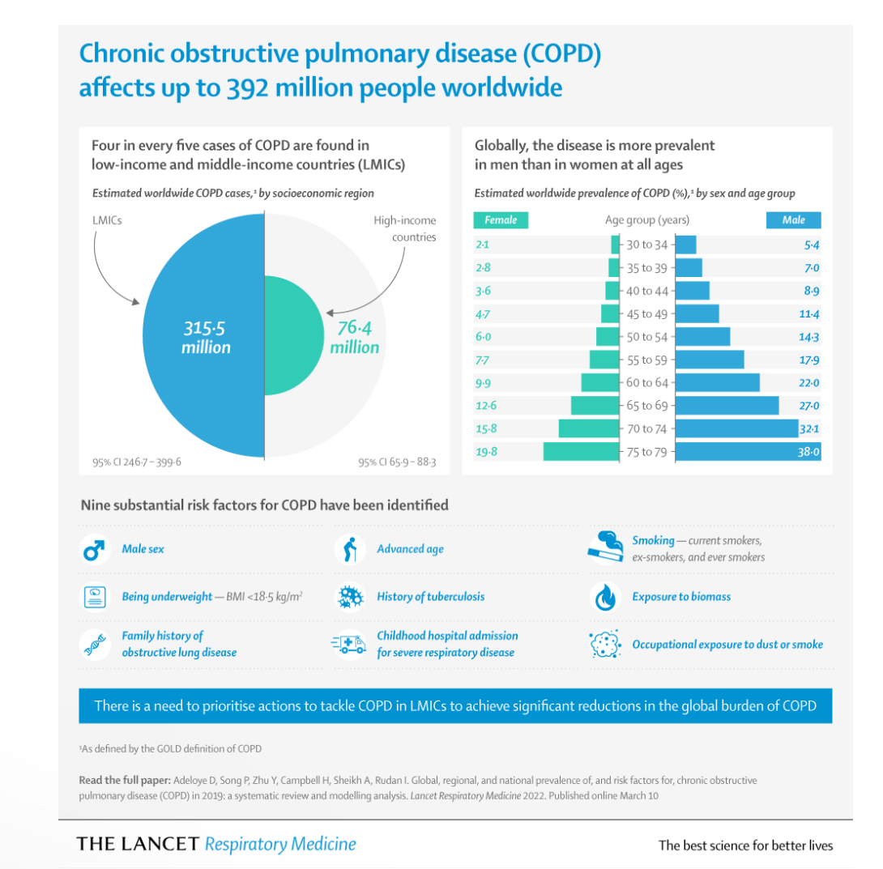
Prevalence
There are approximately 1.2 million diagnosed cases in the UK with more than 2 million undiagnosed (NICE, 2019).
Globally, it affects over 391 million people - 11.7% prevalence (Adeloye et al., 2015).
Accounts for 3.2 million deaths worldwide (2019) (Adeloye et al., 2022).
Low- and middle-class income countries account for over 90% of death (Tabyshova et al., 2021)
This represents major global public health issue worldwide (WHO, 2024).
Figure 4: COPD prevalence worldwide (The University of Edinburgh, 2022)

Slide 7
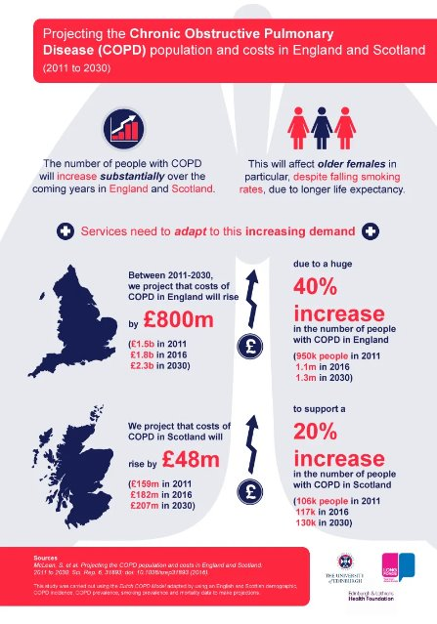
Economic and Social Burden
Healthcare impact
Accounts for approximately 1 in 8 emergency respiratory admissions in the UK (NHS England, 2019)
Economic:
NHS costs estimated at over £2.5 billion annually (Usher Institute, N.D.)
Significant productivity loss affecting workforce participation (Tachkov et al., 2017; Value in Health, 2021)
Social Consequences
Reduced quality of life and functional capacity
Social isolation and decreased community participation
Employment loss and financial hardship
Greater burden in deprived populations (Collins et al., 2018)
Figure 5: Cost and Burden (NHS England, 2023)

Slide 8
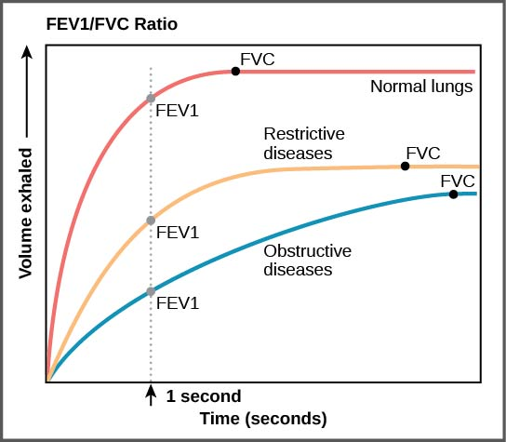
Diagnosis
Diagnosis is established from post-bronchodilator spirometry (National Institute for Health and Care Excellence, 2019).
A FEV₁/FVC ratio < 0.7 indicates persistent airflow limitation (Global Initiative for Chronic Obstructive Lung Disease, 2024; GOLD, 2024).
Chest X-ray is used to exclude alternative diagnoses such as lung cancer or heart failure (NICE, 2019).
Anaemia or polycythaemia in association with chronic hypoxia can be identified in a full blood count.
Oxygenation is determined with pulse oximetry and arterial blood gases in severe disease.
ECG or echocardiography may be used to identify cardiac comorbidities or pulmonary hypertension.
CT thorax may be warranted when symptoms are disproportionate to spirometry findings or to assess for other lung pathology.
Alpha-1 antitrypsin testing should be considered in early-onset disease or when there is a family history.
However, spirometry results may show diurnal variation, which may influence measurement accuracy and interpretation in clinical practice (Dodos et al., 2025).
Figure 6: Spirometry demonstrating airflow obstruction in COPD (NICE, 2019)

Slide 9
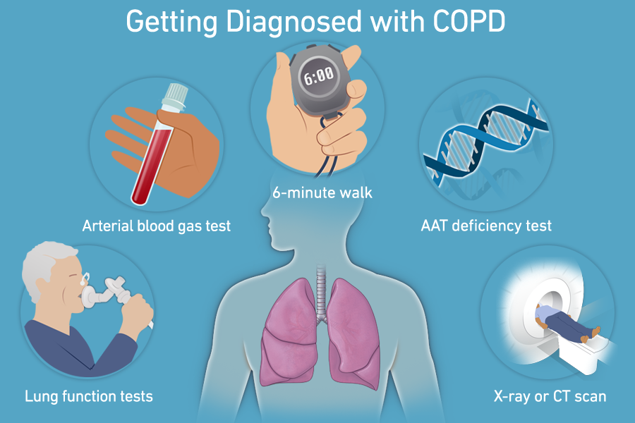
Initial Assessment
Evaluates symptom burden and the impact on a patient (Global Initiative for Chronic Obstructive Lung Disease, 2024).
Evaluation of the symptom pattern, including when symptoms began and how well it developed, its severity and frequency, as well as any potential causes and effects (NICE, 2019).
Smoking history and pack-year calculation as smoking is the predominant risk factor for COPD (GOLD, 2024).
Environmental, occupational exposure such as dust, chemicals and air pollutants (WHO, 2023).
BMI and nutritional status to understand malnutrition or obesity which can compromise results (GOLD, 2024).
Comorbidities assessment i.e. cardiovascular disease, anxiety, depression (Chatila et al., 2008).
Pulse oximetry assessment for oxygen saturation and for the detection of hypoxaemia (NICE, 2019)
Figure 7: Diagnosis strategies and Lung's function test (Temple Health, 2024)

Slide 10
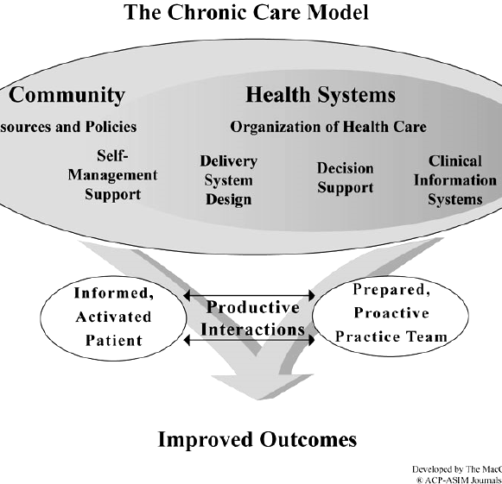
Management (UK Guidance & Models Frameworks)
Quitting smoking is the most effective treatment to slow disease progression (National Institute for Health and Care Excellence, 2019).
Stepwise pharmacological therapy consisting of LABA, LAMA and inhaled corticosteroids (Global Initiative for Chronic Obstructive Lung Disease, 2024).
Pulmonary rehabilitation (National Institute for Health and Care Excellence, 2019).
Self-management education and action plans (Cravo et al., 2022).
Integration of care pathways and multidisciplinary teams (NHS England, 2023). Framework Supporting Long-Term COPD Care.
NHS Personalised Care - embeds choice, self-management, social prescribing and person-led planning
(NICE 2019)
The Chronic Care Model fosters effective long-term management of the condition throughout the continuum of care via healthcare, community resources and care team planning (Adams et al., 2007).
Figure 8: Chronic Care Model supporting long-term COPD management (Wagner, 2001).

Slide 11
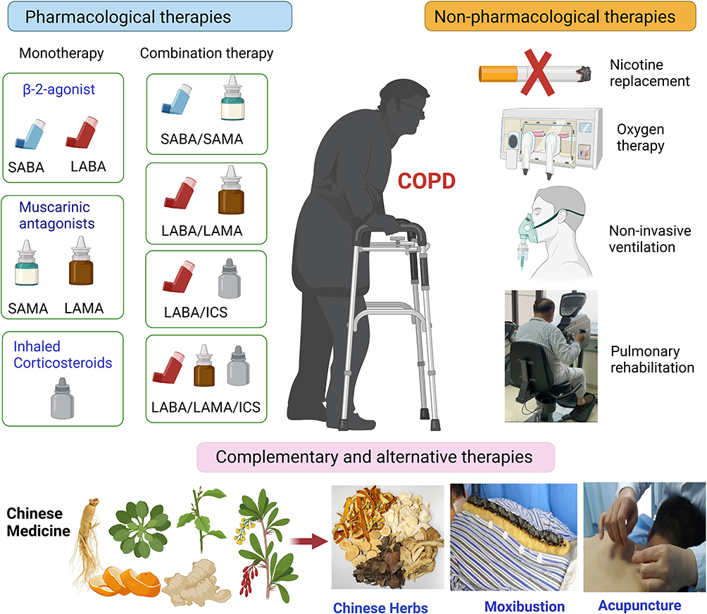
Treatment
Pharmacological treatment
Bronchodilators (LABA and LAMA) (GOLD, 2024).
Inhaled corticosteroids (Miravitlles and Anzueto, 2023).
Non-pharmacological treatment.
Pulmonary rehabilitation (exercise and education programmes) (NICE, 2019).
Smoking cessation (WHO, 2023).
Advanced management.
Long-term oxygen therapy for severe hypoxaemia (GOLD, 2024).
Exacerbation management using personalised action plans (NICE, 2019).
Treatment effectiveness depends on patient adherence and access to healthcare services (Miravitlles and Anzueto, 2023)
Figure 9: Treatment strategies (Arezina, Chen and Wang, 2023)

Slide 12
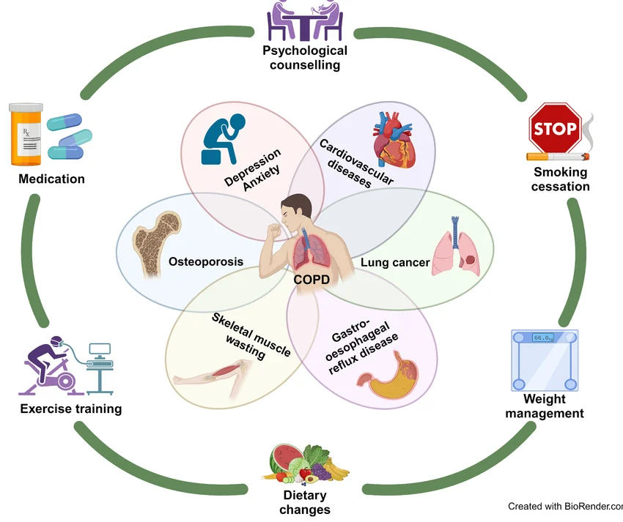
Comorbidities
Cardiovascular disease (e.g. heart failure and hypertension) is the most common comorbidity (Chatila et al., 2008; Mariniello et al., 2024).
Anxiety and depression (BMJ Open Respiratory Research, 2023).
Metabolic disorders (e.g., diabetes and metabolic syndrome) (Mariniello et al., 2024).
Musculoskeletal diseases - osteoporosis and muscle wasting (Chatila et al., 2008).
Respiratory diseases such as lung cancer and sleep apnoea (Sinden and Stockley, 2010; Barnes and Celli, 2009)
Multimorbidity worsens prognosis and increases healthcare utilisation, highlighting the need for integrated care (Valderas et al., 2009).
Figure 10: COPD multi morbidity and management strategies (Researchgate, 2026)

Slide 13
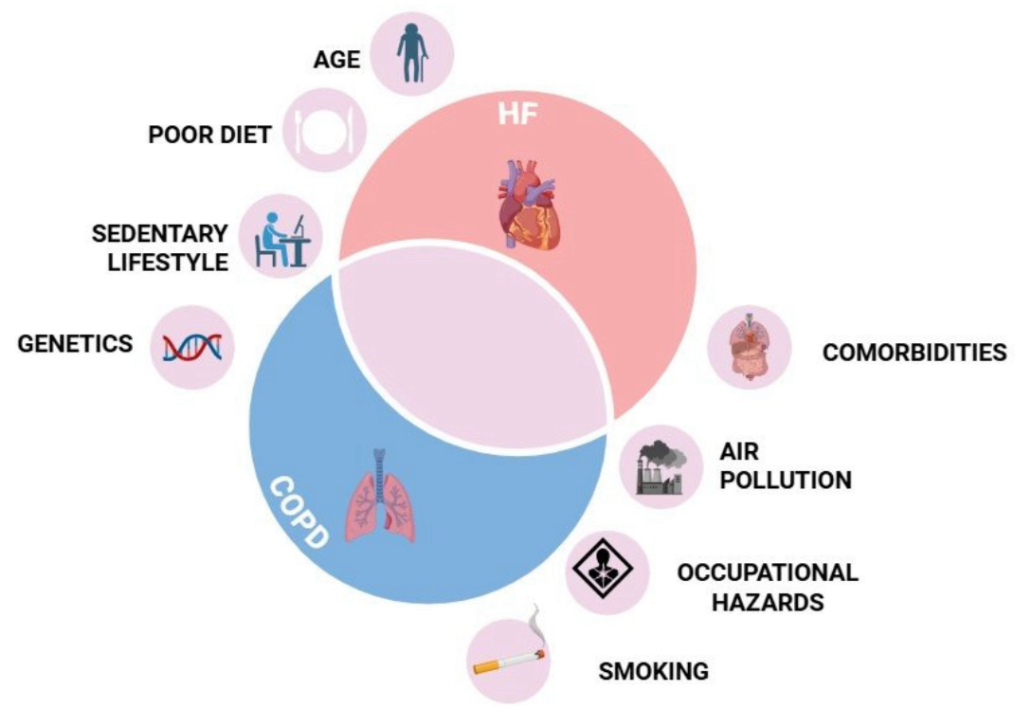
Prevention
Smoking cessation is the most effective strategy to prevent COPD and slow disease progression (WHO, 2023; BMJ Best Practice, 2024)
Reduction of environmental and occupational exposures, including air pollution, dust, and biomass fuel (WHO, 2023)
Vaccination against influenza, pneumococcal infection, and COVID-19 reduces exacerbations and hospitalisation risk (NHLBI, 2023)
Early detection using spirometry in high-risk individuals such as smokers (NICE, 2019; BMJ Best Practice, 2024)
Lifestyle interventions, including regular physical activity and balanced nutrition, improve lung health and overall wellbeing (Ambrosino & Bertella, 2018)
Patient education and self-management support (Cravo et al., 2022)
Public health strategies, such as tobacco control policies and air-quality regulation (WHO, 2023)
Figure 11: metabolic of risk factors (Luiza Elena Corneanu et al., 2025)

Slide 14

Co-Productive Care (Skills, Values and Behaviours)
Professional skills
Effective communication and active listening strengthen therapeutic relationships and trust (Jardim & Nascimento, 2019).
Shared decision-making and collaborative goal setting promote patient engagement (NHS England, 2019)
Supporting self-management and improving health literacy helps patients manage COPD effectively (Cravo et al., 2022)
Core values
Empathy, respect and person-centred care are essential in managing long-term conditions (Jardim & Nascimento, 2019)
Legal and ethical frameworks
Human Rights Act (1998) promotes dignity, autonomy and respect in healthcare
Equality Act (2010) ensures equal and non-discriminatory care (CQC, 2023)
Data Protection Act (2018) protects confidentiality and patient information
Care Act (2014) supports safeguarding and patient welfare (Care Cubed, 2023)
Challenges
Power imbalances and low health literacy can limit patient participation
Workforce pressures and service variation may lead to inconsistent co-production (NHS England, 2019)
Figure 12: The 6Cs care component
(Kwong, 2025)

Slide 15
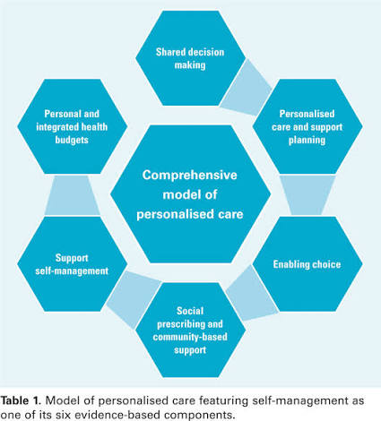
Personalised Care Model (6 Components)
1. Shared Decision-Making
Patients and clinicians choose treatments (e.g. inhalers, rehab)
2. Personalised Care Planning
Individual plans: symptom control, prevention, lifestyle changes
3. Enabling Choice
Right to choose NHS services and providers
4. Social Prescribing
Access to exercise, smoking cessation, community support
5. Supported Self-Management
Inhaler training, symptom monitoring, action plans (Cravo et al., 2022)
6. Personal Health Budgets
Funding for personalised care and community services
Figure 13: Model of personalised care featuring self management as one of the six evidence-based component (Vaughan and Lavery, 2024)
Notes:
Wagner Chronic Care Model - proactive review, decision support and coordinated multidisciplinary working.
House of Care - links informed patients, collaborative conversations and supportive systems for long-term condition care.
NHS Personalised Care - embeds choice, self-management, social prescribing and person-led planning.
https://www.nice.org.uk/guidance/ng115#:~:text=The%20NICE%20guideline%20NG115%20covers%20diagnosing%20and,life%20*%20Keep%20them%20healthy%20for%20longer

Slide 16
Recommended action
Promote early diagnosis through spirometry screening in high-risk population such as smokers (NICE, 2019; GOLD, 2024).
Strengthening smoking cessation as the most powerful preventative measure against disease progression (WHO, 2023).
Expand pulmonary rehabilitation services to enhance physical function and quality of life in COPD patients (NICE, 2019).
Adopt personalised care approaches, including shared decision-making and supported self-management (NHS England, 2019).
Strengthen multidisciplinary and integrated care pathways to address comorbidities and complex patient needs (Adams et al., 2007; NHS England, 2023).
Improve patient education and health literacy to enhance treatment adherence and self-management (Cravo et al., 2022).

Slide 17
Conclusion
COPD is a progressive long-term respiratory condition associated social with significant health,, and economic burden worldwide (WHO, 2023).
Early diagnosis, pharmacological treatment, and non-pharmacological interventions such as pulmonary rehabilitation (NICE, 2019; GOLD, 2024) are very effective management.
Addressing comorbidities and lifestyle risk factors is crucial for improving patient outcomes.
The personalised care model and self-management support can empower individuals and improve quality of life for people living with COPD (NHS England, 2019).
A multidisciplinary and patient-centred approach is therefore essential to improve long-term COPD management.

Slide 18
References
Adeloye, D., Chua, S., Lee, C., Basquill, C., Papana, A., Theodoratou, E., Nair, H., Gasevic, D., Sridhar, D., Campbell, H., Chan, K.Y., Sheikh, A. and Rudan, I. (2015) ‘Global and regional estimates of COPD prevalence: systematic review and meta-analysis’, Journal of Global Health, 5(2), p. 020415. Available at: https://www.ncbi.nlm.nih.gov/pmc/articles/PMC4693508/ (Accessed: 24 March 2026).
Adeloye, D., Song, P., Zhu, Y. et al. (2022) ‘Global, regional, and national prevalence of COPD in 2019’, The Lancet Respiratory Medicine, 10(5), pp. 447–458. Available at: https://www.thelancet.com/article/S2213-2600(21)00511-7/fulltext (Accessed: 24 March 2026).
Ambrosino N, Bertella E. Lifestyle interventions in prevention and comprehensive management of COPD. Breathe (Sheff). 2018 Sep;14(3):186-194. doi: 10.1183/20734735.018618. PMID: 30186516; PMCID: PMC6118879.
Adams, S.G., Smith, P.K., Allan, P.F., Anzueto, A., Pugh, J.A. and Cornell, J.E. (2007). Systematic Review of the Chronic Care Model in Chronic Obstructive Pulmonary Disease Prevention and Management. Archives of Internal Medicine, [online] 167(6), p.551. doi:https://doi.org/10.1001/archinte.167.6.551.
Agustí, A., Celli, B.R., Criner, G.J., Halpin, D., Anzueto, A., Barnes, P., Bourbeau, J., Han, M.K., Martinez, F. and Vogelmeier, C. (2023) ‘Global initiative for chronic obstructive lung disease 2023 report’, European Respiratory Journal, 61(4). Available at: https://www.thelancet.com/article/S2213-2600(21)00511-7/fulltext (Accessed: 10 April 2026).
Arezina, R., Chen, T. and Wang, D. (2023). Conventional, Complementary and Alternative Medicines: Mechanistic Insights into Therapeutic Landscape of Chronic Obstructive Pulmonary Disease. International Journal of Chronic Obstructive Pulmonary Disease, 18, pp.447–457. doi:https://doi.org/10.2147/copd.s393540.
Barnes, P.J. and Celli, B.R. (2009) ‘Systemic Manifestations and Comorbidities of COPD’, European Respiratory Journal, 33(5), pp.1165–1185. doi: https://doi.org/10.1183/09031936.00128008.
Care Cubed (2023) Health and social care policies UK: an overview. Available at: https://carecubed.org/health-social-care-policies-uk-an-overview/ (Accessed: 12 April 026).
Care Quality Commission (CQC) (2023) Equality and human rights in health and social care. Available at: https://www.cqc.org.uk/about-us/how-we-do-our-job/equality (Accessed: 13 April 2026).
Cravo A, Attar D, Freeman D, Holmes S, Ip L, Singh SJ. The Importance of Self-Management in the Context of Personalized Care in COPD. Int J Chron Obstruct Pulmon Dis. 2022 Jan 22;17:231-243. doi: 10.2147/COPD.S343108. PMID: 35095272; PMCID: PMC8791295.
Chronic obstructive pulmonary disease. (2022). Thelancet.com. doi:https://doi.org/10.1016/ffc950a8-e0a2-4881-92fc-7d2889a614ed.
Christiansen , S. (2023). What are the 4 gold stages of COPD? Available at: https://www.verywellhealth.com/stages-of-copd-gold-system-5071328. (Accessed: 27 March 2026)
Cleveland Clinic (2024). What Is COPD? Symptoms, Treatment & More. Available at: https://my.clevelandclinic.org/health/diseases/8709-chronic-obstructive-pulmonary-disease-copd. (Accessed: 27 March 2026).
Collins, P.F., Stratton, R.J., Kurukulaaratchy, R.J. and Elia, M. (2018) ‘Influence of deprivation on health care use, health care costs, and mortality in COPD’, International Journal of Chronic Obstructive Pulmonary Disease, 13, pp.1289–1296. Available at: https://pmc.ncbi.nlm.nih.gov/articles/PMC5914553/ (Accessed: 11 April 2026).

Slide 19
References continues
COPD care costs to exceed £2.5bn: Usher Institute (no date) Usher Institute. Available at: https://usher.ed.ac.uk/news-events/news-2016/copd-care-costs-to-exceed-ps2-5bn (Accessed: 15 April 2026).
Chatila, W.M. et al. (2008) ‘Comorbidities in chronic obstructive pulmonary disease’, Proceedings of the American Thoracic Society, 5(4), pp. 549–555. doi:10.1513/pats.200709-148et.
COPD (2024). What is COPD? Available at: https://www.respiratorydoctor.co.uk/copd.php?utm_source (Accessed: 31 March 2026)
Dodos, K., Kalamara, T.-V., Mavroudi, A., Kapoukranidou, D., Trakas, N., Spandidos, D., Corlateanu, A. and Georgakopoulou, V. (2025). Diurnal variation in spirometry parameters of patients with chronic obstructive pulmonary disease: A systematic review and meta‑analysis. Experimental and Therapeutic Medicine, 30(2), pp.1–10. doi:https://doi.org/10.3892/etm.2025.12906. (Accessed: 12 April 2026)
GBD Chronic Respiratory Disease Collaborators (2022) ‘Global burden of chronic obstructive pulmonary disease’, The Lancet Respiratory Medicine, 10(6), pp. 585–596. Available at: https://www.thelancet.com/article/S2213-2600(21)00511-7/fulltext (Accessed: 24 March 2026).
Global Initiative for Chronic Obstructive Lung Disease (GOLD) (2024) Global strategy for the diagnosis, management, and prevention of chronic obstructive pulmonary disease. Available at: https://goldcopd.org (Accessed: 24 March 2026).
Health, M. and Casper, L. (2025). What is Legislation in Health and Social Care UK? Available at: https://iomh.co.uk/what-is-legislation-in-health-and-social-care-uk/. (Accessed: 24 March 2026).
Jardim, J.R. and Nascimento, O.A. (2019) ‘The importance of inhaler adherence to prevent COPD exacerbations’, Medical Sciences, 7(4), p. 54. Available at: https://www.ncbi.nlm.nih.gov/pmc/articles/PMC6524014/ (Accessed: 24 March 2026).
Kwong, K. (2025). 6 Cs of Care: What They Are and Why They Matter - Flourish. Flourish. Available at: https://flourish.co.uk/community/6-cs-of-care/. (Accessed: 13 April 2026).
Miravitlles, M. and Anzueto, A. (2023) ‘Stepwise management of chronic obstructive pulmonary disease’, Pulmonology, 29(2), pp. 123–135. Available at: https://www.sciencedirect.com/science/article/pii/S2531043723000557 (Accessed: 24 March 2026).
National Institute for Health and Care Excellence (NICE) (2019) Chronic obstructive pulmonary disease in over 16s: diagnosis and management: rationale and impact. Available at: https://www.nice.org.uk/guidance/ng115/chapter/Rationale-and-impact (Accessed: 24 March 2026).
National Institute for Health and Care Excellence (NICE) (2019) Chronic obstructive pulmonary disease in over 16s: diagnosis and management (NG115). Available at: https://www.nice.org.uk/guidance/ng115 (Accessed: 24 March 2026).
National Institute for Health and Care Excellence (NICE) (2019) Pulmonary rehabilitation cost-effectiveness analysis. Available at: https://www.nice.org.uk/indicators/ind101-copd-offered-pulmonary-rehabilitation/downloads/ind101-cost-effectiveness-analysis-10321488-13376648413.pdf (Accessed: 24 March 2026).
NHS England (2023) Core20PLUS5: An approach to reducing healthcare inequalities. Available at: https://www.england.nhs.uk/about/equality/equality-hub/national-healthcare-inequalities-improvement-programme/core20plus5/evidence-for-the-five-clinical-priorities/ (Accessed: 24 March 2026).

Slide 20
References continuation
NHS England (n.d.) The House of Care framework. Available at: https://www.england.nhs.uk/long-read/house-of-care-framework/ (Accessed: 24 March 2026).
None, P., Bharti, K., Pandey, R., Srivastava, N., Kashyap, S., Kumar, D., Kumar, L., Suman, S.K. and Patel, S. (2025). ‘Role of Inflammatory Mediators in Chronic Obstructive Pulmonary Disease Pathogenesis: Updates and Perspectives’, Immuno, 5(2), pp.13–13. doi:https://doi.org/10.3390/immuno5020013.
National Institute for Health and Care Excellence (NICE) (2019) Chronic obstructive pulmonary disease in over 16s: diagnosis and management (NG115). London: NICE. Available at: https://www.nice.org.uk/guidance/ng115 (Accessed: 9 April 2026).
National Institute for Health and Care Excellence (NICE) (2024) Chronic obstructive pulmonary disease – diagnosis. Clinical Knowledge Summary. Available at: https://cks.nice.org.uk/topics/chronic-obstructive-pulmonary-disease/diagnosis/diagnosis-copd/ (Accessed: 13 April 2026).
Nature Publishing Group (2018) ‘COPD pathophysiology and disease mechanisms’, npj Primary Care Respiratory Medicine. Available at: https://www.nature.com/articles/s41533-018-0097-3 (Accessed: 11 April y 2026).
NHS England (2019) The NHS Long Term Plan. London: NHS England. Available at: https://www.longtermplan.nhs.uk (Accessed: 10 April 2026)
Parliamentary Office of Science and Technology (2021) Respiratory diseases statistics and policy briefing. Available at: https://commonslibrary.parliament.uk/research-briefings/cdp-2021-0188/ (Accessed: 28 July 2026).
Primary Care Respiratory Society (PCRS-UK) (2022) GOLD update: clinical implications for COPD management. Available at: https://www.pcrs-uk.org/sites/default/files/2022-December-25-GOLDUpdate-Clinical.pdf (Accessed: 10 April 2026).
Researchgate (2026). The Role of Inflammatory Mediators in Chronic Obstructive Pulmonary Disease Pathogenesis: Updates and Perspectives. Available at: https://www.researchgate.net/figure/Chronic-obstructive-pulmonary-disease-COPD-and-multimorbidity-and-the-management_fig2_383950316. (Accessed: 11 April 20226).
Springfield Medical Clinic. (2023). Spring Field Medical Clinic. Available at: https://springfieldmedicalclinic.com/blogs/what-is-chronic-obstructive-pulmonary-disease-copd. (Accessed: 11 April 2026).
StatPearls Publishing (2023) Chronic obstructive pulmonary disease. Available at: https://www.ncbi.nlm.nih.gov/books/NBK560965/ (Accessed: 24 March 2026).
Temple Health. (2024). COPD Diagnosis. Available at: https://www.templehealth.org/services/conditions/chronic-obstructive-pulmonary-disease-COPD/diagnosis. (Accessed: 10 April 2026).
The University of Edinburgh. (2016). COPD care costs to exceed £2.5bn. Available at: https://usher.ed.ac.uk/news-events/news-2016/copd-care-costs-to-exceed-ps2-5bn. (Accessed: 27 March 2026)
Tabyshova, A. et al. (2021) ‘Gaps in COPD guidelines of low- and middle-income countries’, Chest, 159(2), pp. 575–584. doi:10.1016/j.chest.2020.09.260.
Vaughan, K. and Lavery, J. (2024). Self-management of long-term conditions: a district nursing perspective of patient engagement. British Journal of Community Nursing, 29(10), pp.474–479. doi:https://doi.org/10.12968/bjcn.2024.0035.

Slide 21
References
Vogelmeier, C.F., Criner, G.J., Martinez, F.J., Anzueto, A., Barnes, P.J., Bourbeau, J., Celli, B.R., Chen, R., Decramer, M., Fabbri, L.M. and Frith, P. (2018) ‘Global strategy for the diagnosis, management, and prevention of chronic obstructive lung disease’, npj Primary Care Respiratory Medicine, 28(1), pp. 1–12. Available at: https://www.nature.com/articles/s41533-018-0111-9 (Accessed: 24 March 2026).
Wagner, E.H., Austin, B.T., Davis, C., Hindmarsh, M., Schaefer, J. and Bonomi, A. (2001) ‘Improving chronic illness care: translating evidence into action’, Health Affairs, 20(6), pp. 64–78. Available at: https://pubmed.ncbi.nlm.nih.gov/11343489/ (Accessed: 24 March 2026).
What is personalised care? the comprehensive model and the Six components (no date) What is Personalised Care? The Comprehensive Model and the Six Components - Happy Healthy Lives. Available at: https://www.happyhealthylives.uk/integrated-care-board/resources-and-services/personalising-care-for-our-people/what-is-personalised-care-the-comprehensive-model-and-the-six-components/ (Accessed: 15 April 2026).
World Health Organization (WHO) (2023) Global health estimates: Leading causes of death and disability. Available at: https://www.who.int/data/global-health-estimates (Accessed: 24 March 2026).
World Health Organization (WHO) (2024) Chronic obstructive pulmonary disease (COPD) fact sheet. Available at: https://www.who.int/news-room/fact-sheets/detail/chronic-obstructive-pulmonary-disease-(copd) (Accessed: 24 March 2026).

