Slide 1

The Impact of Remote and Hybrid Working on Employee Productivity and Job Satisfaction in SMEs
Module: LCLM6004 – Research Methods for Business
Student Name: Teya Todorova Ceneva
Student ID: 2325754
Lecturer: Rameses Manalang
Notes:
The present research examines the impact of remote and hybrid working on employes’ productivity and job satisfaction in SMEs. It also examines the management problems of flexible working and how SMEs might build efficient working arrangements.

Slide 2

Introduction
Research Context
Remote and hybrid working have significantly changed modern
employment.
Potential Benefits
Greater employee flexibility
Reduced commuting
Improved work-life balance
Increased autonomy
Potential improvement in job satisfaction
Potential Challenges
Communication difficulties
Employee isolation
Performance monitoring
Digital infrastructure
Maintaining organisational culture
Research Aim
To examine the effects of remote and hybrid working on employee productivity and job satisfaction in SMEs and identify management strategies that facilitate effective flexible working.
Notes:
Remote and hybrid working provide employees with greater flexibility, but they also create challenges for managers. My research focuses specifically on SMEs and examines how businesses can balance flexibility with productivity and employee satisfaction.

Slide 3
Alignment with Business Practices
Question 1
How does your research proposal align with current trends or innovations in the business world?
Answer
My research aligns with several important developments in modern business:
Flexible Working
Remote and hybrid models are now important workforce-management practices.
Digitalisation
Teams increasingly depend on digital communication and collaboration technologies.
Employee-Centred Management
Businesses are placing greater emphasis on flexibility, autonomy and work-life balance.
Outcome-Based Performance
Managers can focus more on employee outputs rather than physical presence.
Employee Retention
Flexible working can form part of an organisation's strategy for attracting and retaining employees.
🏠 Flexibility → 💻 Digitalisation → 👥 Employees → 📊 Performance → 🎯 Retention
Notes:
My proposal is relevant to current business practice because organisations are reconsidering where and how employees should work. Hybrid working is connected with digitalisation, employee flexibility and outcome-based management, making this research particularly relevant to modern SMEs.

Slide 4

Problem Statement
Question 2
How did you determine the relevance of your selected business issue in today's industry?
Answer
I thot the issue was important because:
Remote and hybrid working continue to be prominent job trends.
Flexibility of employees or organisational performance? SMEs’ dilemma
How people organise to work can affect productivity, enjoyment and retention.
Managers have problems with communication, teamwork and performance tracking.
SMEs might not have the same technical, financial and HR resources as bigger organisations.
Existing research indicates the necessity for more SME-specific investigations
Notes:
I selected this issue because flexible working affects both employees and organisational performance. It is particularly relevant to SMEs because they may have fewer resources to manage remote teams effectively, creating a need for SME-specific research.

Slide 5

Problem Statement
Question 2
In what ways does your problem statement address broader societal or economic implications?
Answer
👥 Societal Implications
Better work-life balance
Reduced commuting
Greater employee flexibility
Potential improvement in wellbeing
Support for different personal responsibilities
📈 Economic Implications
Employee productivity
Staff retention
Recruitment opportunities
Potential office-cost savings
Digital investment
SME competitiveness
Wider Impact
Flexible Working → Employees → Business Performance → Wider Economy
Flexible working therefore has implications beyond individual employees because it can influence how organisations attract, retain and manage their workforce.
(Bloom, Han and Liang, 2024)
Notes:
The problem has both societal and economic implications. Employees may benefit from flexibility and reduced commuting, while businesses may benefit through retention and productivity. However, businesses also need to consider technology costs and management challenges.

Slide 6
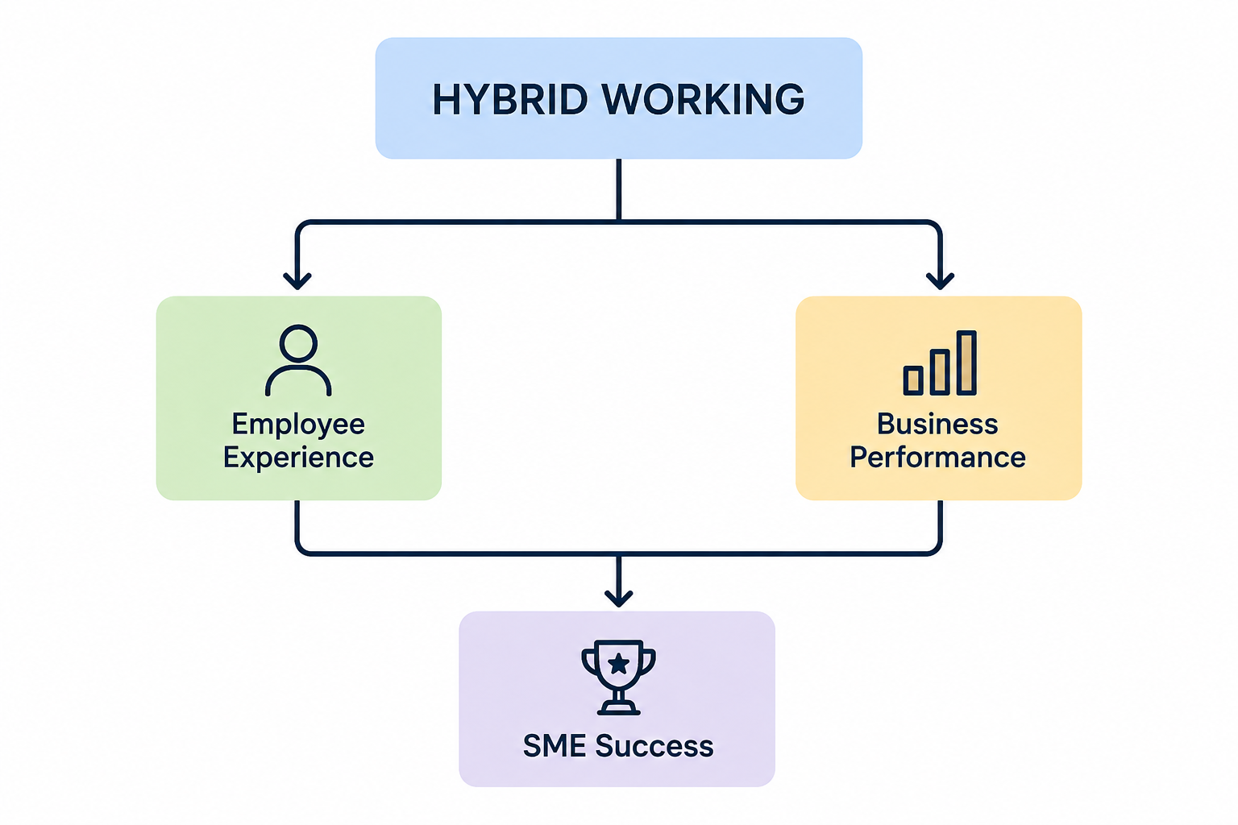
Problem Statement
Question 3
How does your identified business issue align with current industry challenges, and what is its significance in
the broader business context?
Answer
Current Industry Challenges
Communication
Maintaining effective communication between remote and office employees.
Collaboration
Supporting teamwork when employees work in different locations.
Productivity
Measuring performance without relying on physical presence.
Technology
Providing suitable digital infrastructure and cybersecurity.
Employee Experience
Preventing isolation while maintaining flexibility and work-life balance.
Organisational Culture
Maintaining relationships and a sense of belonging.
Why is it significant?
Successfully managed hybrid working may contribute to:
Productivity + Satisfaction + Retention + Competitiveness
Poor management may instead contribute to:
Isolation + Communication Problems + Dissatisfaction + Reduced Performance
Notes:
The issue connects directly with current challenges around communication, collaboration, technology and performance management. Its broader significance is that flexible working can influence both employee experience and organisational competitiveness.

Slide 7
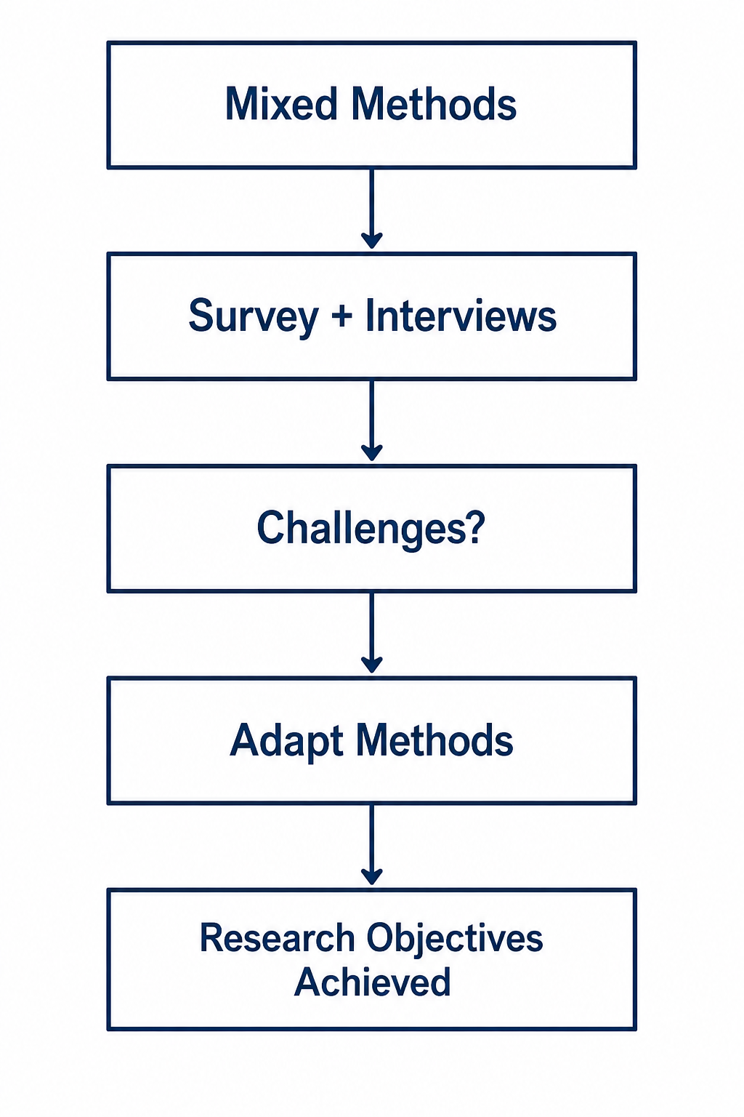
Adaptability and Feasibility
Question 1
If your chosen methodology faces unforeseen challenges, what
alternative approaches could you adopt to ensure your
research objectives are achieved?
Answer
My research uses mixed methods: surveys and interviews.
If challenges occur, I could:
Low survey responses → Recruit more participants
Interview difficulties → Use online interviews
Limited time → Reduce the number of interviews
Limited access to SMEs → Include SMEs from different sectors
Low interview participation → Add open-ended survey questions
Notes:
My methodology is flexible. If I experience problems such as low participation or limited time, I can adapt the data collection methods. For example, I could conduct interviews online or recruit participants from additional SMEs while keeping the same research objectives.

Slide 8

Conclusion
The Research Addresses a Current Business Issue
Remote and hybrid working influence:
Employee Productivity
Job Satisfaction
Work-Life Balance
Organisational Performance
Key Argument
Successful flexible working requires:
Effective communication
Appropriate technology
Employee autonomy
Management support
Clear performance expectations
Regular evaluation
Notes:
In conclusion, remote and hybrid working can provide important benefits, but these outcomes are not automatic. My research aims to help SMEs understand how flexible working can be managed to support both employee satisfaction and organisational performance.

Slide 9

The success of remote and hybrid working depends not simply on where employees work, but on how flexible working is designed and managed

Slide 10
References
Aprilina, R. and Martdianty, F. (2023) ‘The role of hybrid-working in improving employees’ satisfaction, perceived productivity, and organizations’ capabilities’, Jurnal Manajemen Teori dan Terapan, 16(2), pp. 206–222.
Bakker, A.B. and Demerouti, E. (2007) ‘The Job Demands-Resources model: State of the art’, Journal of Managerial Psychology, 22(3), pp. 309–328.
Bloom, N., Han, R. and Liang, J. (2024) ‘Hybrid working from home improves retention without damaging performance’, Nature, 630, pp. 920–925.
Braun, V. and Clarke, V. (2006) ‘Using thematic analysis in psychology’, Qualitative Research in Psychology, 3(2), pp. 77–101.

Slide 11

Questions?

