Slide 1
Extension:
Note-taking

Slide 2
Activity 1
You are going to watch a TedX Video entitled "Why you procrastinate even when it feels bad"
Before watching, discuss these questions with a partner:
What do you remember about the meaning of 'procrastination' from last week (Week 1: Time Management)?
Why do you think people procrastinate? Try to list 3 different reasons.

Slide 3
Activity 1: While Watching
Go to Moodle and download the Note-Taking Activity Worksheet
Look at the questions and make some guesses with a partner about what some answers might be
Watch the video and take notes to cover the answers. If it is easier for you to write with a pen and paper, have the worksheet open on your device while the video plays and take notes in your notebook-you do not have to type!

Slide 4
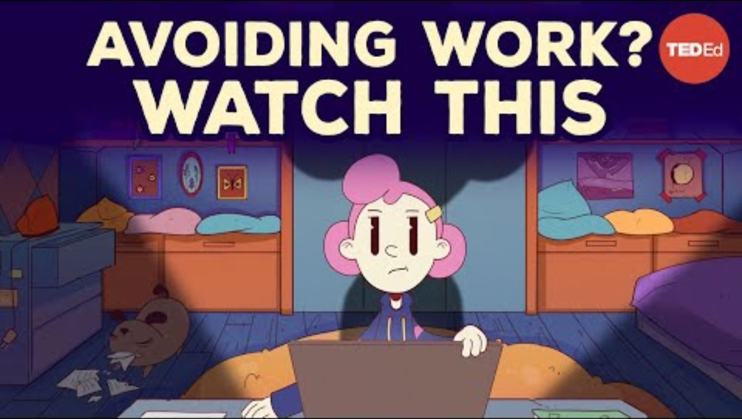
Activity 1: Watch
https://www.youtube.com/watch?v=FWTNMzK9vG4

Slide 5
Activity 1: Check
Reflect on these questions and discuss with a partner:
How did this activity feel while you were doing it?
Were most of your answers correct? If not, that's alright! It's difficult to take notes quickly. What is one thing you think you could improve to take better notes? (No, "everything" is not a good answer!)

Slide 6
Answers will be revealed next week on the Week 2 Tile or will be with your teacher!

