Slide 1
Effective questioning

Slide 2
On average, how many questions does a teacher ask each day?

Slide 3
On average, how many questions does a teacher ask each day? A - 400

Slide 4
On average, how many questions does a teacher ask each day? A - 400
According to research, how long should a teacher wait for an answer to :
a low level question
a higher level question

Slide 5
On average, how many questions does a teacher ask each day? A - 400
According to research, how long should a teacher wait for an answer to :
a low level question A – 3 secs
a higher level question

Slide 6
On average, how many questions does a teacher ask each day? A - 400
According to research, how long should a teacher wait for an answer to :
a low level question A – 3 secs
a higher level question A – 10 secs

Slide 7
Dylan Wiliam
Cwestiynu effeithiol – byr Effective questioning (short)
Cwestiynu effeithiol – hir Effective questioning (long)

Slide 8

Questioning can fail when ……. | Questioning can succeed when …….

Slide 9
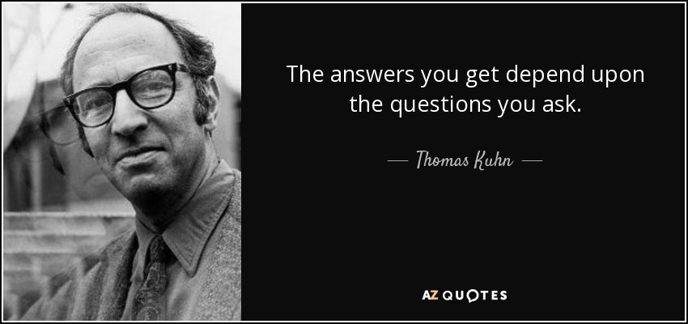

Slide 10
Socratic Questions

Slide 11
Conceptual clarification questions
Get them to think more about what exactly they are asking or thinking about. Prove the concepts behind their argument. Use basic 'tell me more' questions that get them to go deeper.
Why are you saying that?
What exactly does this mean?
How does this relate to what we have been talking about?
What is the nature of ...?
What do we already know about this?
Can you give me an example?
Are you saying ... or ... ?
Can you rephrase that, please?

Slide 12
Probing assumptions
Probing their assumptions makes them think about the presuppositions and unquestioned beliefs on which they are founding their argument. This is shaking the bedrock and should get them really going!
What else could we assume?
You seem to be assuming ... ?
How did you choose those assumptions?
Please explain why/how ... ?
How can you verify or disprove that assumption?
What would happen if ... ?
Do you agree or disagree with ... ?

Slide 13
Probing rationale, reasons and evidence
When they give a rationale for their arguments, dig into that reasoning rather than assuming it is a given. People often use un-thought-through or weakly-understood supports for their arguments.
Why is that happening?
How do you know this?
Show me ... ?
Can you give me an example of that?
What do you think causes ... ?
What is the nature of this?
Are these reasons good enough?
Would it stand up in court?
How might it be refuted?
How can I be sure of what you are saying?
Why is ... happening?
Why? (keep asking it -- you'll never get past a few times)
What evidence is there to support what you are saying?
On what authority are you basing your argument?

Slide 14
Questioning viewpoints and perspectives
Most arguments are given from a particular position. So attack the position. Show that there are other, equally valid, viewpoints.
Another way of looking at this is ..., does this seem reasonable?
What alternative ways of looking at this are there?
Why it is ... necessary?
Who benefits from this?
What is the difference between... and...?
Why is it better than ...?
What are the strengths and weaknesses of...?
How are ... and ... similar?
What would ... say about it?
What if you compared ... and ... ?
How could you look another way at this?

Slide 15
Probe implications and consequences
The argument that they give may have logical implications that can be forecast. Do these make sense? Are they desirable?
Then what would happen?
What are the consequences of that assumption?
How could ... be used to ... ?
What are the implications of ... ?
How does ... affect ... ?
How does ... fit with what we learned before?
Why is ... important?
What is the best ... ? Why?

Slide 16
Questions about the question
And you can also get reflexive about the whole thing, turning the question in on itself. Use their attack against themselves. Bounce the ball back into their court, etc.
What was the point of asking that question?
Why do you think I asked this question?
Am I making sense? Why not?
What else might I ask?
What does that mean?

Slide 17
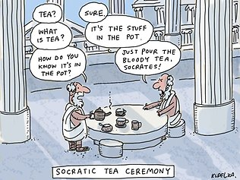

Slide 18

I don’t understand
Some ideas;
Give the answer to the pupil and ask him / her to explain why this is the correct answer.
Give the pupil a ‘multiple choice’ approach.
Remind the pupil of key facts
Reword the question – ‘What is the difference between......’
Think, pair, share.

Slide 19
Summary
Consider – no hands up!
Think of the questioning process as a game of basketball rather than a game of table tennis!
Choose names at random.
Place the names of pupils at the end of the question.
Differentiate questions – know your pupils.
Ask at least one question to follow every answer
Wait ! (3 seconds / 10 seconds)

