Slide 1
BMSW 4006
Managing Enterprise in the 21st Century
Week 6
Exploring Your Market

Slide 2
Recap of Previous Lecture
In week 4 we examined:
Marketing Audit:
SWOT Analysis,
PESTLE Analysis, and
Marketing Mix.

Slide 3
In Today’s Lecture….
We will…..
1. Distinguish between marketing and market.
2. How market research prepares you for success.
3. Choose your market segment, target market and research it.
4. Position your product or service within your
market.
5. Marketing plan and management team.

Slide 4
Markets and Marketing Defined
A market is a group of people or organizations that may be interested in buying a given product or service, can afford it, and can do so legally.
Marketing - the development and use of strategies for getting a product or service to customers and generating interest in it.
Brand - identifies distinctively the goods or services of one organization from others through a design, symbol, name, term, or other distinguishing features.

Slide 5
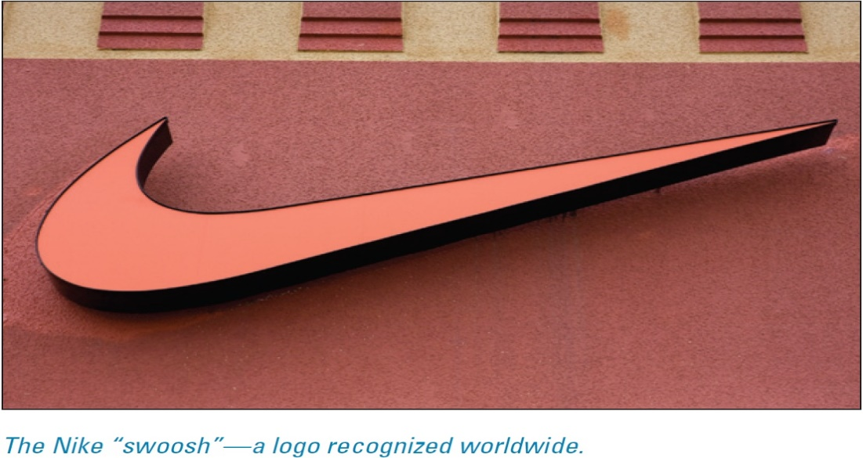
Markets and Marketing Defined
Nike creates advertisements and promotions designed to convince customers that Nike shoes will inspire them to Just Do It.
You can choose athletic shoes from many companies, but Nike hopes you will feel inspired by its marketing to seek out and buy its brand.
Notes:
Nike sells athletic shoes. It puts them in stores where consumers can buy them. But Nike also markets athletic shoes.

Slide 6
A Business That Markets versus a Market-Driven Business
Do not make the mistake of treating marketing as an isolated business function rather than the engine that drives all business decisions.
Most experts agree that to be successful, a business must develop its marketing vision first, with a consistent customer focus, and then use it as the basis for all subsequent judgments.

Slide 7
Research Prepares You for Success
Whether you have a product or service you want to market or are searching for a market opportunity with the aim of creating a product or service to fill that need, research can help you succeed.
Your research can be conducted at the level of the industry, the market segment, or the individual consumer.
Whereas the questions you ask will be different at each level, the methods of conducting the research are similar.

Slide 8
Research Your Market Before You Open Your Business
Large corporations spend a great deal of money on marketing and market research before they introduce a product or service.
Take a lesson from the big companies: research your market.
Introduce your product to potential customers.
Be open to honest criticism.

Slide 9
Research Helps You Know Your Customer
Market research - the collection and analysis of data regarding target markets, industries, and competitors.
Market research is the process of finding out:
who your potential customers are,
where you can reach them,
what they want and need,
how they behave, and
what the size of your potential market is.

Slide 10
Research Helps You Know Your Customer
Whether your customers are individual consumers or other businesses, you will want to get into their minds and find out what they really think about such subjects as:
your product or service,
the name of your business,
your location,
your logo and branding materials,
your proposed prices, and
your promotional efforts

Slide 11
Research Helps You Know Your Customer
Marketing research helps you get a fix on who your customers are by answering these kinds of questions:
How old are they?
What kind of income do they earn?
What are their hobbies and interests?
What is their family structure?
What is their occupation?
What is the benefit your product or service offers that would best attract them?
What problem are you solving with it?

Slide 12
Customer Research
You will want to find out everything you can about your ideal customers:
What do those individuals eat, drink, listen to, and watch on TV?
How much do they sleep?
Where do they shop?
What movies do they like?
How much do they earn?
How much do they spend?

Slide 13
Customer Research
Your marketing survey should ask about:
Product or service use and frequency of purchase;
Places where the product is purchased (the competition!) and why consumers like to purchase from these businesses; and
Business names, logos, letterheads—everything that will represent your business in a customer’s or potential customer’s mind.

Slide 14
Customer Research
Make sure your marketing surveys also gather specific information about customers that will help you understand them better. They should include:
interests and hobbies,
reading, television-watching, Internet, and social-media habits,
educational background,
age,
occupation,
annual household income,
gender, and
family size and structure.

Slide 15
How Customers Decide to Buy
It is critical to understand not only which customers are in your target market, but how they will purchase your product (or service).
Step 1. If you have developed a product or service, ask yourself what consumer need it will serve.
Step 2. Think about who might actually buy your product.
Step 3. Analyze the buying process that will lead customers to your product.

Slide 16
How Customers Decide to Buy
Some ways to analyze the buying process that will lead customers to your product:
Awareness
Information search
Evaluate alternatives
Decide to purchase
Evaluate the purchase
Notes:
Owning a Perception in the Customer’s Mind
More valuable to McDonald’s than all the Big Macs it sells every year is the perception it owns in the minds of its customers. That every time they patronize a McDonald’s, they will eat food that tastes exactly the same as at every other McDonald’s. That the prices will be reasonable, and that the service will be friendly and fast.
For Burger King to compete with McDonald’s, it had to fight for a mind share of the fast-food customer:
Burger King opened its attack with “Have It Your Way,” which targeted McDonald’s mass-manufacturing approach to making hamburgers. It is almost impossible to topple an established leading brand in a market. Burger King’s executives wisely decided that their goal was to be a strong number two.
Avis lost money for 15 years while trying to overtake Hertz. You do not have to be number one to be successful.
Discover a competitive advantage and attack the market by creating a new category in the customer’s mind.

Slide 17
Which Segment of the Market Will You Target?
Market segment - a group of consumers or businesses that have a similar response to a particular type of product or service.
Marketing strategies are focused on the customer, and a business has to choose which customers to target.
Home Depot’s competitive advantage would not be strong in the market segment composed of professionals, in which the distribution channels are strong and well established.
It is difficult to target very different segments of a market simultaneously.

Slide 18
Successful Segmenting:
The Body Shop
The Body Shop is a good example of the success that can result from choosing the right market segment.
Founder Anita Roddick disliked paying for expensive packaging and perfuming when she bought cosmetics.
She was also annoyed by the extravagant claims made by many cosmetics companies and by the high prices of their perfumes and lotions.
Roddick saw an opportunity to create a different line of cosmetics.
She would use natural products that would be packaged inexpensively and marketed without extravagant claims.

Slide 19
Applying Market Segmentation Methods
Marketers have developed four basic ways to segment:
Market Segmentation
Geographic
Demographic
Psychographic
Behavioral

Slide 20
Applying Market Segmentation Methods
Marketers have developed four basic ways to segment:
• Geographic: Dividing a population by location.
• Demographic: Dividing a population based on a variable such as age, gender, income, or education.
• Psychographic: Dividing a population by psychological differences, such as values (conservative, liberal, open-minded, traditional), lifestyle (sedentary, active), personality traits (worrier, Type A, shy, extroverted), and social group (white collar, blue collar).
• Behavioral: Dividing the market by purchase behaviors that have been observed, such as brand loyalty or responsiveness to price.

Slide 21
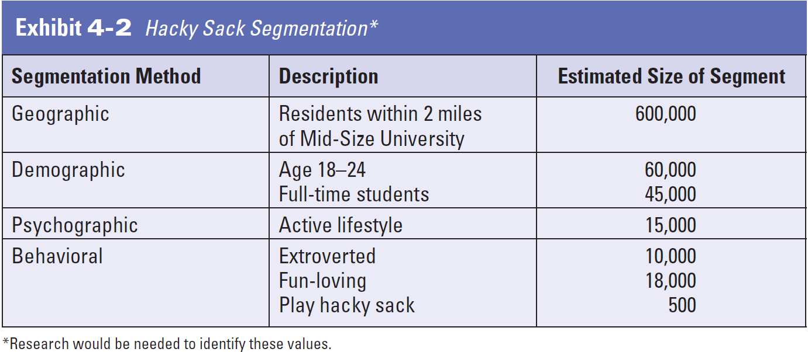
Applying Market Segmentation Methods

Slide 22
Applying Market Segmentation Methods
Here are a few questions you can adapt to your own product or service:
1. Do you currently use this type of product?
2. What brand of this product do you currently use?
3. Where do you buy it? Please be specific about the source, such as the name and location of the store, the direct-marketing representative, or Web site.
4. How much do you pay for it? (Probe for size and price, if appropriate.)
5. How often do you buy it?
6. Would you buy our product/service?
7. How much would you be willing to pay for it?
8. Where would you shop for it?
9. How would you improve it?
10. Now that you have seen/tasted/felt/smelled this product, what do you consider to be its closest competitor?
11. Is our product/service worse or better than those of our competitors?

Slide 23
Market Targeting
The process of evaluating each market segment’s attractiveness and selecting one or more segments to enter.
A company should target segments in which it can profitably generate the greatest customer value and sustain it over time.
A company with limited resources might decide to serve only one or a few special segments or market niches.

Slide 24
Market Targeting
The target market section of the business plan details who you are selling to.
Understanding your target market is key to building marketing campaigns and sales processes that work.
Beyond marketing, your target market will define how your company grows.

Slide 25
Market Positioning:
Helps Drive Home Your Competitive Advantage
Positioning - distinguishing a product or service from similar products or services being offered to the same market.
After deciding which market segments to target, an entrepreneur will need to figure out what position the company should try to occupy in those segments.
Use the following format to develop a positioning statement for your business:
1. Your business name/brand
2. Competitive industry/category
3. Provides these benefits, or points of difference
4. Audience/target market
Notes:
The position of a product is its relative place in the customer’s mind compared with its competitors.

Slide 26
Developing a Marketing Plan
After you understand how customer-focused marketing should permeate your business, you will be ready to develop a plan for introducing your product to your market.
The marketing plan can serve as a stand-alone document or be part of an overall business plan.
Before you can develop a marketing vision, you will need to know who your customers are and what they want.
Your marketing plan must include an understanding of prospective customers and their wants, needs, and demands.

Slide 27
Marketing Plan
A marketing plan is central to coordinating and managing all marketing efforts within an enterprise.
It does not need to be long or expensive to put together. However, it need to be well thought out, carefully researched, and analyzed.
It should aim at realizing enterprise set goals, mission and vision statements.

Slide 28
Marketing Plan
The marketing and sales plan details the strategies that you will use to reach your target market.
This portion of your business plan provides an overview of how you will:
Position your company in the market.
Price your products and services, how you will promote your offerings, and any sales processes you need to have in place.

Slide 29
Marketing Plan
The primary roles of the marketing plan include:
Demonstrating to potential investors that your company can grow and offer returns,
Identifying the most beneficial target markets for the organization,
Evaluating the competitive and industry environments,
Illustrating the pricing strategy, and
Detailing the promotional plan and budget.

Slide 30
Marketing Plan
Based on the explained points, marketing plan strategies among other things leverage on:
The enterprise product offerings (product & service).
The price of the product/service on offer.
The place -location and/or channel to purchase the product, and
The promotion – means of persuading the target customers to buy the product.
The appropriate combination of product, price, place and promotion (marketing mix) can help the enterprise prepare a competitive marketing plan.

Slide 31

Management Team
Management team is of immense interest to investors and other stakeholders e.g., suppliers and employees.
Investors increasingly focus on the quality of the management team:
its technical and industry specific qualifications,
its entrepreneurial experience,
its integrity, as well as,
the commitment and skills of each individual manager.

Slide 32
Management Team
The management team through the quality of its leadership answers the question: ‘how can enterprise achieve its goals, and what resources will it need to
achieve the set objectives?
The management team involves the management process. It serves as basis for structuring the enterprise.
It is the main feature of the organizational structure and should be configured according to the enterprise requirements.

Slide 33
Management Team
It is a good practice to generate the organizational structure and units.
This could include head of units, the job descriptions, the tasks, the activities and the responsibilities are assigned to the different organizational units.
Depending on the volume and complexity of the different tasks, they can be assigned to one or more organizational units.

Slide 34
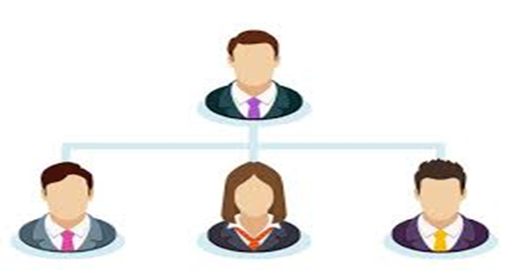
Management Team
The management team section should include:
Relevant team bios that explain why your management personnel are the right people for their jobs.
After all, good ideas are a dime a dozen—it’s a talented entrepreneur who can take those ideas and turn them into thriving businesses.

Slide 35
Group Activities
Complete the:
Target market,
Marketing plan, and
Management team sections of
your business plan.

