Slide 1
BSc Health & Social Care
Changemakers – Creativity and
Value Creation (BMHP5014)
WEEK 8

Slide 2
Today we will…
The session will include the following items:
To look at more examples from the topic areas covered in Unit 3 and Unit 4.
To take any final questions relating to the 1st assessment task and any queries relating to the assessment assignment.
To provide time for you to work on your e-learning units in Moodle.
To take questions on the remaining assessment tasks and provide assignment support.

Slide 3
Unit 3 - examples

Slide 4

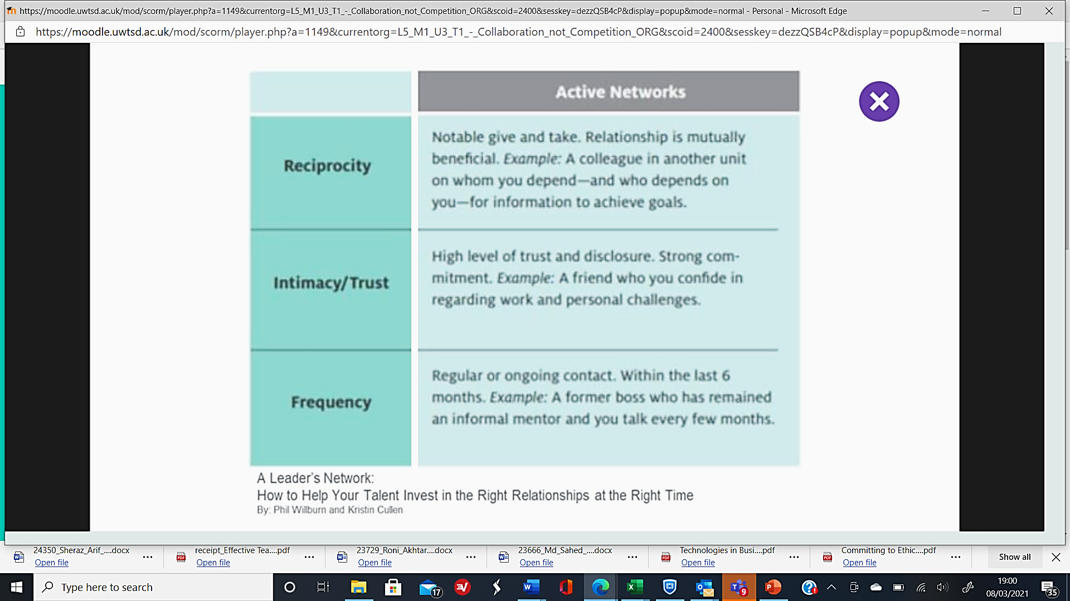
Active Networks
Notes:
Active Networks
Active networks have three elements to them to help establish if they are active net works. Go through the three elements and then get the students to share with the cohort their ideas of this type of networks in their lives or lived experiences. You can also link the ideas to professional practice around the health and social care profession.
Reciprocity which is a mutual exchange and interchangeable relationship with someone, where there is a trade-off between the parties. Its is about giving and taking which has a mutual benefit for all and where there is a giving and taking between the parties.
Active networks can be intimate and trusting. In an active network there is a high level of trust between the parties. Each party has the ability to disclose trusting information as they share a mutual respect and confidence between each other.
Active network involves having meetings or meeting up or contact with each other frequently. The relationship is regular and ongoing. An example could be once a month, or once every 3 months but no longer than at least once every 6 months. You can link back to week 7 when we covered the role of the mentor and how frequently they may meet up with them.
The idea within active networks is emphasising the regularity, the mutual respect and trusting relationship between the parties.
As the students to think about their active networks and to think on what basis they are part of their network. See if they can tick box all of these three elements which can be explored in a discussion in the chat or in open discussion in the forum of the teaching session.

Slide 5
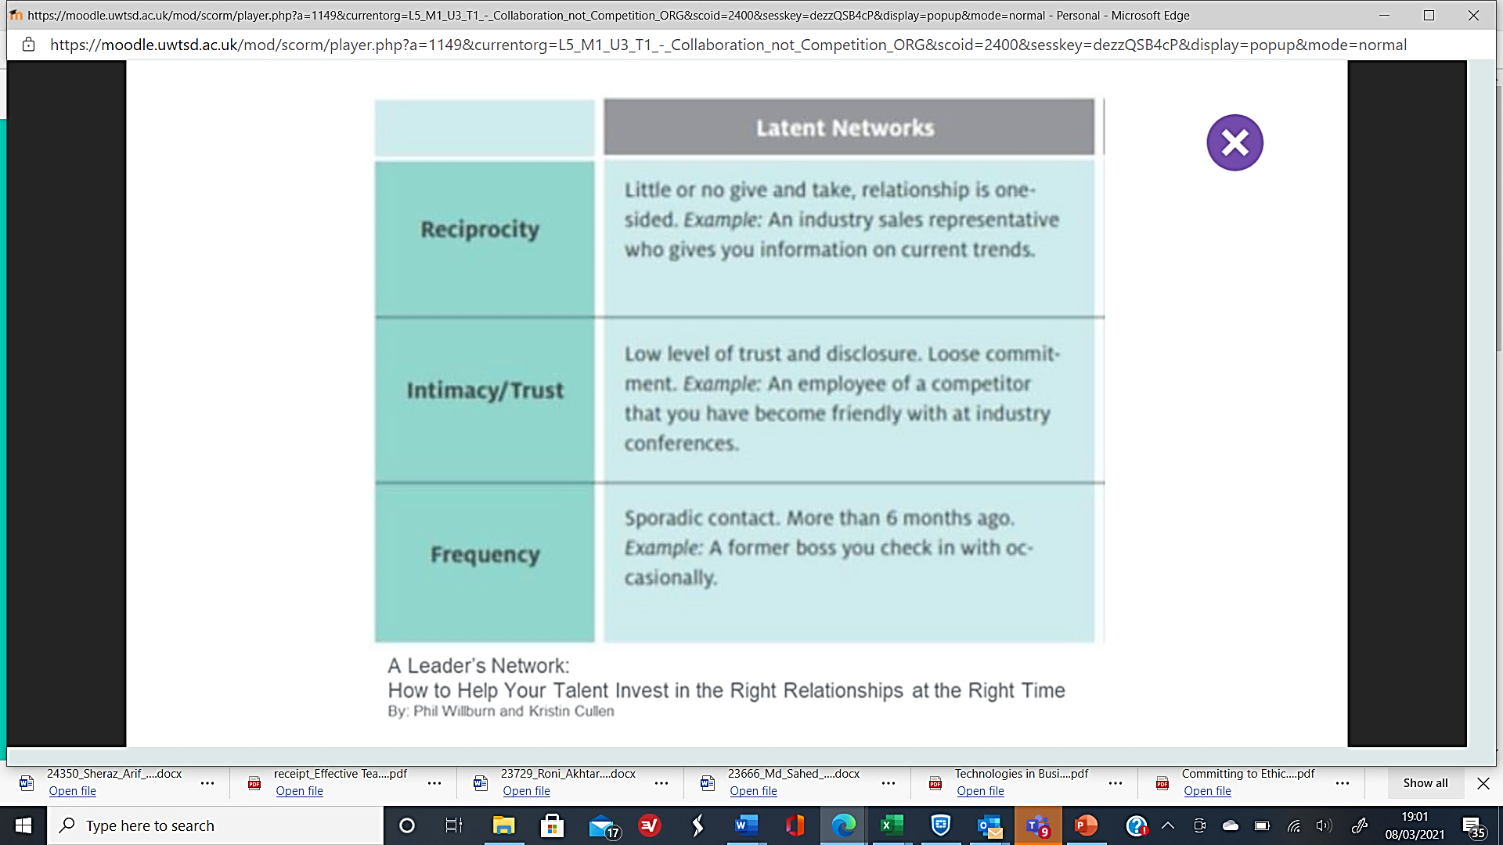
Latent Networks
Notes:
Latent Networks
Laten networks work in a completely different way to active networks.
Laten networks also has the three core elements but they are structured differently.
In Laten networks, Reciprocity means that not much happens in fact it can be a cause of isolation. There is very little give and take and the relationship can be one-sided. This can be mutually acceptable to both parties as it is the nature of the relationship. An example within health and social care, is when a dementia patient is in receipt of care, and the health and social care worker provides the care, but the dementia patient is not able to give much back. This form of relationship is acceptable to both parties as the relationship is based heavily on a one-sided mutually respectful way.
In a Laten network, there is low intimacy and trust with very little disclosure. There is a loose commitment towards each other. There will be little intimacy and the trusting relationship will be based on need and necessity or requirement.
In a Laten network the frequency of contact is sporadic and is less often. The contact might be longer than 6 months between meetings or contact. There is no need to have contact more frequently as there is little give and take, or intimacy or trusting relationship between the parties.

Slide 6
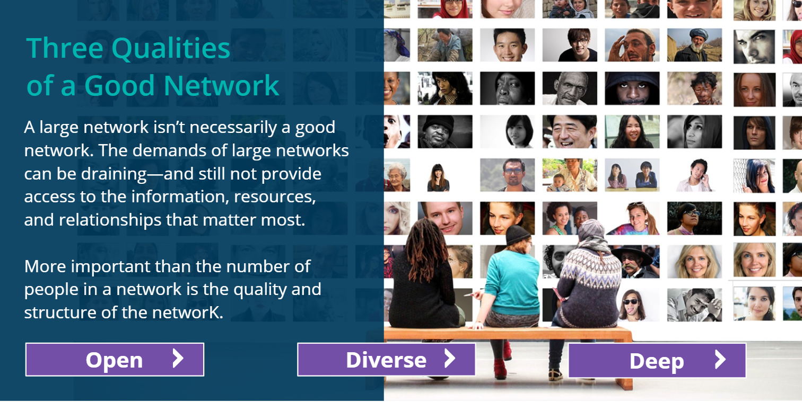
Unit 3 - Three Qualities of Good Network
Notes:
There are three qualities to good networks.

Slide 7
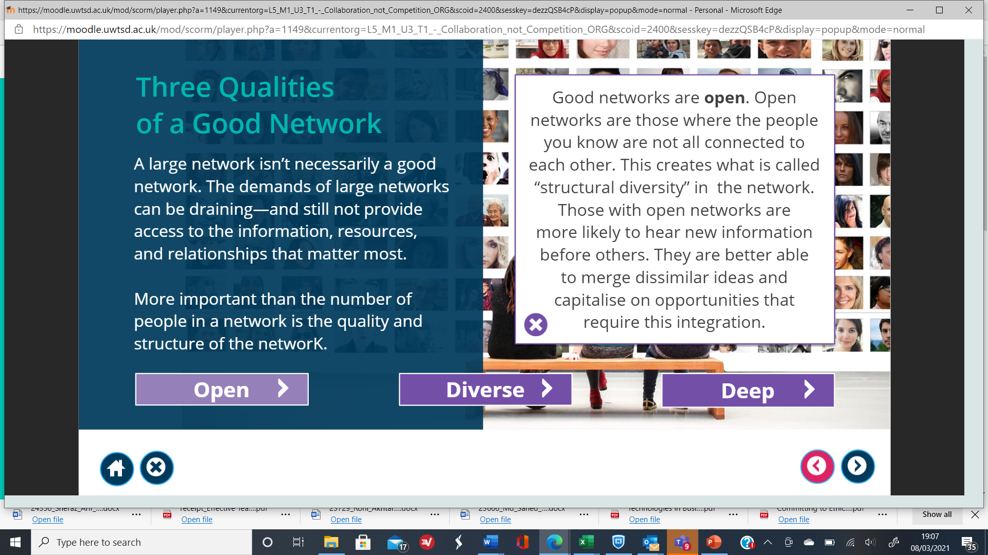
Open Networks
Notes:
The slide provides an explanation of what constitutes an open networks.

Slide 8
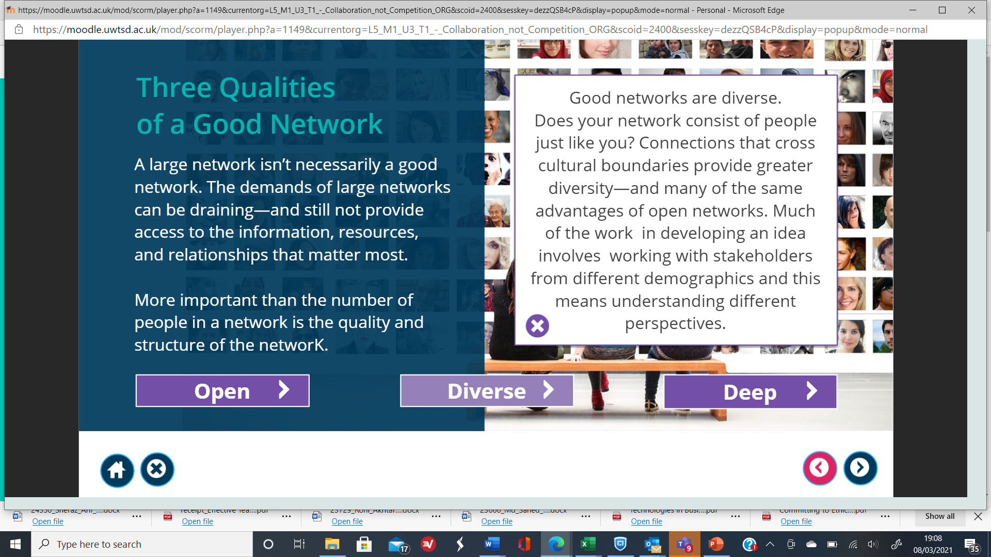
Diverse Networks
Notes:
The slide provides an explanation of what constitutes diverse networks.

Slide 9
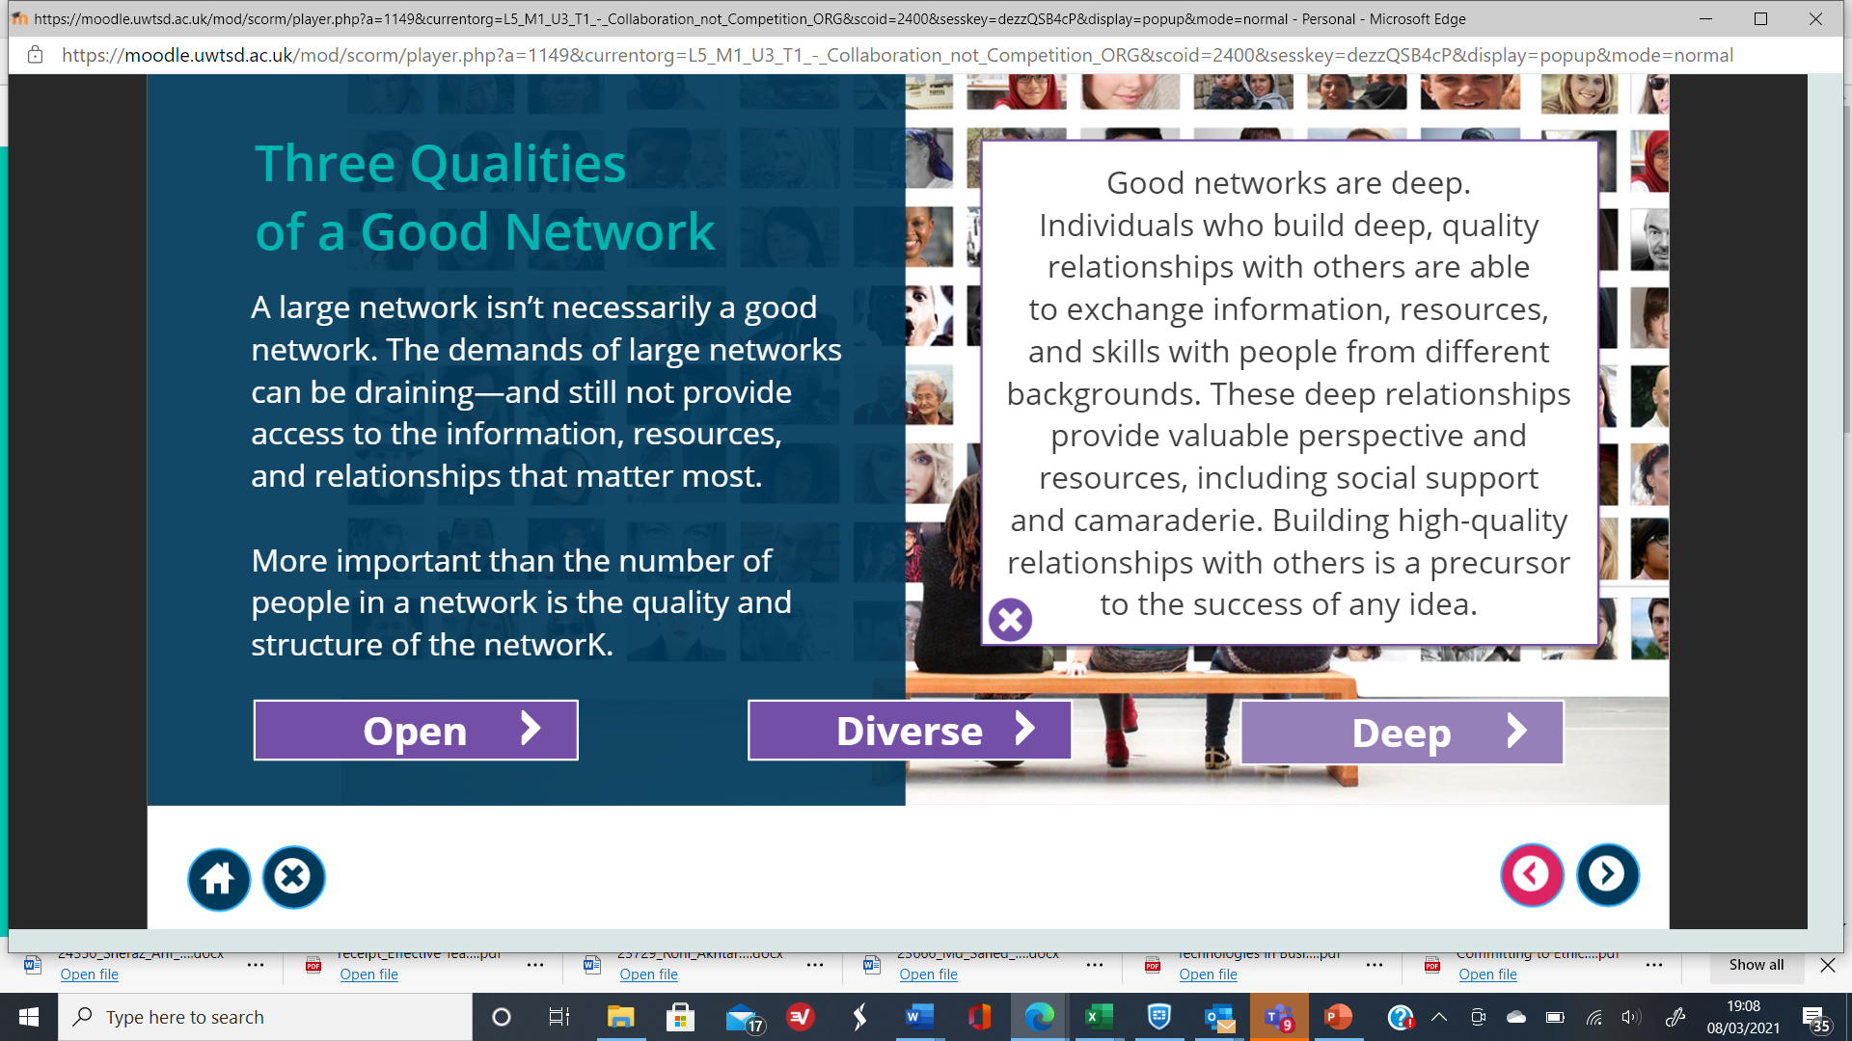
Deep Networks
Notes:
The slide provides an explanation of what constitutes the depth of the network.

Slide 10
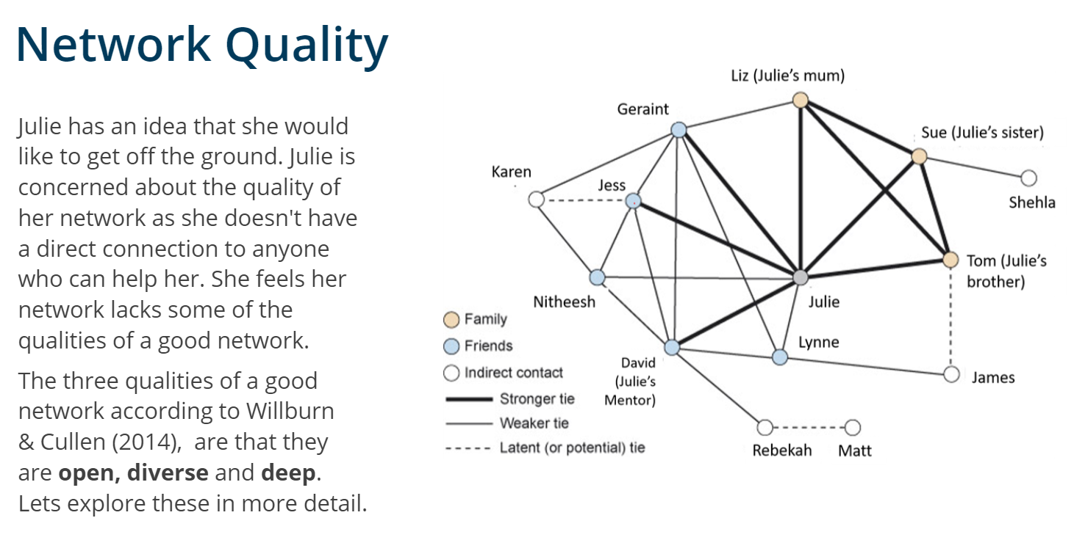
Julie’s case study example
Notes:
Julie’s case study example around the quality of her networks.
Willburn and Cullen (2014) ideas around the quality of networks.
Talk through the contents of the next works as Julie examines her networks and the quality of them.

Slide 11
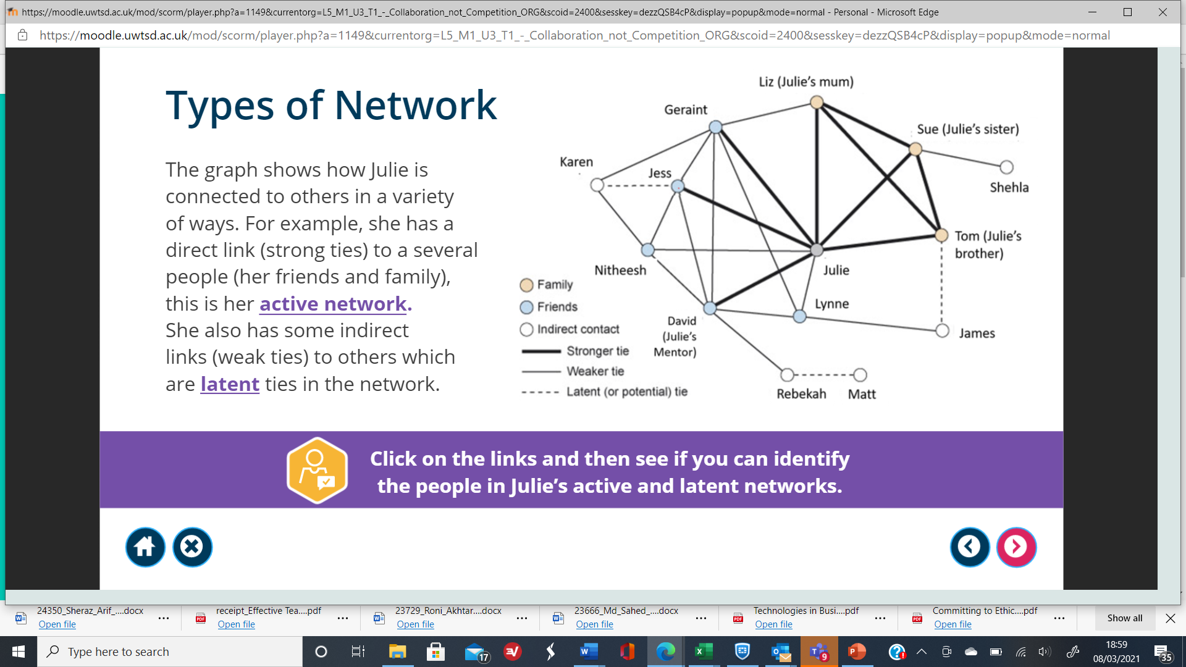
Networks – the importance of them
Notes:
Julie’s case study example around the importance of networks.
The case study is self-explanatory around Julies networks relating to active or latent network links.
Take the students through the strong ties, weaker ties and latent networks.

Slide 12
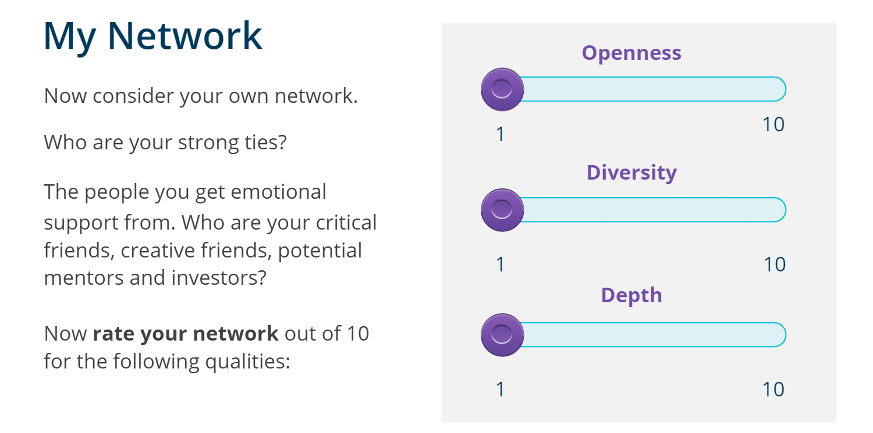
Assessing your networks
Notes:
There is an online activity to look at the quality of your networks.
The assessment relates to networks which are open, has diversity and has depth.
The online activity asks students to assess the quality of their networks out of 10 and to assess them.

Slide 13
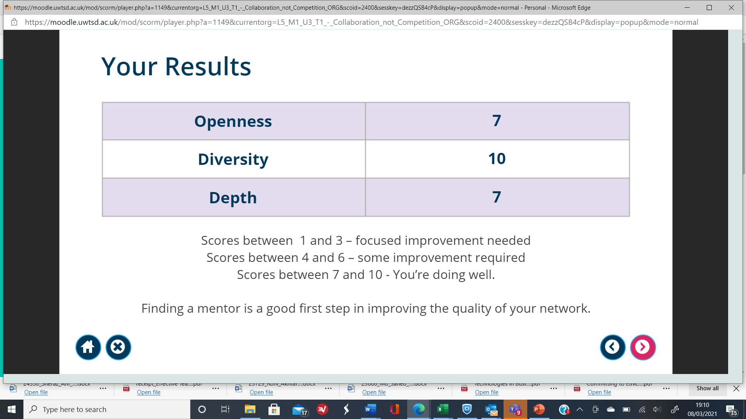
Evaluating your networks score
Notes:
There is an online activity which asks the students to look at their net works.
This is Azora’s assessment results of the networks.
The scores determine what one has to do to improve their network.
Scores between 1 to 3 requires the individual to focus on improving their networks.
Scores between 4 – 6 requires the individual to look at their networks and consider how they can be improved.
Scores between 7 to 10 means that the networks are good and the individual is doing well.

Slide 14
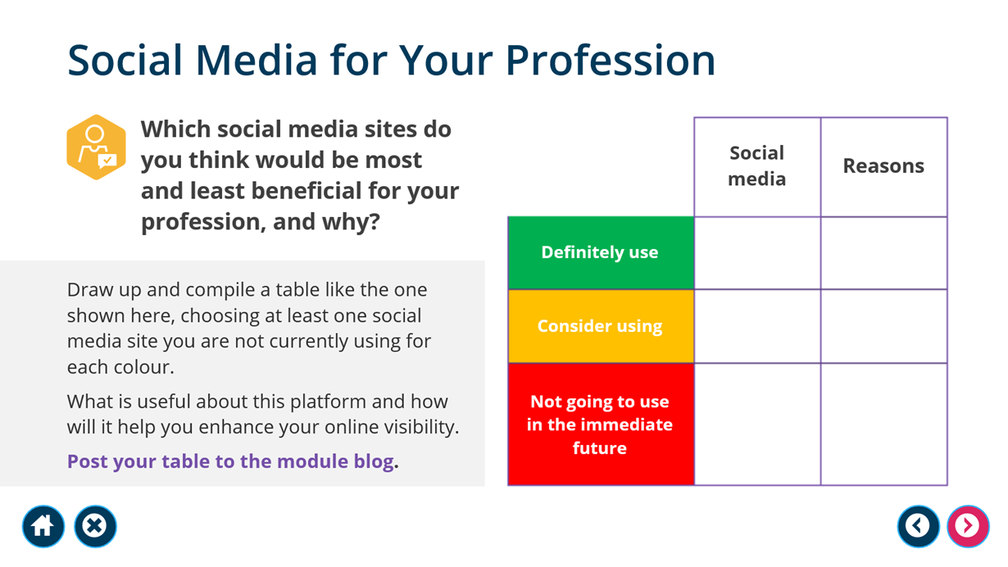
Which social media you use as a health and social care professional?

Slide 15


Slide 16
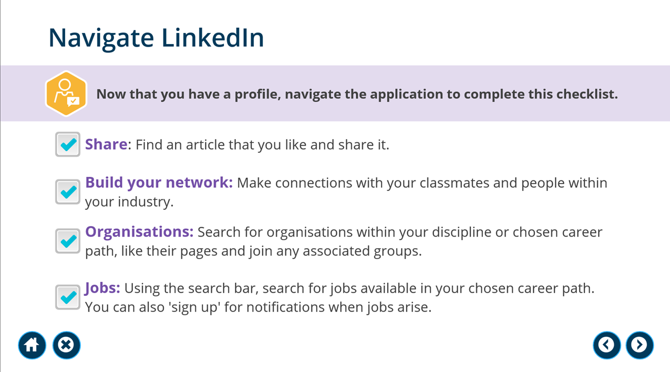
Which profiles can you follow on LinkedIn related to health and social care?

Slide 17
Unit 4 - examples

Slide 18

Is teamwork important in the health and social care profession?
Any examples?

Slide 19
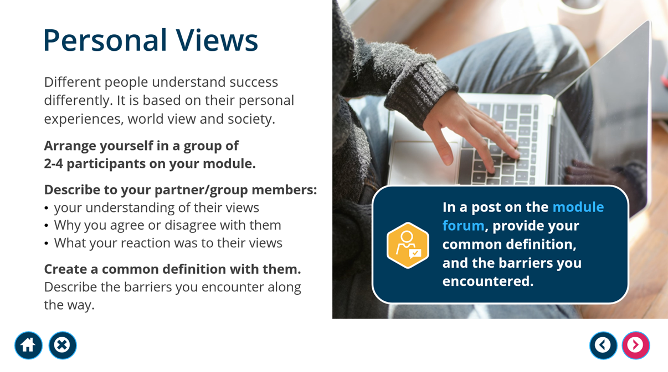
Activity – Defining success
(group activity in class)

Slide 20
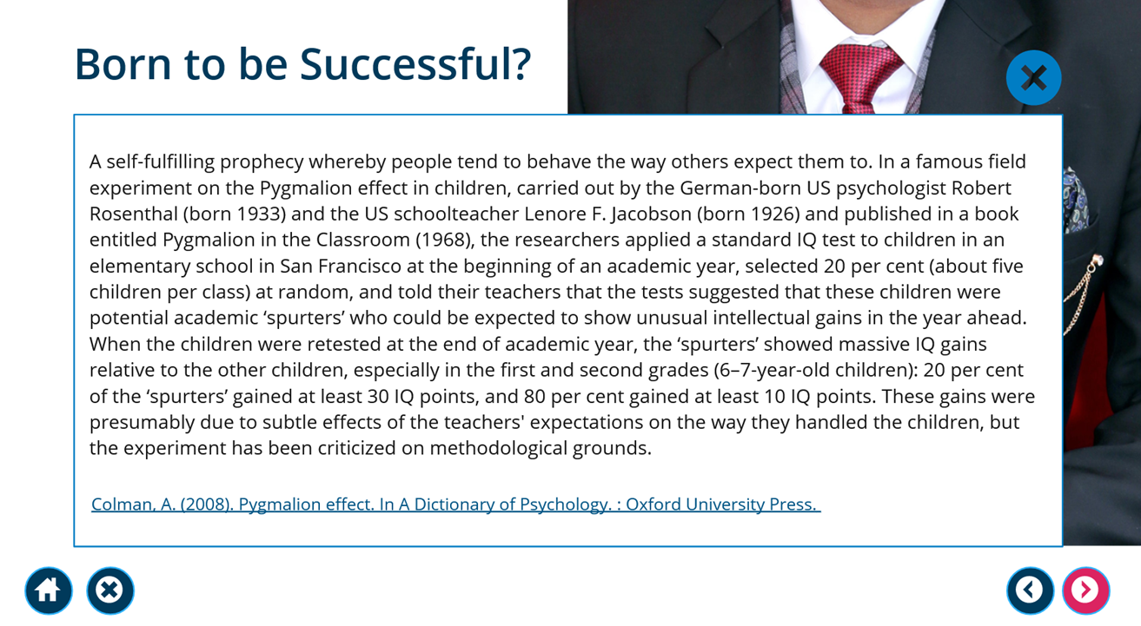
The Pygmalion Effect:
What are its effects on you as students or workers in health and social care?

Slide 21
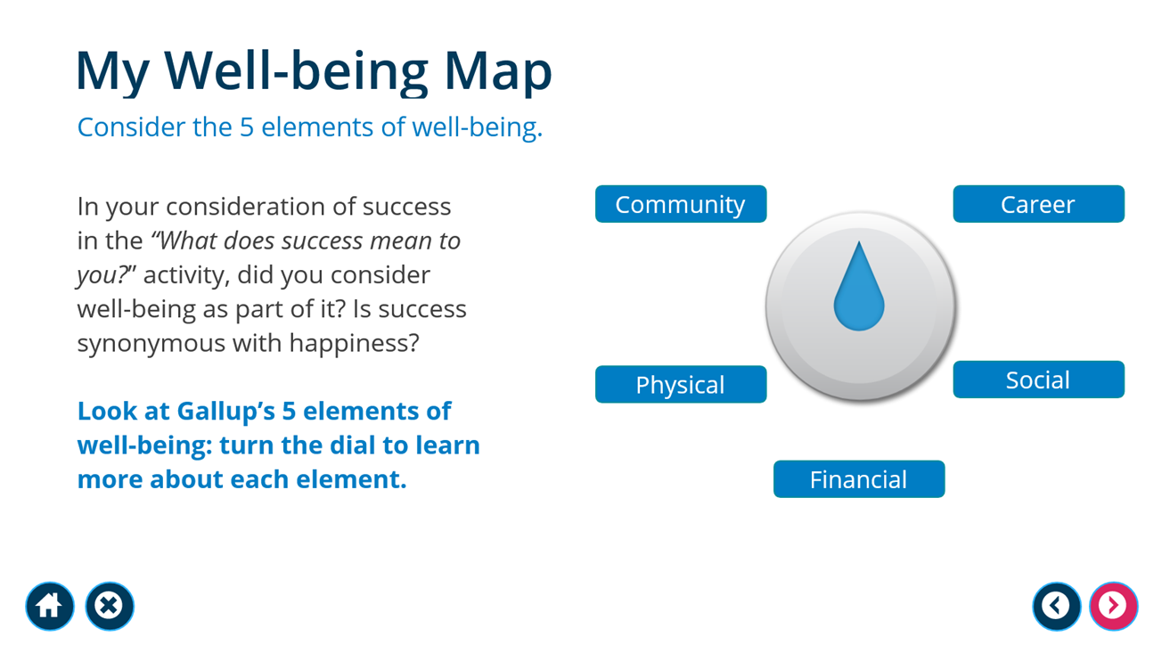
What is well-being? Do you think is important for health and social care professionals in specific?

Slide 22
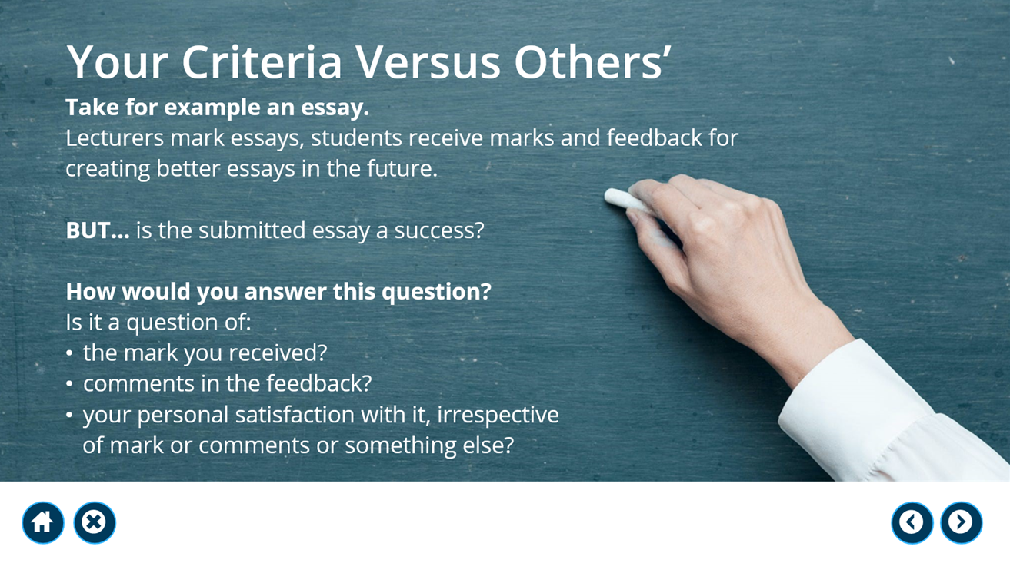

Slide 23
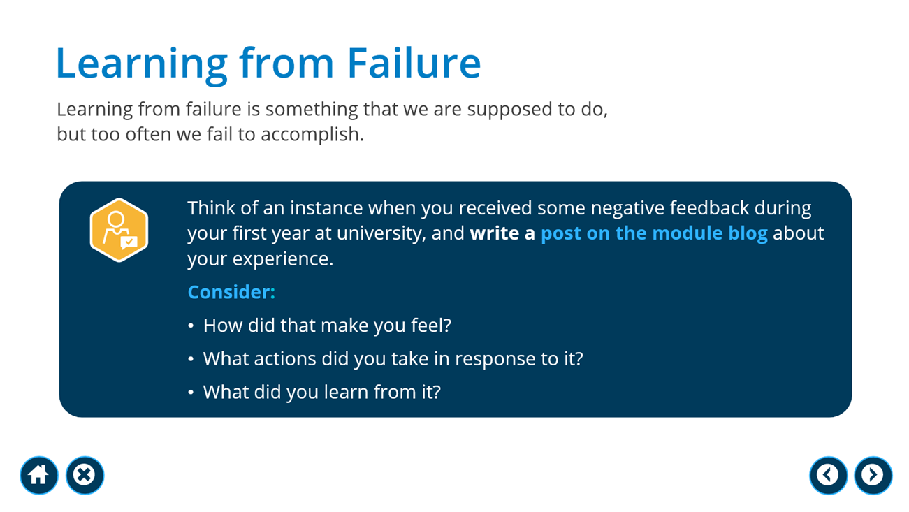

Slide 24
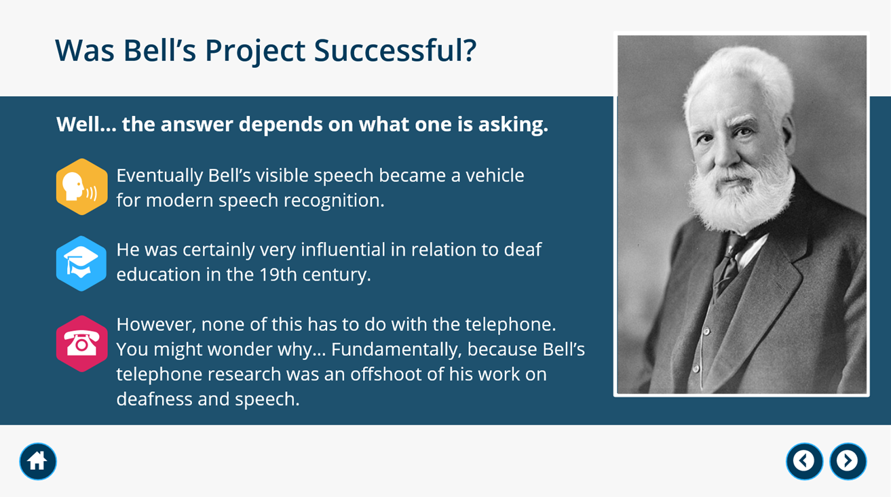
Can you think of an example that a health and social care-related breakthrough was applied in practice differently compared to its original purpose?

Slide 25
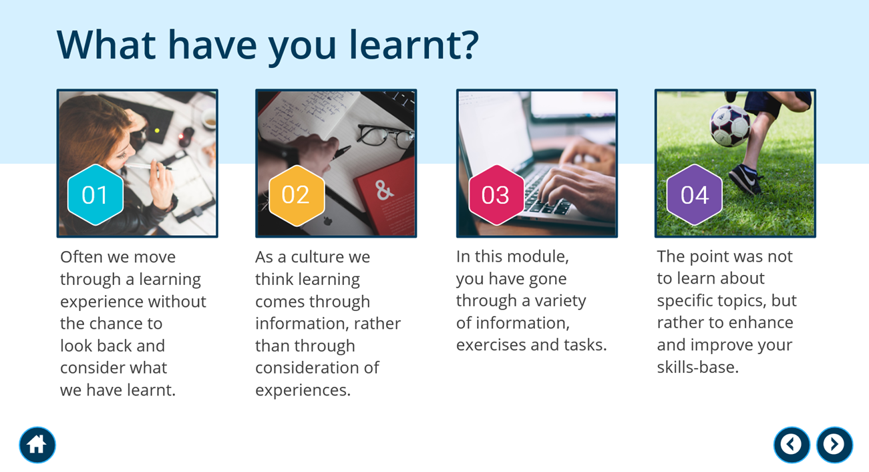
Self-assessing your Learning Outcomes from this module

Slide 26
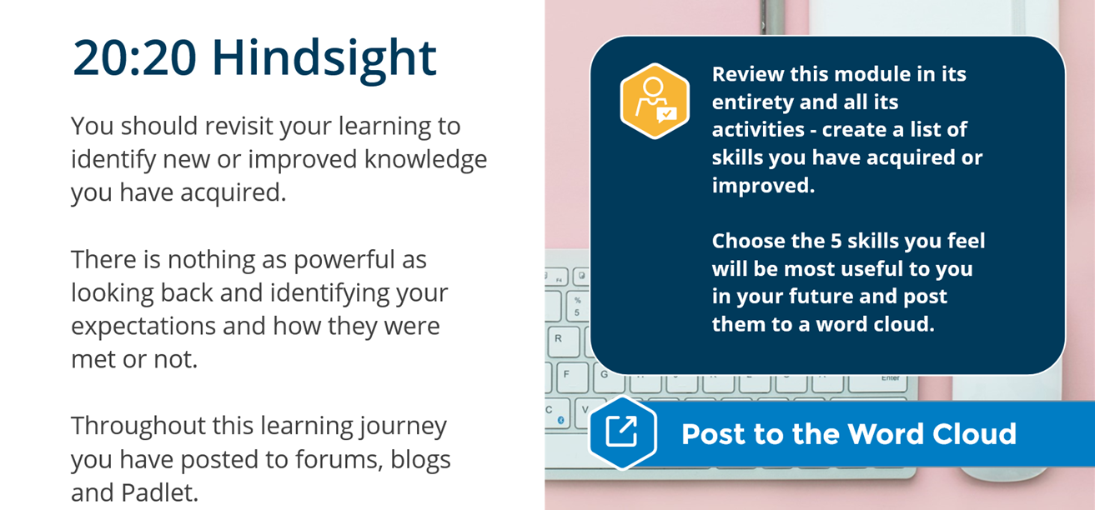
Activity – List 5 skills that you learned during this module.

Slide 27
Goals timeline
E-learning platform
By Week 2 completion​ | By Week 4 completion​ | By Week 6 completion​ | By Week 8 completion​
Unit 1​ | Unit 2​ | Unit 3​ | Unit 4

Slide 28

Assessment 1 Final Questions?

Slide 29
Assessment 2 Queries?

Slide 30
Any other questions?

Slide 31

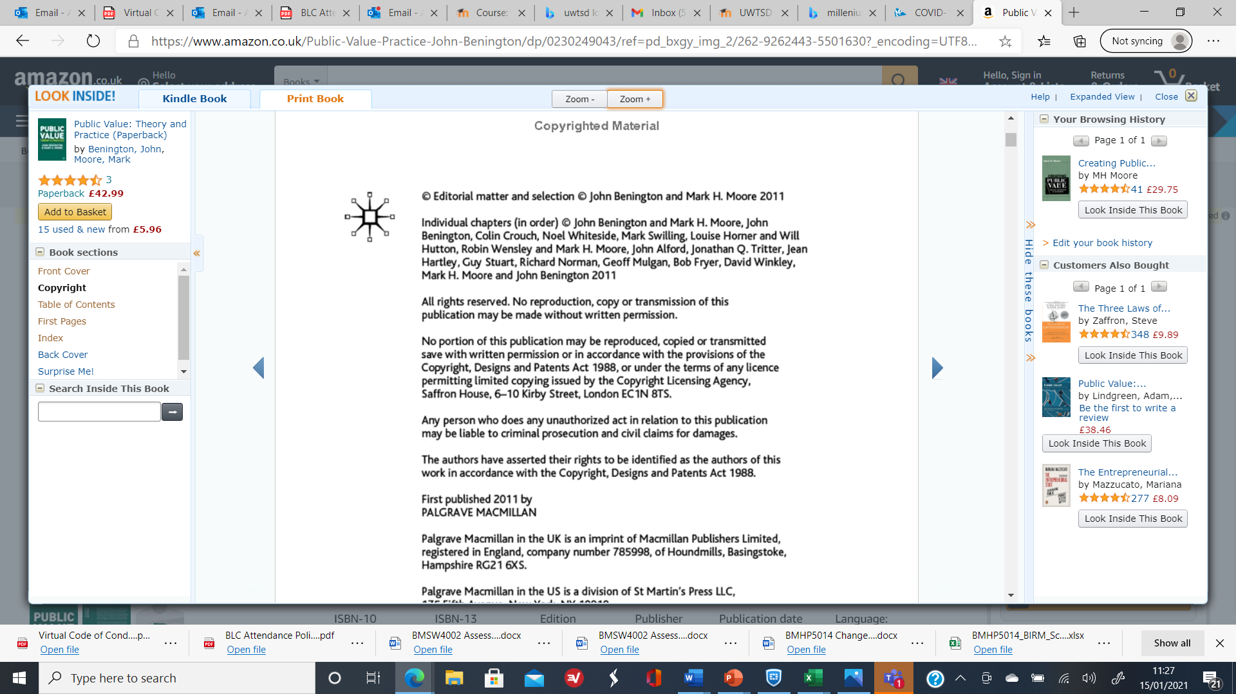
References
Moodle site material Course: Changemakers: Creativity and Value Creation (BMHP5014_BIRM) (uwtsd.ac.uk)

Slide 32

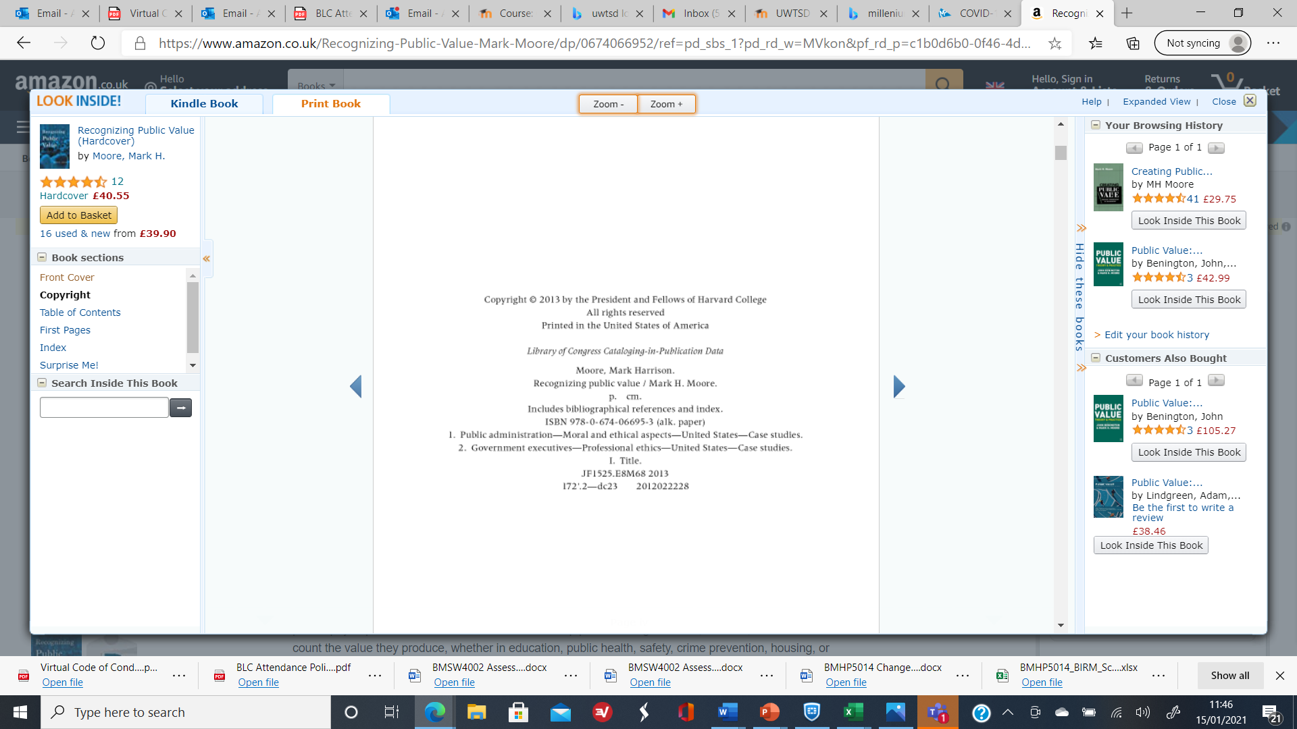

Moore, H. M. (1995) Creating Public Value – Strategic Management in Government. Cambridge: Harvard University Press.

Slide 33

Units for the on line tasks – Unit 1
TOPIC 1 HOW INNOVATION CHANGES THE WORLD
Introducing innovation
Innovation and society
Creating the future
Creativity and society
TOPIC 2 WHO AM I? MY SENSE OF SELF
The idea of self
Social influences
Developing creative confidence
TOPIC 3 ADDRESSING SUSTAINABILITY
What is the problem?
Sustainability changemakers
Be the changemaker.
Additional resources
TOPIC 4 MAKING STATEMENTS
Big (traditional) values
Designing tool recipes
Small (personal) values
Additional resources

Slide 34
Units for the on line tasks – Unit 2
TOPIC 1 CHANGE MARKING – THE ACT OF CREATING VALUE
Who and what are changemakers?
Value creation pedagogy
The practice of changemaking
TOPIC 2 STORYTELLING
Stories and why we tell them.
Spotting competences in stories
Creating our own competency story
TOPIC 3 IDENTIFYING NEW IDEAS
Scoping
Finding meanings
Identifying attributes
TOPIC 4 SEEKING SOLUTIONS
Creative solutions tool cards
Tool Kits
Making your own tool kit

Slide 35
Units for the on line tasks – Unit 3
TOPIC 1 COLLABORATION NOT COMPETITION
Establishing a supportive network
Stakeholders analysis
Creating a stakeholder map
TOPIC 2 FUNDING YOUR IDEA
Sources of funding
Creating a crowdfunding campaign
Understanding social enterprise
TOPIC 3 TELLING YOUR STORY
Storytelling as a persuasive communication tool
Self-confidence and authenticity
Preparing a strong presentation
TOPIC 4 BE IN IT TO WIN IT
Navigating social media
Developing your professional persona
Linkedin the professional network

Slide 36
Units for the on line tasks – Unit 4
TOPIC 1 MEASURING SUCCESS
What is success?
The Pygmalion effects
Success and wellbeing
TOPIC 2 PERSONAL EVALUATION
Your project success
You, your project and others
Success through teamwork
TOPIC 3 MOVING FORWARD
Building up from the project
The power of failure
Looking forward
TOPIC 4 CLOSING THE LOOP
Skills and attributes
Showcasing your work

