Slide 1


Knowledge and Information Management Skills For the Workplace BMW5106
Task 2
Student Name: Nicusor – Ionut Aliu
Student ID: 2131114

Slide 2
Table of Contents
1. Introduction
2. Overview of Organisations
3. TOWS Analysis
4.Similarities and Differences of Knowledge Management of the Organisations
5. Main Issues
6. Recommendation
7. Conclusion
8.References

Slide 3
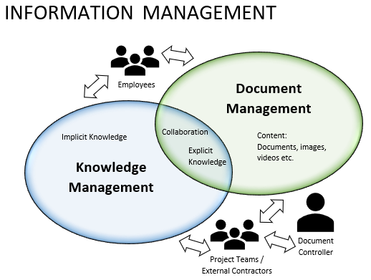
Introduction
The presentation will critically examine the knowledge management systems of two well-known IT companies, Microsoft and Amazon.
The TOWS analysis is utilised to examine the knowledge management aspects of strengths, weaknesses, opportunities, and threats.
It also covers the main issues uncovered by the analysis and discusses how their knowledge management strategies differ and are similar.
Notes:
The presentation will critically examine the knowledge management systems of two well-known IT companies, Microsoft and Amazon. The TOWS analysis is utilised to examine the knowledge management aspects of strengths, weaknesses, opportunities, and threats. It also covers the main issues uncovered by the analysis and discusses how their knowledge management strategies differ and are similar.

Slide 4


Overview of Organisations
Amazon
Amazon is well-known for its offerings in artificial intelligence, cloud computing, internet streaming, as well as e-commerce (Amazon, 2024).
Microsoft
Microsoft is a global technology business, is well-known for include Windows, the Office suite, and Azure cloud computing services (Microsoft, 2024).
Notes:
Amazon
The world's largest technological company, Amazon, is well-known for its offerings in artificial intelligence, cloud computing, internet streaming, as well as e-commerce (Amazon, 2024). It started as an online bookshop but today provides a wide range of goods and services.
Microsoft
The software products that Microsoft, a global technology business, is well-known for include Windows, the Office suite, and Azure cloud computing services (Microsoft, 2024). Empowering individuals and organisations worldwide is one of the company's goals one of the biggest in the globe.

Slide 5
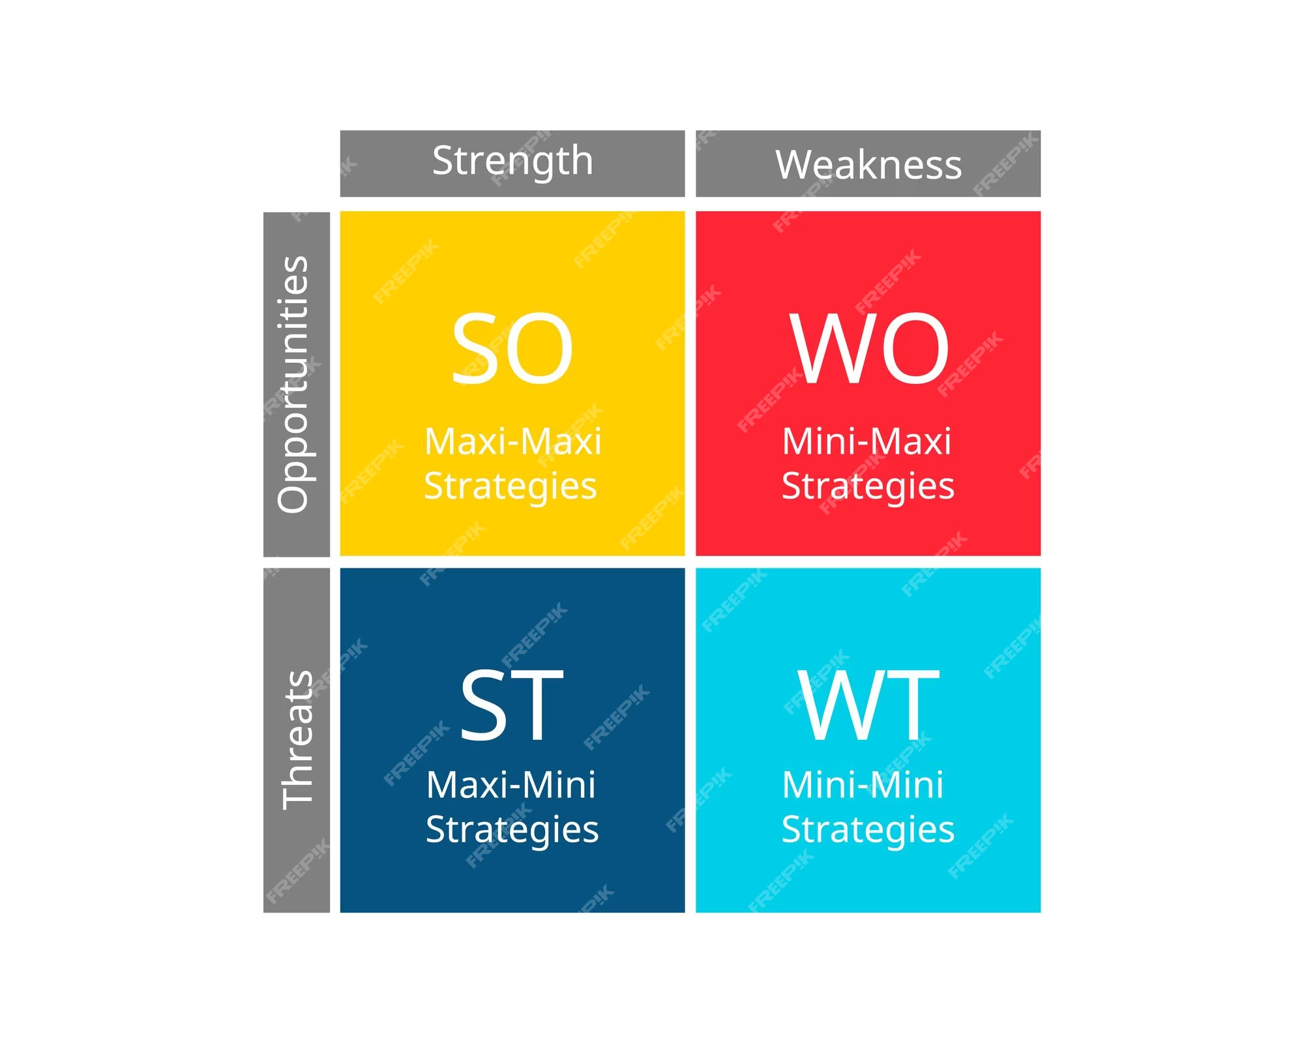
TOWS Analysis
Strong technological infrastructure, innovative culture, and large consumer data.
Dependence on outside vendors and outdated licensing schemes.
New technology and market expansion.
Fight for rivalry and regulatory obstacles.
Leverage strengths, minimize threats, and promote long-term growth.
Notes:
Based on the TOWS analysis, Microsoft and Amazon are strong in terms of technological infrastructure, innovative culture, and large consumer data. They do have certain weaknesses too, such as their dependency on outside vendors and outdated licencing schemes (Jurevicius, 2023). New technology and market expansion are examples of opportunities, whereas fierce rivalry and regulatory obstacles are examples of dangers. Maintaining competitive advantage and promoting long-term growth in the fast-paced technology sector will require both firms to leverage their strengths to seize opportunities while minimising threats and limitations (Microsoft, 2024).

Slide 6

Similarities and Differences of Knowledge Management of the Organisations
Similarities
Both prioritize data usage, technology infrastructure, innovation culture, and collaborative tools.
Differences
Amazon is consumer-oriented, exploiting user data for digital streaming and e-commerce.
Microsoft focuses on commercial clients with software and cloud services.
Understanding these differences is crucial for optimizing knowledge management strategies and aligning with corporate goals and industry trends.
Notes:
In their knowledge management systems, Amazon and Microsoft place the same importance on data usage, technology infrastructure, innovation culture, and collaborative tools. However, there are differences in their methods regarding market orientation, employee participation, corporate structures, and regulatory frameworks (Williamson, 2023). Amazon is more consumer-oriented, exploiting user data for digital streaming and e-commerce, while Microsoft is more focused on commercial clients with its software and cloud services as per Williamson, (2023). An awareness of these similarities and differences is necessary to optimise knowledge management strategies and maintain alignment with corporate goals and industry trends.

Slide 7

Main Issues of Organisation
Information fragmentation, user engagement, content quality, security, privacy, and interoperability issues.
Dispersed knowledge management hinder decision-making and cross-functional cooperation.
Quality and applicability of knowledge material crucial for innovation and organizational goals.
User adoption and involvement essential. • Strong security measures and privacy legislation compliance required.
Integration and interoperability necessary for data sharing and collaboration.
Notes:
Knowledge management systems struggle with information fragmentation, user adoption and engagement, content quality and relevance, security and privacy, integration, and interoperability (Spyropoulos et al., 2023). Knowledge sources that are spread out make it harder for people to work together on making decisions and running processes, which is a problem for both companies. Strong security measures are needed to ensure that consumer trust, protect personal customer data, and ensure privacy rules are followed. For instance, users should make use of and actively take advantage of knowledge management systems, because this is how you really get the most out of them. On one hand, being creative and accomplishing team goals requires easy access to up-to-date, high-quality information. On the other hand, companies could collaborate across functions and processes, data could be exchanged only if systems could connect and interact with one another quickly.

Slide 8
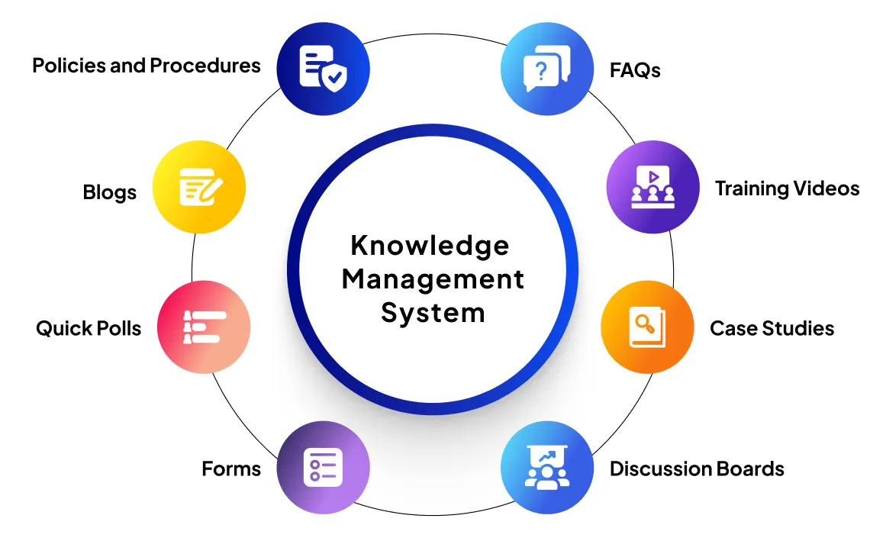
Recommendation
Implementing Knowledge Management Platforms
Adoption of integrated platforms.
Investment in data governance and content curation.
Fostering knowledge-sharing culture.
Strengthening security protocols for confidential data.
Prioritising interoperability standards for smooth data exchange.
Notes:
Spyropoulos et al. (2023) contend that to reduce data fragmentation, Amazon and Microsoft must work together. Moreover, Amazon and Microsoft must stay on their business plans and the norms of their industry to change their knowledge management if the market is even slightly volatile and technology's growth too rapid. Third, they need to invest in data governance and content curation to ensure that the data is true and useful, they also need to promote interoperability standards to help data flow across systems, improve security mechanisms to protect sensitive information. There also needs to be an emphasis on the promotion of Information sharing which increases app use and engagement.

Slide 9
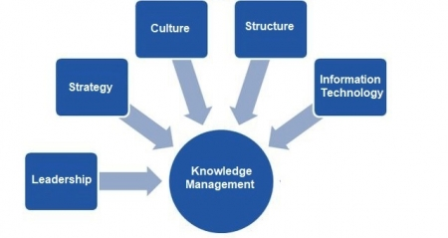
Conclusion
Optimize technology infrastructure and data utilization.
Address user engagement and information fragmentation.
Improve operational efficiency and cooperation.
Maintain leading positions in digital world.
Implement advised methods and update approaches regularly.
Notes:
In order to protect their competitive edge and drive innovation, the two companies Amazon and Microsoft are required to improve their knowledge management system. If they were to follow the rules and frequently assess their tactics, they have a chance to improve their overall operations, encourage collaboration among their employees, and be ahead of the game in the digital age. For information separation and user participation, it will be necessary to solve crucial problems with first-class data utilization facilities and technological infrastructure.

Slide 10
References
Amazon, 2024. Who We Are [Online] Available at: https://www.aboutamazon.com/about-us [Accessed on: 15 February 2024]
Jurevicius, O., 2023. SWOT analysis of Amazon 2023 [online] Available at: https://strategicmanagementinsight.com/swot-analyses/amazon-swot-analysis/ [Accessed on: 15 Feb 2024]
Microsoft 2024. Our Company [online] Available at: https://www.microsoft.com/en-us/about/company [Accessed at: 15 February 2024]
Microsoft, 2024, We believe in what people make possible [online] Available at: https://strategicmanagementinsight.com/swot-analyses/amazon-swot-analysis/ [Accessed on: 15 Feb 2024]
Spyropoulos, A.Z., Bratsas, C., Makris, G.C., Garoufallou, E. and Tsiantos, V., 2023. Interoperability-Enhanced Knowledge Management in Law Enforcement: An Integrated Data-Driven Forensic Ontological Approach to Crime Scene Analysis. Information, 14(11), p.607.
Williamson, B., 2023. Governing through infrastructural control: artificial intelligence and cloud computing in the data-intensive state. Digital Society, p.521.

Slide 11


