Slide 1

Programme: Master of Business Administration
Module: Human Resource Management
Lecturer: Prof D G Pepple
Assessment component 2 – PowerPoint Presentation -15 minutes
Student Name: Monuar Moni
Student ID number: 1818185
W e l c o m e

Slide 2
INTRODUCTION
HR Management refers to bridging the gap between the performance of the employee
The overall discussion is based on the peer journal review of the selected articles
The implication of the HR management model implication on the business of two different modes of business.
Notes:
HR management refers to bridging the gap between the performance of the employee, and the strategic objectives of the organization. Furthermore, the reorganization of an effective HR management team helps the firm to provide an edge over the competition. Thus, in the current report, the overall discussion is based on the peer journal review of the selected articles such as “The Impact of High-Performance Human Resource Practices on Employees’ Attitudes and Behaviors”, “Validating the human resource system structure: A levels-based strategic HRM approach”, and “Understanding HRM–Firm Performance Linkages: The Role Of The “Strength” Of The HRM System”. Therefore, the implication of the HR management model implication on the business of two different modes of business such as the British Council, and 2 Sisters Food Group is presented.

Slide 3

SUMMARY OF THE LITERATURE REVIEW OF 3 ARTICLES
HR practices are likely to work on the basis of upward or downward through the different levels.
The proximal effects of the perception of the employees at the HR practices
The impact of high-performance of HR practices that are likely to affect the key employee’s attitude.
The HRM system in the organization involves a highly functioning model which is related to the employment of the individuals in the organization.
A “Social cognitive Psychology” concept is utilized by the personnel in order to identify the suitable individual within the business fit for the job role (Bowen and Ostroff, 2004, p. 9).
Notes:
Organization, business market, financial, and HR are suggested that the HR practices are likely to work on the basis of upward or downward through the different levels. Therefore, most of the effect affects the behavior, and attitude of the employees. The article, “The Impact of High-Performance Human Resource Practices on Employees’ Attitudes and Behaviors”, represents the proximal effects of the perception of the employees at the HR practices that are used in an aggregate manner at group job levels (Kehoe, and Wright, 2019, pg. 09). Hence, the study considered that the different employees are at the behavioral, and attitudinal outcomes at the high-performance at the research remain scarcity, HR systematic management, and also the impact of high-performance of HR practices that are likely to affect the key employee’s attitude. However, the employment behavior that is recently argued requires further empirical attention and a theoretical manner that fulfills a consideration of the attitudinal outcomes of the affected organizational behavior, and commitment. The study paper mainly focused on the commitment process of the positive affection towards the firm as a reflective desire the organizational success to fulfill its goals at a pride that being part of the organization (Kehoe, and Wright, 2019, pg. 11). The assignment of opportunities based on the employee's participation by taking an extent to perceive the employee's existence at a formal participation process.
The reorganization the article “Validating the human resource system structure: A levels-based strategic HRM Approach”, refers to describing the growing empirical various evidence of systematic high performances or progression in Human Resources Management that are related to outcomes of an organization (Arthur, and Boyles, 2007, pg.02). Furthermore, the determination related to methodological, and persistent conceptual issues that remain concerning the nature, and size of this relationship. The key purpose of the study paper refers to pay contribution to the firm performance and HR system relationship creation that addresses levels and definitional analysis of issues that involved conceptualizing and also measuring the HR system construct. The HRM system in the organization involves a highly functioning model which is related to the employment of the individuals in the organization. The role of the HR recruiters is to determine the “situationism” element which is a powerful tool to assume the organizational situation by the manager. A “Social cognitive Psychology” concept is utilized by the personnel in order to identify the suitable individual within the business fit for the job role (Bowen and Ostroff, 2004, p. 9). The “social influence theories” are utilized as well to convince the human asset to work with the organization and make the business flourish on its own terms. The HRM strength is portrayed by the competitive individuals hired by the companies in these sectors in order to hire or recruit employees with specific skill sets apt for the organization alongside a set of soft skills which might be an advantage for the organization. Unambiguous messages are subsequently delivered by the HRM so that the employees are communicated with appropriate knowledge regarding the skills requirements and the appropriate behavior which is needed to be undertaken within the environment can be ascertained as well.

Slide 4
CONTINUE
A “strong situation” creation is significantly essential in order to maintain the linkage with the different employees and relate to the job role to efficiently utilize the company’s input fund capacity.
The “distinctiveness” of the HRM involves the “visibility concept” which highlights the components of the business to be disclosed to the employees.
Notes:
A consistent message may be given towards the employee in regard to the different performance measures to be undertaken by the personnel at each level while performing the job role to the responsibilities that must be undertaken. A “strong situation” creation is significantly essential in order to maintain the linkage with the different employees and relate to the job role to efficiently utilize the company’s input fund capacity. The “distinctiveness” of the HRM is certainly an essential factor in the business which involves the “visibility concept” which highlights the components of the business to be disclosed to the employees. The “cognitive organization” is identified which critically includes the “cause and effect attributes” which help in figuring out the transparent feature in the administration.

Slide 5
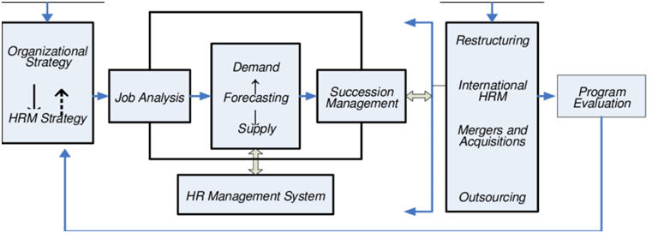
HR STRATEGY RELATED MODEL
The HR practice engagement refers to includes various tasks such as training employees, recruitment
The nature of the UK public services as a “Human Service organization” in the UK is examined
This may include the distinction between the administrative, technical, and human services
(Source: Google.com,2023)
Notes:
In the public sector human resources management is applicable to the human resources principles of the public sector organization at the British Council. The HR practice engagement refers to includes various tasks such as training employees, recruitment, employee remuneration, and also the process of evaluation of the employees (Loon, Otaye‐Ebede, and Stewart, 2020, pg.05). The implication of the core function in the public sector of HR management includes the recruitment of employees through the process of arranging recruitment, and interview drives. The nature of the UK public services as a “Human Service organization” in the UK is examined, and also the implication of the threefold paradox at a “contradictory policy, management, and service domains”, that explored the uses of the domain theory at a supplemented by the application of the “professional bureaucracy model” (Smlr.rutgers.edu, 2020, pg.03). This may include the distinction between the administrative, technical, and human services that refers to discussing the peculiarities in the UK system at Public Sector Organizations.

Slide 6
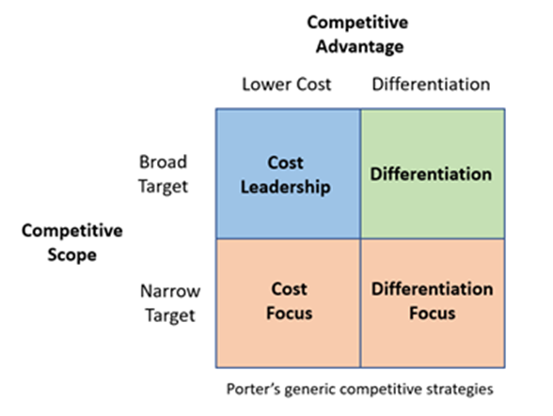
COMPETITIVE STRATEGY
The implication of the competitive advantages in the public sector organization
the different order achievement in order to prevalence in the low-cost management, and quality.
The business in the UK are commonly grouped into the public sectors organization
(Source:Google.com,2023)
Notes:
The implication of the competitive advantages in the public sector organization such as the British Council refers to positioning the organization in front of the ‘’different order achievement in order to prevalence in the low-cost management, quality, worth, and innovation process in the business management (Pipestone.com, 2021). While, these factors allow the company to produce services, and good management for the better or more rivals in the management. These factors refer to allow the HRM to produce more sales and superior margins increasing the comparison at the different market rivals. While, the business in the UK are commonly grouped into the public sectors organization by consisting financed by the local government, and central. Thus, providing a good community at the emphasis of the public sector which refers to providing a fund supplied through government borrowings, and taxes.

Slide 7
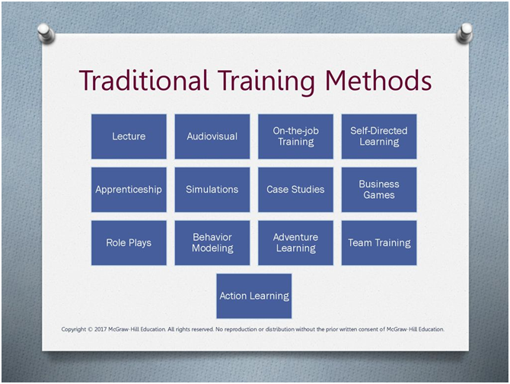
TRADITIONAL TRAINING MODEL
The traditional activities related to creating benefits and remuneration advancement
the key defining aspects of strategic HR management which is not changeable in the activities
evaluating the effectiveness of HR practices, and policies towards the measurement of the organizational effectiveness
Notes:
The traditional activities related to creating benefits and remuneration advancement to the employees by tracking employees' progress, and bargaining collectively, and with the union of employees. Furthermore, the evaluation of the employee's performance remains under the aegis of the HR professionals (Slideplayer.com, 2020). Hence, the key defining aspects of strategic HR management which is not changeable in the activities including under the sequence of HRM is required. It is an essential shift in respect to making changes that rely solely on a technical and professional standard for evaluating the effectiveness of HR practices, and policies towards the measurement of the organizational effectiveness as primary criteria for making the employees work efficiently by judging effectiveness.

Slide 8
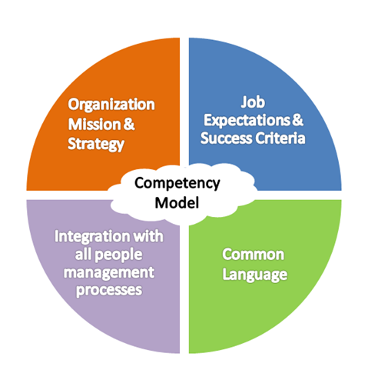
COMPETENCY MODELING
The public sector organization in the UK firm at British Council
The key role is to meet the legal requirements of the HR practices in business management to meet the legal requirements
The involvement of the competency model in the business refers to meeting the strategic need
(Source: Google.com,2023)
Notes:
The implication of this type of model in the public sector organization in the UK firm at British Council with a framework of traditional HRM depicts the job analysis at a firm established with an appropriate basis (Centranum.com, 2020). Hence, the key role is to meet the legal requirements of the HR practices in business management to meet the legal requirements under this model. The implication of this technique in the management of the British Council refers to creating original directions providing a foundation of HRM in a systematic way. These refer to providing proper guidance for the creation o an aligned strategic direction for the organization by creating an internal alignment with the HRM system (Rosli et al. 2020, pg.04). The involvement of the competency model in the business refers to meeting the strategic need in the business management of the British Council as compared to the traditional job analysis, which mainly focuses on job specification. Furthermore, introducing more attribution throughout the management with more determination abilities, knowledge, skills, and organizational progression to make the working environment tendency for future workers is presented.

Slide 9
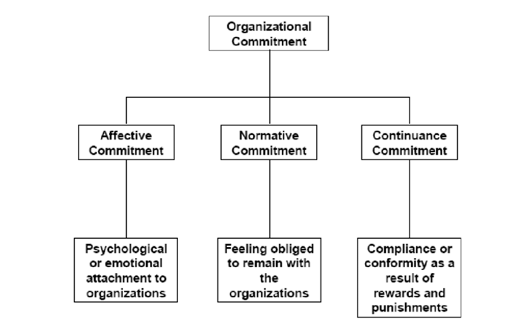
THREE-COMPONENT MODEL
The implication of this type of model by the British Council
consisting three different dimensions such as “normative, affective, and continuance commitment”
The key role of the section of linking with the mechanism between the high performances in the HR management practices.
(Source:Google.com,2023)
Notes:
The implication of this type of model by the British Council in their business refers to reforming the conceptualized commitment that consisting three different dimensions such as “normative, affective, and continuance commitment”. Furthermore, the model supported the factors analysis and confirmed research that has main three components related to different various consequences, and antecedents (12manage.com, 2020). While focusing on the affective commitment of the HR in the British Council refers to representing positive affection towards the firm. As per the reflective desire, the organization has mainly succeeded in fulfilling the goals of feeling pride that being part of the organization for several preseason. Secondly, affective commitment refers to demonstrating the strong consistency that reflects the derided working outcomes such as organizational citizenship, and absenteeism behaviors (Tchitnga et al. 2019, pg.02). Furthermore, the key role of the section of linking with the mechanism between the high performances in the HR management practices.

Slide 10
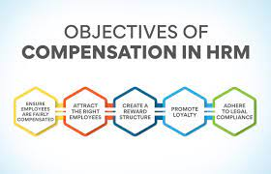
COMPREHENSIVE AND COMPENSATORY MODEL
A “Comprehensive model” has of risk regarding the funding proposition (Collins, 2021, p. 7).
The comprehensive model in the hiring process includes a high funding estimation in the beginning.
Compensatory model helps the HRM managers to ascertain the overall criteria and the shortcoming of the candidates at the same time.
Thus, the managers are highly competent in making assessments regarding the “compensatory skills or qualities” possessed by the employees which might help the business to grow similarly.
(Source: Google.com,2023)
Notes:
A “Comprehensive model” has been identified to be undertaken by the business concern such as “2 Sisters Food Group” which is a private concern which poses a high amount of risk regarding the funding proposition (Collins, 2021, p. 7). Thus it is essential for the organization to use its assets and revenue in a strategic manner. The comprehensive model in the hiring process includes a high funding estimation in the beginning, however, in the long term the strategy helps the concern in maintaining a stable human resource base. The private concern is more strict in involving personnel as the soft skills are evaluated alongside the overall performance capability and the hardcore skills possessed by the individuals (Yong et al. 2020, p. 32). The comprehensiveness and the intensive hiring process help the organization to make the concern flourish through the establishment of the skills of the human resource towards the profit earning of the business.
The “Compensatory model” is involved by the HRM of the “2 sisters food group” through an intensive assessment method which includes extensive steps. This model helps the HRM managers to ascertain the overall criteria and the shortcoming of the candidates at the same time. Thus, the managers are highly competent in making assessments regarding the “compensatory skills or qualities” possessed by the employees which might help the business to grow similarly (Widyanty et al. 2020, p. 4). Thus, the strategic involvement or identification of compensatory skills may help the recruiter to determine the most appropriate personnel for the job role. The “configurable model” boosts the MRM practice in the identification of the right fit in the “internal environment”. The reinforcement of the concern within the HRM and making it relevant decision regarding the recruitment decision and further make the right decision by collaborating the external fit to the internal fit.

Slide 11
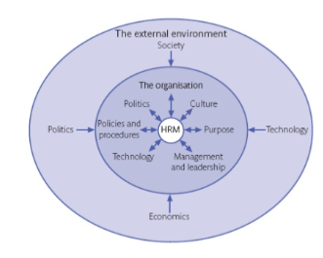
CONFUGURATION MODEL
The “configurable model” boosts the MRM practice in the identification of the right fit in the “internal environment”.
The consistent updating of the HRM regarding the external environment must be affecting the organizational aspect such as the appropriateness of the recruitments.
(Source: Google.com,2023)
Notes:
The “configurable model” boosts the MRM practice in the identification of the right fit in the “internal environment”. The reinforcement of the concern within the HRM and making it relevant decision regarding the recruitment decision and further make the right decision by collaborating the external fit to the internal fit.The particular business strategy needs certain human resources to fulfill the target in due time. Furthermore, the likelihood of making the organization prosper in the future through proper and appropriate recruitment holding is the basic need which may be helpful in mitigating the requirement for the business (Meyers et al. 2020, p. 10). The “Contingency model” is highly dependent upon the situational adept and further depends upon the effectiveness of the leader or the HR manager. “2 Sisters Food Group” has been performing in the market with due competence which needs intricate models and strategy designs to carry on the complicated operations and changes which is required for the survival of the business. The consistent updation of the HRM regarding the external environment must be affecting the organizational aspect such as the appropriateness of the recruitments.

Slide 12
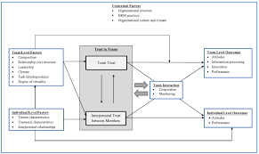
MULTILEVEL AND CONTINGENCY MODEL
The “contingency” model in the HRM provides an idea of an analysis of the available to assess candidate list (Pham Tučková, and Phan, 2019, p. 21).
Thus, the “Multilevel model” is identified by the organization to be followed with this enterprise so that the recruiters are well aware of the requirement in business at all levels.
(Source: Google.com,2023)
Notes:
The recruitments help the organization to set the standard in the market and provide certain restrictions for the competitors to enter the market developed by the firm. The “contingency” model in the HRM provides an idea regarding the collaboration of the external requirement analysis and the internal requirement and makes an analysis of the available candidate list (Pham Tučková, and Phan, 2019, p. 21). Furthermore, it is observed that since the private enterprise has been operating at different levels, the requirement for recruitment at different levels by maintaining various standards is certainly necessary. Thus, the “Multilevel model” is identified by the organization to be followed with this enterprise so that the recruiters are well aware of the requirement in business at all levels and make decisions in advance regarding the volume of recruitment. The “Likelihood model” is involved by the HRM section in the business by the managers in order to ascertain the employee retention and development rate.
Furthermore, the requirement in further recruitment and the essential amount of persuasion in joining the organization and assenting the competence of the candidates is done by the HRs (Fernandez And Gallardo, 2021, p. 9). strategising the recruitments so that the competing business might not possess more competent human resources than this business is identified through intensive model application within each level. The “Human resource management model” is included by the experts who have been identifying the company’s interest first and prioritizing growth as well. The requirement for using the potential of the huge human force recruited by the business. The management of the human workforce has been identified to be highly essential since the organizational position in maintaining the differentiated requirements and job role fulfilment is possible due to the varied skills possessed by these persons (L'Écuyer et al. 2019, p. 28). Varied human management techniques such as holding candidates with a similar job profile in a certain team may help the business to utilize the heightened profit from the aggregate team.

Slide 13
CONCLUSION
This can be concluded that both the public organization “British Council '' and the private concern “2 Sisters Food Group '' have been operating with an integrated inclusion of HRM practices.
Organizations are more likely to be more prosperous in undertaking various models within the enterprise in relation to the size and nature of the business.
Furthermore, the varied reason for the growth in the business apart from the internal requirement is ensured by the HRM through the external assessment and making the required decision accordingly.
Notes:
This can be concluded that both the public organization “British Council '' and the private concern “2 Sisters Food Group '' have been operating with an integrated inclusion of HRM practices. Organizations are more likely to be more prosperous in undertaking various models within the enterprise in relation to the size and nature of the business. The models such as the comprehensive and the multilevel models help businesses to identify varied prospects which can be gained through holding the recruitments in the organization. Furthermore, the varied reason for the growth in the business apart from the internal requirement is ensured by the HRM through the external assessment and making the required decision accordingly. Since the private firm has been possessing several or multiple independent variables in the HRM system by providing holistic views, the internal with the external match is done through iteration of the rules and collaboration. However, public firm has more recruitment with more elaborate funding sessions.

Slide 14
REFERENCE LIST
Arthur, J. B. and Boyles, T. (2007) Validating the human resource system structure: A levels-based strategic HRM approach. Human Resource Management Review, 17: 77-92
Bowen, D. E. and Ostroff, C. (2004) Understanding HRM-financial performance linkages: The role of the “strength” of the HRM system. Academy of Management Review, 29, 203–221.
Centranum (2020), Competency Modeling, 2020, Available at: https://www.centranum.com/resources/competency-management/what-is-a-competency-model/ (Accessed: 23. June 2023)
Kehoe, R. R. and Wright, P. M. (2013) The impact of high-performance human resource practices on employees’ attitudes and behaviors. Journal of Management, 39: 366-391.
Loon, M. et al. (2020) Thriving in the new normal: The HR micro foundations of capabilities for business model innovation. An integrated literature review. Journal of Management Studies, 57(3), pp.698-726.
Notes:
Bowen, D. E. and Ostroff, C. (2004) Understanding HRM-financial performance linkages: The role of the “strength” of the HRM system. Academy of Management Review, 29, 203–221.
Collins, C.J., (2021) Expanding the resource based view model of strategic human resource management. The International Journal of Human Resource Management, 32(2), pp.331-358.
Widyanty, W. et al. (2020). Gaining a competitive advantage through strategic human resource management in Indonesian construction industry. Management Science Letters, 10(9), pp.2021-2028.
Meyers, M.C. et al. (2020) HR managers’ talent philosophies: prevalence and relationships with perceived talent management practices. The International Journal of Human Resource Management, 31(4), pp.562-588.
Pham, N.T. et al. (2019) Greening human resource management and employee commitment toward the environment: an interaction model. Journal of Business Economics and Management, 20(3), pp.446-465.
Fernandez, V. and Gallardo-Gallardo, E. (2021) Tackling the HR digitalization challenge: key factors and barriers to HR analytics adoption. Competitiveness Review: An International Business Journal, 31(1), pp.162-187.
L'Écuyer, F. et al. (2019) Strategic alignment of IT and human resources: Testing a mediation model of e-HRM in manufacturing SMEs.
Yong, J.Y. et al. (2020) Pathways towards sustainability in manufacturing organizations: Empirical evidence on the role of green human resource management. Business Strategy and the Environment, 29(1), pp.212-228.
google (2022) HRM strategy. Available at: https://www.google.com/url?sa=i&url=http%3A%2F%2Fabouthumanresourcemanagement.blogspot.com%2F2016%2F01%2Fhrm-in-context.html&psig=AOvVaw2ddZECACA7SOdhxnl_Mf0A&ust=1687584410703000&source=images&cd=vfe&ved=0CBQQ3YkBahcKEwjw89T809j_AhUAAAAAHQAAAAAQCA (Accessed: 23 June 2023)
Google (2019) Multi-level HRM model. Available at https://www.google.com/url?sa=i&url=https%3A%2F%2Fwww.researchgate.net%2Ffigure%2FFigure-A-Multilevel-Model-of-Trust-in-Work-Teams_fig1_336312905&psig=AOvVaw3IHx19y9_rug1vdZBHLZCj&ust=1687584480563000&source=images&cd=vfe&ved=2ahUKEwi03pqd1Nj_AhXCmmMGHUtsBwsQr4kDegUIARDBAQ (Accessed: 23 June 2023)

Slide 15
CONTINUE
12manage.com (2020) Three-component model, Available at: https://www.12manage.com/forum.asp?TB=organizational_commitment&S=26
(Accessed on: 23 June 2023)
Pipestone (2021), Competitive Strategy on Farm, 2021, Available at: https://www.pipestone.com/competitive-strategy-on-farm/
(Accessed on: 23 June 2023)
Rosli, N.M. et al. (2022) A Conceptual Core Competency Model for Halal Executives in Food Manufacturing Companies. Journal of Halal Science and Technology, 1(1), pp.1-14.
Slideplayer (2020) Traditional Training Methods, 2020, Available at: https://slideplayer.com/slide/14299449/ (Accessed on: 23.06.2023)
Smlr.rutgers.edu (2020) A Quarter-Century Review of Human Resource Management in the U.S.: The Growth in Importance of the International Perspective, Available at: https://smlr.rutgers.edu/sites/default/files/Documents/Faculty-Staff-Docs/Jackson_A%20Quarter%20Century%20Review%20of%20HRM%20in%20the%20US.pdf (Accessed on: 23 June 2023)
Tchitnga, R. et al. (2019) A novel hyperchaotic three-component oscillator operating at high frequency. Chaos, Solitons & Fractals, 118, pp.166-180.
Weldetekle, H. (2013) The Role of Strategic Human Resource Management on Organizational Effectiveness: The Case of Ethio Telecom Doctoral Dissertation, St. Mary's University, p.20.
Notes:
12manage.com (2020) Three-component model, Available at: https://www.12manage.com/forum.asp?TB=organizational_commitment&S=26
(Accessed on: 23 June 2023)
Pipestone.com, (2021), Competitive Strategy on Farm, 2021, Available at: https://www.pipestone.com/competitive-strategy-on-farm/
(Accessed on: 23 June 2023)
Rosli, N.M. et al. (2022) A Conceptual Core Competency Model for Halal Executives in Food Manufacturing Companies. Journal of Halal Science and Technology, 1(1), pp.1-14.
Slideplayer.com (2020) Traditional Training Methods, 2020, Available at: https://slideplayer.com/slide/14299449/ (Accessed on: 23.06.2023)
Smlr.rutgers.edu (2020) A Quarter-Century Review of Human Resource Management in the U.S.: The Growth in Importance of the International Perspective, Available at: https://smlr.rutgers.edu/sites/default/files/Documents/Faculty-Staff-Docs/Jackson_A%20Quarter%20Century%20Review%20of%20HRM%20in%20the%20US.pdf (Accessed on: 23 June 2023)
Tchitnga, R. et al. (2019) A novel hyperchaotic three-component oscillator operating at high frequency. Chaos, Solitons & Fractals, 118, pp.166-180.
Weldetekle, H. (2013) The Role of Strategic Human Resource Management on Organizational Effectiveness: The Case of Ethio Telecom Doctoral Dissertation, St. Mary's University, p.20.

Slide 16


(Source: Google.com, 2023)

