Slide 1
Academic Writing
HPFY3005
Ros Coard 2023

Slide 2

What’s going to happen…..
Lecture based, discussion and activities
Introduce you to the skills of academic writing = HOW to do it
  From referencing to reading
  Essay construction
    Title, Introduction Conclusion, etc.
  Presentation of information
LOTS of assessment is linked to the module
Linked to HPFY3004 essay

Slide 3
Portfolio: Brief
The assessment for this module is a portfolio of five short assignments, which you will compile and submit during the module. The assessments are closely connected to your assessments for HPFY3004.
Submission is via moodle – see links and by 11.59 p.m. (effectively Midnight).
The assignment for this module will consist of many interrelated components designed to address YOUR topic of ‘boundaries’.
Notes:
You will be required to complete a PowerPoint presentation and a 1000 word essay on the concept of ‘boundaries’ and its significance to the understanding of the academic discipline of your choice. You can address the theme relating to an accepted discipline, such as History, Anthropology or Philosophy. If your interest is in areas not traditionally seen as a ‘discipline’, please feel free to include such areas. The content will be fully explored throughout the module.
The assessment is designed to let you explore any concept of boundary you wish, it could be physical boundaries, social boundaries, conceptual or definitional ones. Part of the course will be dedicated to discussing, in detail, the requirements of both the Essay and Presentation components of the assignment, and how best to approach each of these tasks. Advice will be given on essay writing and presentation, as well as how to create and deliver an effective power point presentation.

Slide 4

Academic writing has many forms
Essay
Journal article
Book/article review
Textbook
Critique
Report
Website
Exhibition catalogue

Slide 5

Increasingly the visual
PowerPoint
Poster
Infographic
Photo – essay
Video
(you don’t need to be good at drawing!)

Slide 6
Portfolio details: P1-P5
P1: Compose a title and bibliography for your essay: Tuesday 7th November
P2: Primary sources: Identify one primary source for your essay, and summarise the relevant information for your specific topic in 250 words. Remember to provide references throughout: Wednesday 8th November
P3: Discuss the main weaknesses of your primary sources, and how these affect your argument in 300-400 words. Remember to reference throughout: Tuesday 14th November
P4: Identify your main argument and create a plan for your essay/presentation in 300-400 words: Wednesday 15th November
P5: Critically engage with one scholarly viewpoint relevant to your essay in 300-400 words: Tuesday 21st November

Slide 7

Introduction to the Humanities: the other module
It sets the parameters
presentation= PowerPoint presentation on your chosen topic relating to ‘boundaries’.
Essay = one essay of 1000 words on your chosen topic relating to ‘boundaries’.

Slide 8
Preparation for assessments on the theme of 'Boundaries'
think about an area or topic you are interested in
think about where your topic may contain an idea of a boundary or be defined by a boundary or have an ambiguity where 'its' boundaries lie
start to construct an area of interest and think about
A title AND a bibliography for next week (as well as having a nice weekend)
Work through your ideas in the sessions

Slide 9
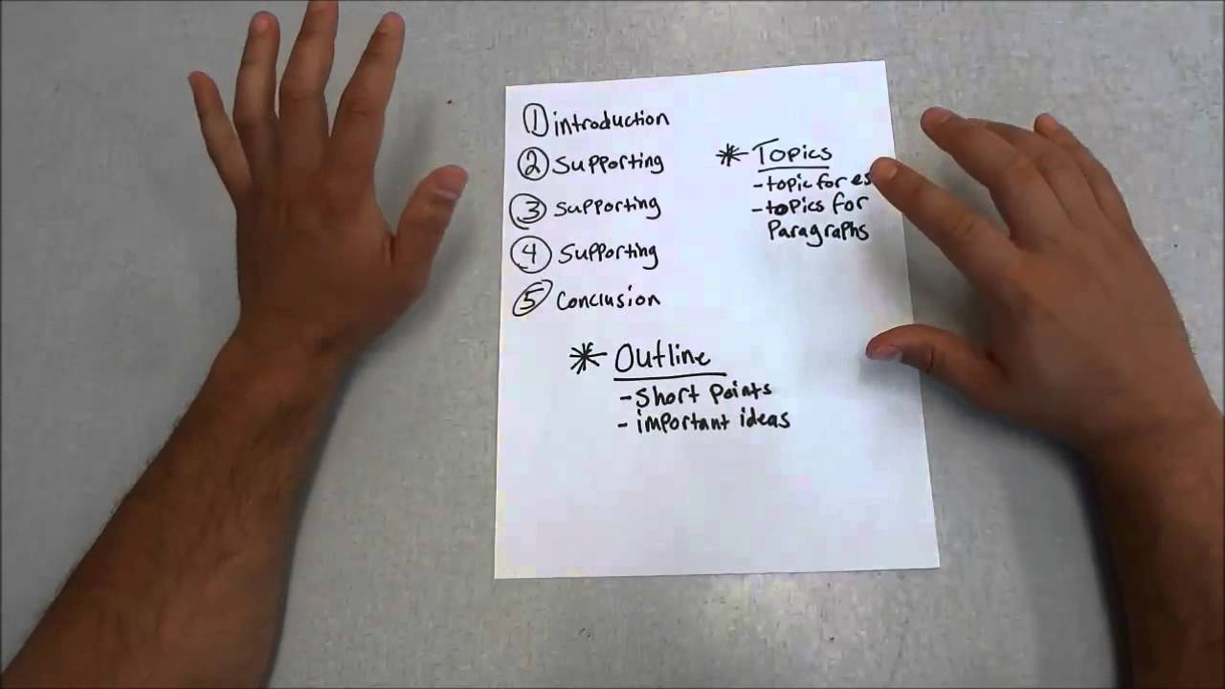
Today – looking at in no particular order…..
Essay titles
  Words used – helpful ones
  How to ‘present’ them – ‘rules’
Bibliography and Reference Lists
https://www.youtube.com/watch?v=HvrmAdjcEbY

