Slide 1
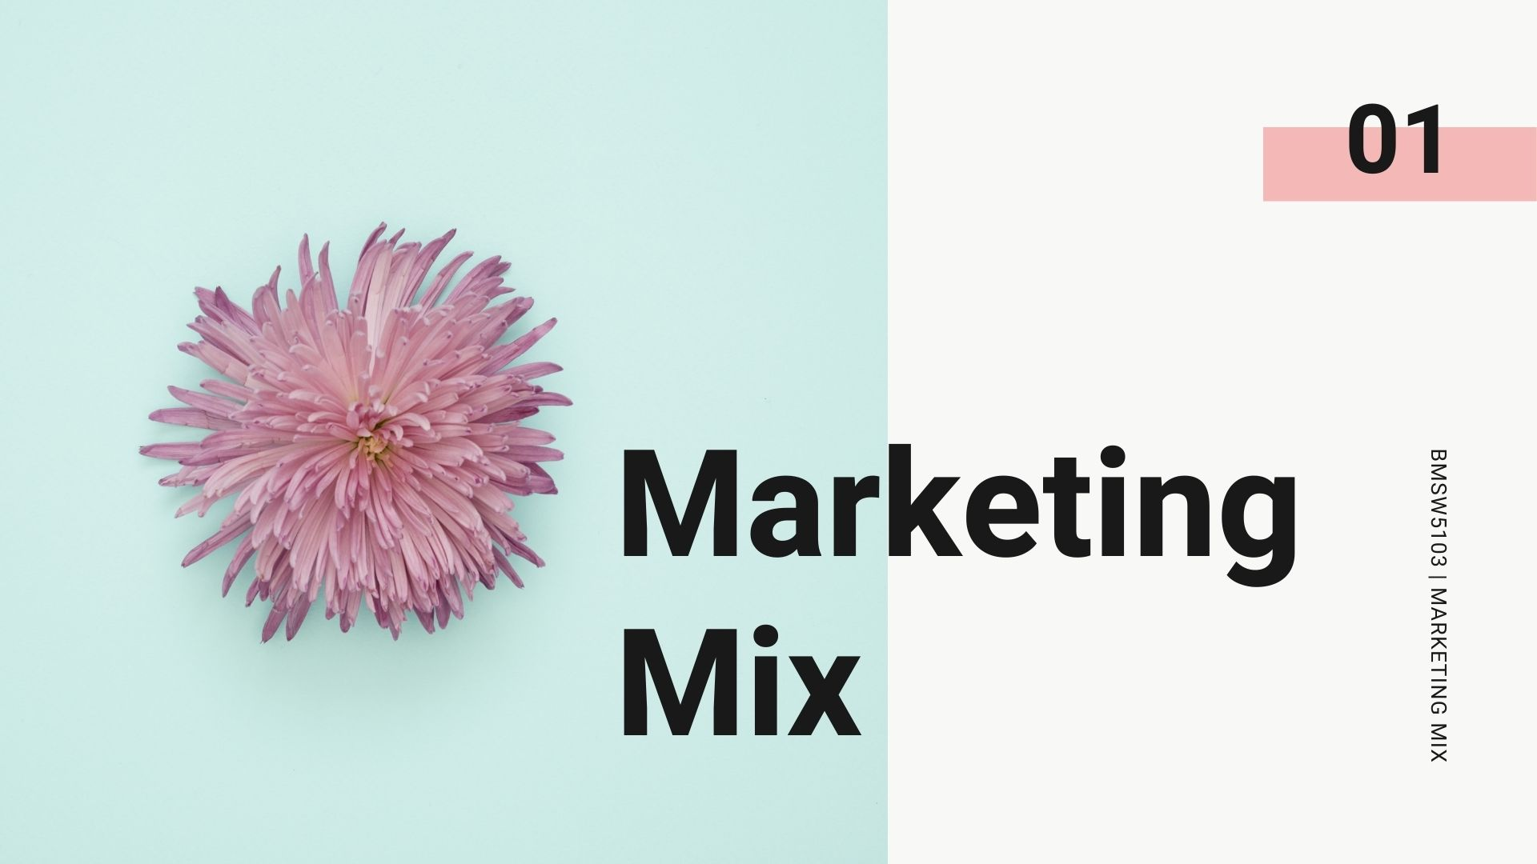

Slide 2
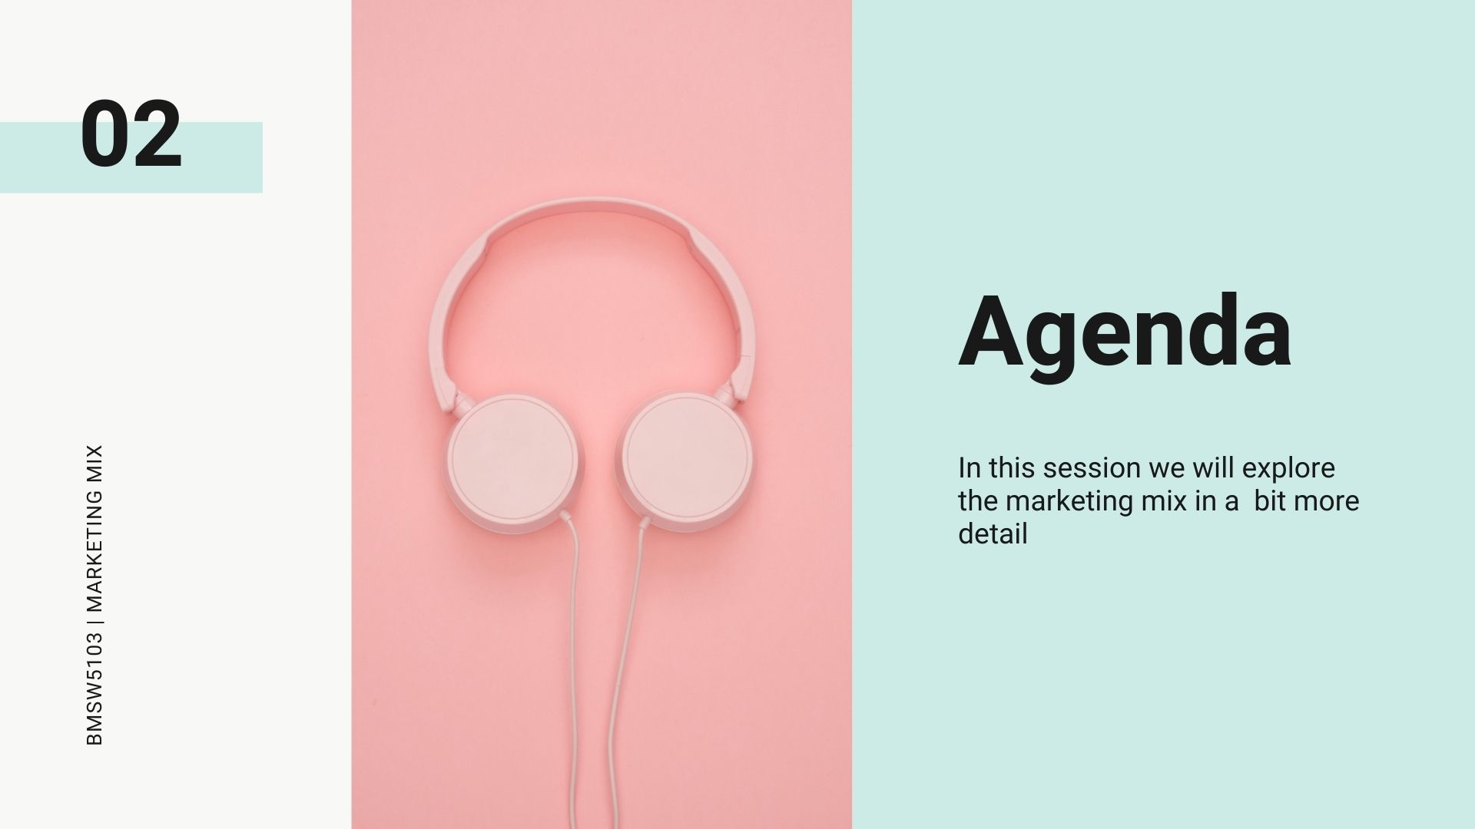

Slide 3
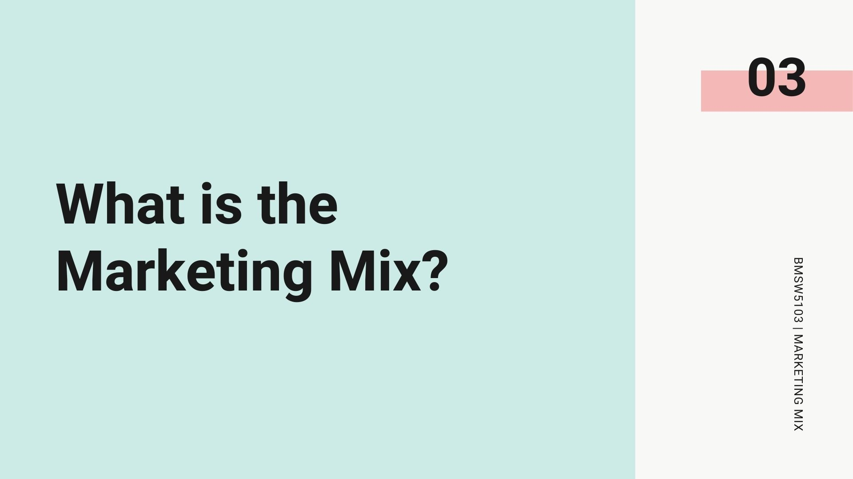

Slide 4
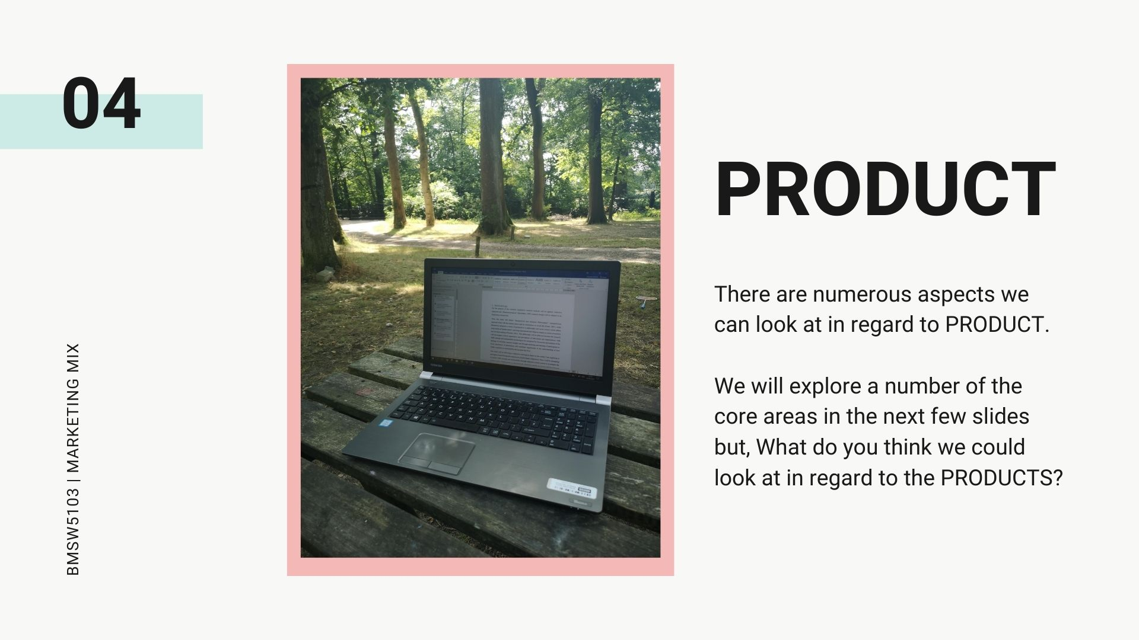

Slide 5
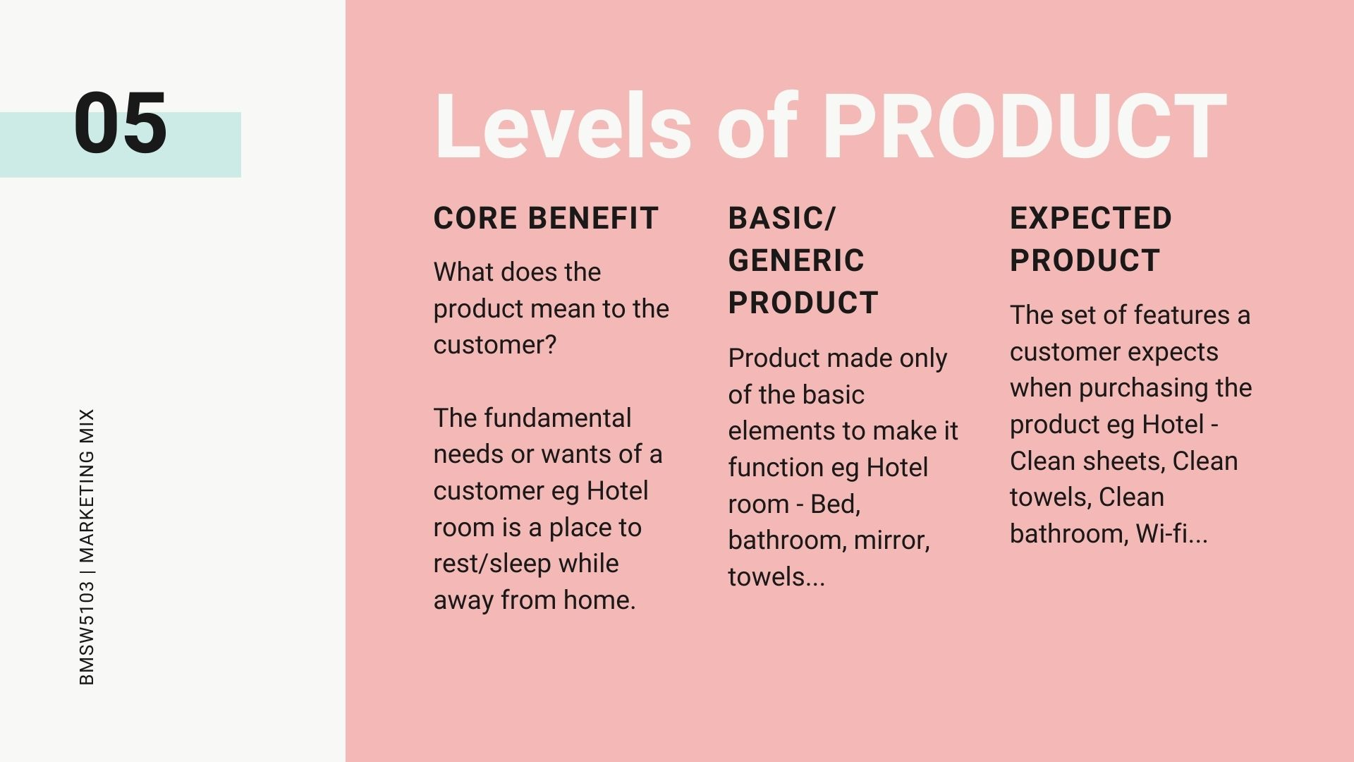
Notes:
This fits in with the 6 Sigma quality model that we briely explored in a previous session _ if you want to find out more about that, look in to the Critical To Quality (CTQ) and KANO model of 6 sigma but we will briefly connect to it here: -
Core benefits and basic/generic and expected products are 6-sigma "must be" factors - the core functional elements that a product or service must have in order to be accepted by consumers.

Slide 6
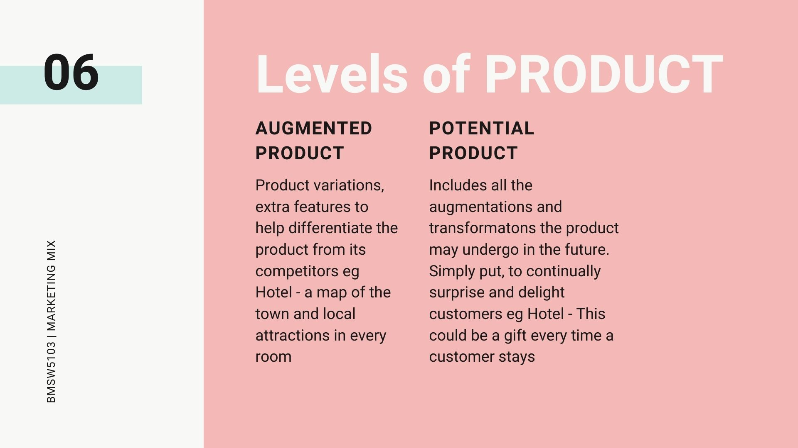
Notes:
Continuing to look at the 6-Sigma quality model
Augmented products are what 6-Sigma would deem as "performance" aspects or, the more the better
Potential products - 6 sigma delighters, those things you didn't ask for or wasnt expecting but you like it

Slide 7
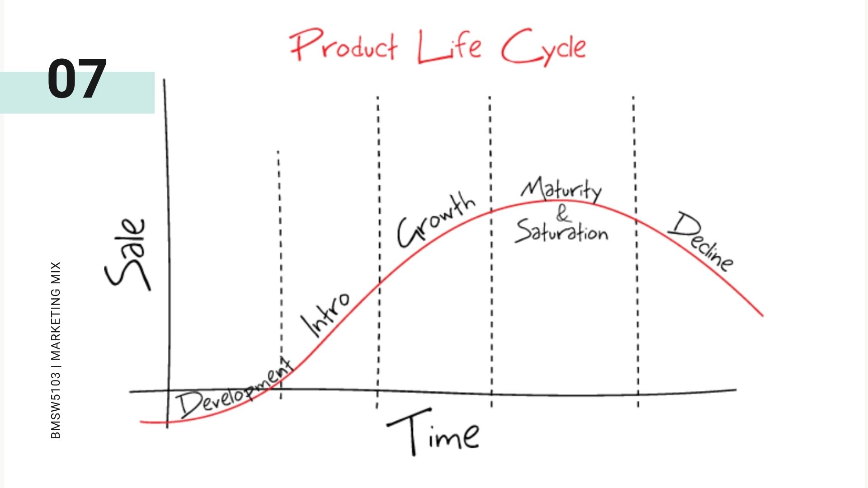
Notes:
Development stage known as the valley of death as costs incurred with no revenue. High risk area
Intro - Huge investment here as the product is undergoing testing, mass production, ad campaigns etc
Growth - product becomes accepted by consumers. Sales begin to grow as does profits
Maturity - Turnover and demand reaches saturation levels. Competition begins to impact pricing but, product is stable
Decline - Sales begin to drop as the market and competitors adapt and bring in new products

Slide 8
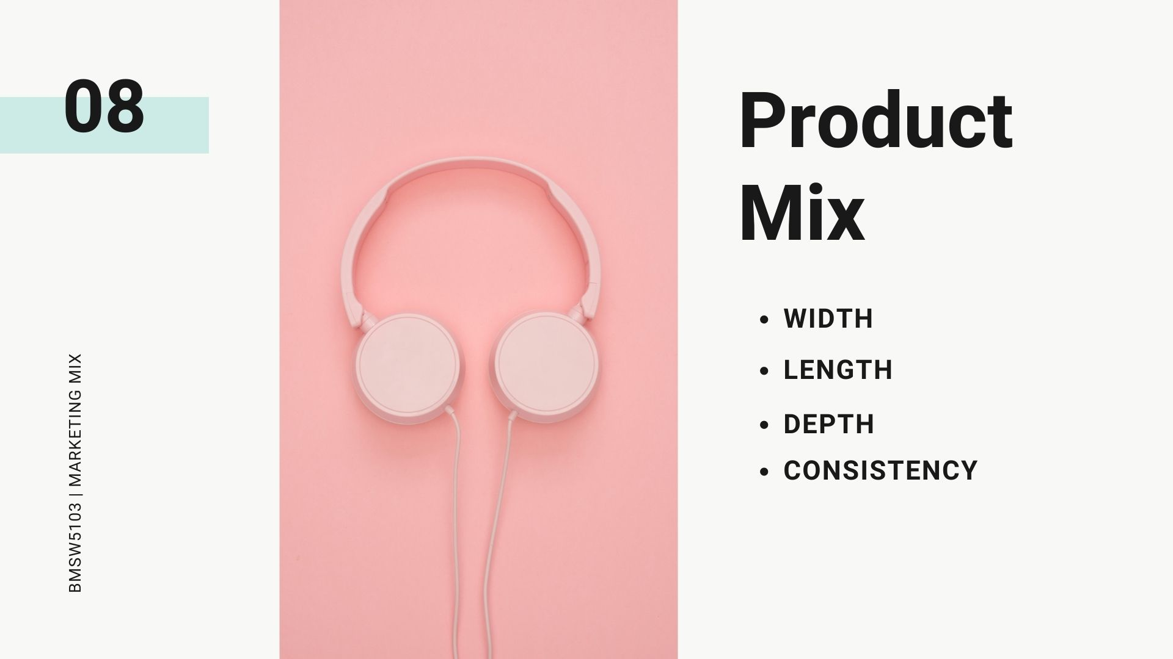
Notes:
Width - Number of different product lines by the company
Length - Total number of items in the product mix
Depth - Variation of each product
Consistency - relationship and continuity of the product mix

Slide 9
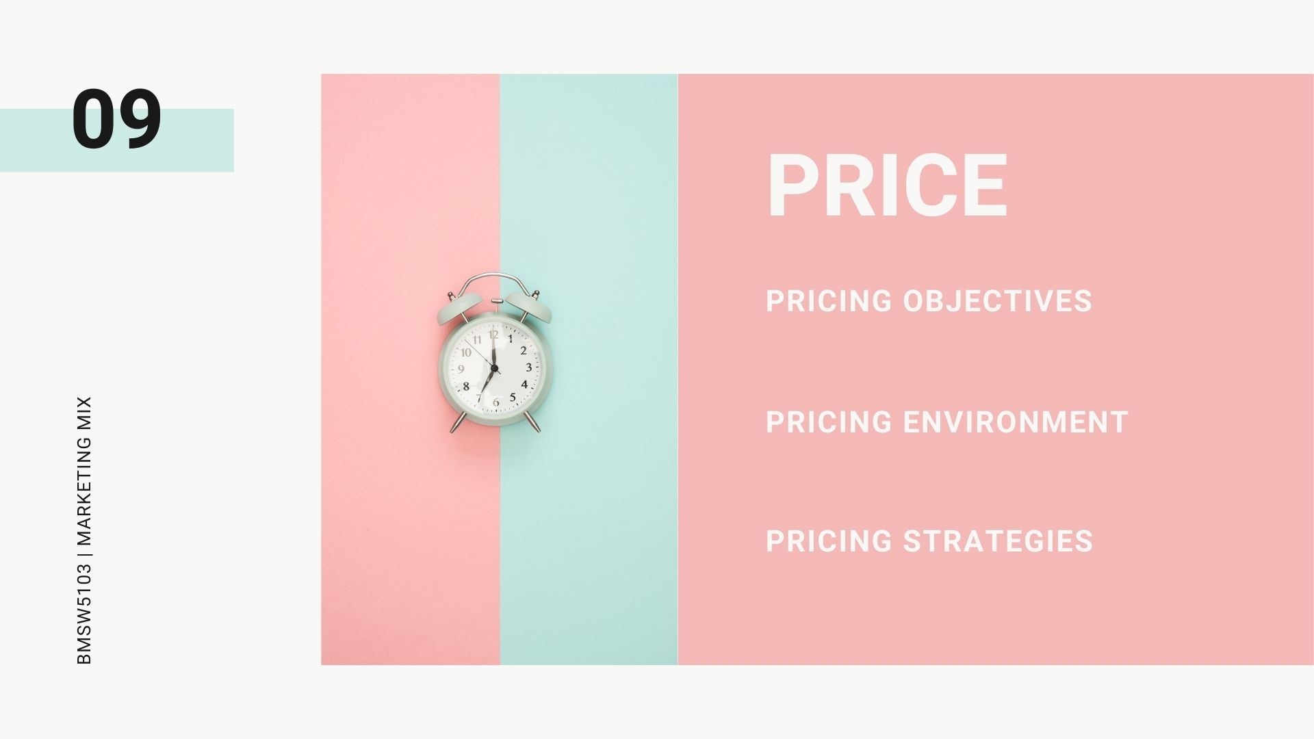
Notes:
Pricing objectives - Are we looking for straight profit, number of sales, market share? What is demand like?
Pricing environment - What is the local economy like? What/where are the competition headed? Sociat trends and government regulation
Pricing strategies - We will return to this one shortly but, are we focusing on costs - demand - need - competition

Slide 10
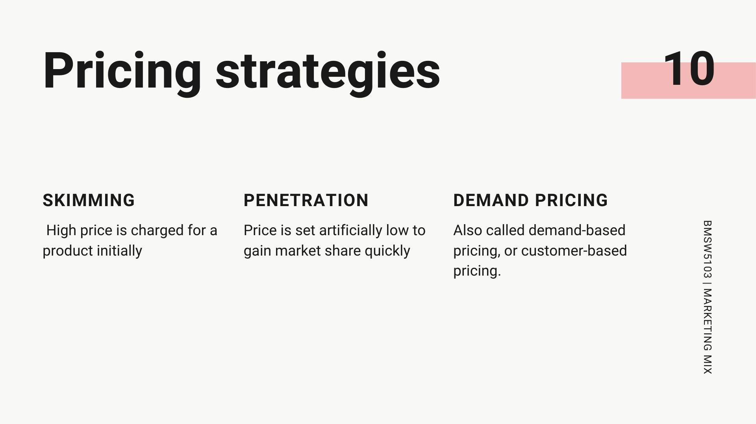
Notes:
Skimming - High price is charged for a product initially till the time competitors allow and thereafter prices may be dropped. The idea is to recover maximum money before the product or segment attracts more competitors who will lower profits for all concerned.
Penetration Pricing: Price is set artificially low to gain market share quickly. This is done when a new product is being launched.
Demand Pricing: Also called demand-based pricing, or customer-based pricing. This pricing method uses consumer demand of a product or service as the main element of setting a price for a product or service.

Slide 11
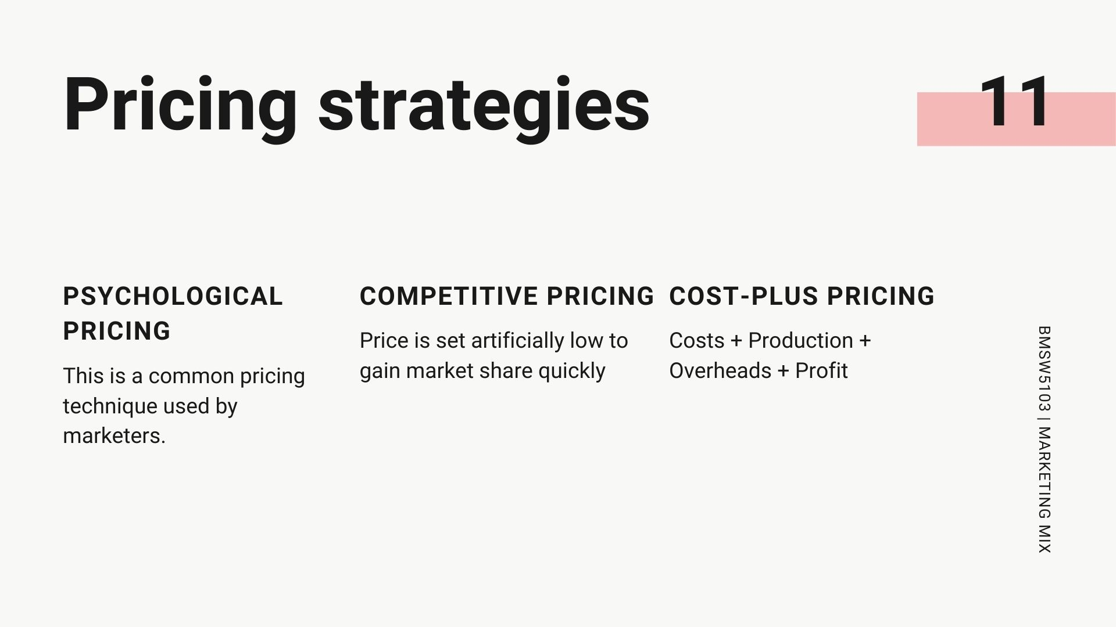
Notes:
Psychological Pricing: This is a common pricing technique used by marketers. A minor difference in prices is a huge difference for customers. For example, an item whose price is listed as Rs. 199 may be seen as much cheaper than a product or service priced at Rs. 200.
Competitive Pricing: Also called the strategic pricing, this is a method that uses the prices set by competitors. More or less using competitor’s price is considered to price its own products.
Cost-Plus Pricing: When setting the cost-plus price, the marketer takes the cost of the raw materials and the cost of production and add them to the overhead costs of a product or service. To this total, he may add a markup percentage (profit margin) and this total sum is the cost-plus price.
Other pricing strategies: -
Discount Pricing: A pricing strategy that offers products and services at a reduced price. Discount prices can come in the form of seasonal discounts, loyalty rebates etc.
Geographic Pricing: This pricing strategy is one where different prices are charged in different geographical locations or markets for the t same product or service.
Price Bundling: This is a strategy used when two or more products or services are priced together as a package, with a single price.

Slide 12
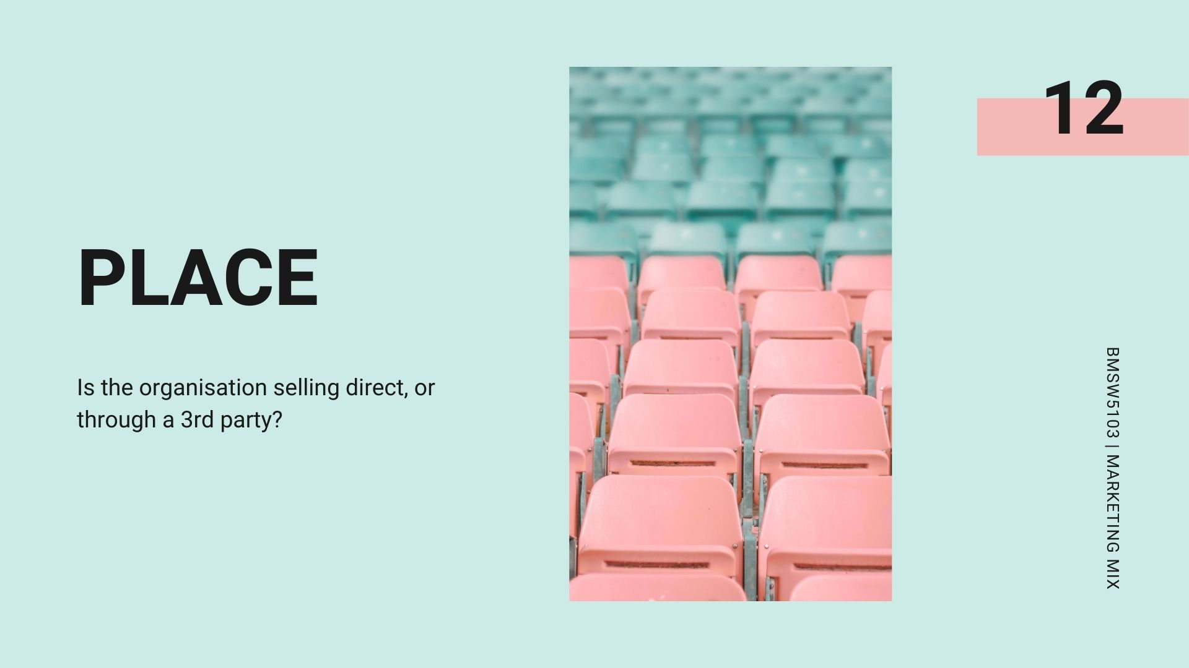
Notes:
So previously we have looked upon place as to whether we will be selling the product through either a bricks & Mortar or online store.
Here, we look at it from a different perspective - will we be selling the product the customer ourselves or through a 3rd party. 3rd party choices include: -
1. Wholesalers: They are the people who buy in bulk from the producers and sell in small quantities to the retailers.
2. Retailers: They are the people who buy in small quantities from the wholesalers and sell to the ultimate consumers
3. Agents: They are the middlemen who do not take any title to goods. They render all services required in marketing. They represent either the seller or the buyer and receive commission for their work.
4. Brokers: Like agents, brokers also represent either the buyer or the seller. They do not usually have physical control over the goods in which they deal. Example: share brokers. They get ‘brokerage’ for their work.
5. Dealers: They are the business houses that resell goods.
6. Distributors: They are the same as wholesalers.

Slide 13
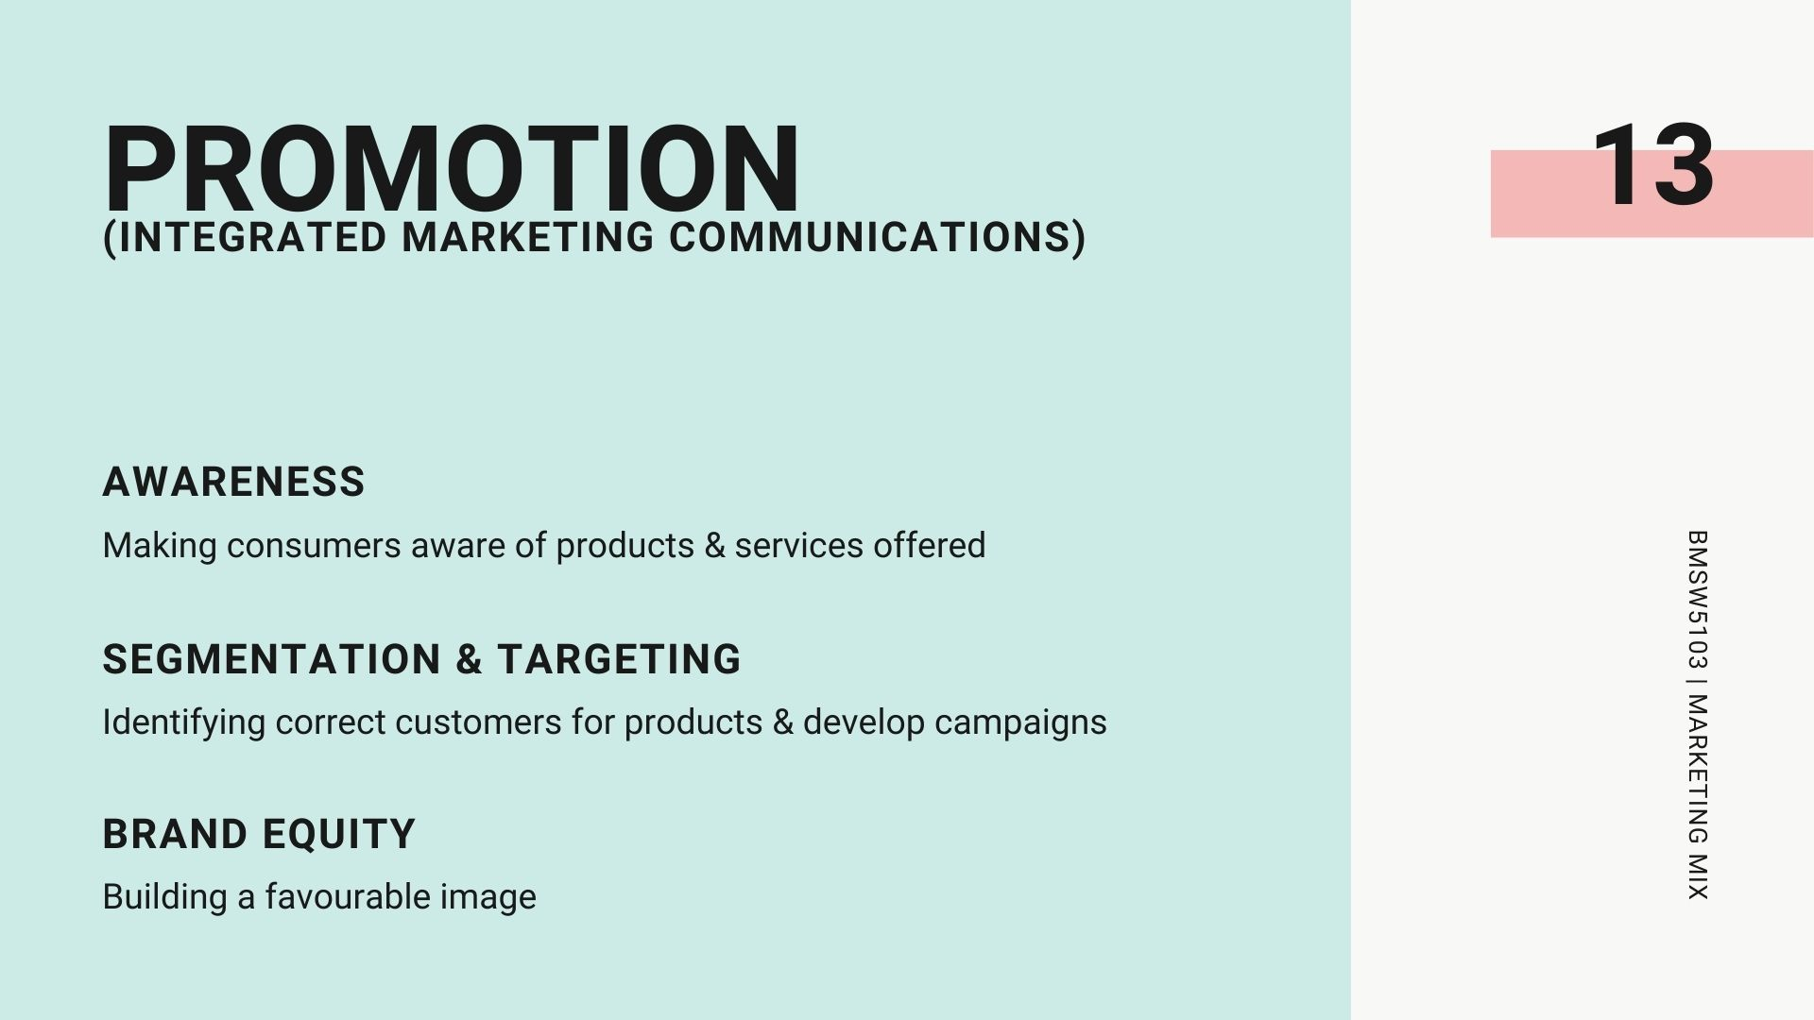
Notes:
Integrated Marketing communication
promotion increases awareness of products and services and eventually increases their sales, yielding high profits and revenue for the organization.
A tool for establishing long-term relationships
This is where we develop our segmentation and targeting, identifying correct customers for products and building advertising campaigns
Build brand equity
Brand equity is an intangible asset that results from a favorable image, impressions of differentiation, or consumer attachment to the company, brand, or trademark. Aaker defines brand equity as a set of assets and liabilities linked to a brand, its name and symbol, that add value or subtract from the value provided by a product or service to a firm and/or to that firms customers.

Slide 14
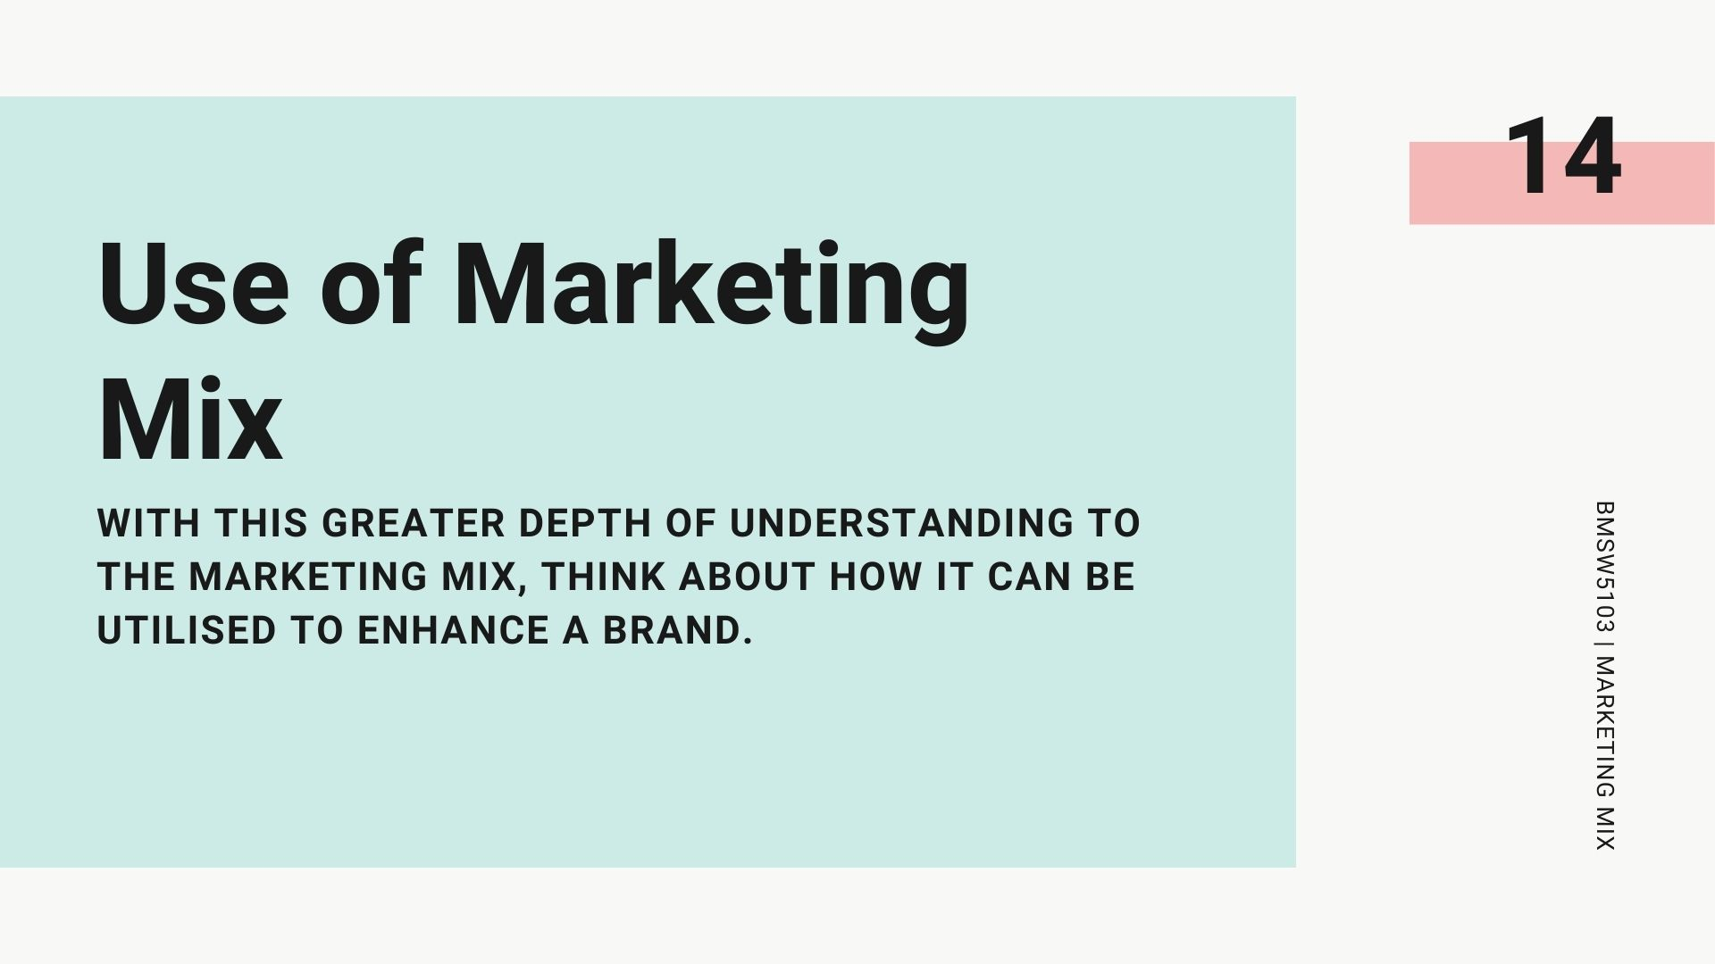

Slide 15


