Slide 1
LCBB5013-Portfolio - 6 elements
Task 2-Element 5-Presentation

Slide 2
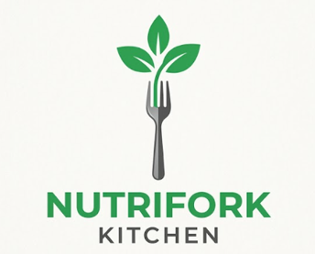
Business Overview-NutriFork Kitchen
Healthy meal preparation and delivery service based in the UK for busy professionals, students, families and fitness freaks (Núñez Rivas et al. 2025).
Provides freshly prepared meals at a healthy balance, or items can be ordered in advance for flexible subscription and one-time delivery.
The mission is to ensure healthy eating is convenient, affordable and accessible.
USP is personalised healthy meals delivered on time and eco-friendly.
The created logo of this company will symbolise fresh nutrition, healthy eating, sustainability and premium quality of meal to be delivered through its simple yet modern design.

Slide 3
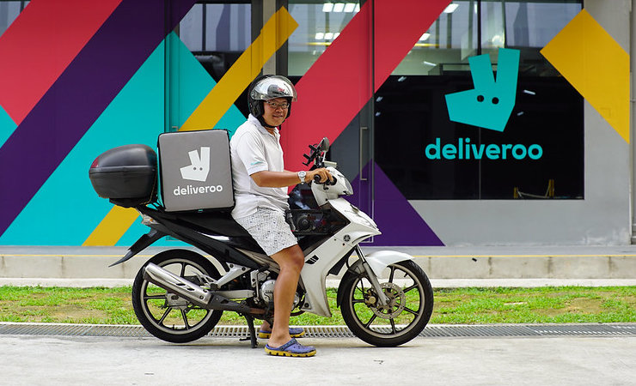
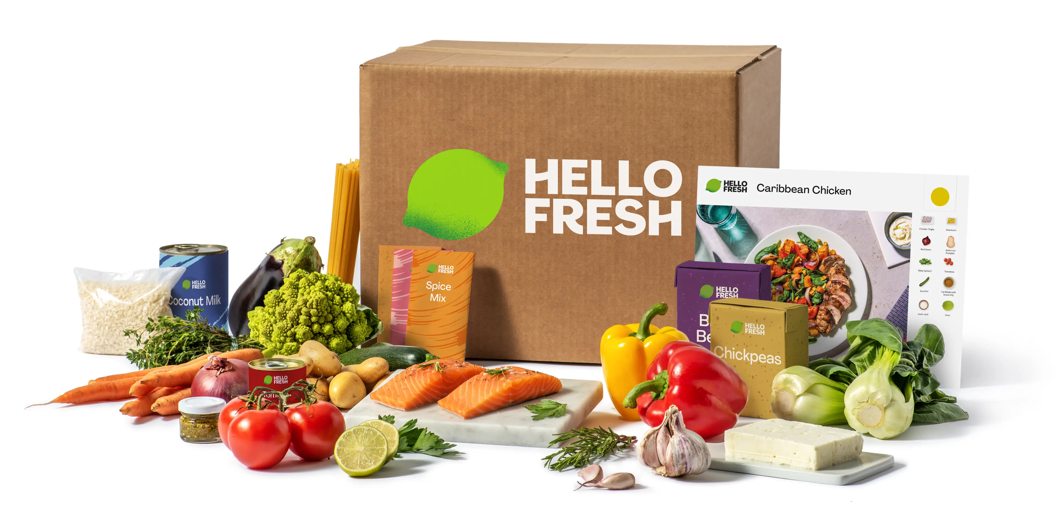
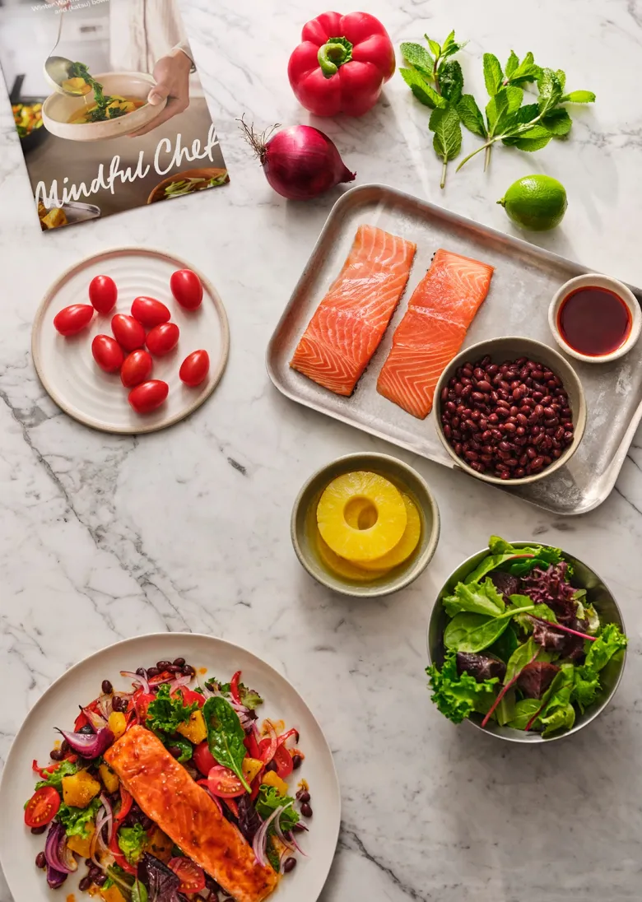
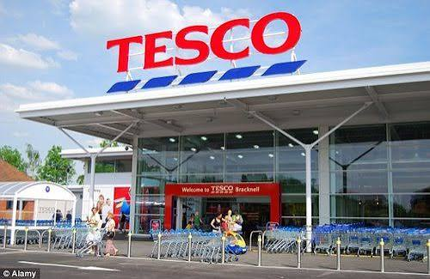
Market Opportunity and Competitive Position
Business and increasing health awareness in the UK is driving the need to have food available that is convenient and also healthy (Amiri and Hasan, 2023).
The customers targeted range from cosmeticians and university students to young families and health-minded individuals.
Personalised meal plans, flexible subscription plans, and transparent information on nutrition provide a competitive edge.
Some of the major players are HelloFresh and Mindful Chef, which run a similar kind of business concept and companies like Tesco and Deliveroo give indirect competition.

Slide 4
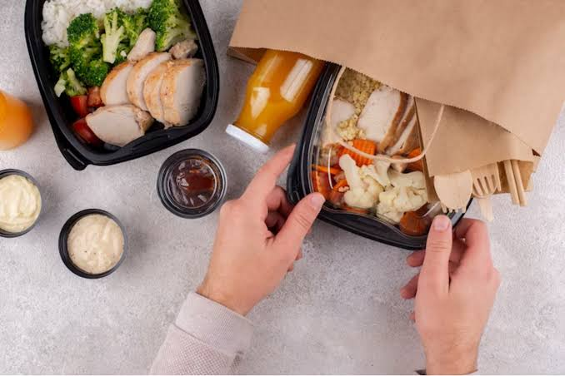

Marketing Strategies
Products are fresh, ready-to-eat healthy food with a variety of choices.
Price would be cost-competitive, value-based pricing with discounted subscription rates (weekly/monthly).
Place: Online via the company website and then have the product delivered at home or workplace (Chen et al. 2026).
Promotion: SEO, social advertising, Google Ads, social influencers, referral programs, and loyalty incentives.

Slide 5
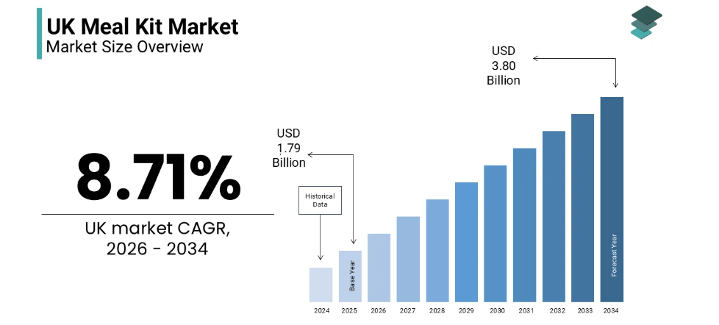
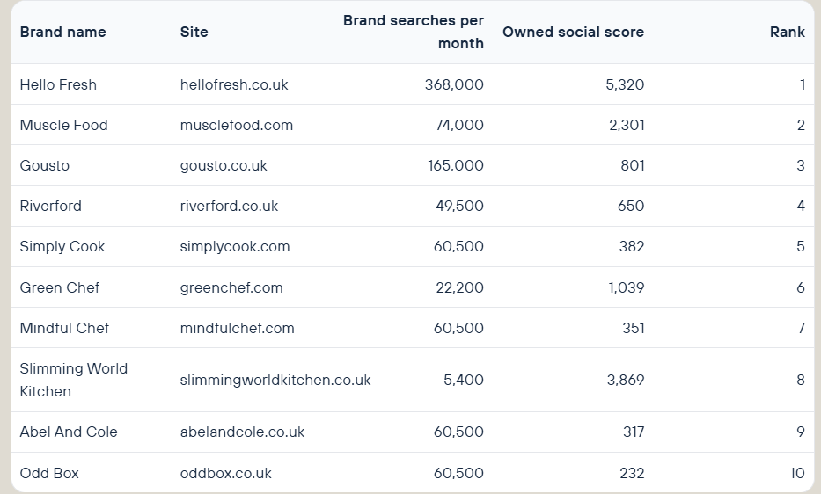
Business Situational Analysis
Strengths of this company would be personalised healthy food and meals, subscription-based food service, and sustainable packaging.
Weaknesses of this company would be expensive operations, little brand recognition, not a wide variety available.
Opportunities of this company would be the expansion of the healthy eating food market, the rise of online ordering for food, and corporate wellness programs (Market Data Forecast, 2025).
Threats of this company include intense competition, financial instability, and increased food and delivery price fluctuations.

Slide 6
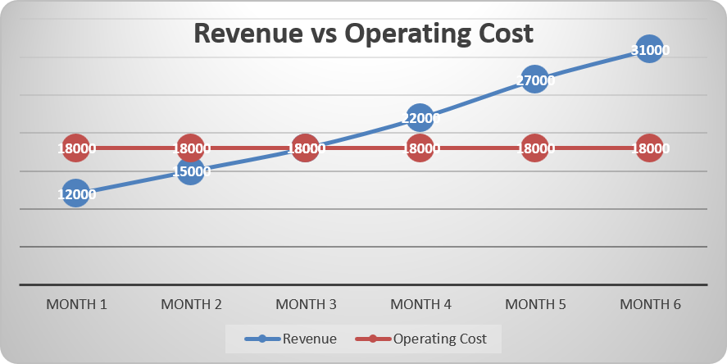
Financial Plan & Future Growth
Potential start-up costs estimated as £50,000 and monthly running costs around £18,000.
It is anticipated that the monthly revenue will grow from month 1 of £12,000 to month 6 of £31,000.
Expected to break even in the first three months of business and investment recovered within 12-15 months.
Long-term goal is to grow in major cities across the UK with Digital marketing and Customer Loyalty Programs and partnerships.

Slide 7
References
Núñez Rivas, H. P., Holst Schumacher, I., Roselló Araya, M., and Blanco Metzler, A. (2025). Food literacy and caregivers' perceptions related to healthy eating and salt/sodium reduction in children and adolescents: A qualitative study in Costa Rica.
Amiri, M., Li, J., and Hasan, W. (2023). Personalized Flexible Meal Planning for Individuals With Diet-Related Health Concerns: System Design and Feasibility Validation Study. JMIR formative research, 7, e46434. https://doi.org/10.2196/46434
Chen, L., Han, H., Yan, W., and Yang, Y. (2026). How Online Food Delivery Services Are Reshaping the Urban Food Environment: Evidence from Hangzhou, China. Foods, 15(14), 2481. https://doi.org/10.3390/foods15142481
Market Data Forecast (2025) UK meal kit market size, share, trends and analysis, 2034, Market Data Forecast. Available at: https://www.marketdataforecast.com/market-reports/united-kingdom-meal-kit-market (Accessed: 05 August 2026).

Slide 8


