Slide 1
Operations Management
WEEK 1
BMTP 5019
Lecturer: Debbie Jenkins
deborah.jenkins@uwtsd.ac.uk

Slide 2

WHAT DO YOU KNOW?
What do you know about operations management?
Tell us about where you have worked and experienced this area ?

Slide 3
AIM(S)
To provide the student with an understanding of the key strategic and operational management functions including planning, programming and the operational skills necessary for effective facility management.
To appreciate the wider operating context and impacts relating to employment obligations, legal responsibilities and operational risk challenges faced by managers operating venues in all sectors of the travel, tourism, events hospitality and leisure resort management industry.

Slide 4
LEARNING OUTCOMES
Demonstrate an appreciation of the principles of commercial law and licencing and analyse the effect of employment legislation within the industry globally.
Evaluate the relationship between financial statements and yield management in controlling budgets and establishing performance targets within management operations.
Coherently analyse the relationship between managerial expertise and organisational performance, identifying the key skills and knowledge required to manage service organisations effectively and to operationally manage risk, health, safety and crisis management.
Evaluate the impact of the wider social and business environment on the business operations and the management challenges it represents

Slide 5
Assignment : 6th April 2025 11.59pm - 4000 words
In this assignment, you are required to analyse and evaluate the operations management practices of a hotel that is part of a larger corporate group. The hotel is located in a popular holiday destination and attracts tourists from around the world. Your focus will be on assessing the key areas of operations management within the hotel, including Human Resources (HR), Finance, and Legal Policies and Procedures in one of the departments. You will also need to consider the diverse types of tourists visiting the hotel and how the operations are tailored to meet their needs and expectations.
Assignment Tasks: Task 1 (40%) : Choose a hotel that is part of a corporate group in a popular holiday destination, attracting international tourists. In a report format analyse and discuss how the hotel adapts its operations to cater to these visitors.

Slide 6

Discuss the operations management in key areas for adapting operations to the needs of International Tourists :
  Provide an analysis of the different types of tourists that visit the hotel (e.g., families, solo travellers, business travellers, luxury tourists, etc.).
  Discuss how the hotel tailors its operations, services, and facilities to meet the specific needs of these different tourist groups.
  Explore how the hotel manages the challenges of attracting a diverse international customer base and maintaining a high level of service quality across different markets.
Choice of Key Operational departments that you should choose :
Food and Beverage
Conferencing & Events
Front of House
Housekeeping

Slide 7
In your analysis, ensure that the following key areas of operations management are addressed. Use supporting evidence from academic research, relevant theories, operational management models, and insights from class learning to substantiate your findings:
  Human Resources (HR):
  Assess the staffing requirements and organisational structure within the hotel.
  Evaluate recruitment, training, and staff management practices to ensure high levels of service and customer satisfaction.
  Discuss how the hotel manages cultural diversity and adapts HR practices to cater to a multinational guest profile.
  Finance:
  Analyse of the financial management practices within the hotel, including budgeting, forecasting, and cost control.
  Discuss how the hotel maximises profitability while maintaining competitive pricing for international tourists.
  Explore pricing strategies tailored to different markets and the role of revenue management for financial success.

Slide 8

Legal Policies and Procedures:
    Review the legal and regulatory requirements that the hotel must comply with, considering the international clientele and local regulations.
    Examine the hotel's policies on health and safety, insurance, and contracts with suppliers and service providers.
    Discuss the importance of compliance with international standards (e.g., GDPR, accessibility regulations) and how the hotel ensures these standards are met.

Slide 9
Task 2 (60%) : Create an Operations Management Plan:
Develop a comprehensive Operations Management Plan outlining strategies for the key areas identified in Task 1—Human Resources (HR), Finance, and Legal Policies and Procedures— tailored to a hotel situated in a popular holiday destination.
Executive Summary
Overview of Operations: Brief introduction to the hotel’s operational framework, objectives, and key performance indicators (KPIs).
Scope of the Plan: Define the operational areas covered (HR, Finance, Legal, etc.) and their relevance to the hotel’s success in a tourism-heavy location.
Key Objectives: Summarise the overall goals of the operations plan (e.g., achieving high guest satisfaction, ensuring efficient use of resources, maintaining legal compliance).

Slide 10
Human Resources (HR) Management
Staffing Structure: Outline the hotel’s organisational structure, making links and detailing the different departments (e.g., Front Desk, Housekeeping, F&B, conferences & events) staff roles.
Recruitment and Training: Discuss strategies for recruiting and onboarding new employees, especially considering the seasonal demand from international tourists.
Discuss training programs (e.g., customer service, cultural sensitivity for international guests, emergency response procedures).
Identify any specific training for high-traffic periods (peak tourist seasons).
Staff Scheduling and Allocation:
Plan for flexible staffing models, considering fluctuating guest numbers based on seasonality etc.
Discuss shift schedules/ rotas, part time, full time employment for different departments /areas to ensure adequate coverage and smooth operations.
Performance Management: Describe how employee performance will be monitored and managed, incentivised including KPIs for customer service and operational efficiency.

Slide 11
Financial Management
Budgeting and Financial Planning: Discuss budgets covering all operational costs such as staffing, maintenance, utilities, marketing, guest services, and supplies etc.
Discuss how to plan for both peak and off-peak seasons, anticipating changes in income and expenditure because of this
Revenue Management and Pricing Strategy: Show the importance of a dynamic pricing strategy based on market demand, competitor pricing, and seasonality.
Provide examples of revenue management systems to adjust pricing for rooms, amenities, and events (if applicable), maximizing profitability.
Cost Control and Efficiency: Identify opportunities for cost savings (e.g., bulk purchasing of supplies, energy-saving initiatives, outsourcing non-core services).
Financial Reporting: Outline the frequency and format of financial reports to monitor performance, cash flow, and profitability.

Slide 12
Legal Policies and Procedures:
Legal Compliance: Ensure that the hotel complies with all relevant local, national, and international laws and regulations, including:
Health and safety regulations. Labor laws (e.g., working hours, wages). Data protection and privacy laws (e.g., GDPR if serving international guests).
Health and Safety Protocols: Develop procedures for guest and staff safety, including fire safety, emergency evacuation plans, and protocols for health crises (e.g., COVID-19).
Ensure compliance with local health standards, including hygiene and sanitation practices in rooms and public areas.
Insurance and Liability: Identify necessary insurance policies, including property, liability, business interruption, and staff-related insurances.
Define procedures for managing any claims or legal issues that arise (e.g., guest accidents, property damage).
Contracts and Agreements: Outline standard procedures for entering into contracts with suppliers, contractors, or external partners (e.g., event organizers, tourism agencies).

Slide 13
Operational Logistics:
Guest Services Management:
Plan for managing guest needs before, during, and after their stay, ensuring personalised service for different tourist segments (families, solo travellers, business tourists).
Discuss systems for booking and check-in/check-out processes, handling special requests, and complaint resolution.
Technology Integration:
Plan for the integration of technologies such as Property Management Systems (PMS), point-of-sale systems, guest Wi-Fi, and digital booking platforms (OTA’s).
Consider automation for routine tasks like check-in/out, billing, and guest feedback collection to improve efficiency.

Slide 14
Customer Experience and Satisfaction:
Guest Feedback Systems:
The importance of implementation of systems to collect real-time guest feedback via surveys, online reviews, or in-person comments.
Establish procedures for quickly addressing and resolving guest complaints or issues.
Quality Control:
Develop internal standards and procedures to ensure that services meet or exceed guest expectations, including cleanliness, food quality, and service delivery.
Sustainability and Social Responsibility:
Consider incorporating sustainable practices into the hotel’s operations (e.g., waste reduction, energy efficiency, community outreach).
Highlight the hotel’s commitment to responsible tourism and promote it as a key selling point to environmentally conscious travellers.

Slide 15
Risk Management:
Risk Assessment: Identify potential risks affecting hotel operations (e.g., natural disasters, economic downturns, political instability) and assess their impact on operations.
Contingency Plans: Develop contingency plans for various scenarios, including staff shortages, supply chain disruptions, or safety incidents.
Crisis Communication: Establish a communication plan for dealing with crises, both internally (to staff) and externally (to guests and stakeholders).

Slide 16
Monitoring and Evaluation
Key Performance Indicators (KPIs):
Define KPIs for operational efficiency, financial performance, guest satisfaction, and employee productivity.
Regularly monitor performance through reports and data analysis.
Continuous Improvement:
Develop a system for ongoing assessment and improvement based on feedback, operational audits, and industry trends.
Conclusion
Summary of Key Strategies: Summarise the major points of the operations management plan and reinforce their alignment with the hotel’s long-term objectives.
Recommendations for Future Growth: Offer insights into potential areas for growth and future improvements based on current trends in tourism and hospitality.

Slide 17

Ops Management

Slide 18
The History of Operations Management
Operations management dates to 5000 B.C. with the Sumerians, who tracked inventories, transactions, and taxes, and has evolved into modern day services like overnight and same-day deliveries. Rather than bartering (using one good or service, not money, to pay for another good or service), the ancient Sumerians used ancient clay coins to pay. The sizes and shapes of coins represented value .
The Industrial Revolution (1760s to early 1800s) ushered in the foundations of division of labour and interchangeable parts, keys to efficient production. Eli Whitney, inventor of the cotton gin, also manufactured 10,000 muskets by using the concept of interchangeable parts.
In 1883, Frederick Winslow Taylor used the stopwatch method to time tasks for complex jobs. This became key for studying efficiency and productivity.
In about 1912, Frank and Lillian Gilbreth laid the foundation for predetermined motion time systems (PMTS), which predict the time it takes to complete tasks.
Notes:
Sumer had a flourishing merchant culture in which goods such as grains, livestock, perfumes, and pottery were sold to customers. Rather than bartering (using one good or service, not money, to pay for another good or service), the ancient Sumerians used ancient clay coins to pay. The sizes and shapes of coins represented different amounts of currency and signaled the types of goods for which they could be exchanged

Slide 19
The History of Operations Management
In 1913, Henry Ford’s first moving assembly line started rolling, cutting production time for a car from 12 hours to less than three.
In post-World War II Japan, Toyota developed just-in-time production (JIT), later called the Toyota Production System. The company designed it to eliminate waste and increase productivity and quality.
In 1971, FedEx started overnight package deliveries. Today Amazon even offers same-day delivery.

Slide 20
Operational Responsibilities
Development & Design
Management & Control
Risk Management
Legal & Licencing
Recruitment, Training, Organisation & Management of Staff
Departments & Responsibilities - Operations managers facilitate cooperation between departments and ensure that department and company goals are aligned
Customer Satisfaction & Service Excellence
Crisis Management
Finance – Costs, Revenue & Pricing / Profit & Loss / Yield Management
Operational Systems - Stock Control / Order

Slide 21
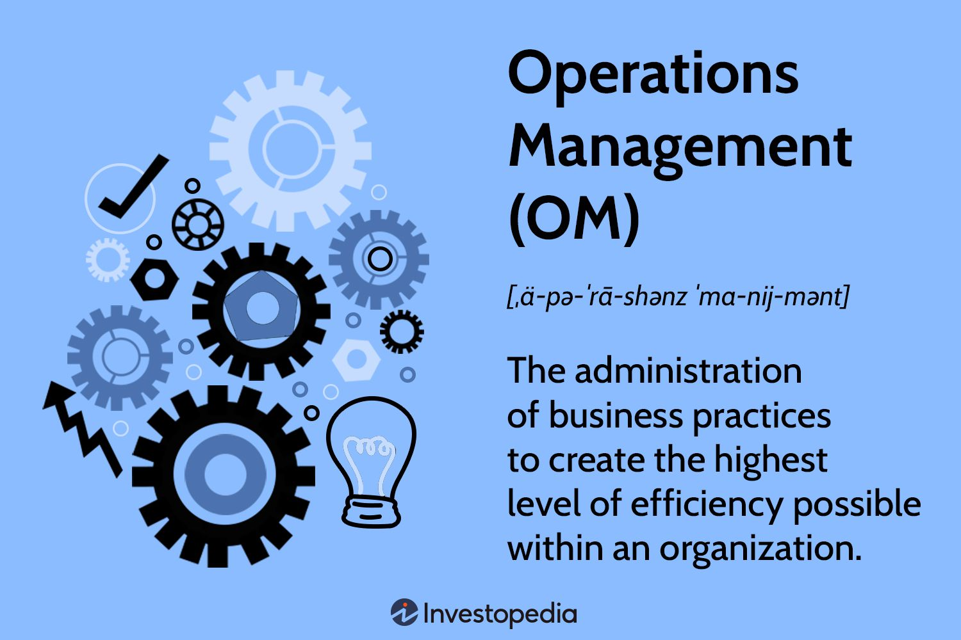
What is Operations Management?
Operations Management (OM) is the process of planning, organising, and overseeing the production or delivery of goods and services.
The goal is to ensure that an organisation’s resources—such as people, technology, materials, and processes—are used efficiently and effectively to meet customer demands.

Slide 22
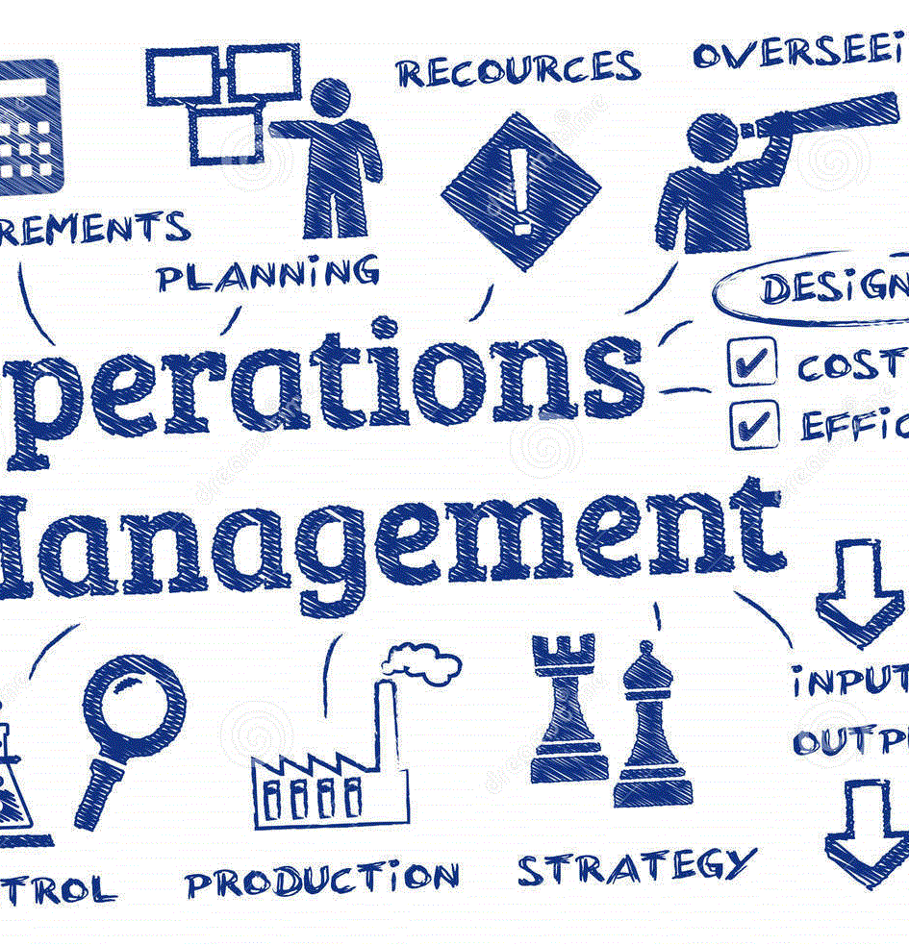
What are the 3 roles of operation management?
The term operations management encompasses planning, implementing, and supervising the production of goods or services
Operations managers have responsibilities in both strategy and day-to-day production, in either manufacturing or services.
Forbes magazine reported in 2011 that three-quarters of CEOs come from an operations background, which shows the importance of understanding how a company functions.

Slide 23
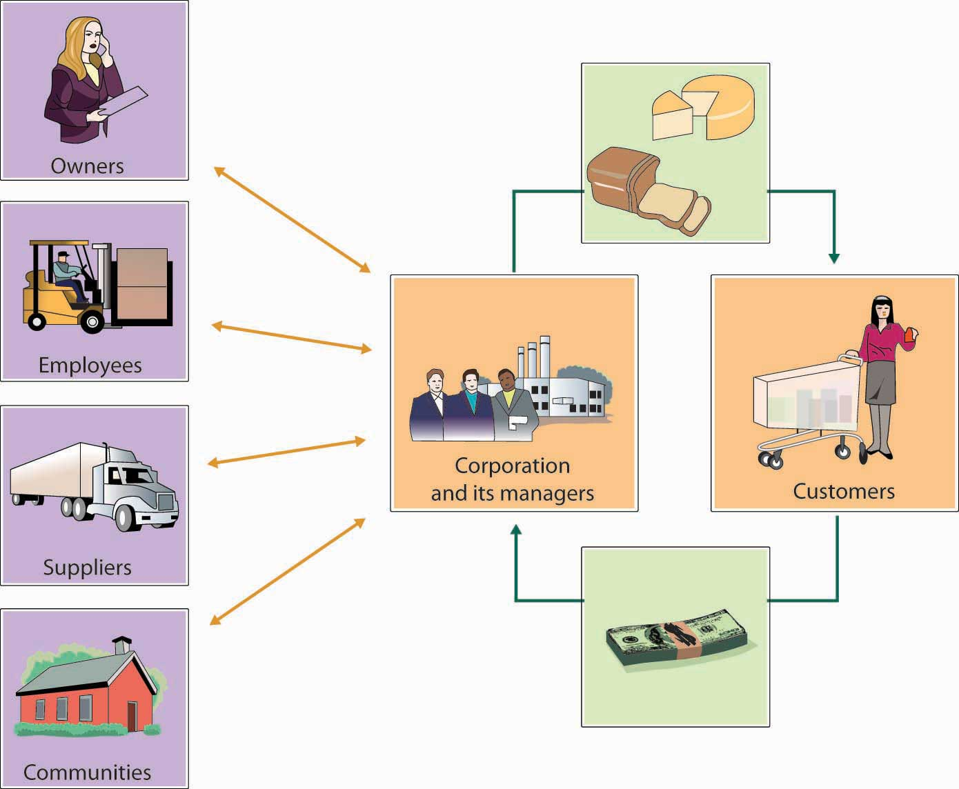
Why Is It Important?
It drives efficiency, reducing costs and waste.
Enhances customer satisfaction by ensuring timely delivery of high-quality
products or services.
Supports the strategic goals of the business by aligning operations with the
organisation’s broader objectives.
It applies to all industries, from manufacturing to healthcare, retail, and even non-profits.
Operations management ensures businesses function smoothly while meeting market demands and maintaining profitability.
This Photo by Unknown Author is licensed under CC BY

Slide 24
Key Aspects of Operations Management:
Process Design and Improvement: This involves structuring workflows to enhance efficiency and minimize waste. A study by Wolniak (2020) identifies seven main functions of OM, including planning, scheduling, and quality control, emphasizing the importance of designing effective processes to boost organizational effectiveness
Supply Chain Management: Effective management of the flow of materials and information is crucial. Research published in the Journal of Operations Management Research highlights the significance of supply chain optimisation in achieving operational excellence. (Operations Management Research Journal, 2023)

Slide 25

Capacity Planning: Determining the optimal level of resources is essential for meeting demand. An article in Operations Management Research discusses the relevance of capacity planning in aligning resources with organisational goals. (Journal of Operations Management Research, 2023).
Resource Allocation: Optimal assignment of resources enhances productivity. The Operations Management Research journal discusses the impact of effective resource allocation on organisational performance

Slide 26
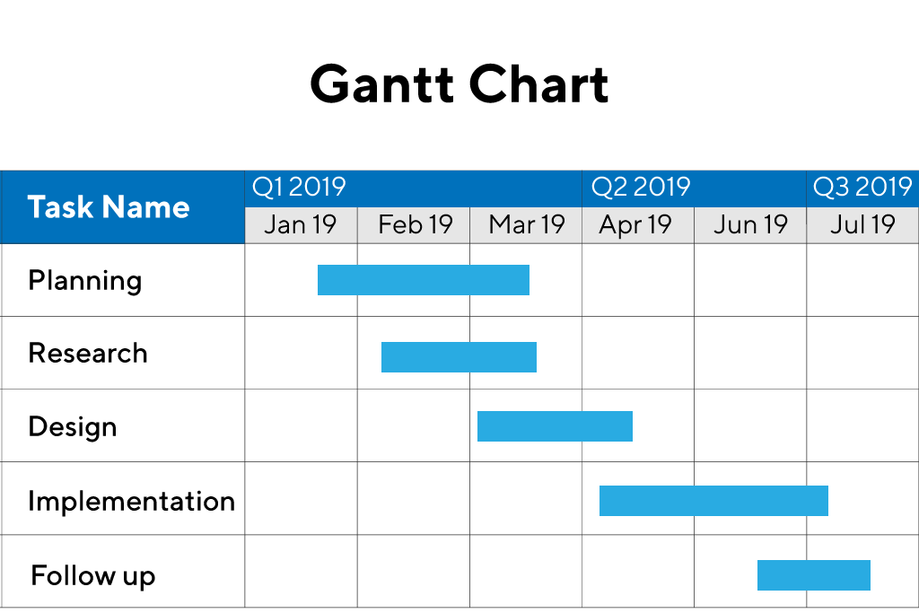
Operational Processes
Planning – Gantt Charts, a team or department draws from a company-wide strategic plan and puts it under a microscope. It's future-oriented: mapping department budgets and goals to propel the success of the strategic plan with specific, team-based activities for the next 1-3 years.
Programming - identified the problem areas in organization, need to find the right solutions by following a series of steps.
Capacities - the highest level of goods or services that a company can produce to meet demand.
Booking Systems - control HR, payroll and internal processes to deliver single solution modern, personalised experience increasing efficiency and compliance.
Opening / Soft Openings ( trial run): running & delivering
An operational review is an in-depth and objective review of an entire organization or a specific segment of that organization
Notes:
An operational review is an in-depth and objective review of an entire organization or a specific segment of that organization

Slide 27
Operational Processes
TERMS: NOP’s (normal operating procedure), SOP’s (standard operating procedure) and EOP’s (emergency operating procedure)
Management Challenges - globalization, sustainability, ethical conduct, ineffective communication, and system design
AREAS: HR Functions – recruitment; training; development
Marketing – new product idea generation, market research, diversification
Safety - Changing work environment, changing demographics, economic unpredictability, new skills
An operational review is an in-depth and objective review of an entire organization or a specific segment of that organization
Reviews - identify and address existing concerns such as communication issues between departments, problems with customer relations, operating procedures, lack of profitability issues.

Slide 28
Performance Management Reviews
Operational performance reviews (OPRs) focus on identifying LEAN processes that improve efficiency: on‑time, on‑budget deliveries and high‑quality outputs
How do you evaluate operations performance?
Operational performance can be evaluated by tracking a project's performance and capability to reach its goals in the planned budget. Human capacities and issues and opportunities are also assessed in the process.
What do we find out ?
Usage/Visitor Numbers/ Occupancy Figures/
Financial Reviews / Yield Management /Pricing /Costs
Customer Reviews & Feedback
Independent Reviews
Staff Reviews / Staff Turnover/Performance Management

Slide 29
Operational Issues can affect operational performance, cause problems with the execution of strategy, and stand in the way of a business’ growth if they aren’t dealt with properly.
Must be clear Aims & Objectives​
Different issues for Commercial Sector / Voluntary Sector / Public Sector​
Affected by Supply & Demand​
High Season / Low Season​
Community Use / Usage Times​
Management Issues – changes i.e., pandemic​
Technology – fast changing​
Trends - Behavioural Operations Management: This approach focuses on human behaviour as it relates to operations management.​
Sustainability: This approach highlights maintaining ecologically-minded practices under changing laws.​
Terrorism Impacts​
Economy​
Brexit​

Slide 30
Topics
Risk Management - reduce risks through risk identification, risk assessment, measurement and mitigation, and monitoring and reporting while determining who manages operational risk
Purple Book – Festivals Operations - The Purple Guide has been written by The Events Industry Forum in consultation with the events industry. Its aim is to help those event organisers who are duty holders to manage health and safety, particularly at large-scale music and similar events
Green Book – Sports Events Operations
Hotel Management – Operations
Policies and Procedures - part of risk management
Licencing and Legalities – compliance, trust & reputation – safety
Events Operations - the department responsible for co-ordinating and integrating all other operations within an event and its associated venues.
Special Facilities Operations – maintenance
Industry Engagement - enables to explore the capabilities of suppliers (and potential suppliers) to provide the goods and services you're likely to need

Slide 31
references
Wolniak, R., 2020. Main functions of operation management. [online] ResearchGate. Available at: https://www.researchgate.net/publication/341656435_Main_functions_of_operation_management [Accessed 27 January 2025].
Operations Management Research Journal, 2023. Capacity planning and operational goals. [online] Pubsonline. Available at: https://pubsonline.informs.org/doi/10.1287/msom.2023.0691 [Accessed 27 January 2025].
Journal of Operations Management Research, 2023. Supply chain optimization and operational excellence. [online] Available at: https://pmc.ncbi.nlm.nih.gov/articles/PMC8249437 [Accessed 27 January 2025].

Slide 32

Lets discuss
https://sgsa.org.uk/greenguide/
https://www.thepurpleguide.co.uk/

