Slide 1
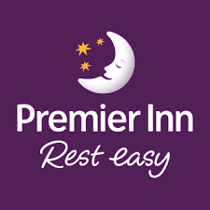
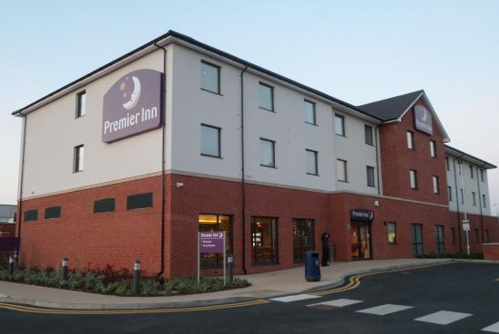
Benefits of Multilingualism and Language Awareness Skills for Hotel Staff
Enhancing Guest Experience and Service Quality
Foreign Languages & Cultural Awareness
BMIH5003
Lecturer: Giulia Chifari
Student name: Loredana-Marina Pal
Student ID: 2222512
Date 17/05/2024

Slide 2
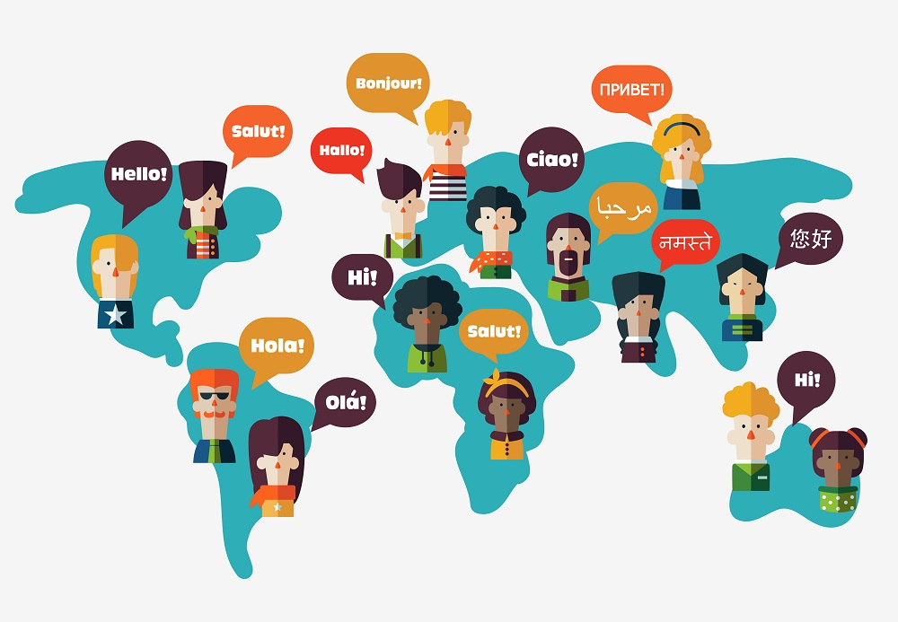
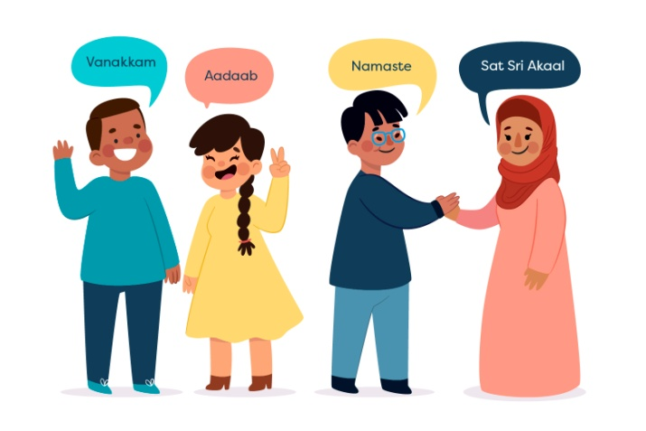
Introduction
In our increasingly globalized world, multilingualism is a valuable asset in the hospitality industry. Understanding and speaking multiple languages can significantly enhance guest experiences and improve communication.

Slide 3
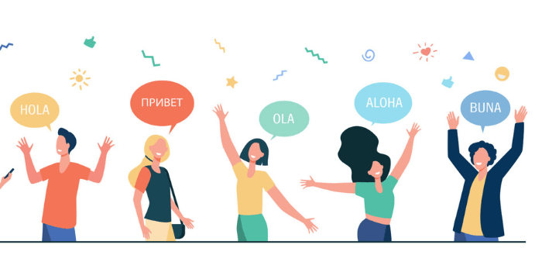
Benefits of Multilingualism
Multilingualism offers numerous benefits:
1. Enhanced Guest Satisfaction: Communicating with guests in their native language can make them feel more comfortable and valued.
2. Improved Communication: Reduces misunderstandings and ensures clear, accurate information exchange.
3. Competitive Advantage: Hotels with multilingual staff are more attractive to international guests.
4. Cultural Understanding: Encourages cultural sensitivity and awareness among staff.

Slide 4

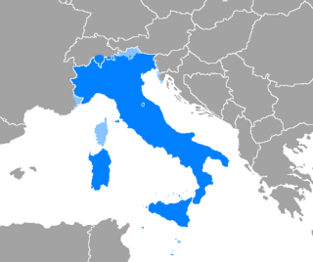
Focus Language: Italian
Let's focus on Italian as a modern European language.
- Where is it spoken? Italian is the official language of Italy and San Marino, and it is one of the official languages of Switzerland. It is also widely spoken in Vatican City and some parts of Croatia and Slovenia.
- Difficulty Level: Italian is considered moderately easy for English speakers to learn, due to its relatively straightforward grammar and pronunciation.
- Politeness in Business Context: In
Italian culture, formality and
respect are important. Using
formal titles like "Signore"
(Mr.) or "Signora" (Mrs.) and
the formal "Lei" form is crucial
in business interactions.

Slide 5
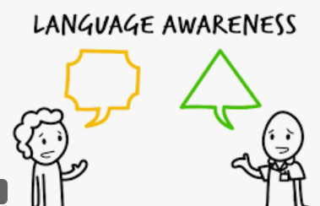
Language Awareness in the Hotel Industry
Language awareness goes beyond just speaking a language; it involves understanding cultural nuances and context. For example:
- Greeting Guests: In Italian, a warm greeting such as "Benvenutinel nostro hotel" (Welcome to our hotel) sets a positive tone.
- Handling Requests: Understanding polite forms of requests, like "Potrebbeaiutarmi con...?" (Could you help me with...?), is essential.
- Apologizing and Thanking:
Polite expressions like
"Mi dispiace" (I'm sorry)
and "Grazie" (Thank you)
should be used frequently.

Slide 6
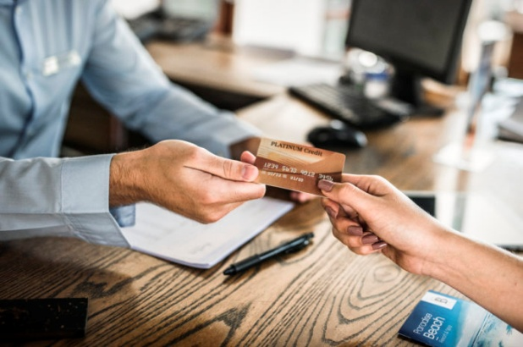
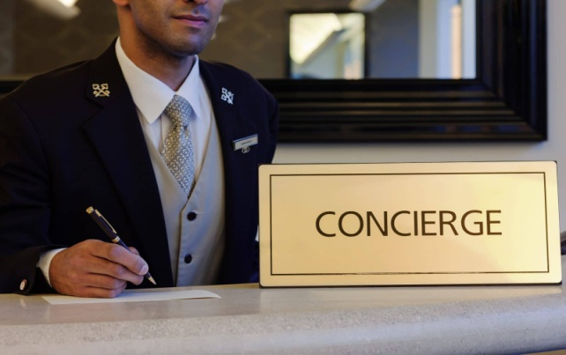
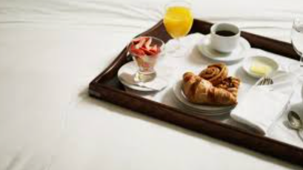
Direct Examples from Premier Inn
At Premier Inn, we have seen firsthand the benefits of multilingualism:
- Check-In/Check-Out Process: Multilingual staff can handle international guests' inquiries more efficiently, reducing wait times and enhancing satisfaction.
- Room Service: Clear communication in the guest's native language ensures accurate orders and better service delivery.
- Concierge Services: Providing local recommendations and directions in the guest's language improves their overall experience.

Slide 7
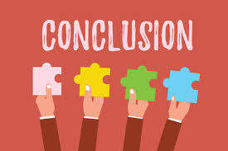
Conclusion
In conclusion, multilingualism and language awareness are crucial skills for hotel staff. They improve guest satisfaction, enhance communication, provide a competitive edge, and foster cultural understanding. By investing in language training, Premier Inn can continue to offer exceptional service to our international guests.

Slide 8
References
1. Crystal, D. (2010). The Cambridge Encyclopedia of Language. Cambridge University Press.
2. Dewaele, J. M. (2013). Multilingualism and Emotions. Annual Review of Applied Linguistics, 33, 23-50.
3. García, O., & Wei, L. (2014). Translanguaging: Language, Bilingualism and Education. Palgrave Macmillan.
4. Kroll, J. F., &Dussias, P. E. (2017). The Benefits of Multilingualism to the Personal and Professional Development of Residents of the US. Foreign Language Annals, 50(2), 248-259.
5. Thomas, D. C., &Inkson, K. (2009). Cultural Intelligence: Living and Working Globally. Berrett-Koehler Publishers.

