Slide 1
The Army of the Eight Banners: Multi Ethnic Segregation But A System Off Social Progression
By
Henry Gillson – Gant

Slide 2
Introduction
The aim of this presentation is to introduce you to the social construct of the Eight Banners and how granted an alternative method of social advancement.

Slide 3
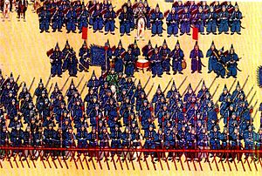
So What were the Eight Banners?
Each of the Eight Banners represented one of the five races of Imperial China.
Upper Banners comprised of Manchu and other Chinese Ethnicities.
The Lower Banners represented those races not Chinese such as the Mongols and the other non-Chinese Races.
Upper Banners considered the personal forces of the Emperor.
(Fredholm, 2009, p. 78)
Image 1: Print of the Blue Banner Army in the Reign of Qianlong Circa 1774. Sourced from: http://britishbattles.homestead.com/manchuria.html

Slide 4
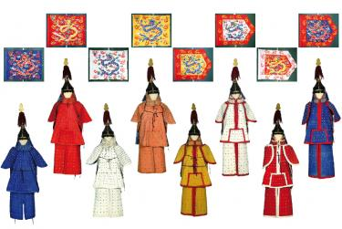
Use of the Eight Banners
The Banner Armies were permanent military forces identifiable by color of their uniforms.
Primarily used as Garrison Troops across the empire.
Each Banner governed itself within these Garrisons through economic and social policy.
All Banners outside of the control of the Provincial Governments and Governors.
(Fredholm, 2009, p.120)
Image 2: Wall Display of Ceremonial Uniform and Banners of the Eight Armies in Taipei. Originally part of the Shengyang Palace Collection. Sourced from: http://taipeitimes.com/News/feat/archives/2011/02/16/2003495996

Slide 5
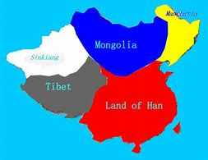
Institutional Segregation
The Chinese Empire was governed on the principle It was a multi ethnic empire.
Only members of the relevant ethnic groups could be part of the relevant banner.
Social integration forbidden – i.e. inter marriage of the races.
However permitted an explosion of culture that could have been wiped out.
(Dabringhaus, 2011, p. 266)
Image 3: Map in colour code showing the five races of China. Sourced from: https: polyglotlegend.blogspot.com/2016/03/china-cool-facts-105.htm

Slide 6
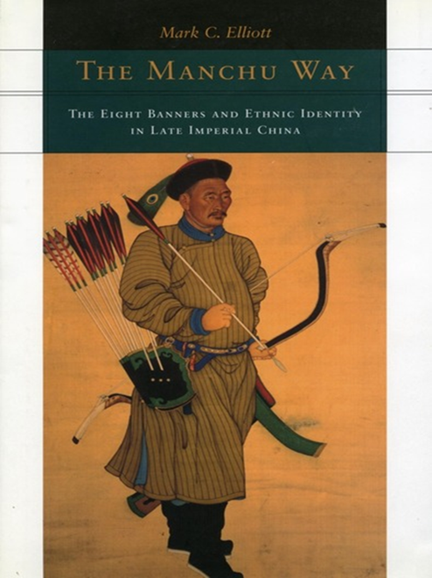
Mark Elliot: The Manchu Way – A Study of the Peking Garrison
Mark Elliot surmises that that the segregation of the Banners also existed in a physical form.
He uses the separation of the Peking Garrison as the crux of his argument.
Each banner could only reside in a certain area of the city, forbidden to enter either one.
Use of Social Control – equal but separate.
(Elliot, 2001, p. 103)
Image 4: Front cover of the Manchu way. Sourced from: https://www.sup.org/books/title/?id=709

Slide 7
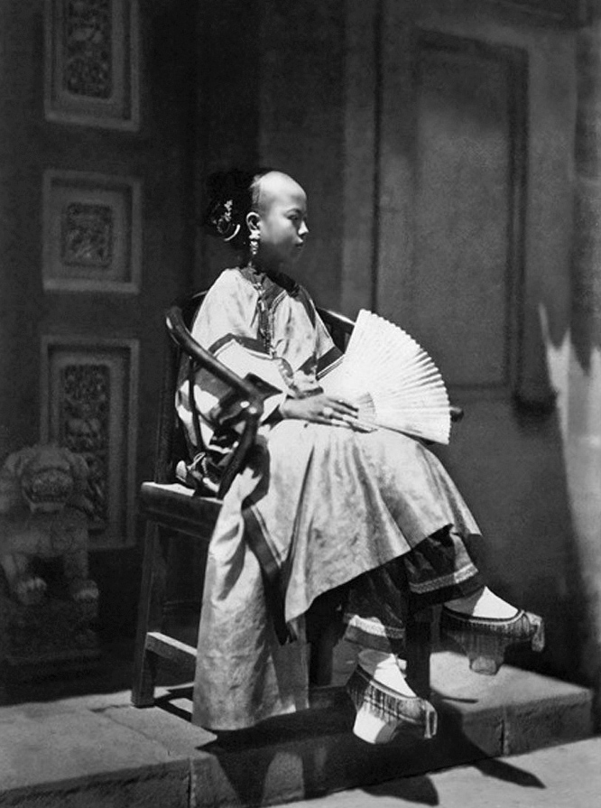
A New Aristocracy?
The status of Bannerman or Bannerwomen became a de facto social class.
In 1727, military rank was merged with the hereditary nobility as part of the court system.
Bannerman who held certain ranks could obtain privileges only enjoyed by Manchu nobles.
(Daubringhaus, 2011, p. 267)
Image 5: A Banner Girl in Late Imperial China. Sourced from: http://www.csstoday.com/Item/1984.aspx

Slide 8
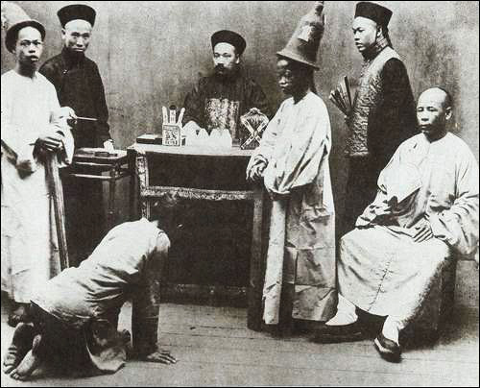
Alternate Means of Social Progression
Throughout the Ching Dynasty only one Bannerman reached third rank of the Imperial Examination in 1730.
New status permitted exemption through exemplary service.
Middle ranking Officers could be made provincial Magistrates.
Known appointment in 1724 due to “Unemotional Judgement” in Fujian.
(Elliot, 2001, p. 231)
Image 6: Magistrate at Work. Sourced From: http://multipletext.com/2011/10-xinhai-revolution-2.htm

Slide 9
Conclusions
The Eight Banner Armies were a deliberate construct of the Ching Dynasty to control and perpetuate the multi ethnic empire that was Imperial China.
This separation allowed cultures to diverge and establish their own identity within the Banners whilst being considered part of the Chinese Identity.
Bannerman through steady service could accumulate privileges otherwise not available to the non Manchus.
The ability to assume positions without attending the Imperial Exam.

Slide 10
Bibliography
S. Dabringhaus, ‘The Monarch and Inner-Outer Court Dualism In Late Imperial China’ in Royal Courts in Dynastic States and Empires: A Global Perspective, ed. by Jeroen Duindam, Tülay Artan and Metin Kunt (Leiden: Brill, 2011), pp. 265-287.
M. Elliot, The Manchu Way, (Stanford: Stanford University Press, 2001)
M. Fredholm, Eight Banners and Green Flag, (London: Pike and Shot Society, 2009)

Slide 11
Image References
Image 1: http://britishbattles.homestead.com/manchuria.html
Image 2: http://taipeitimes.com/News/feat/archives/2011/02/16/2003495996
Image 3: https: polyglotlegend.blogspot.com/2016/03/china-cool-facts-105.htm
Image 4: https://www.sup.org/books/title/?id=709
Image 5: http://www.csstoday.com/Item/1984.aspx
Image 6: http://multipletext.com/2011/10-xinhai-revolution-2.htm

