Slide 1
Driving Change and Building a Business Case
Rhiannon Akers, April 2025

Slide 2
Agenda
Presentations
Overview of assignment brief
Project Initiation Document (PID)
Research methods recap

Slide 3
Tasks
Task 1 – Conduct primary and secondary research on an HR topic that is relevant to your organisation. Create an academic poster accompanied by a report (3500 words for both, no more than 800 words for the poster).
Task 2 – Participate in a conference style event in which you will make a 10-minute presentation that proposes the recommendations for improvement/development related to your research. Support this with an implementation plan based on a cost-benefit analysis (1000 words for both, allocate 400 words to the implementation plan).
Notes:
Task 1
Conduct primary and secondary research on a HR topic that is relevant to your organisation. The learner will then provide a formal report on their research (supplemental notes) accompanied with an AO sized poster which provides an overview of the research as noted below:
Create an academic poster accompanied with a report based on the following:
Identify a suitable HR topic for investigation that has relevance to your organisation.
Design a research strategy, using contextualisation, clear aims and objectives, and an appropriate methodology.
Conduct secondary research (literature review) including relevant existing knowledge drawn from theory, research and contemporary practice.
Conduct primary research based on your own organisation within the ethical guidelines and regulations of the University.
Engage in systematic data analysis and locating findings and discussion within a framework drawn from the literature.
Formulate conclusions.
The above will then be presented in an A0 sized research poster that summarises the outputs of your research and contains the following sections:
Introduction – which must include the rationale for your investigation.
Literature - A summary of the key findings from your review of the literature.
Methodology – An overview of how you conducted your primary research.
Findings – An analysis of your findings
Conclusions – What you have concluded are the key points of interest to your organisation.
(Word count for both is 3500; we would recommend the report be at least 2700 words and would recommend you do not go over 800 words for the poster).

Slide 4
Submissions
Academic Poster that summarises your research.
Supplementary notes in the form of a report, providing more detail on your research.
Presentation slides.
One page implementation plan, with costings.
PID submission date 19/05/25.
Tutorials will be arranged for Tuesday afternoons throughout the Summer (first tutorials 27/05/25).
Deadline for drafts 18/09/25.
Submission date 29/09/25.
Conference style event 30/09/25.

Slide 5
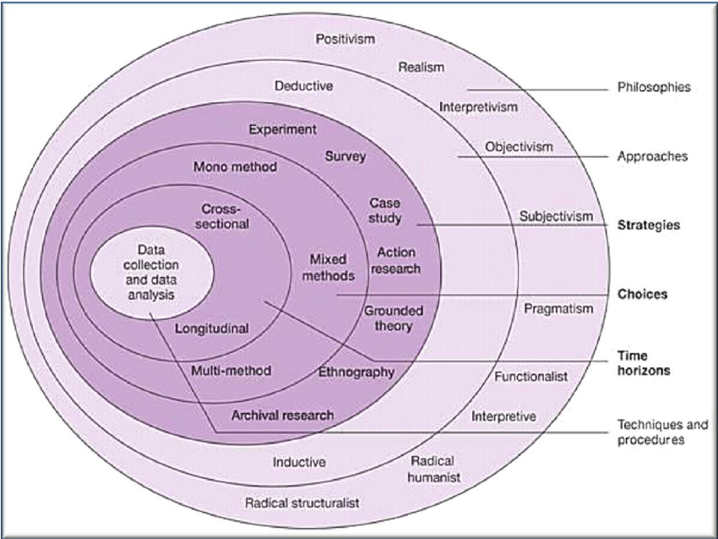
Research Methodology
Your research philosophy will inform
your approach to research.
Inductive or deductive
Research strategy
Research choices
Timing
Data collection
Notes:
Research assumptions – research philosophies. Researchers differ in terms of how free they believe individuals are to change their lives and the world around them, and conversely how constraining the societal structures are on the lives and actions of individuals.
Our beliefs and assumptions, our research philosophies, all impact on research design.
Ontology – refers to the assumptions about the nature of reality, how you see the business world, management and choice of research project. Differences of opinion, EU membership = over bureaucratic whilst others see as providing legal protections for workplace rights and the environment.
Epistemology – refers to the assumptions about knowledge, what constitutes as acceptable, valid and legitimate knowledge, and how we communicate that to others. Brexit – different types of knowledge – ranging from numerical data to textual and visual, facts and opinions, narrative, stories – could all be considered legitimate.
Axiology – role of values and ethics. Brexit example – feelings of being ignored by politicians. One of the key axiological choices that researchers face is the extent to which to view the impact of your own values and beliefs on your research as a positive thin as well as the values of those you are researching.
Philosophies in management
In groups, research Positivism, Interpretivism and Constructivism/Pragmatism.
Inductive – theory follows data: e.g. retail store absence, interviewing a sampe of employees and their line managers, get a feel for what is going on, better understand the problem, analyse the data, formulate a theory. May be a relationship between absence and length of service, or there may be other reasons not related to age or length of service.
Deductive: developing a theory and then subjecting it to rigorous testing – i.e. data follows theory.

Slide 6

Activity
In groups, research Positivism, Interpretivism and Constructivism/Pragmatism in relation to completing research.

Slide 7
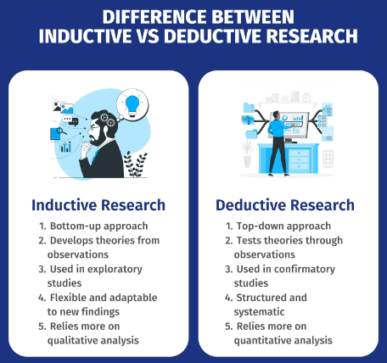
Inductive Vs Deductive
Notes:
What is deductive research?
Deductive research is a type of research in which the researcher starts with a theory, hypothesis, or generalization and then tests it through observations and data collection.
It uses a top-down method in which the researcher starts with a general idea and then tests it through specific observations. Deductive research is often used to confirm a theory or test a well-known hypothesis.
What is inductive research?
Inductive research is a method in which the researcher collects and analyzes data to develop theories, concepts, or hypotheses based on patterns and observations seen in the data.
It uses a “bottom-up” method in which the researcher starts with specific observations and then moves on to more general theories or ideas. Inductive research is often used in exploratory studies or when not much research has been done on a topic before.

Slide 8
Primary and Secondary data
Primary: collected first-hand for the study in which it will be used (e.g. questionnaires, observation, focus groups, interviews, brainstorms)
This is the information that you collect by doing your own research. It is not data you analyse from pre-collected information e.g. a company survey.
Secondary: already published sources from other studies to draw a conclusion
(e.g. academic journals, online databases, industry reports, the Internet , governmental reports, market research, studies, podcasts, website articles). Can also be raw data from your organisation such as absence data
Notes:
Which will you collect first?

Slide 9
Commonly used methods
Questionnaires, surveys
Interviews
Documentation review
Observation
Focus Groups
Tip: You will need to justify your selection, so write up the advantages and disadvantages of different research methods, why you decided on the method you chose and why you didn’t choose the other possible methods.
Notes:
Methods are the research tools that allow you to implement your methodology
Is your research descriptive, exploratory or causal?
Will asking the question bias the answer?
Can the question be answered by observation?
Will knowing that research is occurring have an impact on what is recorded?
Will knowing what research is about have an impact on responses?
What type of data do you need to solve your research problem?

Slide 10

Interview Design Process
Structured or Semi-Structured
What type of questions will you use? Open, closed, probing etc.
How will interviews be recorded?
How will you ensure anonymity?

Slide 11
Questionnaire Design Process
Questionnaire objectives
Data collection method (in person, by post, online)
Question response format and question wording
Questionnaire flow and layout (satisficing)
Reliability and validity
Testing & revision
Finalisation & implementation
Notes:
Ordinal scale – level of satisfaction, ranking possible answers
Interval scale (Likert) strongly agree given a numerical value to strongly disagree – decide if you are going to force a response for those who are quite indifferent or are likely to satifcing.
Will also need to talk briefly around how you plan to issue the tool, and why over other options – considering anonymity

Slide 12
Important to note
Are the response options clear and complete?
How many response categories are required?
How do the response options link with the planned analysis? (Will you get what you need?)
Is the question necessary?
Several questions or just one?
Can respondents answer the question?
Will respondents answer the question?
Is the question clear and unbiased?
You can find out the answers to the questions by completing a pilot

Slide 13

Sampling Strategy
Who is your research population (overall who are the people being researched) and the sample (who is targeted as a participant); sample strategy used (how you selected the participants) & size explanation & justification.
Methods include probability sampling and selective sampling.
Your selected sample will impact on the generalisability of your findings
Notes:
Probability sampling uses statistical theory to randomly select a small group of people (sample) from an existing large population and then predict that all their responses will match the overall population. Everyone in a population has a chance of getting selected, in non-probability sampling, not all population members can participate.
Selective sampling is the process of picking samples from a larger sample size depending on the survey taker's or researcher's assessment. To put it simply, a selective sample is collected based on the needs of the exam, survey, or study for which it will be utilised.
A researcher wants to study the eating habits of people living in a particular city. To do this, they use convenience sampling to select people who are easily accessible such as those living in the downtown area.

Slide 14
Other considerations
Reliability and Validity (Internal and External)
Generalisability
Timing – Longitudinal study not possible due to time frame
Notes:
To what extent will your data collection techniques or analysis procedures yield consistent findings? Is your study replicable?
Internal validity - the instruments or procedures used in the research measured what they were supposed to measure. Example: As part of a stress experiment, people are shown photos of war atrocities. After the study, they are asked how the pictures made them feel, and they respond that the pictures were very upsetting. In this study, the photos have good internal validity as stress producers.
External validity - the results can be generalized beyond the immediate study. In order to have external validity, the claim that spaced study (studying in several sessions ahead of time) is better than cramming for exams should apply to more than one subject (e.g., to math as well as history). It should also apply to people beyond the sample in the study.
How far can your findings be generalised?
Within your organisation
Within the wider industry
Across industries
Within geographical areas
Across different demographics (WEIRD)
Most people who take part in surveys are WEIRD: western, educated, industrialized, rich and democratic"
Within the scope of this project it is not possible to conduct a longitudinal study.
All projects will be cross-sectional:
based on data gathered for a specific point in time.
from a pool of participants with varied characteristics and demographics known as variables.
findings help remove assumptions and replace them with actual data on the specific variables studied during the time period accounted for in the cross-sectional study.
Triangulation may be possible – data from different sources are used to ‘cross check’ the findings e.g an initial survey with follow up interviews.

Slide 15
Analysing Quantitative Data
What approach will you take?
This may depend on what program you use to collate your data.
‘Clean’ the data set.
Organise your data.
Statistical analysis.
Cross triangulation.
Notes:
Correlation analysis in research is a statistical method used to measure the strength of the linear relationship between two variables and compute their association. Simply put - correlation analysis calculates the level of change in one variable due to the change in the other.
If you have used Google forms, Survey Monkey etc., will populate within an CSV file that can be exported to Excel for manipulation and analysis.
‘Clean’ the data set e.g. check over for impossible codes, e.g. in a scale of 1-5 a value of 6 would be an error in the case of manual input.
Organise your data – consider ways in which you will label it up.
Consider how to present it using tables and charts (Pivot table function).
Consider the chart options and layouts within Excel, ensure your approach is consistent, using consistent colour themes throughout.
Consider statistical analysis: Variables: probability and significance, tests of correlation etc.
Excel has some statistical functionality. For in-depth programmes include SPSS and StatPlus.
Cross triangulation refers to the process of using multiple methods, data sources, theories, or investigators to validate research findings and ensure their credibility. It is a form of triangulation aimed at cross-verifying data from different perspectives, thus reducing bias and enhancing validity. You could apply this by linking your findings to relevant theory.

Slide 16
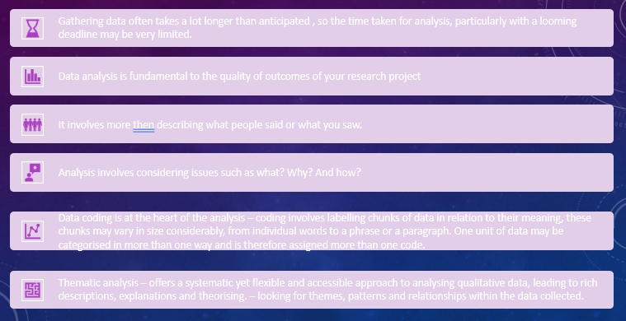
Analysing Qualitative Data

Slide 17
Results
Accept or reject your hypothesis.
Use appropriate presentation methods.
Plan and organise how you will present them
Consider your audience at all times.
Notes:
The aim of the results section is to create an argument to accept or reject your hypothesis, or to answer positively or negatively to your research question(s). Therefore, only include the information that helps to develop the argument. You may place a presentation of "raw data" as an appendix if necessary.
In presenting the results, you should ensure that the approach you have used, whether it be pie charts, tables, or graphs, is the most appropriate. It is easier for the reader if there is consistency of approach throughout the chapter, so keep your presentation easy to read and follow.
You need to plan and organise carefully the presentation of your results and the analysis. You can either present and analyse issue by issue or have separate sections where you first present your findings and then secondly discuss them. If you are presenting and analysing qualitative data such as responses to interviews, you must include quotes as evidence. Quantitative data will usually be presented as graphs or charts and figures.
Consider your audience at all times, and how it will be presented on your A0 poster effectively in summary form.

Slide 18
Any questions?

